Slide 1
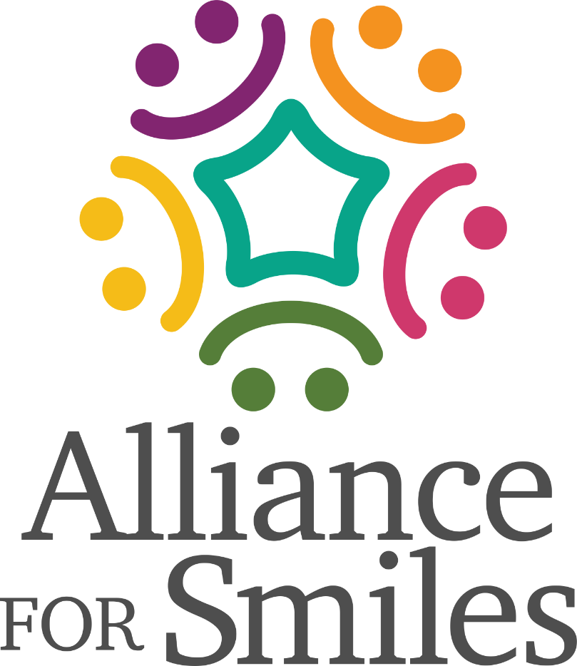
Oral Hygiene Education For Cleft Lip And Palate Patients
Why Is It So Important?
Updated 2026.April

Slide 2

Presentation Overview
(Include relevant photos >>>

Slide 3
Children With Cleft Lip And Palate
Present With Many Needs, Including
Dental And Oral Problems
Feeding Problems
Missing Teeth (50%)
Supernumerary Teeth (20%)
Dystrophic (Hypoplastic) Teeth (30%)
Disturbances Of Tooth Eruption
Malocclusion (100%)
Dental Caries And Gingivitis
Notes:
Read slide

Slide 4
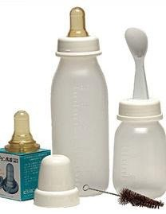
Feeding Problems
Use Of A Medicine Dropper, Spoon, Or Special Feeder May Simplify Feeding
Breast Feeding Reduced Risk Of Ear Infection
A Removable Obturator May Be Required To Close Defect And Prevent Regurgitation Of Food Into The Nasal Cavity
Notes:
Read slide

Slide 5
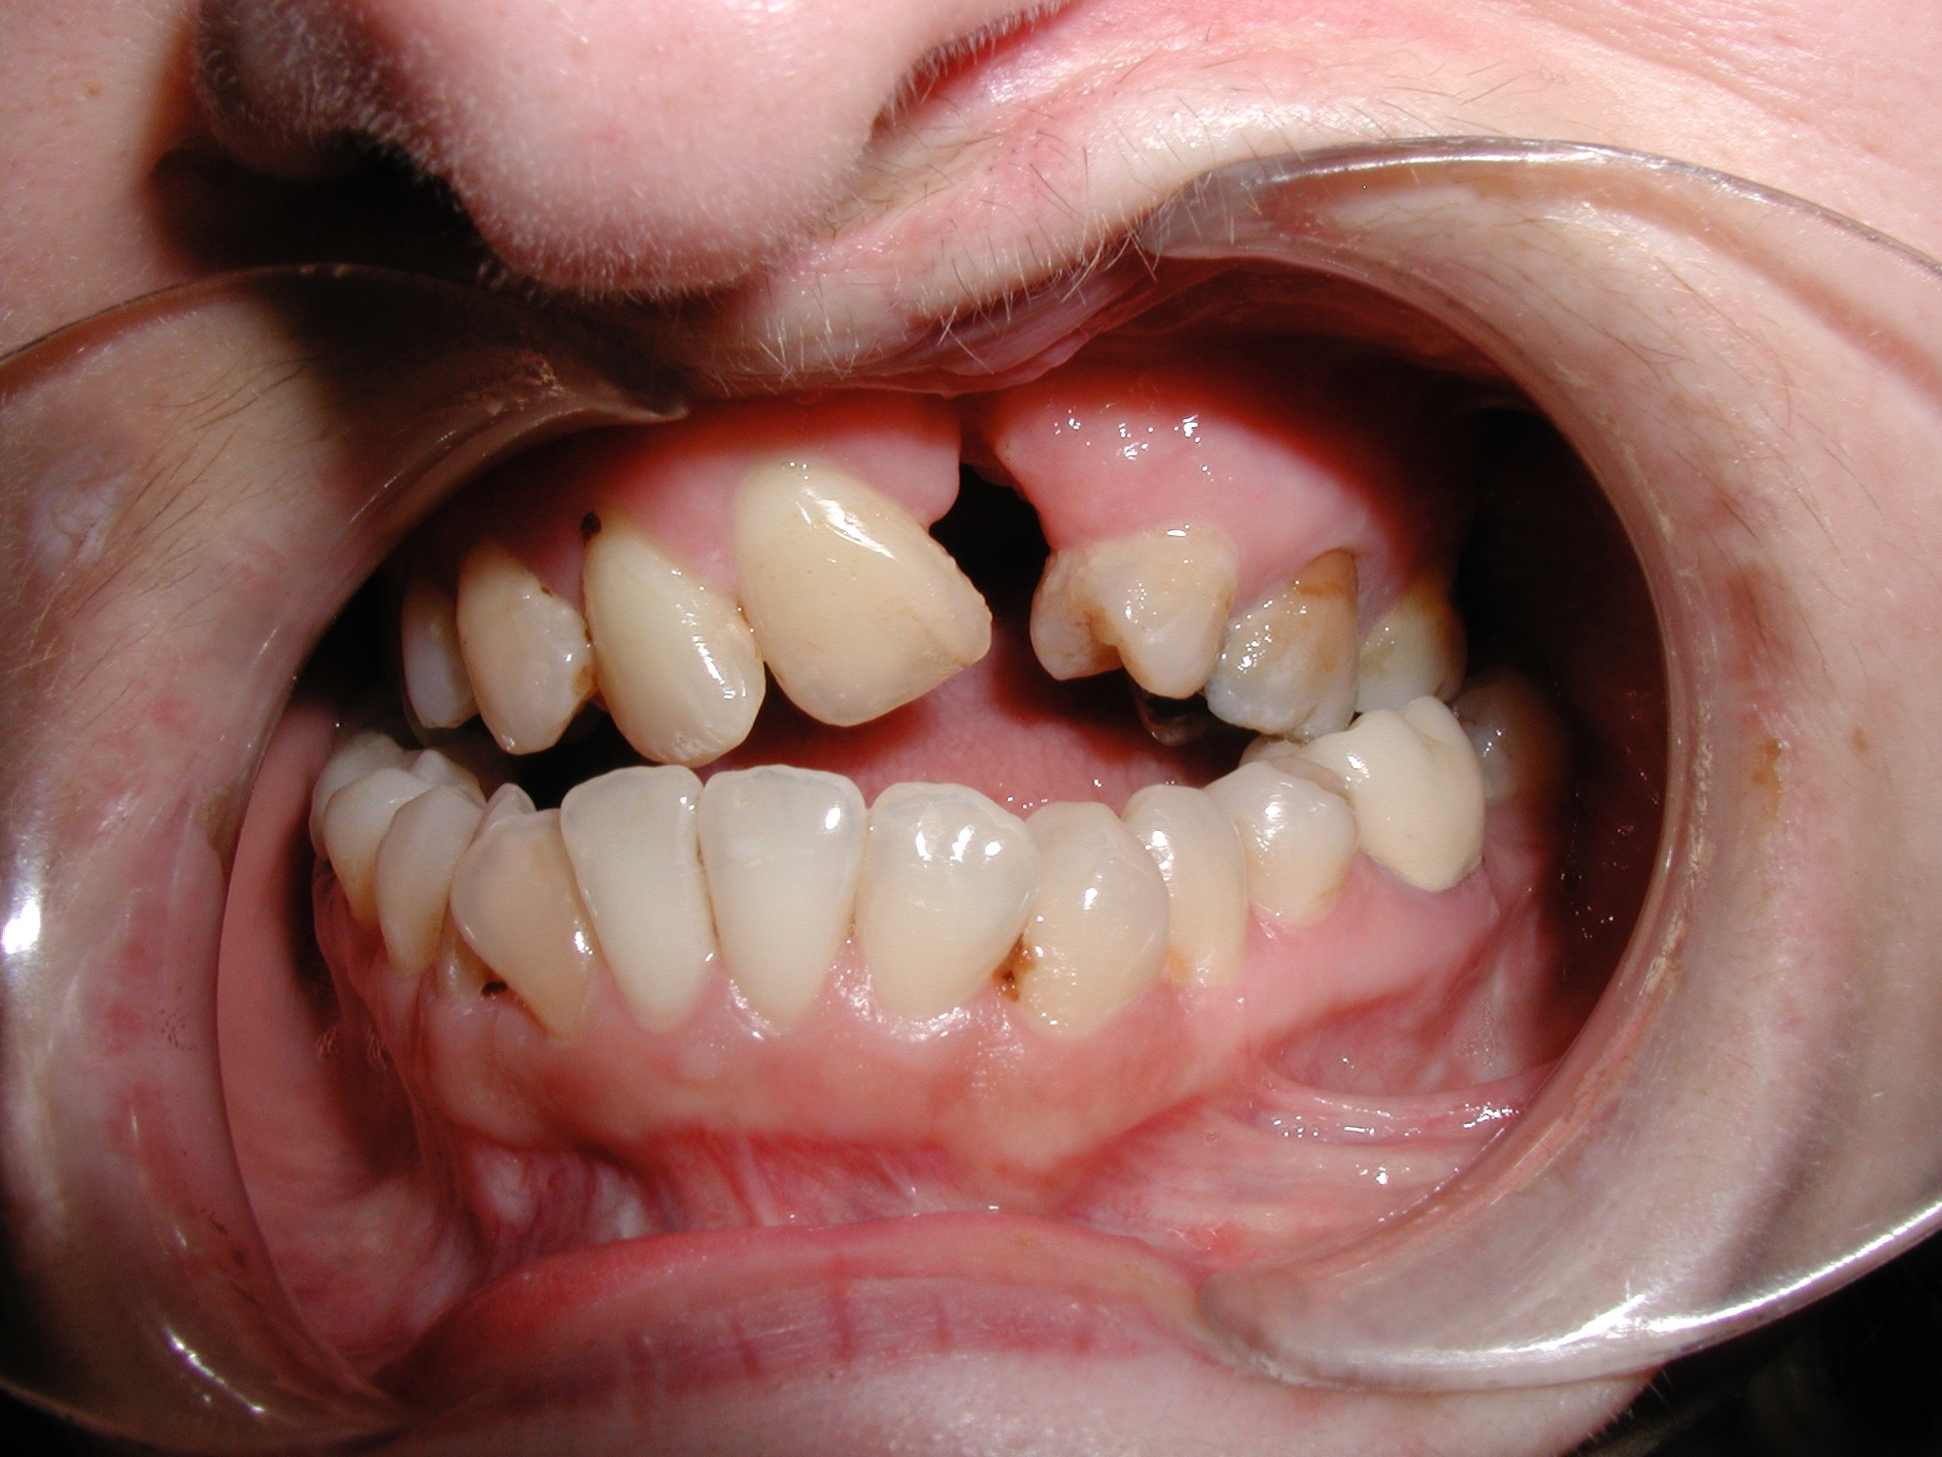
Missing Teeth
Notes:
Many times patients are missing several teeth

Slide 6
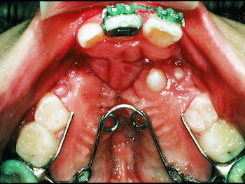
Supernumerary Teeth
Notes:
Or, they have extra teeth

Slide 7
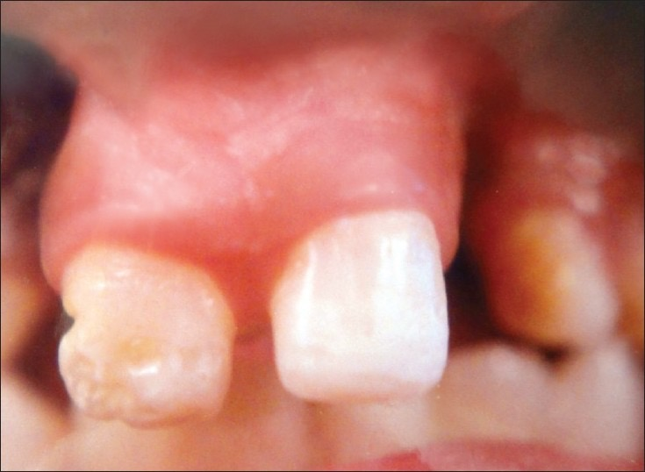
Dystrophic (Poorly Formed) Teeth
Notes:
Or poorly formed teeth

Slide 8
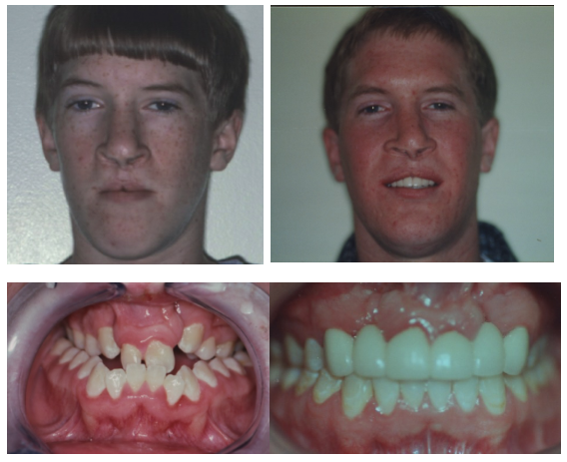
Malocclusion
Notes:
These issues due to the cleft location can lead to misaligned teeth. Malocclusion

Slide 9
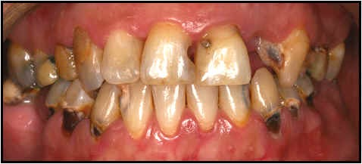
Caries (Dental Decay)
Notes:
Crowded teeth can make oral care more difficult and lead to an increase in caries (dental decay)

Slide 10
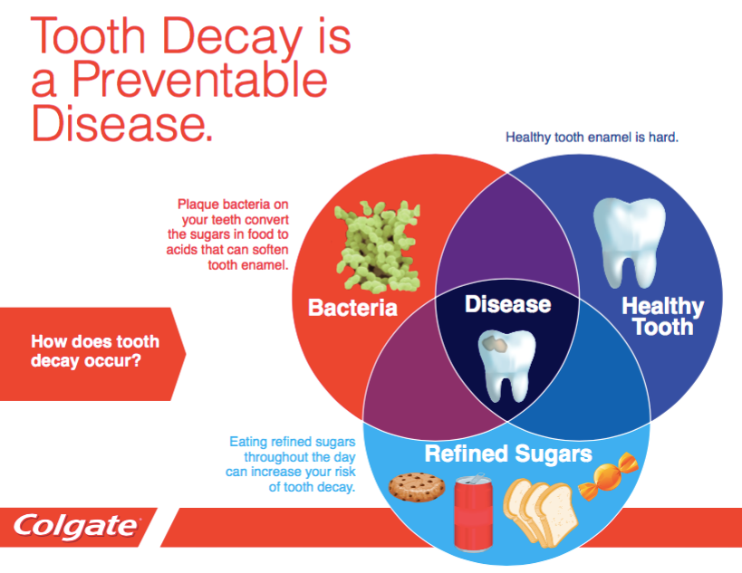
Notes:
Review slide

Slide 11
Start
Even
Before
They
Have
Teeth
Notes:
It is best to start from birth wiping the mouth with a warm cloth after feeding.

Slide 12
Let Them Brush By Themselves First
Notes:
For older children, let them brush first….

Slide 13
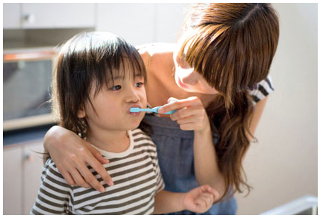
Then You Brush For Them
Notes:
And, then you brush for them

Slide 14
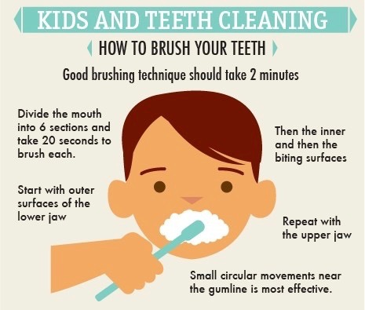
Brushing Technique
Notes:
Describe sllide

Slide 15
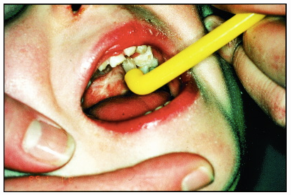
Notes:
Spicialized brushes can be used for difficult to reach areas

Slide 16
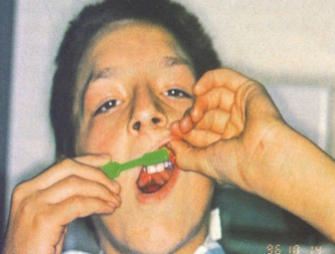
Notes:
Proper alignment of the brush on the teeth is very important

Slide 17
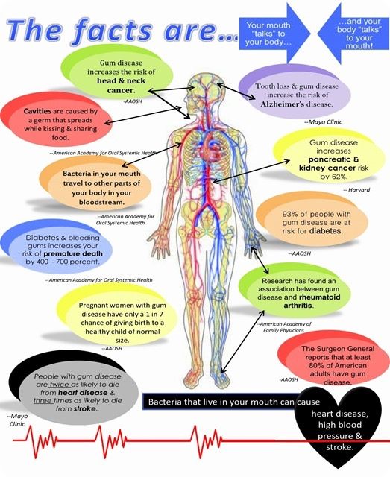
Oral Bacteria are being found all throughout the body
Periodontal Disease is linked to cardiovascular disease, heart attacks and strokes
Increased risks for people with diabetes
Increased risks for types of cancer
Bad Occlusion can lead to Migraines and sleep apnea
Notes:
Review oral systemic link

Slide 18
Take Aways
Early oral hygiene care using proper technique is imperative for healthy teeth and gums!
Notes:
read

