Slide 1

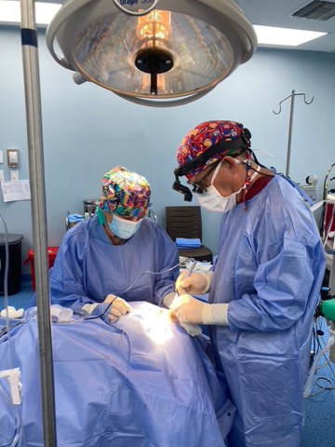
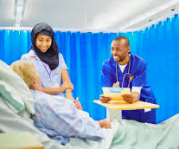
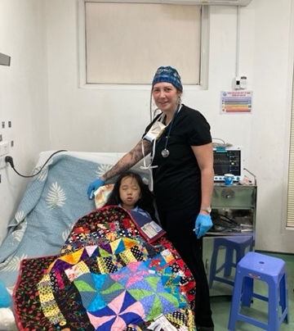
Surgical Site Infection Prevention for the Pre-op RN

Slide 2
Surgical Site Infection Statistics
Healthcare Associated Infections (HAIs) continue to be a major patient safety issue•
SSIs are one of the most prevalent HAIs
SSIs account for 1/3 of HAIs in hospitalized patients
The majority of SSIs are deemed preventable using evidence-based strategies
•There is significant evidence that following a pre-op patient preparation protocol drastically reduces surgical site infection (SSI) rates
Notes:
SSI Statistics•Healthcare Associated Infections (HAIs) continue to be a major patient safety issue•SSIs are one of the most prevalent HAIs•SSIs account for 31% of HAIs in hospitalized patients •55% -70% of SSIs are deemed preventable using evidence-based strategies •There is significant evidence that following a pre-op patient preparation protocol for up to three days before surgery drastically reduces surgical site infection (SSI) rates

Slide 3
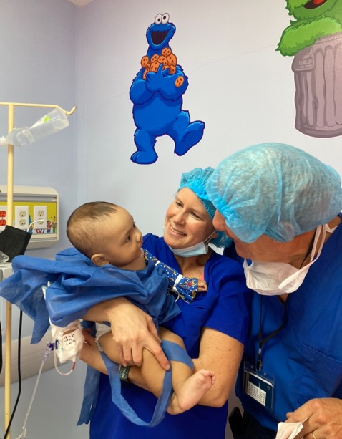
Role of the Pre-op RN in SSI Prevention
Hair Removal
Site Prep
Cleansing
Emerging Trends
Notes:
Learning objectives should be: Specific, Measurable, Achievable, Relevant, Time-bound (SMART)
DO NOT use the verbs: understand and know (they are not measurable)
USE the sentence: After this learning experience, learner will be able to:
USE these verbs for KNOWLEDGE (mostly for lectures): define, describe, identify, list, outline, recall, reproduce, show, etc.
USE these verbs for SKILLS (mostly for practicals): apply, operate, measure, assemble, construct, design, demonstrate, examine, execute, fix, etc.
USE these verbs for ATTITUDE (mostly for small groups and practicals): accept, appreciate, embrace, relate, resolve, value, etc.
Example lecture: Preoperative planning
Highlight the importance of preoperative planning
Describe various techniques for preoperative planning
Formulate and draw an operative plan
Describe a surgical tactic step by step p (eg, positioning, choice of surgical approach, instruments, reduction technique, implants)
Incorporate patient safety protocols (mark site, time-out check list) in the preoperative plan

Slide 4
Hair Removal
Complete clipping as close to surgery time as possible
Timing of hair removal is important
  Immediately before = 3.1% SSI
  24 hours = 7.1% SSI
  > 24 hours = 20% SSI
Notes:
Learning objectives should be: Specific, Measurable, Achievable, Relevant, Time-bound (SMART)
DO NOT use the verbs: understand and know (they are not measurable)
USE the sentence: After this learning experience, learner will be able to:
USE these verbs for KNOWLEDGE (mostly for lectures): define, describe, identify, list, outline, recall, reproduce, show, etc.
USE these verbs for SKILLS (mostly for practicals): apply, operate, measure, assemble, construct, design, demonstrate, examine, execute, fix, etc.
USE these verbs for ATTITUDE (mostly for small groups and practicals): accept, appreciate, embrace, relate, resolve, value, etc.
Example lecture: Preoperative planning
Highlight the importance of preoperative planning
Describe various techniques for preoperative planning
Formulate and draw an operative plan
Describe a surgical tactic step by step p (eg, positioning, choice of surgical approach, instruments, reduction technique, implants)
Incorporate patient safety protocols (mark site, time-out check list) in the preoperative plan

Slide 5
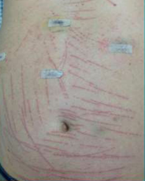
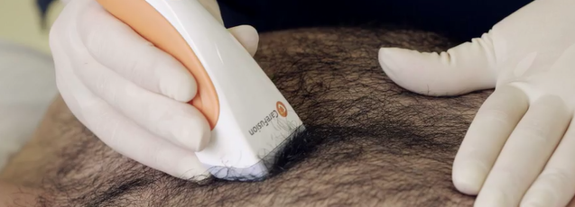
Hair Removal
Proper technique is critical
  Raking can damage the skin, creating a portal for microorganisms.
  To prevent raking hold the clipper at an approximate 40 degree angle to the skin.
Notes:
Surgical hair clippings can contain the same pathogenic bacteria and normal flora as skin.
Hair and airborne particles from surgical clipping left on the patient and linens can potentially contaminate the surgical environment and may increase risk of SSIs

Slide 6
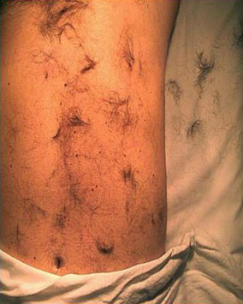
Surgical Hair Clipping – An Infection Risk
Surgical hair clippings can contain the same pathogenic bacteria and normal flora as skin
Hair and airborne particles from surgical clipping can potentially contaminate the surgical environment and may increase risk of SSIs
Notes:
Surgical hair clippings can contain the same pathogenic bacteria and normal flora as skin.
Hair and airborne particles from surgical clipping left on the patient and linens can potentially contaminate the surgical environment and may increase risk of SSIs

Slide 7
Antiseptic Skin Prep
Before surgery, patients should shower or bathe with bath wipes (full body)
  Use soap or an antiseptic agent
    There is no evidence that the use of chlorhexidine instead of soap reduces the incidence of SSIs.
  For a planned surgery, shower daily for three days until surgery day

Slide 8
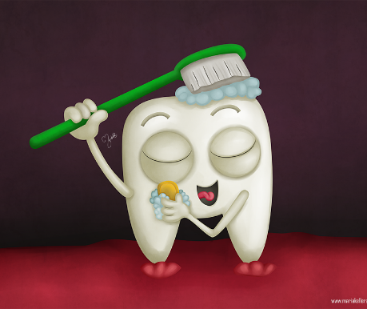
Oral Care
Have patient brush their teeth twice daily and morning of procedure.
If patient unable to brush their teeth, provide oral care twice daily and morning of procedure.
Notes:
Your take-home messages should
Match with your learning objectives
Summarize three to maximum five important points
Be your last slide (this is what your learners will remember and that will stay until the next speaker is up)
Your take-home message can
Be a powerful graphic or picture that is related to the topic
Not be something that has nothing to do with the topic (eg, a picture of your hospital or family or a “thank you” slide)
Example: Preoperative planning
Formulate a preoperative plan
Identify and assess benefits of preoperative planning
Develop a surgical tactic
Describe steps involved

Slide 9
Nasal Swabs
Apply the solution 1 hour prior to surgery
Excellent anti-staph activity of iodine, effective for 12
hours after application
If shellfish or iodine allergy, use alcohol-based swabs
Phillips, M. (2014). Infect Control Hosp Epidemiol., 826-32
Notes:
Nasal cleansing with iodine or alcohol- infused swabs helps prevent post-operative infections. There is excellent anti-staph activity of iodine, effective for 12
hours after applications
Easy application ~ 1 hour prior
Apply the solution by rotating the applicator around the circumference of the nostril for 15 seconds and then rotating the applicator around the anterior nares for 15 seconds.
If shellfish or iodine allergy, use alcohol-based swabs

Slide 10
Emerging Evidence on SSI Prevention
Maintenance of normoglycemia and normothermia (Enhanced Recovery After Surgery)
Antibiotics redosing and weight-based dosing
New and additional topical agents for preventing SSIs
Mechanical bowel preparation with oral antibiotics
Standardization of skin preparation

Slide 11
Review of Major Points
SSIs are one of the most common and costly HAIs
Standardization of patient prep is one of the most important ways to prevent SSIs
SSI prevention includes antibacterial wash, safe clipping and hair disposal, nasal cleansing and oral care

