Slide 1


Pediatric Pain Control for Cleft Lip/Palate Patients
Adapted from original presentations by N. Madden RN, MS, PNP and P. Rand MD
Adapted by S Bradman MD

Slide 2
Definition of Pain
Pain is an unpleasant sensory and emotional experience.
It is associated with actual or potential tissue damage or described in terms of such damage.
Pain is always subjective.
International Association for the Study of Pain and American Pain Society

Slide 3
Pain is not the same for everyone, it is subjective
Pain is an individual, multifactorial experience influenced by:
--culture,
--previous pain events,
--beliefs,
--moods or emotional state
--ability to cope and or support available.

Slide 4
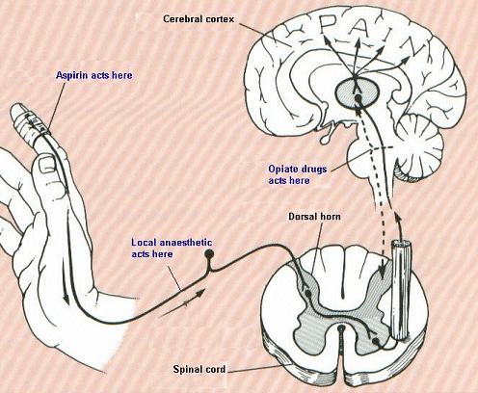
Pain Pathway

Slide 5
Pain is modulated at several points along the pain pathway between the peripheral site of the pain, the spinal cord and the brain.
There is evidence that pain also alters this pathway and effects the experience of later painful stimuli.
Areas in the brain that process pain are the same that process emotion so….
Fear, anxiety and depression impact pain we can help by addressing these.

Slide 6
Types of Pain
Nociceptive Pain: Acute pain from trauma including surgery, distension or pressure, ischemia
Inflammatory Pain: Infection, inflammatory conditions (arthritis)
Neuropathic Pain: Nerve damage

Slide 7
Should Pain Be Treated ??
Of course!!
Untreated pain negatively impacts multiple systems, including the immune system and healing
Inadequate analgesia for an initial procedure decreases the effect of analgesia in subsequent procedures.
Poorly treated pain makes all subsequent pain harder to treat.
There is increasing evidence of permanent long term effects of inadequately treated pain (PTSD)

Slide 8
ASSESSMENT
How do we assess pain?
“Pain is whatever the experiencing patient says it is, existing wherever and whenever the patient says it does” (McCaffery, 1968)
There is no real objective measure by which to “measure” pain; the same insult may result in different amounts of pain for different people.
The best assessment tools allow us to monitor the effects of therapy in a given patient, NOT to decide how much medication to give initially.
McCaffery M. (1968). Nursing practice theories related to cognition, bodily pain, and man-environment interactions. Los Angeles: UCLA Students Store.

Slide 9
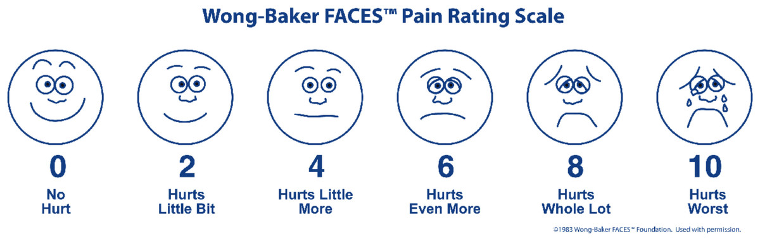
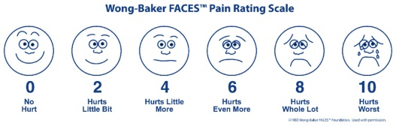
Assessment
Numerical scales- For older children and adults:
1-10, “0” being no pain and “10” being the worst ever experienced

Slide 10
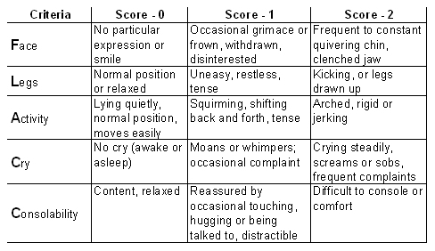
ASSESSMENT
FLACC scale for infants, toddlers

Slide 11
Pain Management
The pain assessment scale evaluates the starting point, and then efficacy, of pain control interventions with or without medications.
Assessment never determines how much pain medication to give.
Goal of Pain Management:
--- A pain level that allows a child to sleep, eat, and engage in social interaction and quiet play for age.
--- Not the complete absence of pain.

Slide 12
Using the WHO Pain Management Algorithm
.
1. By the Clock: Scheduled medication around the clock for 1st post op day at least
2. By the Mouth: Easiest, best tolerated and can be given by parents. (avoid IM!)
3. By the Ladder: Add or increase doses of medications only if pain is not controlled enough with earlier interventions.

Slide 13
1. By the Clock
Medication around the clock avoids peaks and valleys in pain control
Less medication is needed to control pain overall if you don’t have to catch up after it has escalated.
PRN or as needed dosing is never the main form of pain management for this reason. It may have a place if starting doses of meds are inadequate for a patient.
“PRN” is a Latin term meaning “pro-re nata,” which means “as the thing is needed”.
Some say PRN stands for Patient Receives Nothing.

Slide 14
2. By the Mouth
Give medications by the least invasive route possible.
Oral is the preferred route,
IV only with a Dr’s direction if pain control is ineffective and child already has an IV.
Oral meds are as effective as IV when dosed properly for age and size.
Avoid IM! Shots hurt, and they are scary.

Slide 15
3. By the Ladder
Start with mild medications and move to higher dosing or stronger meds if pain is not controlled.
Always use and teach/support families to use tried-and-true comfort techniques also: soothing, positioning, feeding, and distraction for example.

Slide 16
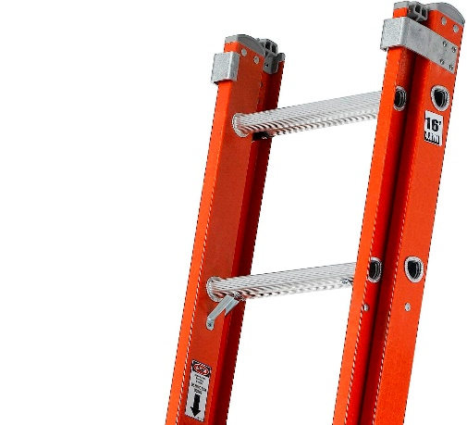
WHO Pain Ladder for Medications
Step 1- Mild pain
Acetaminophen (Paracetamol)
Ibuprofen or other NSAIDS
Step 2- Moderate to severe pain
Opioids (Morphine is the gold standard)

Slide 17
Medications WHO Ladder: Step 1
Mild Pain:
Acetaminophen (Paracetamol)
15 mg/kg q 6h oral preferred Max 4000 mg/day for bigger kids or adults
20 mg/kg rectal (30 mg/kg one time load) usually in the OR by anesthesia
15 mg/kg q 6 IV to a maximum of 1000 mg q 6 for bigger kids or adults
Care with dosing- overdose cases hepatotoxicity
IV acetaminophen: only marginal advantage over po.
Acetaminophen good in post op pain control in conjunction with other medications (Not alone)
Can be combined with NSAIDs as q 6h medication
NSAIDS not for infants under 6 months

Slide 18
Medications WHO Ladder: Step 1 Continued
Mild Pain:
Non-Steroidal Anti-Inflammatory Drugs (NSAIDS)
Analgesic, anti-inflammatory, antipyretic
Ibuprofen (least GI side effects) 10mg/kg q 6h po
Bleeding risk is less than formerly thought
Generally not used under 6 months
Ketorolac 0.5 mg/kg q 6h (max 30 mg) IV may be used in OR or PACU
Diclofenac (Voltaren) Not all preparations are equal!
Check doses locally
Little evidence to choose any one NSAID over another
Not for infants under 6 months

Slide 19
Medications WHO Ladder: Step 2
For Moderate to Severe Pain: OPIOIDS
Morphine is the best known and most available
Oral is the preferred route outside of the OR or PACU
Use only if step 1 meds with comfort measures are not working
Examine patients carefully before starting in case there is another problem casing increased pain- infection, diaper rash, hunger,or fear
10%-20% may have side effects such as nausea, pruritus or poor pain control; this is best handled by switching the medication if possible
Start at lowest dose

Slide 20
Oral Morphine
Starting dose 0.1-0.2 mg/kg every 4 hours (NOT PRN). Max 5 mg for bigger kids or adults
If oral preparation not available can add IV morphine 100 mg to 100 ml simple syrup to get 1 mg/ml for po use
Measure dose with a syringe
Breakthrough dose 1/10 to 1/6 of total daily dose between scheduled doses- only with MD supervision.
50% rule for inadequate pain control- Next dose increase by 50% (example: 0.1-0.2 mg/kg goes to 0.15 to 0.3 mg/kg every 4hours)

Slide 21
Do Not use Codeine- Why?
All of the analgesic effect of codeine derives from its metabolism to morphine
It is metabolized to morphine in the Cytochrome P450 system – there is large metabolic variation among populations:
-----From 1% up to 28% of people (most commonly North African, Ethiopian, and Arab) are ultra rapid metabolizers and may become toxic on usually prescribed doses
-----From 1% up to 50% of people (most commonly Caucasians) are intermediate or slow metabolizers and get little to NO relief from codeine

Slide 22
Why not Tramadol or Hydrocodone?
Both are also metabolized through the Cytochrome P450 system so have some of the same concerns as codeine because of variable metabolism.
Increased toxicity in ultrarapid metabolizers is a shared problem.
This group is small in MOST countries, but caution and close observation are necessary.
Safer to use oral morphine everywhere.

Slide 23

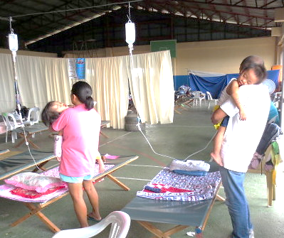
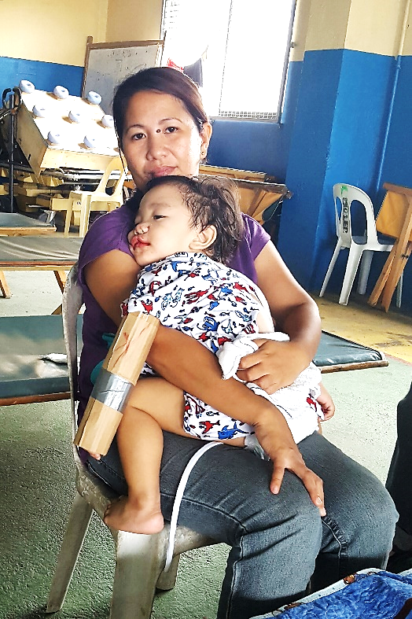
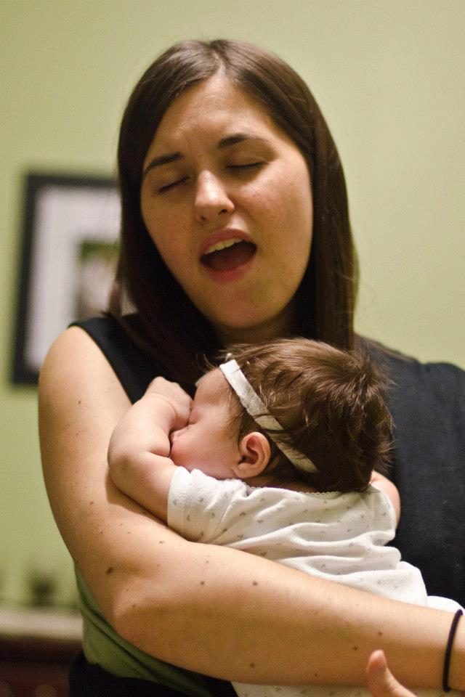
What else will help child feel better besides medications?
Distract child
Walk with child, holding IV bottle if necessary
Hold child
Sing to child

Slide 24
Pain Management Everywhere
Pre-operative
In the OR
In the PACU/Recovery Room
On the ward

Slide 25
Pre-Operative: Before the Hospital
Education/Anticipatory Guidance:
Pediatrician, surgeon and Nurses teach parents and kids at preop appointments:
---What to expect at the hospital.
---What surgery and recovery will be like
---What will be useful for pain control- bring your child’s favorite toy or blanket?

Slide 26
Pre-operative at the Hospital
At the hospital: First more education!
Before surgery:
-Feeding: Why all orders to stop feeds must be followed. (surgery may be cancelled if a child eats at the wrong time)
-What to expect after- swelling, stitches, bleeding
- Comfort Measures: positioning, holding, soothing, singing, feeding as allowed, medications first day at least.

Slide 27
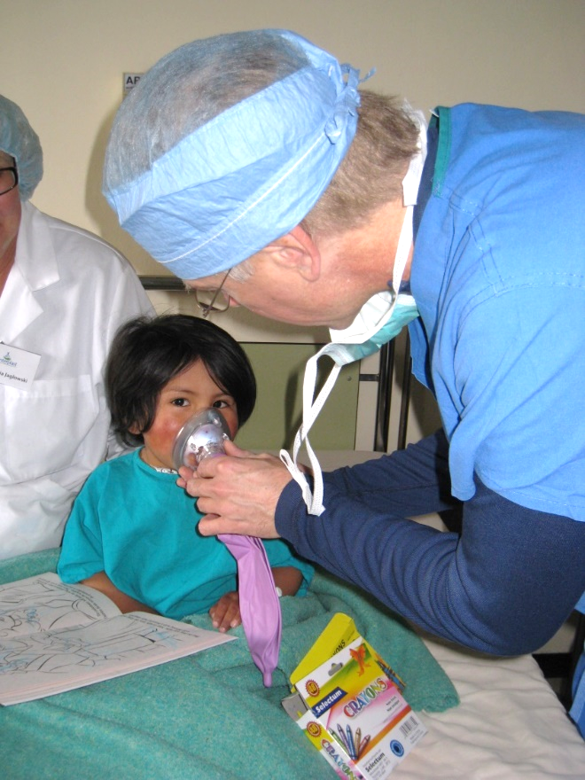
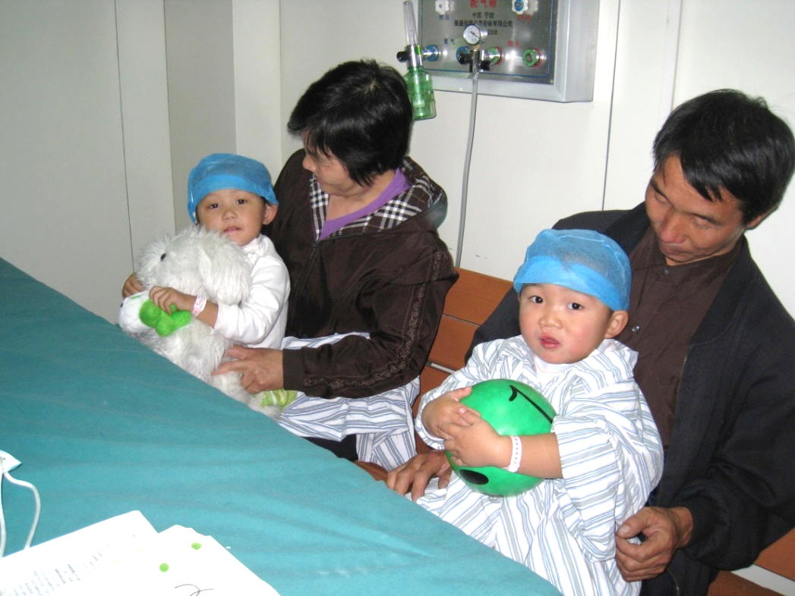
Pre-operative Area
Patients are distracted
with toys and games
Small amount of oral medication sometimes given to relax patient

Slide 28

In the OR
Local medication at incision site
Regional blocks
Acetaminophen 30 mg/kg per rectum
Decadron
Morphine at the end of case

Slide 29
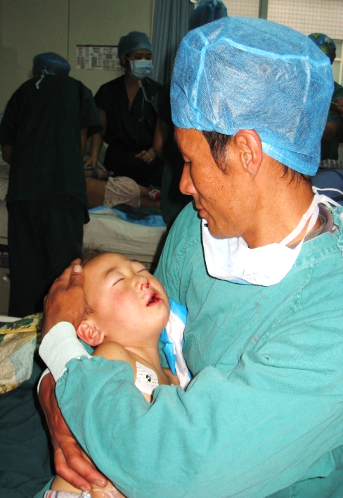
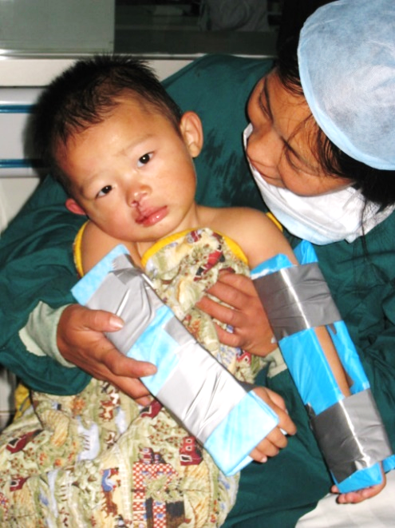
In the PACU/Recovery Room
Medications:
Morphine or Fentanyl
Possibly Lorazepam
***Positioning, families holding and soothing, start feeding clear liquids as tolerated.

Slide 30
On the Ward
Acetominophen/Paracetamol will be ordered around the clock for the first 24 hours for cleft lip repair; first 48 hours for cleft palate/fistula repair.
Ibuprofen usually around the clock first 24 hours and then as needed
Rare addition of prn oral morphine for intractable pain- always examine patient looking for other problems before adding this.
Encourage families to soothe, position, feed per orders, reassure and distract their children according to their practices, and allowed foods, post op.

Slide 31
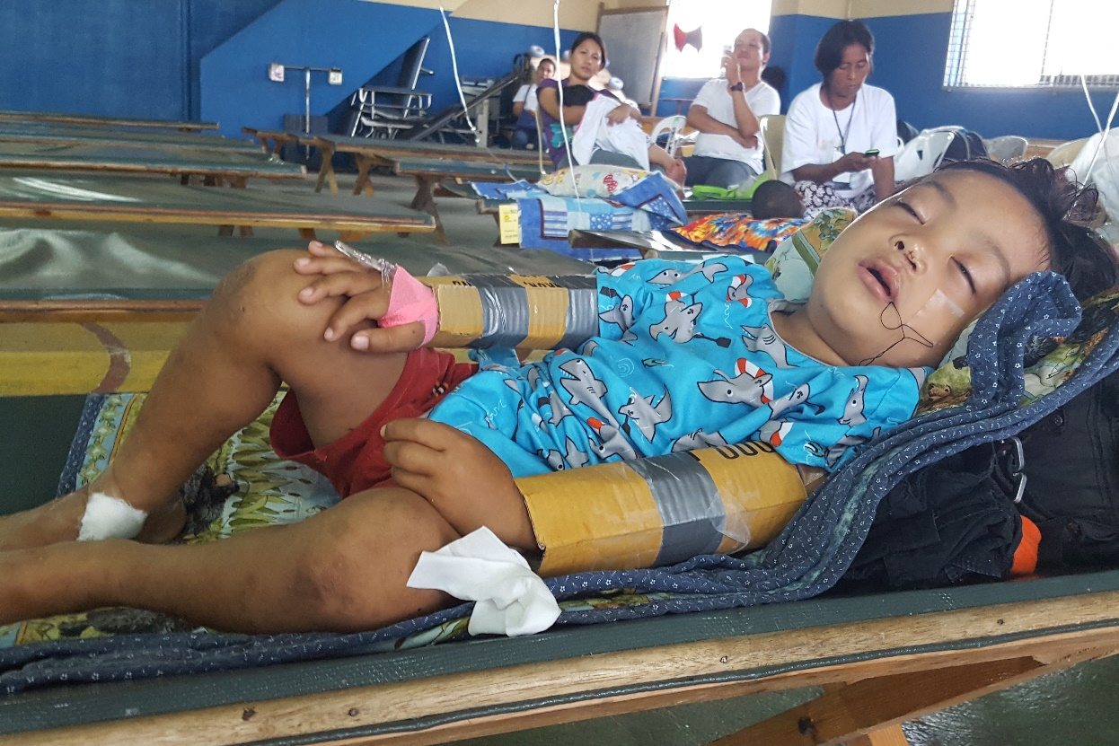
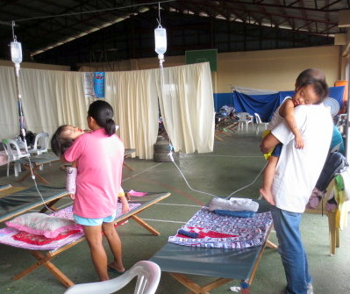
On the Ward

Slide 32
Take home messages
Children will have pain post op and it should be effectively treated.
Pain Management begins with preop education!
Comfort measures should always be used with and without pain medication.
Pain medication around the clock for the first 24 hours after surgery for cleft lips, and 48 hours for palate/fistula repairs, then given as needed.
Time first dose based on meds given in the OR and or PACU
Acetaminophen/paracetamol and Ibuprofen a nonsteroidal anti-inflammatory medication (NSAID)to be given together at the same time, every 6 hours for the first 24 hours to patients with mild to moderate pain. ( NSAIDS generally not under 6 months old)
Cleft palate/Fistula repair patients may need this combination for 48 hours.
24 to 48 hours after surgery this combination can be given as needed every 6 hours.
Morphine is the medication of choice for moderate to severe pain.

Slide 33

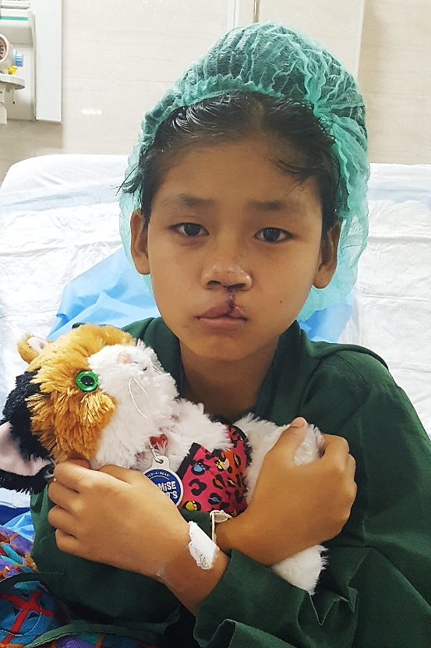

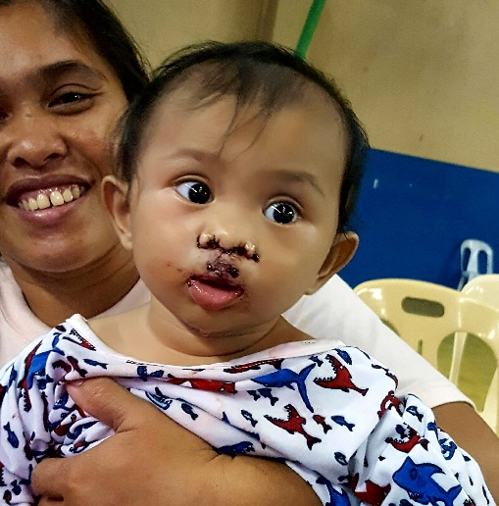
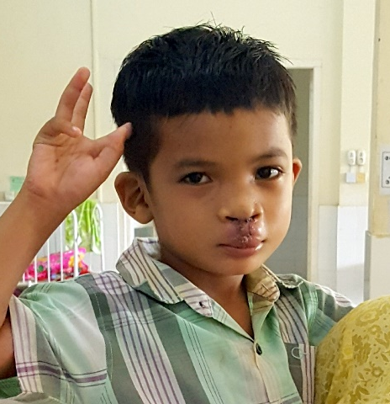
Let’s Keep Our Postoperative Patients Comfortable!
A special thanks to Kathy Gallagher, MD, Pediatrician, for her help with content of presentation.

