Slide 1
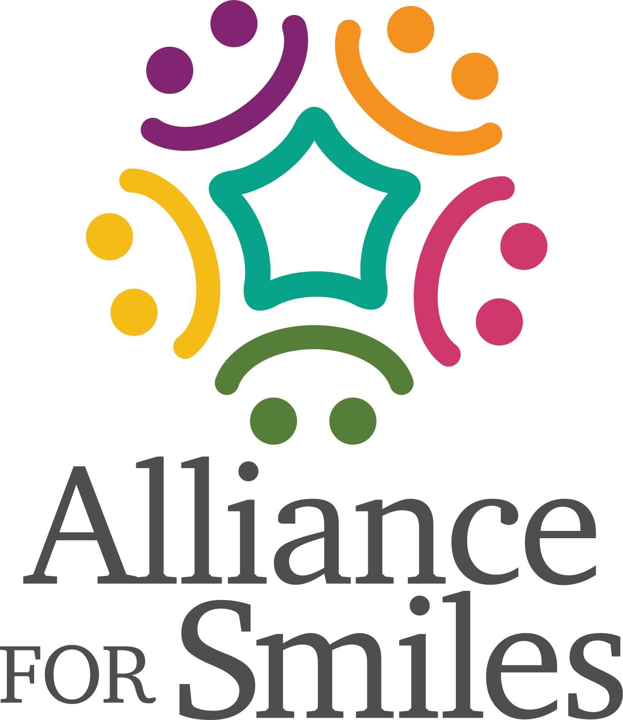
Oral Hygiene Education For Cleft Lip And Palate Patients
Why Is It So Important?

Slide 2
Presentation Overview
(Include relevant photos >>>

Slide 3
Children With Cleft Lip And Palate
Present With Many Needs, Including
Dental And Oral Problems
Feeding Problems
Missing Teeth (50%)
Supernumerary Teeth (20%)
Dystrophic (Hypoplastic) Teeth (30%)
Disturbances Of Tooth Eruption
Malocclusion (100%)
Dental Caries And Gingivitis

Slide 4
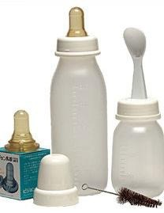
Feeding Problems
Use Of A Medicine Dropper, Spoon, Or Special Feeder May Simplify Feeding
Breast Feeding Reduced Risk Of Ear Infection
A Removable Obturator May Be Required To Close Defect And Prevent Regurgitation Of Food Into The Nasal Cavity

Slide 5
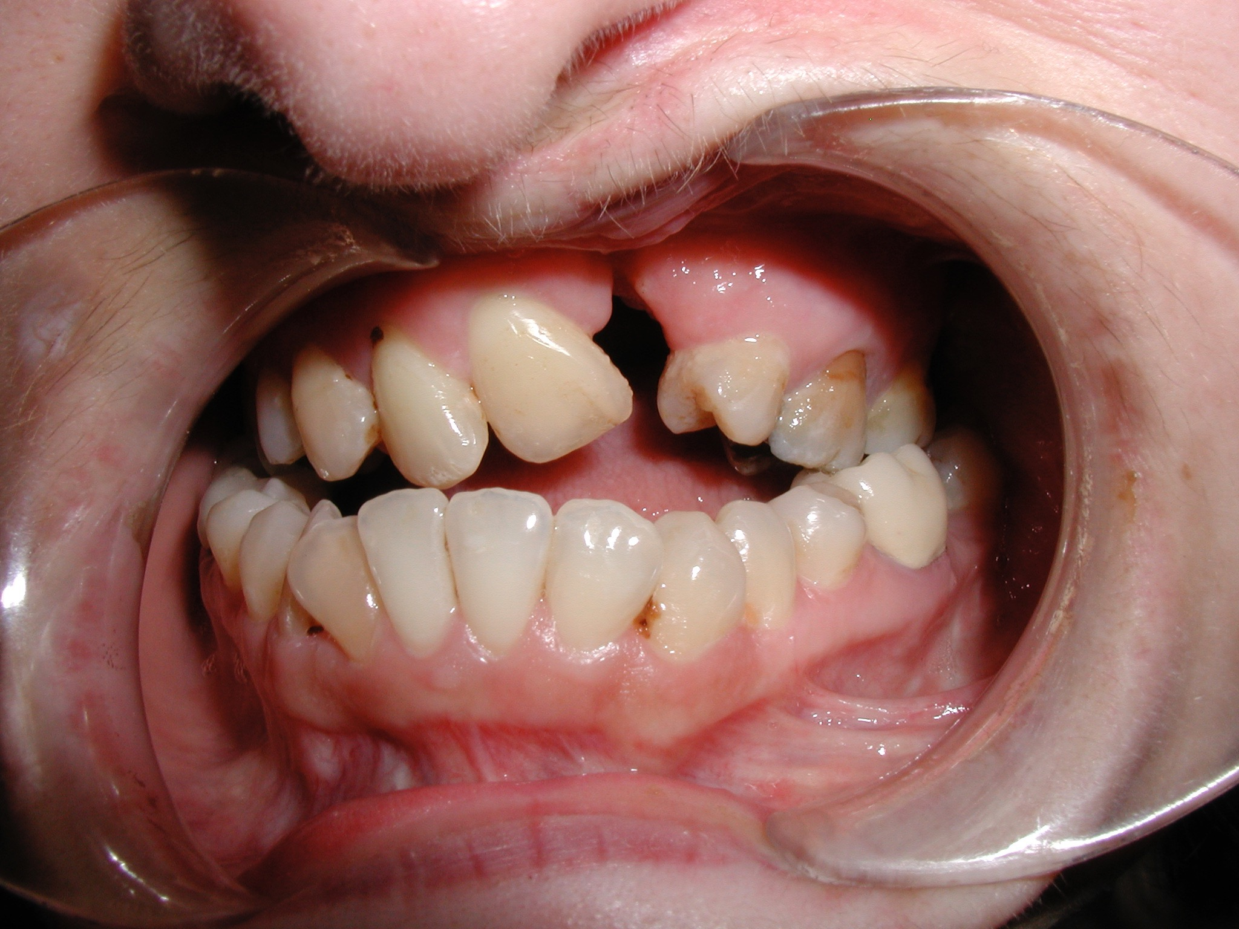
Missing Teeth

Slide 6
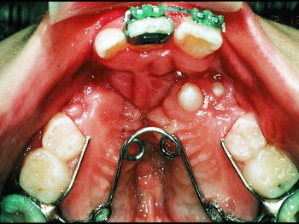
Supernumerary Teeth

Slide 7
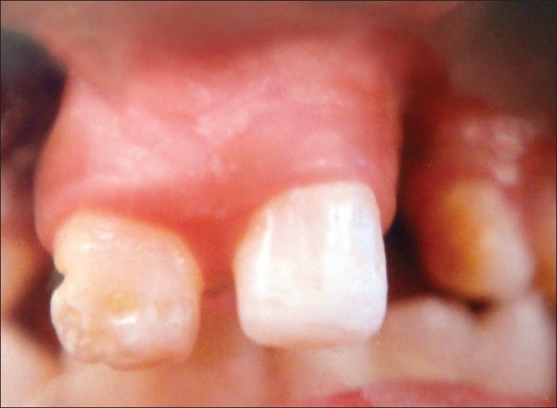
Dystrophic (Poorly Formed) Teeth

Slide 8
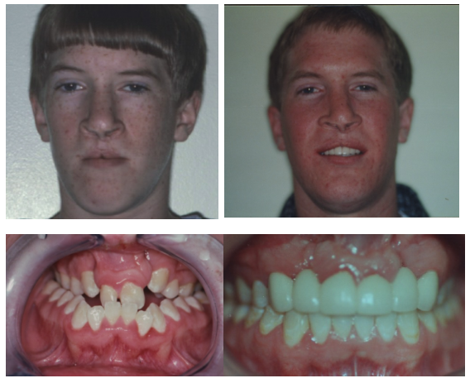
Malocclusion

Slide 9
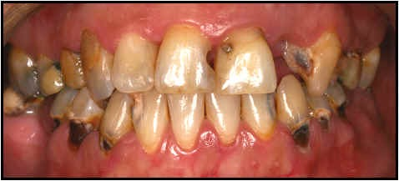
Caries (Dental Decay)

Slide 10
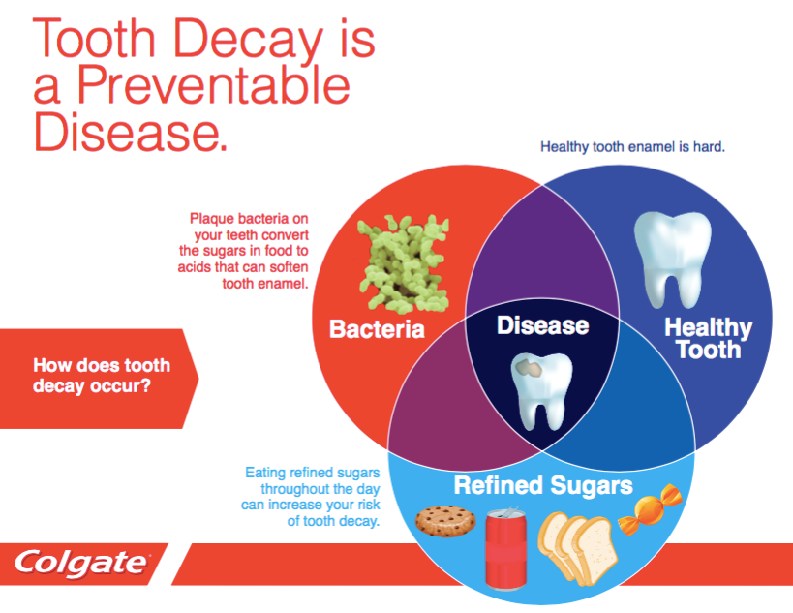

Slide 11
Start
Even
Before
They
Have
Teeth

Slide 12
Let Them Brush By Themselves First

Slide 13
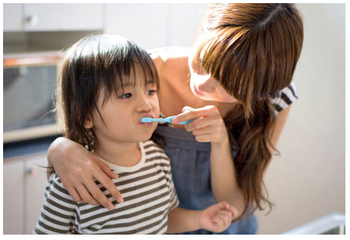
Then You Brush For Them

Slide 14
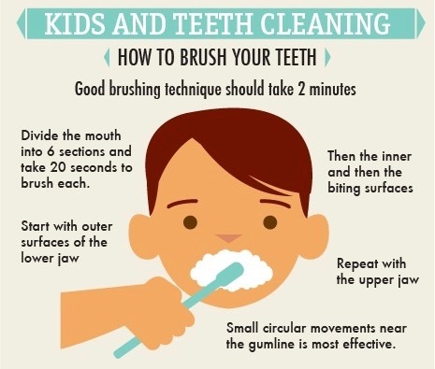
Brushing Technique

Slide 15
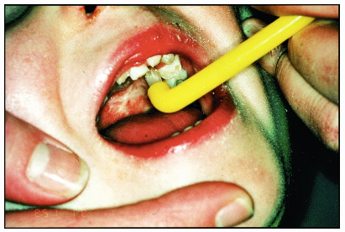

Slide 16
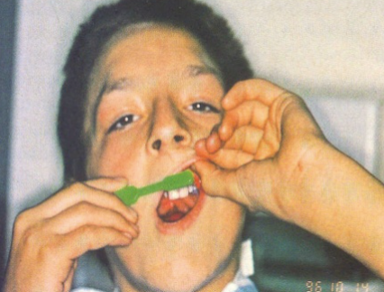

Slide 17
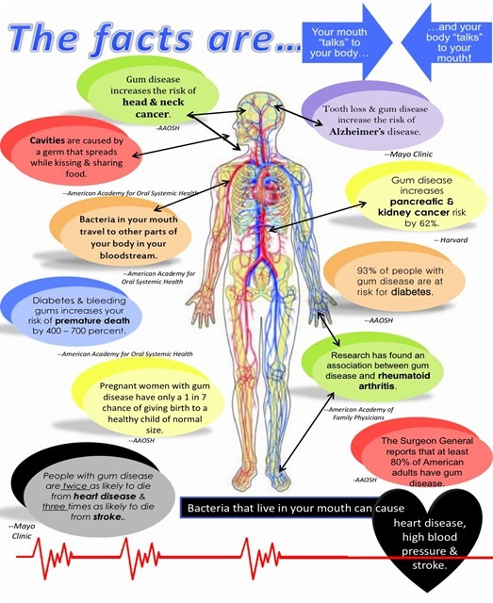
Oral Bacteria are being found all throughout the body
Periodontal Disease is linked to cardiovascular disease, heart attacks and strokes
Increased risks for people with diabetes
Increased risks for types of cancer
Bad Occlusion can lead to Migraines and sleep apnea

Slide 18
Take Aways
Early oral hygiene care using proper technique is imperative for healthy teeth and gums!

