Slide 1

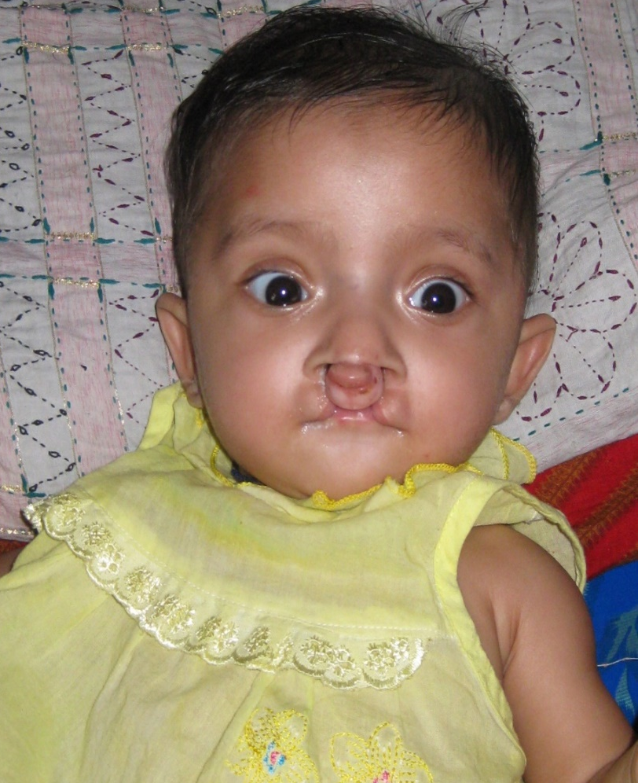
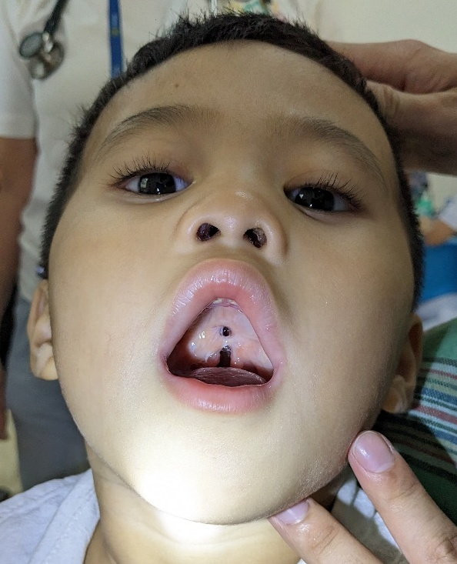
Nursing Care of Cleft Lip and Cleft Palate Patients

Slide 2
Presentation Outline
Introduction
Types of cleft lip and palate deformities, incidence, and possible causes
Patient selection for surgery
Patient Care on the Ward
Preparing patients for surgery
Morning of surgery clearance screening
Surgical procedures
Post-operative care
Patient and Family Education
Discharge instructions for families
Examples of discharge forms

Slide 3
Classification of Cleft Lip Deformities
Classified by location:
Unilateral = Left or right side only Bilateral = Both sides
And extent (where it goes):
Complete = the opening extends from the mouth into the nose.
Incomplete = the opening does not reach the nose

Slide 4
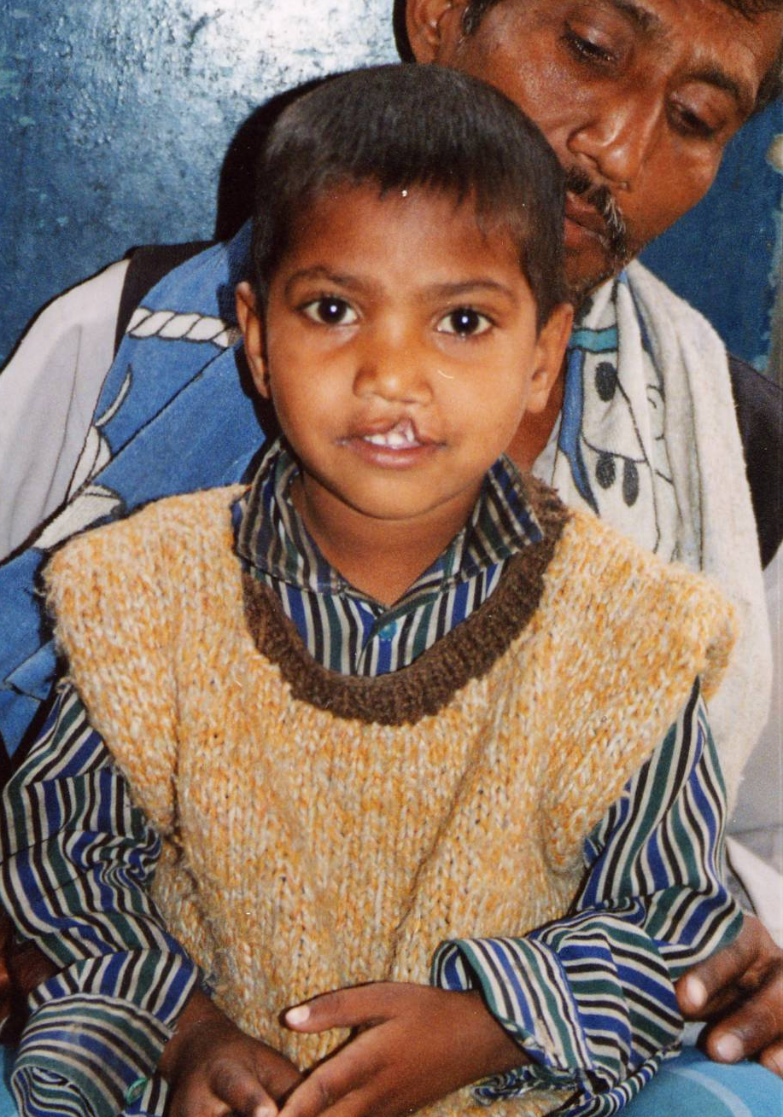
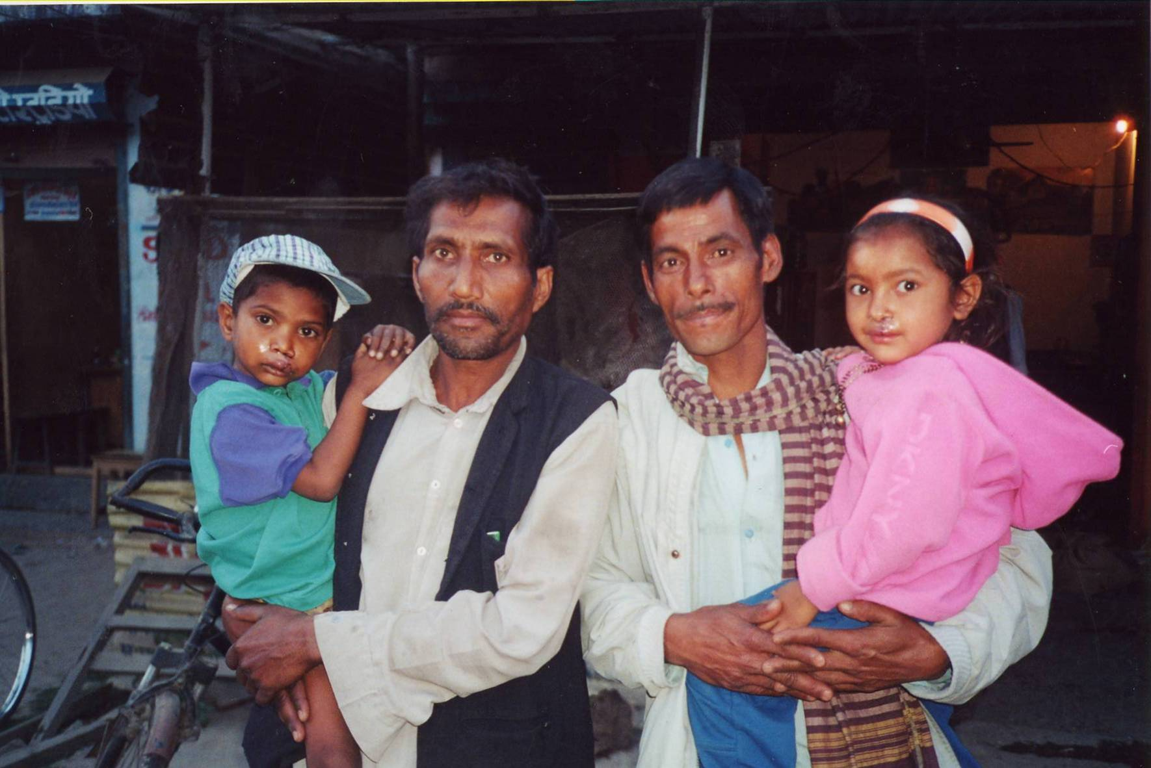
Unilateral Incomplete Cleft Lip
Before
After

Slide 5
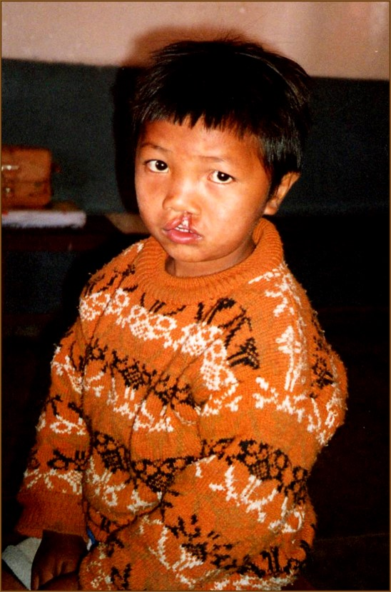
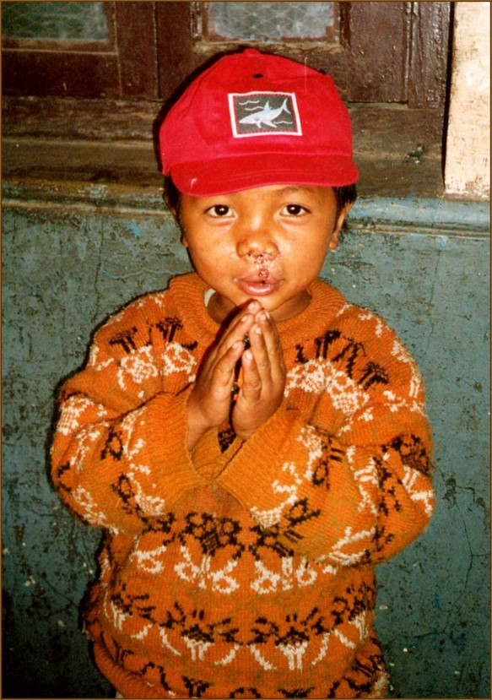
Unilateral Complete Cleft Lip
Before
After

Slide 6
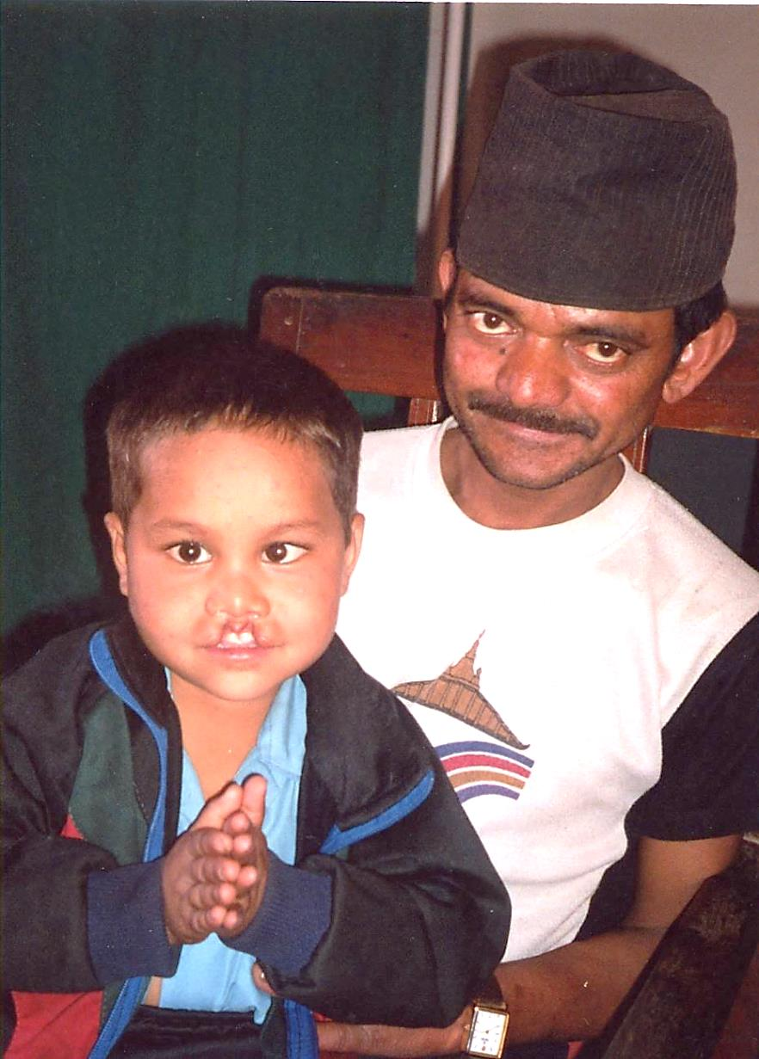
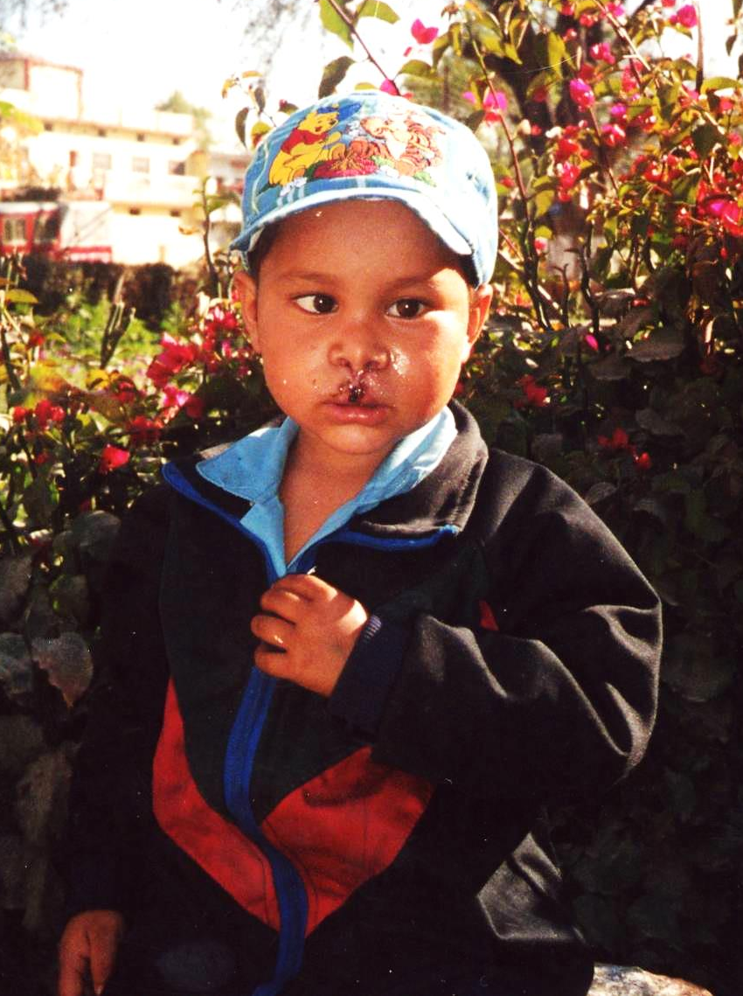
Bilateral Incomplete Cleft Lip
Before
After

Slide 7
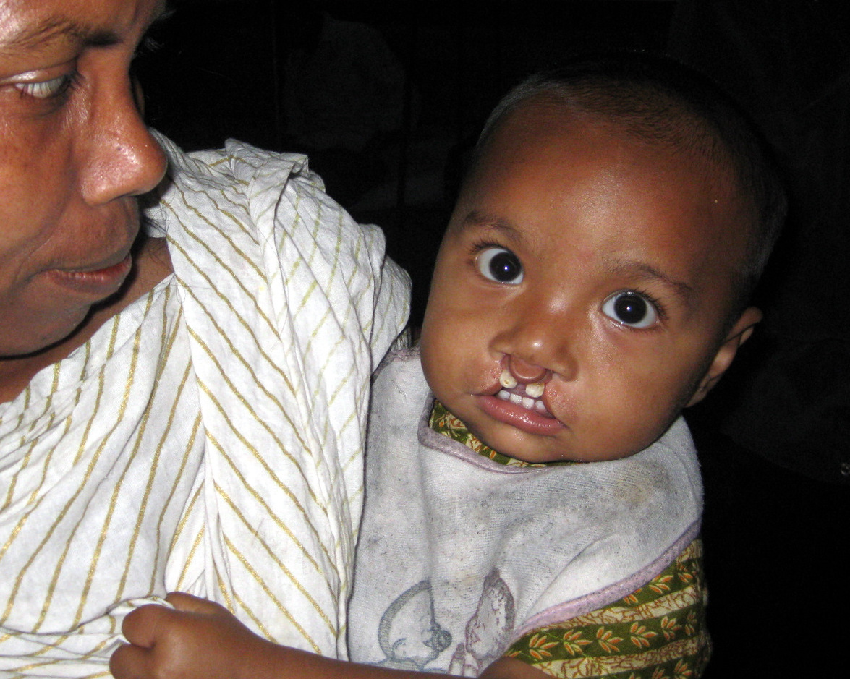
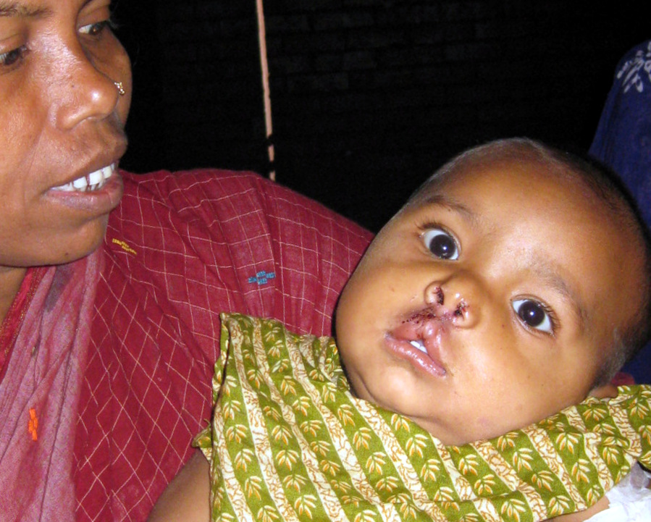
Bilateral Complete Cleft Lip
Before
After

Slide 8
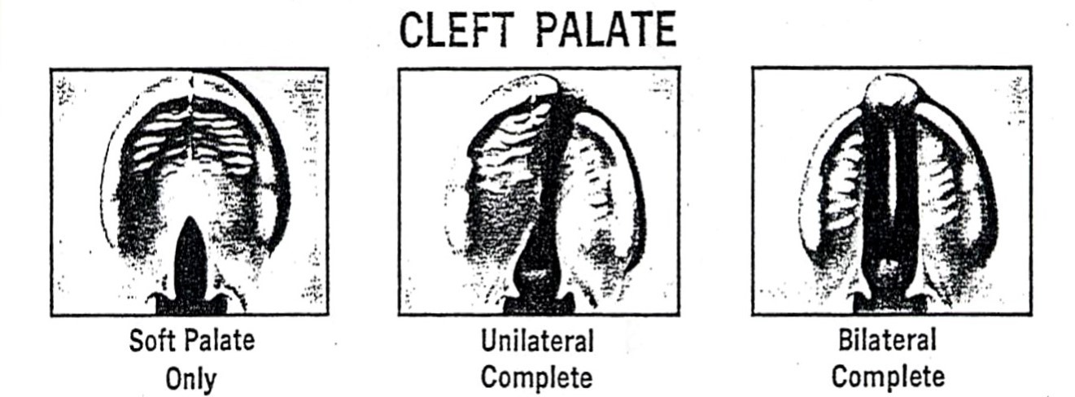
Cleft Palate Deformities

Slide 9
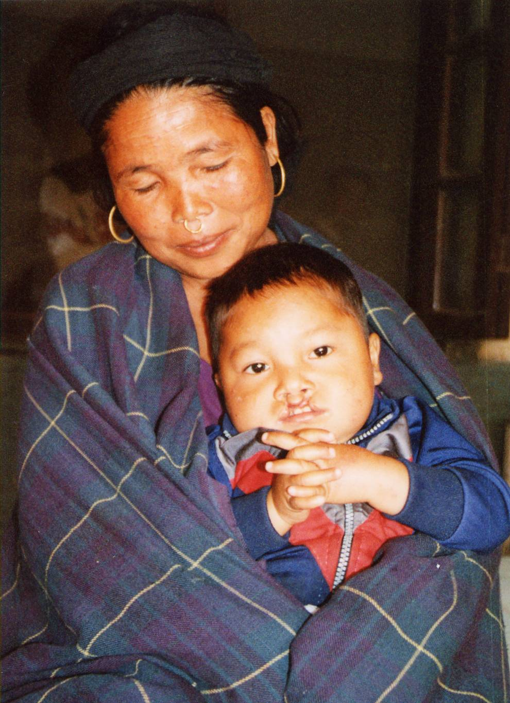
Incidence
Clefts are the 4th most common birth defect, about 1/700 births worldwide
Statistics are difficult to confirm since not all countries keep central records.
Cleft lip and palate occurs more frequently in males. Cleft palate alone is more common in females.
Notes:
Statistics are difficult to confirm due to lack of population data in some countries. In addition, many afflicted children likely die shortly after birth.

Slide 10
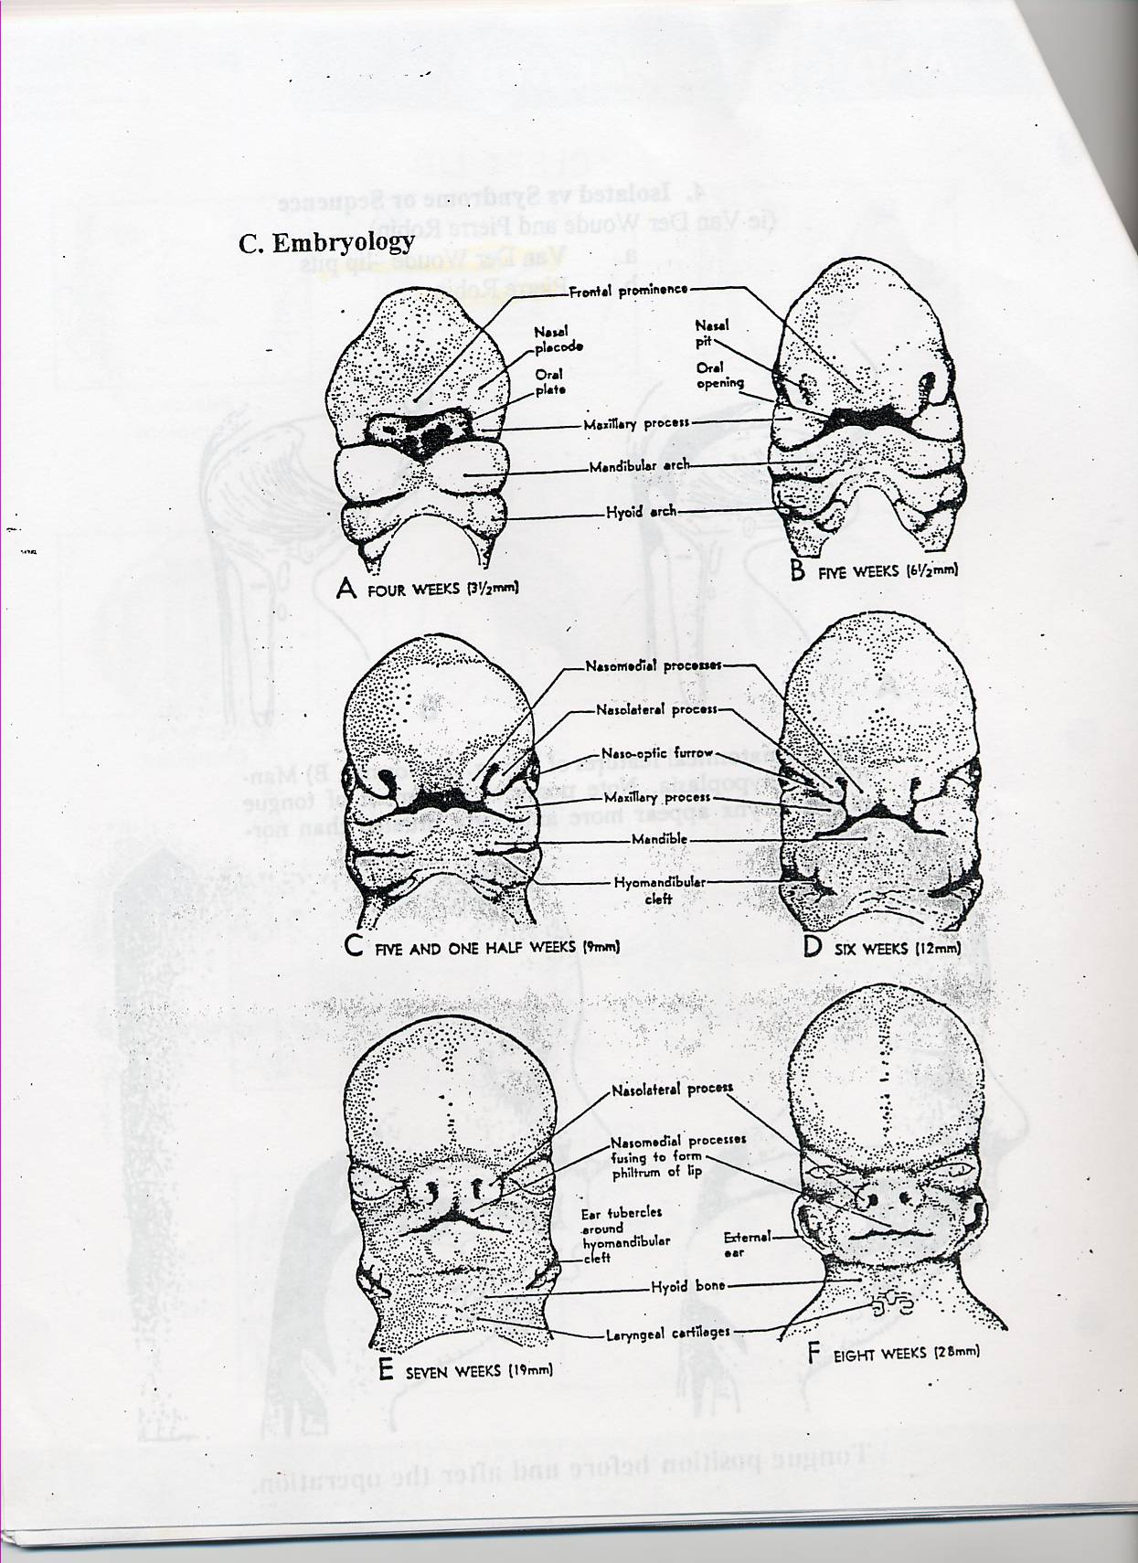
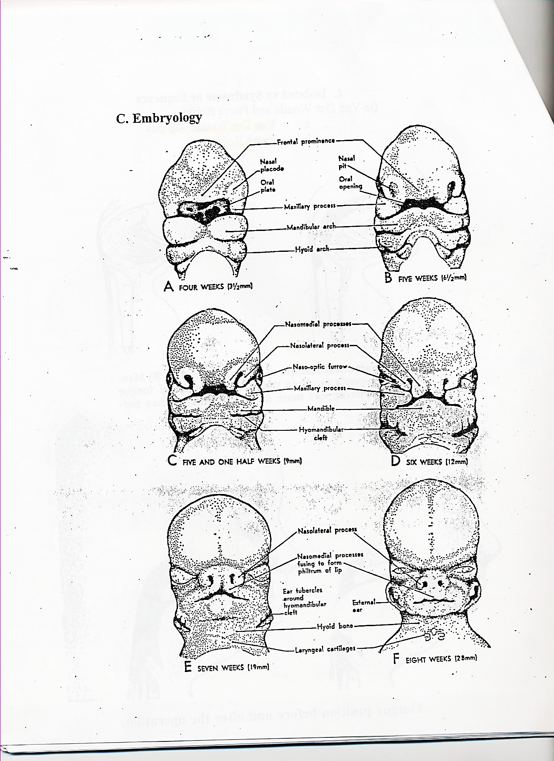
Embryology
Clefting occurs during the first trimester of pregnancy.
The lip fails to fuse during the fifth week of gestation.
The palate fails to fuse during the eighth week of gestation.
Five
Weeks
Eight
Weeks

Slide 11
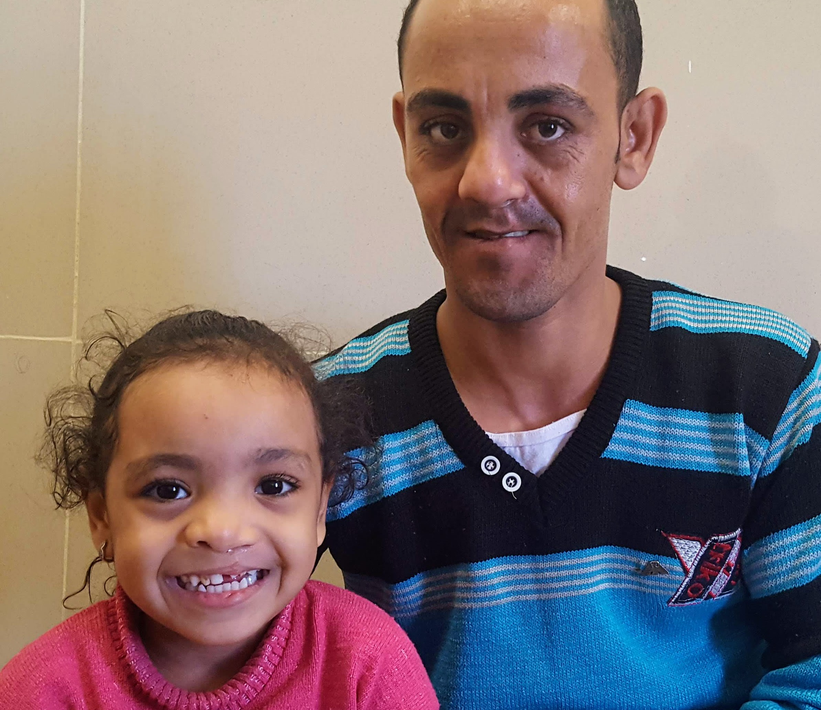
Causes
Genetic causes:
Deformities run in families
Possible environmental causes:
Toxins
Advanced maternal age
Maternal diet during pregnancy
Recurrence risk may be decreased with folic acid supplements prior to and during pregnancy.

Slide 12
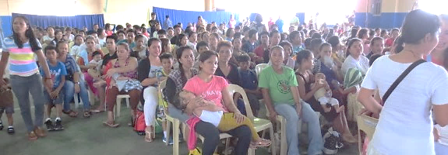
Patient Selection for Surgical Repair
First Day: Intake Clinic
1. Registration, including photograph
2. Seen by our nurses for ht, wt, O2 saturation , blood work
3. Examined by surgeons
4. Examined by anesthesiologist
5. Examined by pediatrician
6. Examined by dentist

Slide 13
PEDIATRIC INTAKE CLINIC QUESTIONS – Slide 1
Universal pre-op questions assess understanding of procedure and suitability of a patient for surgery (listed on Slide 2 below)
AFS team will ask these at the intake clinic:
What surgery is your child going to have?
How is child today? Cough, fever, runny nose? Sick in the past two weeks? Did they get medicine for this?
Any allergies to medication or food? Medications, (including herbal)?
Any ongoing problems you see a doctor for? History of asthma, bronchitis or lung problems?
IMPORTANT: ***Sometimes families forget to tell us things. If you see anything that concerns you, like a parent giving medication we do not know about, or a child who gets blue while feeding, let the AFS team know before surgery ***

Slide 14

PEDIATRIC INTAKE CLINIC QUESTIONS – Slide 2
Previous surgeries? Problems with any surgery or anesthesia?
Family members who had problems with anesthesia? What happened?
Was your child born early or on time?
Feeding problems? Sweating or shortness of breath while breast feeding?
Developmental delay? Does the baby or child do what others their age can do? School performance?
Can the child run, jump, climb stairs like most children? Heart problems? Does the child turn blue from exercise? Snore at night? History of seizure? Fainting?
Excess or prolonged bleeding in child or family?

Slide 15
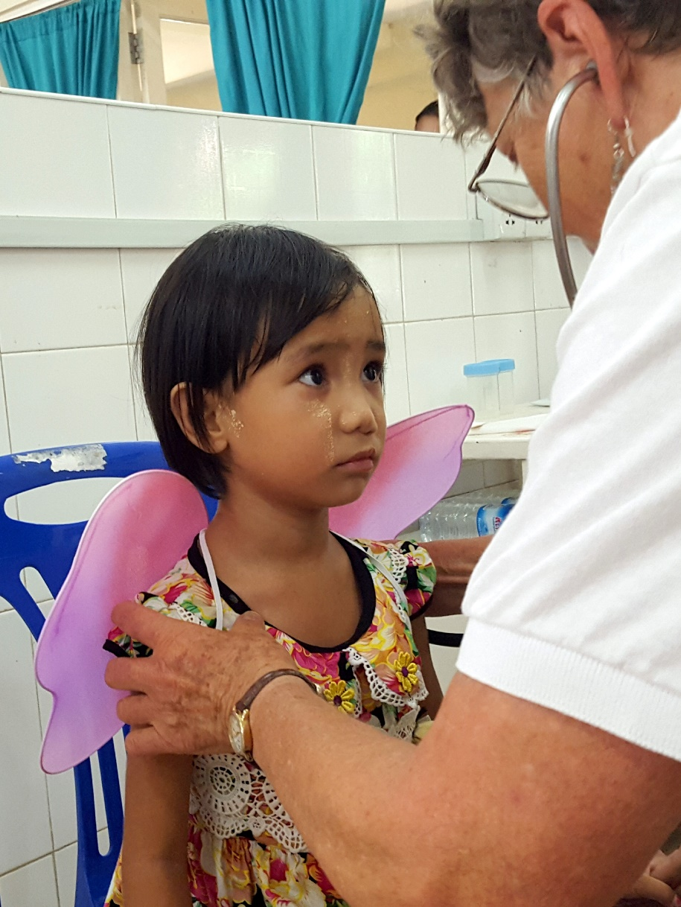
Physical Exam
Vital signs
General Appearance
Head and scalp
Mouth and throat
Lymph nodes
Chest
Heart
Abdominal
Extremities
Why examine the extremities when the operation will be on the mouth?

Slide 16
Requirements for Surgical Eligibility
At least 3 months of age and weight of 5kg for lip repair
At least 12 months of age for palate repair
Hemoglobin 10gm or greater (rare exceptions for simple lip repairs)
No acute upper respiratory symptoms
No or clearly understood abnormal physical findings: children with heart, lung, or neuromuscular disease or metabolic abnormalities have been shown to be at an increased risk for problems under anesthesia
Why would we not want to do surgery on a child who has an upper respiratory infection with a loose cough and mucous in their throats?

Slide 17
Pre-op: Admittance to the Ward
Use standard admittance procedure for hospital including the following:
Vital signs
Permits for surgery
Baths
Nothing by mouth instructions
Urine pregnancy test for all menstruating females (Yes, even if unmarried)
Blood work if not done previously
Patient’s identification cards on each bed
Patient’s weight on each bed.
Surgery schedule for the next day needs to be delivered to the ward every afternoon the nurses can prepare for the patient who will be admitted.

Slide 18
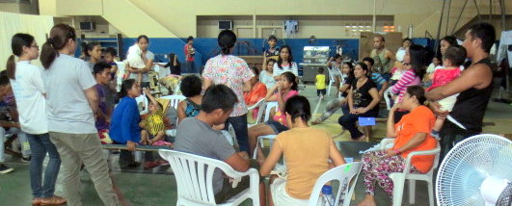
Family Teaching and Pre-op Instructions

Slide 19
Pre-operative Instructions for Families the Night before Surgery
Importance of following feeding instructions for the child
Surgery may be cancelled if a child eats or drinks after the allowed times before surgery
What to expect after surgery – stitches, swelling, oozing, new feeding instructions, no-no’s, IV, tongue stitch
Pain control strategies (next slide)

Slide 20
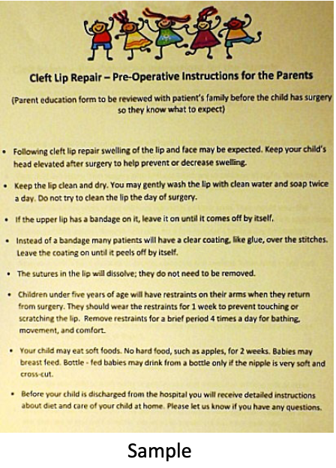
Pre-operative Instructions, continued
Pain control strategies for parents and staff along with medications:
Distraction is great for pain control: soothing, singing, rocking, story telling, walking with supervision when ready.
Feed feed feed as tolerated - hunger and dehydration make us feel worse.
Note sample form for families here --→
Make sure they get cleft palate information for either palate or fistula repair, and lip information for lip repair.

Slide 21
Pre-op: The Morning of Surgery
Before the patient leaves for surgery the following should be done:
Early morning vital signs
Patients bathed
The first six patients on the schedule should be dressed in clean clothes or in a clean hospital gown
The patients should be in their beds and ready to leave for surgery after having a final examination.
The patients should be in their beds and ready to leave for surgery
Final preop exam by pediatrician either on ward or in preop area.
Once the patients are cleared for surgery they can be taken to the operating room when the personnel in the operating room are ready.

Slide 22
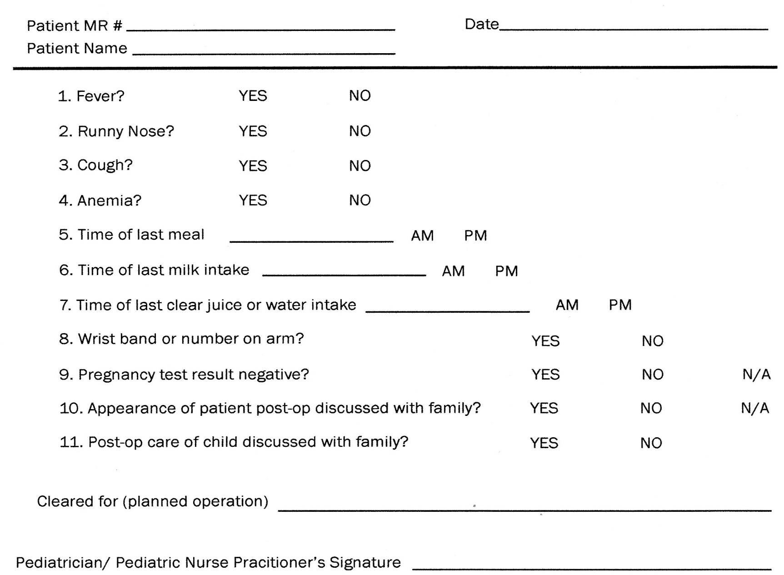
Clearance Form
A clearance form should be filled out by a medical professional and then sent to the operating room with the patient and their chart

Slide 23
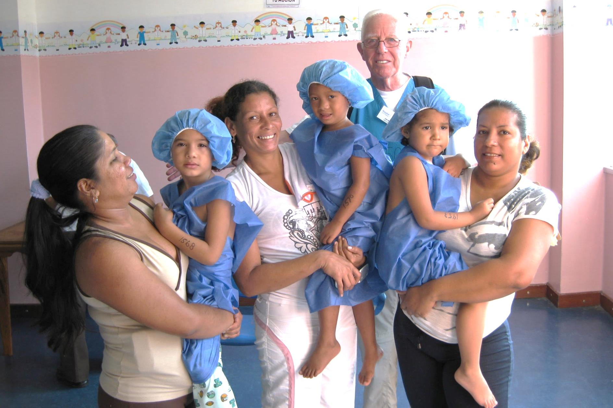
The first three patients being taken to surgery.

Slide 24
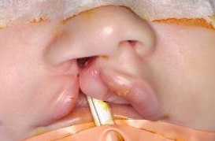
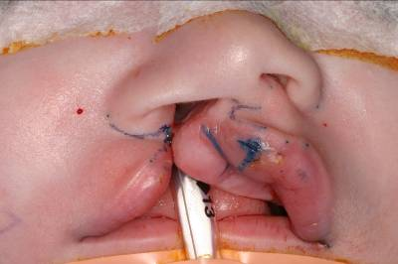
Unilateral Cleft Lip Repair
The breathing tube is in place
The surgeon draws where the incisions will be made with a special pen

Slide 25
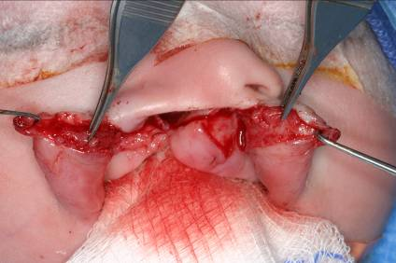
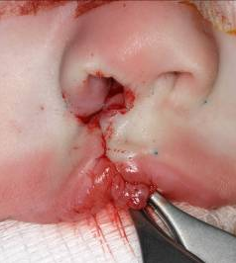
Intraoperative approximation
The layers of tissue are separated
The layers are then sutured together correctly

Slide 26
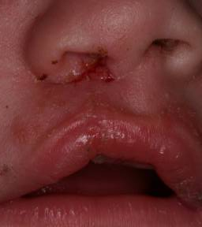
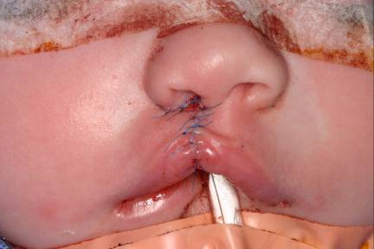
Post-Operative Results
Immediately after surgery
One week after surgery

Slide 27
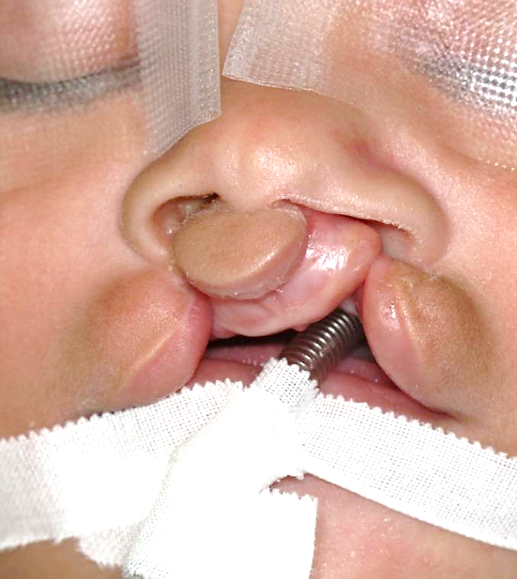
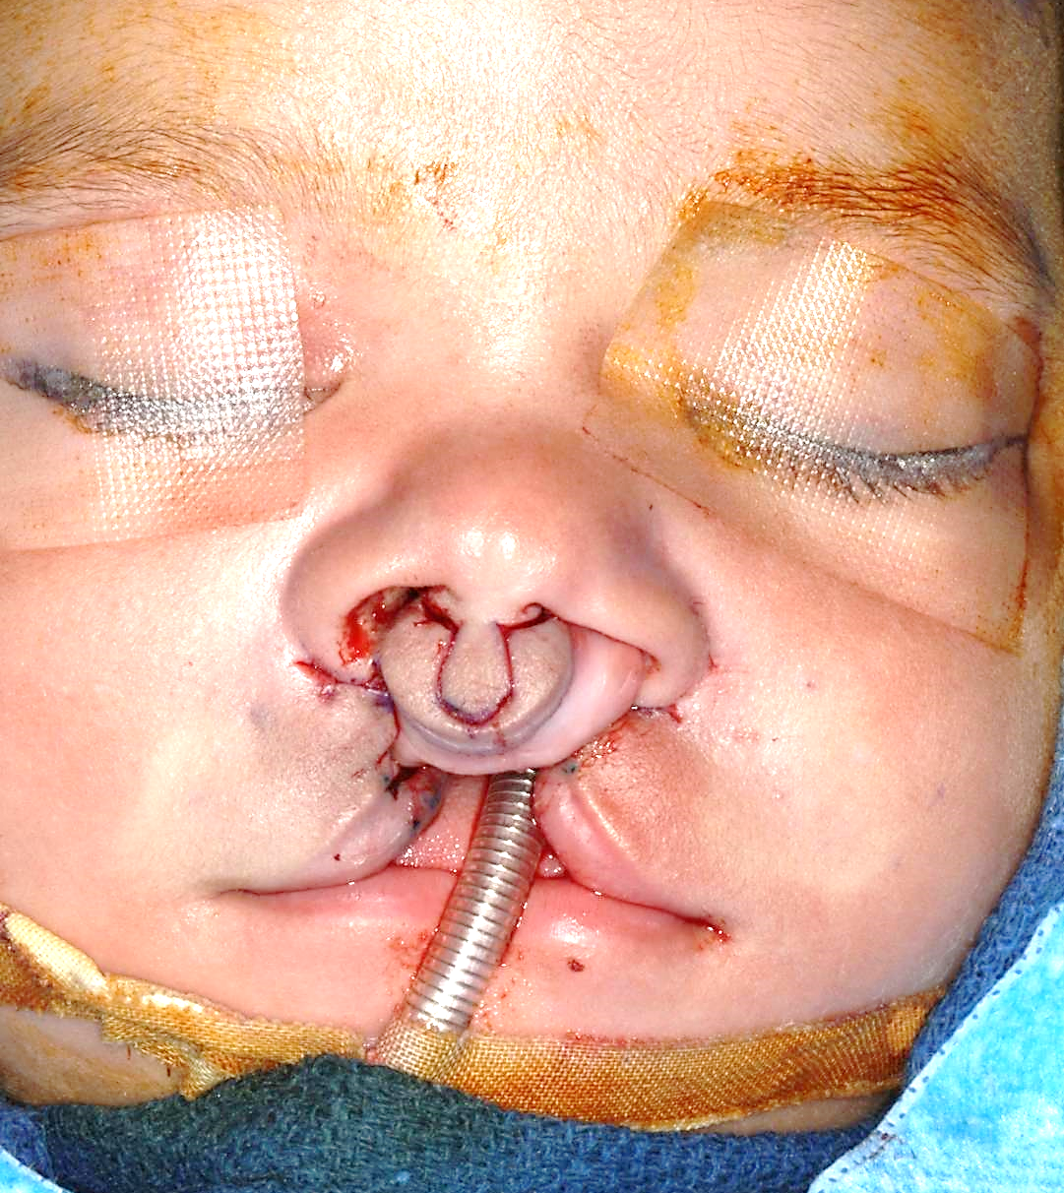
Bilateral Cleft Lip Repair
The breathing tube is in place
The surgeon draws incision lines
Does this baby have a complete or an incomplete bilateral cleft lip?

Slide 28
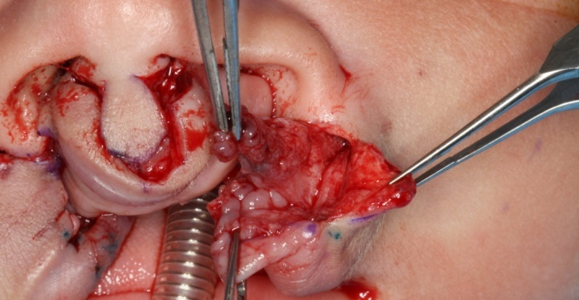
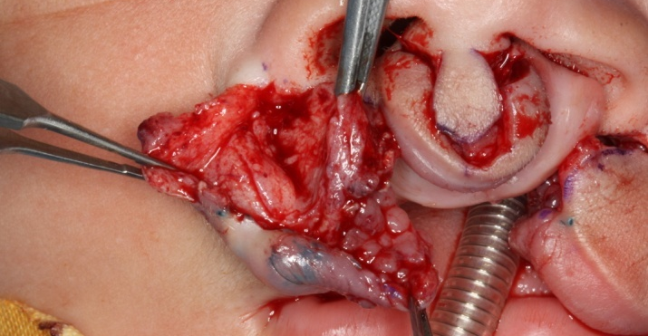
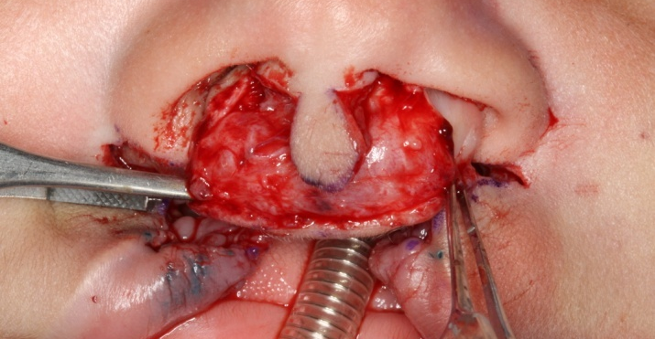
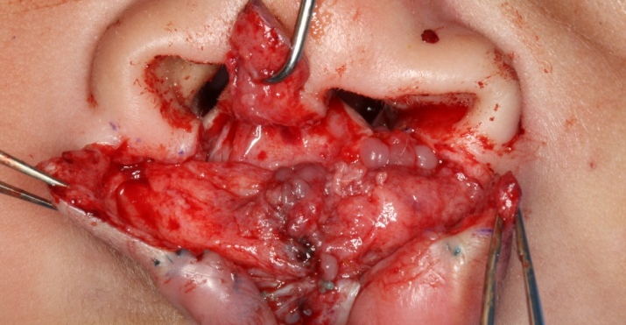
Intraoperative approximation
All the layers from both sides of the cleft lip need to be separated

Slide 29
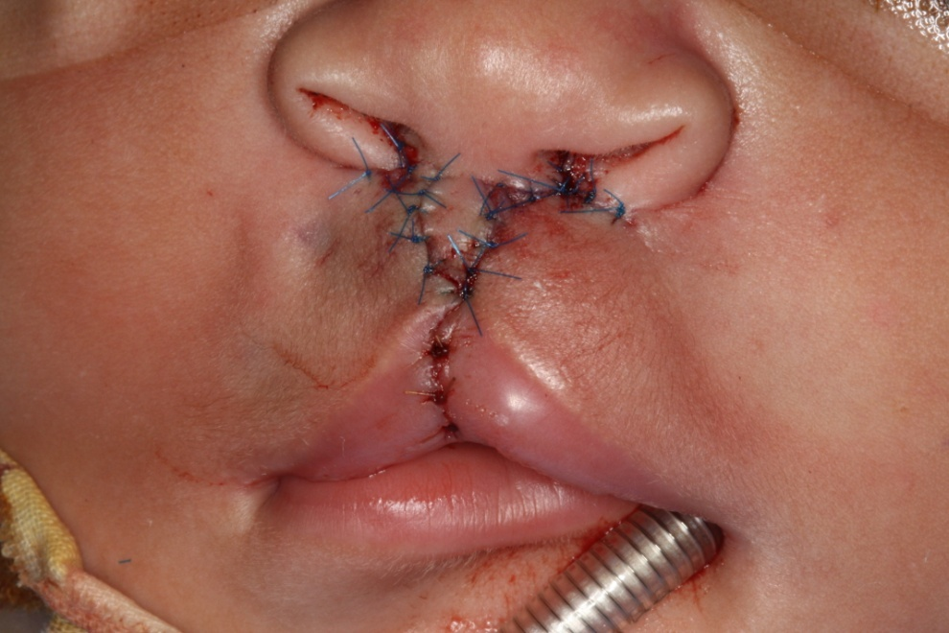
Bilateral cleft lip repair when surgery is completed
After this operation the nostrils look flat and flared out. You can reassure the family that the nostrils will look more normal after about a month.

Slide 30
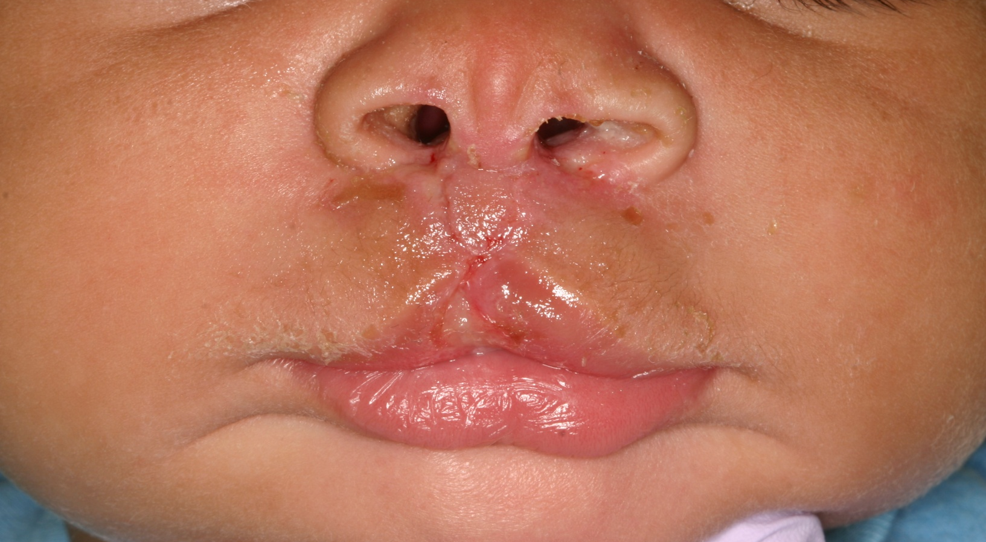
One-week after surgery

Slide 31
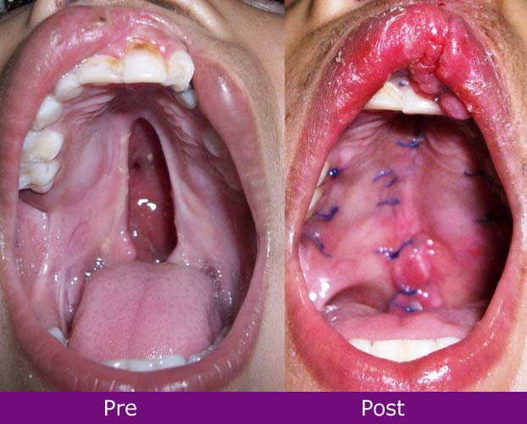
Cleft Palate
Complete cleft palate involves the hard and soft palate.
Some cleft palates only involve the soft palate.
The sutures will dissolve on their own.

Slide 32
Post-Operative Care: First Things
1. Position: In bed on their side OR on their parent’s lap with the head up.
-Head up can decrease bleeding and swelling.
- Side position makes it easier to see bleeding and is better in case of vomiting.
2. Clear liquids: Help parents offer clear liquids or breast milk as soon as possible.
- Helps with pain control- being hungry makes everything worse!
- Hydration is important!
3. Remind families what to call you for:
- Lots of blood: a small amount of blood coming from the nose or mouth is okay.
Call a nurse if there is more
- Vomiting: let the nurse know
4. IV running if ordered. 5. Pain control: Reassure parents that some pain is normal
- All kids get pain meds for the first 24 hours
- Positioning, soothing, distraction like massage or singing, feeding as ordered are all helpful.

Slide 33
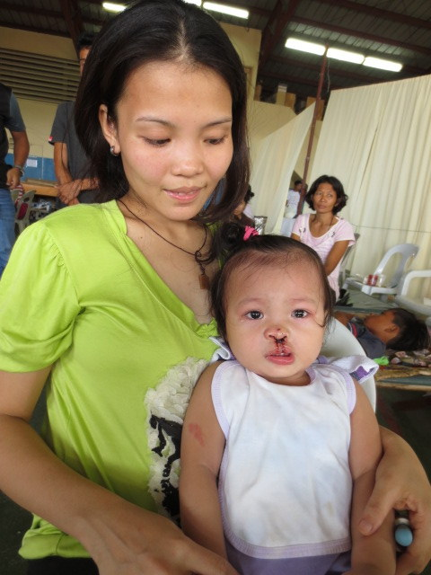
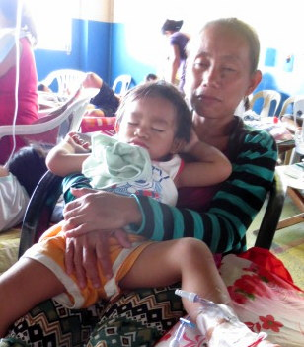
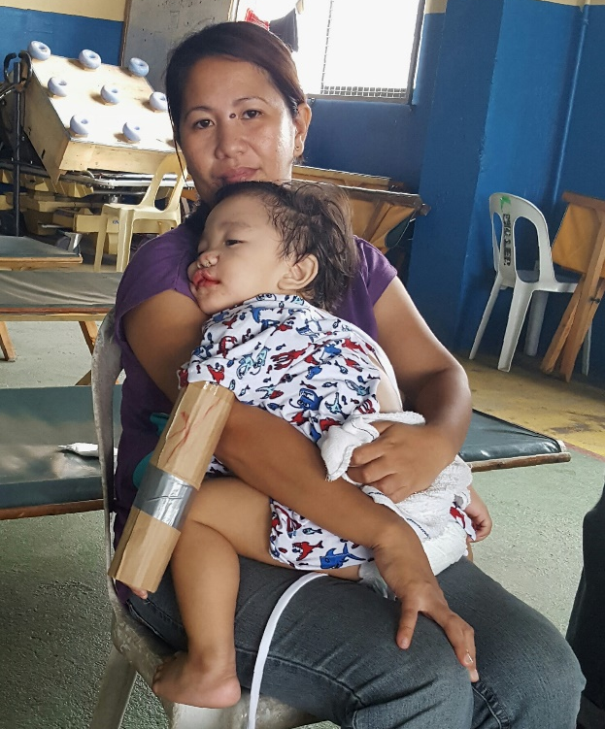
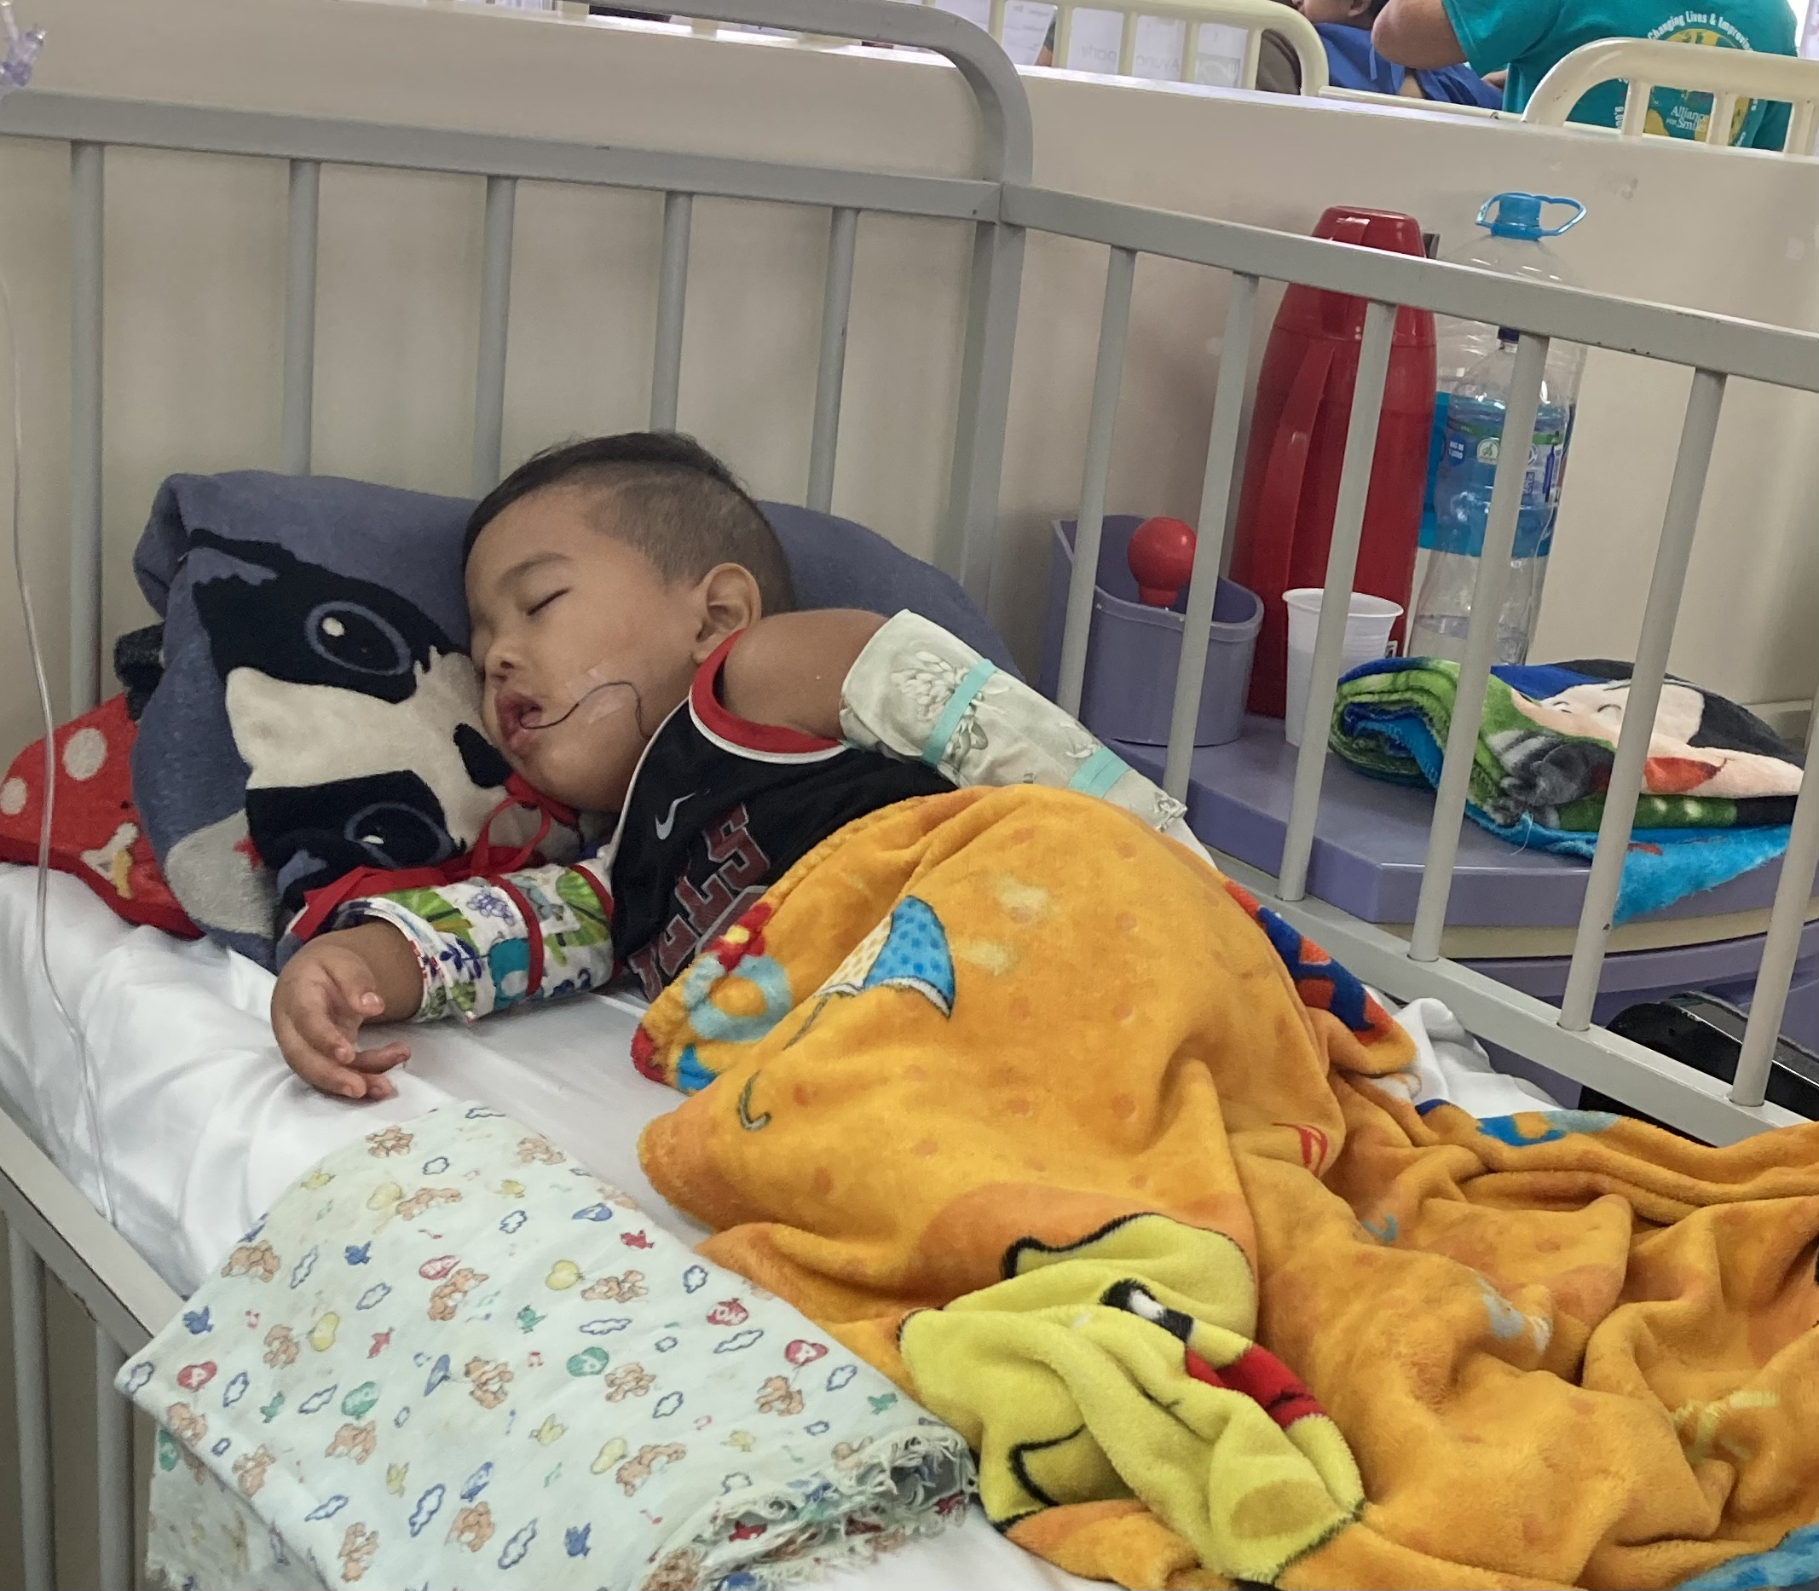
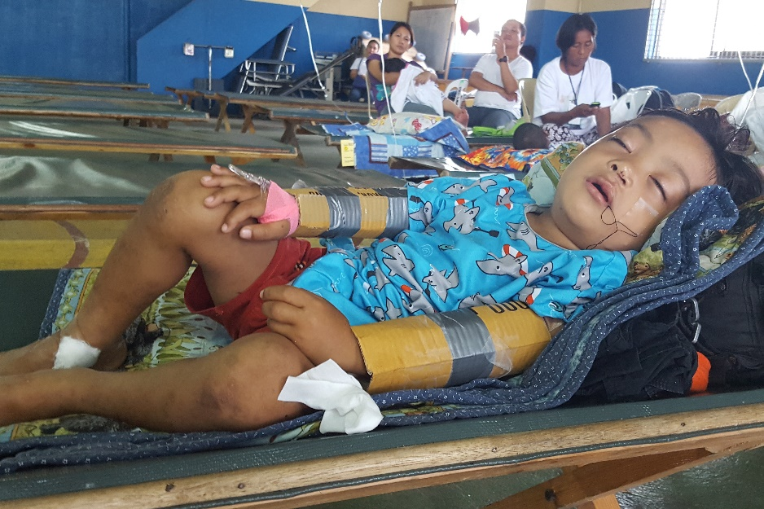
Positioning

Slide 34
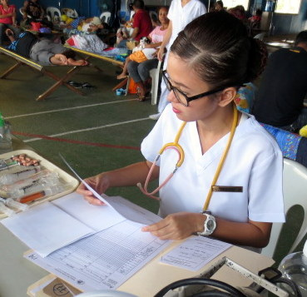
Orders for Ward Nurses
Patients will return to the ward with an order sheet regarding the following:
Wound care
IV fluids
Diet
Pain medications
Vital signs
Emergency care
Nurse reading and recording orders

Slide 35
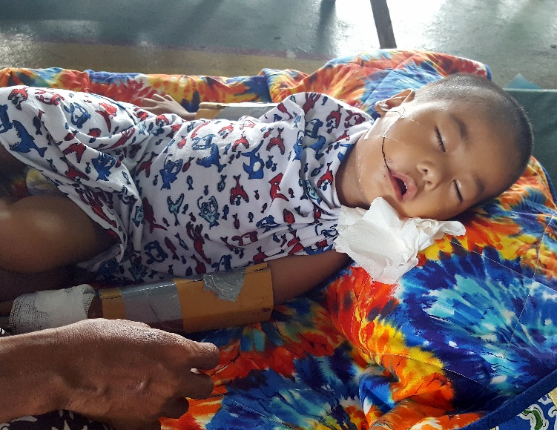
Wound Care
All patients should keep their hands away from their faces.
Children under 5 should use arm restraints (“No-Nos”) which should be removed 4 times a day for bathing and comfort.
Cleft lip repairs should be kept clean and dry. If dirty the wound can be washed with a soft cloth and mild soap twice a day.
It is important that patients with cleft palate repairs drink water after drinking or eating anything to keep their palate clean.
The purpose of the tongue stitch taped to the cheek is to hold the tongue in place in case of an emergency. It will be removed the morning after surgery.
Notes:
No-nos should be removed 4 times a day for bathing and comfort.

Slide 36
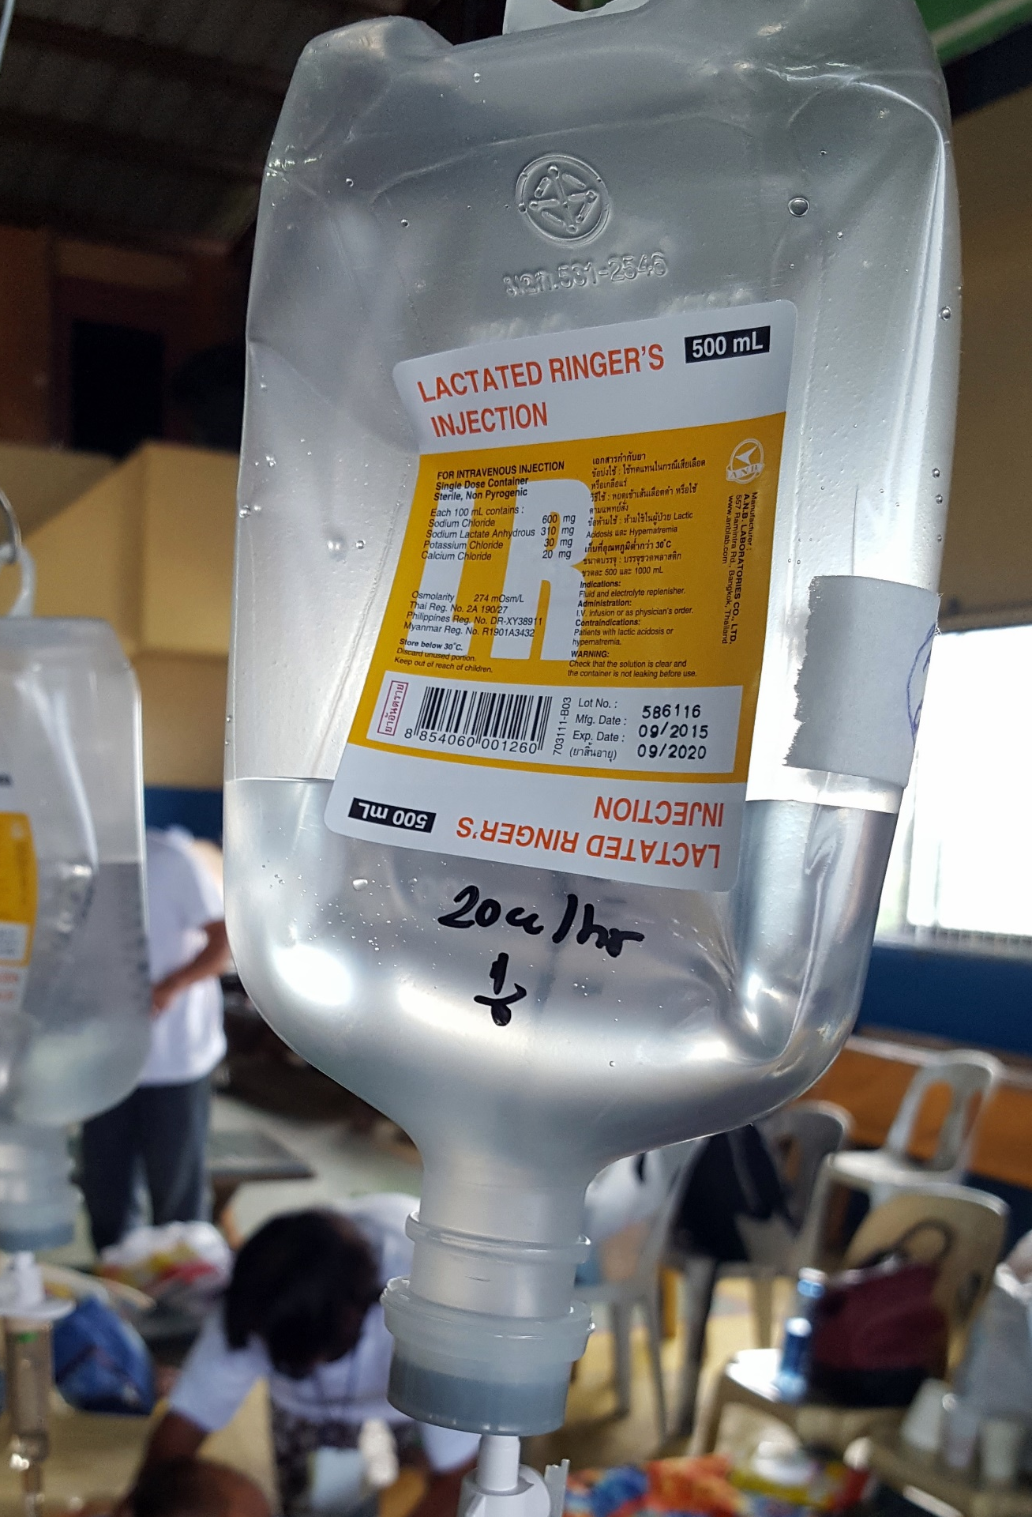
IV Fluids
Everyone gets IV fluids during surgery.
Cleft lip repair: the IV can be removed as soon as they are taking fluids, this could be in the recovery room.
Cleft palate and fistula repairs: IV running at least until the next day.
Always monitor the rate of the IV and change the bag if needed so it does not run out if needed overnight.
Mark the IV bottle with the ordered ml/hour or per your protocol
How fast should this IV run?
Notes:
The IV on cleft lip patients is usually removed in the recovery room.
It may be helpful to mark the IV bottle with the ordered ml/hour.

Slide 37
Post-Operative Diet
Cleft lip patients:
Clear liquids first few hours after surgery
Then soft diet for age
Infants may breastfeed
Bottle fed babies can use a bottle with a very soft nipple. (Babies are usually very hungry after surgery)
Older patients may use a spoon and drink from a cup. No forks
Cleft palate patients:
First day: Clear liquids – small amounts at frequent intervals
Next 2 days: Only liquids – clear soups and broths, milk, juices without pulp. Serve at room temperature
Patients should rinse mouth or drink water after drinking milk to keep palate clean
Patients should drink from a cup, although some parents like to give fluids using a syringe the first day
No bottles, no breast feeding, no forks, no straws, no pacifiers, and no toothbrushes
It would be helpful to place this information on the wall of the nurse’s station.
Why is the diet so restrictive for the cleft palate patient?
Notes:
It may be helpful to place this information on the wall of the nurse’s station.

Slide 38
Medications
PAIN CONTROL:
All patients will have orders for pain medications every 6 hours for the first 24 hours. --Remember to help parents use soothing methods and feeding to help with pain.
Cleft lip repair: Acetaminophen (Paracetamol) every 6 hours for the first 24 hours. They may also get ibuprofen as needed if they are still in pain.
Cleft palate /fistula repair: Acetaminophen (Paracetamol) together with Ibuprofen every 6 hours for the first 24 hours . Notify a doctor if the patient seems to continue to have pain after receiving the medication.
ANTIBIOTICS:
Palate/Fistula repair patients get antibiotics in the OR. Some will get a few doses on the ward. Check the orders and give if needed.
**Please notify a doctor immediately if there is any unusual reaction to either the pain medication or the antibiotic.
Notes:
All patients will have orders for pain medications. The medication may be ordered on a regular schedule for the first 24 hours to keep the patient from having severe pain. After the first 24 hours the medication can be given as needed.
Patients with cleft palate repairs should have an order for a stronger pain medication than patients with cleft lip repairs. The combination of Ibuprofen together with Acetaminophen (Paracetamol) every 6 hours for the first 24 hours is very effective in controlling most post-operative cleft palate pain.

Slide 39
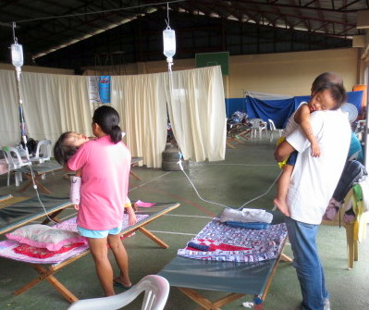
More about pain and parenting
Many parents are not used to seeing their child in pain and feel helpless in trying to make them stop crying.
As nurses you can teach the parents different ways to comfort their child before and sometimes after they have their pain medication.
What could you encourage the parents to do to help their child?
What would you do if your child or a child in your family hurt themself and was crying?

Slide 40
Post-Operative Care
Parents are the main caregivers for their children.
Nurses must supervise and advise as needed to support parents.
Vital signs every 4 hours for first 24 hours at least.
Frequent beside rounds for the first night- use a flashlight to see the child’s face well. Tired parents will fall asleep.
Call MD for: bleeding, repeated vomiting, temp > 38.5, trouble breathing or any other concern.

Slide 41
Post-Operative Care, continued
• Positioning: Head elevated. Side lying on the day of the surgery.
• Feeding: No food other than what is ordered.
Encourage frequent fluids- dry mouth hurts more.
• Activity: No hands or any other object in the mouth No-no’s used correctly if ordered.
• IV is running at the correct rate and is not infiltrated.
• Call MD for: bleeding, repeated vomiting, temp > 38.5, trouble breathing or any other concern.

Slide 42
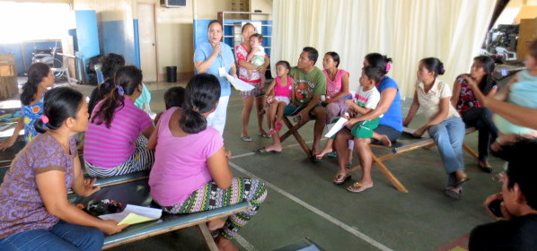
Discharging Patients
Cleft lip patients who are drinking well usually go home the morning after their surgery . Cleft palate and fistula patients usually stay in the hospital two nights after surgery.
Discharge only after patients are seen by surgeons and pediatrician, and orders are written.
Discharge teaching can be done in groups according to surgical procedure.
Notes:
If there are several patients going home on the same day it is sometimes easier to give the families group discharge instructions. If possible, gather all the cleft lip patients in one group and give them their instructions. Then gather all the cleft palate families in a group and give them their instructions.
They can be given their discharge medications at the same time as well.

Slide 43
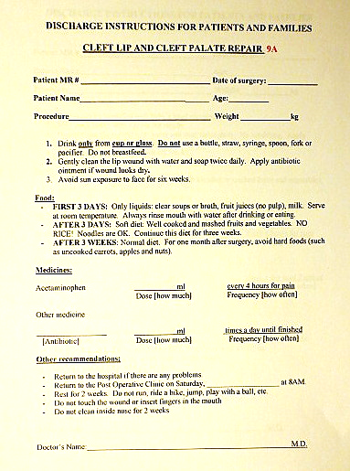
Discharge Instructions
Discharge form is sent home with family and includes:
There are 3 forms depending on the surgery:
-Cleft lip repair
or
-Cleft palate/fistula repair
or
-Cleft lip and palate repair.
Samples available in your language
Patient information
General Information
Feedings
Wound care
Diet
Medications
Other recommendations
Return to hospital for problems
Activity restrictions
Return to final clinic on ______
Why is it important for the family to be given written instructions
when the child is discharged?

Slide 44
Equipment and Supplies Needed on Ward
10ml syringes (no needles)
Hand sanitizer
Thermometers
Alcohol
Gauze (2x2 & 4x4)
Paper tape
Scissors
Tongue blades
Cotton applicators
Gloves
Bed pillows
Emesis basins
Towels
Oxygen
Suction
IV Solutions (Saline or Ringer’s Lactate)
IV poles
Chairs (at least one for each family)
Bedside tables
Cups for patients
Juice and water for patients
Non-acidic juice for patients after surgery

Slide 45
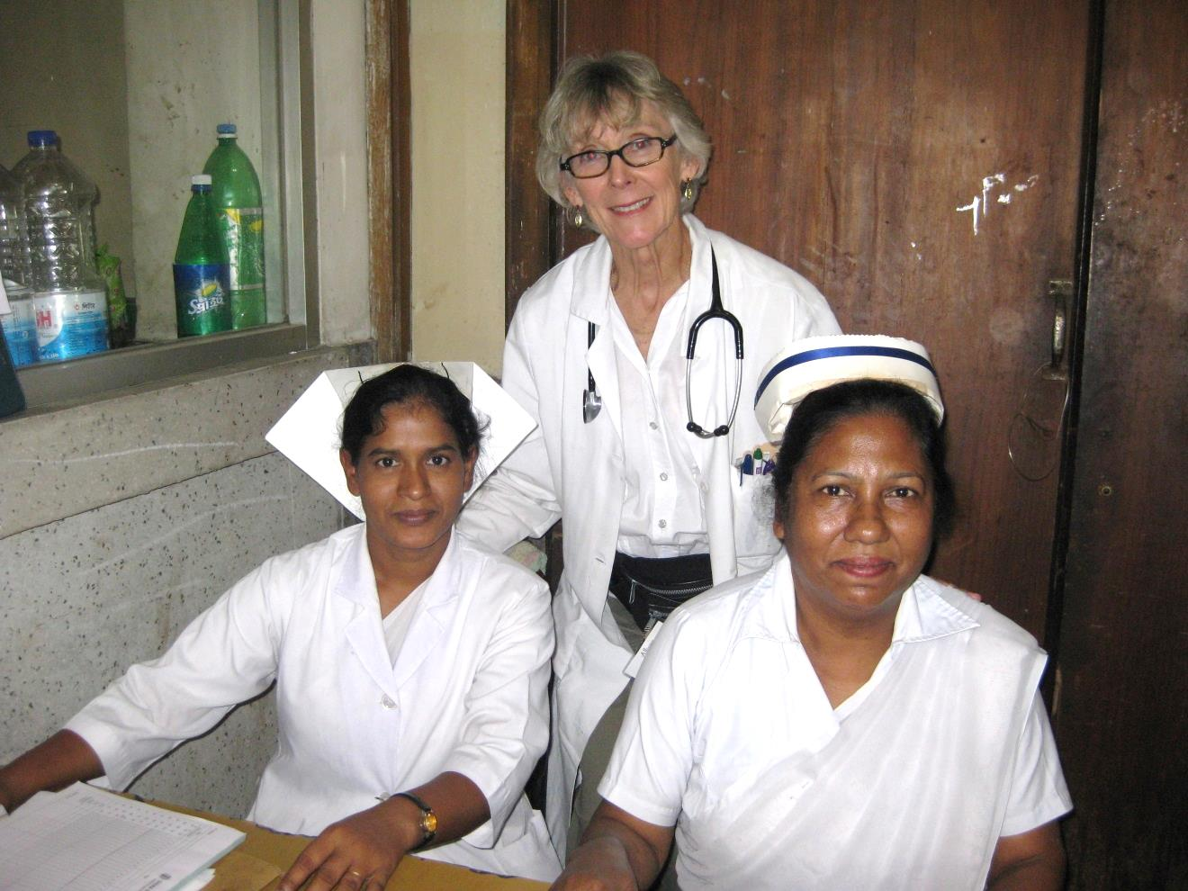
Thank you for your attention.
A special thanks to Christopher Olynic, DMD for his permission to use his photography of the surgical procedures

