Slide 1
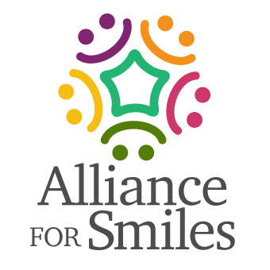
Minimally invasive Dentistry-
Minimally Invasive Dentistry is the application of "a systematic respect for the original tissue."
An Alliance for Smiles Educational mission Presentation
Ericson D. What is minimally invasive dentistry? Oral Health Prev Dent. 2004;2 Suppl 1:287-92. PMID: 15646587.
Notes:
The common delineator is tissue preservation, preferably by preventing disease from occurring and intercepting its progress, but also removing and replacing with as little tissue loss as possible.

Slide 2
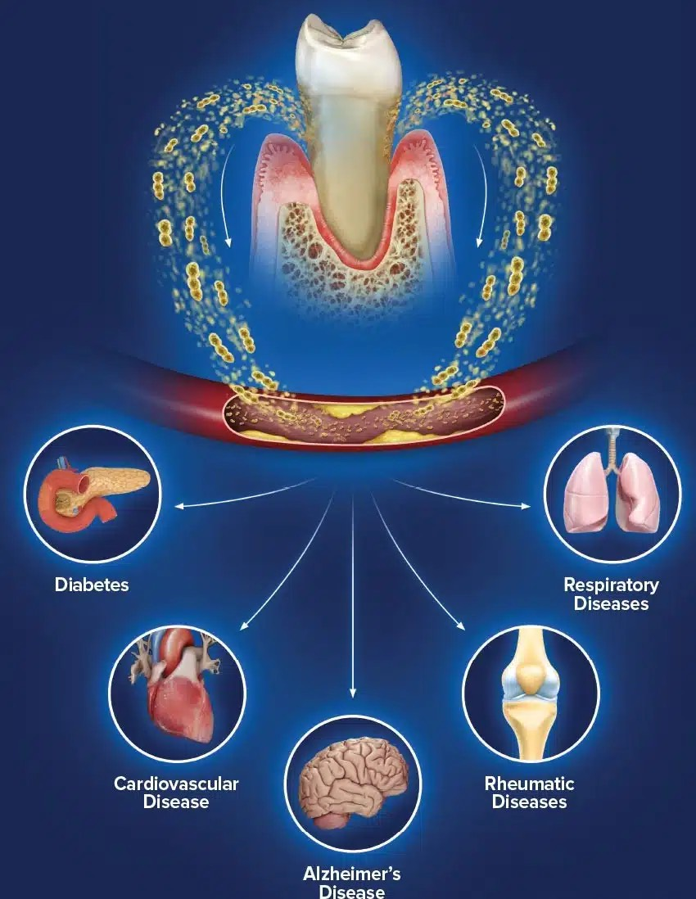
Oral Systemic Health Link
Bacteria in the mouth can enter the bloodstream causing inflammation and contributing to many diseases.
Cardiovascular Disease
Diabetes
Adverse Pregnancy Outcomes
Can increase the risk of certain cancers
Can increase the risk of respiratory infections

Slide 3
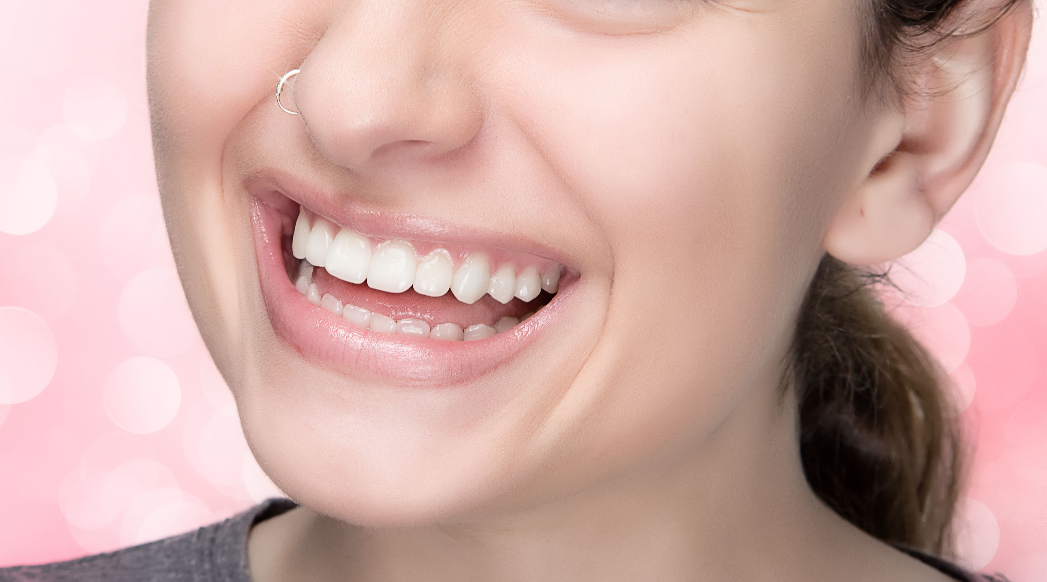
Prevention
Our Ultimate Goal
Education
Good oral hygiene habits
Nutrition
Education

Slide 4
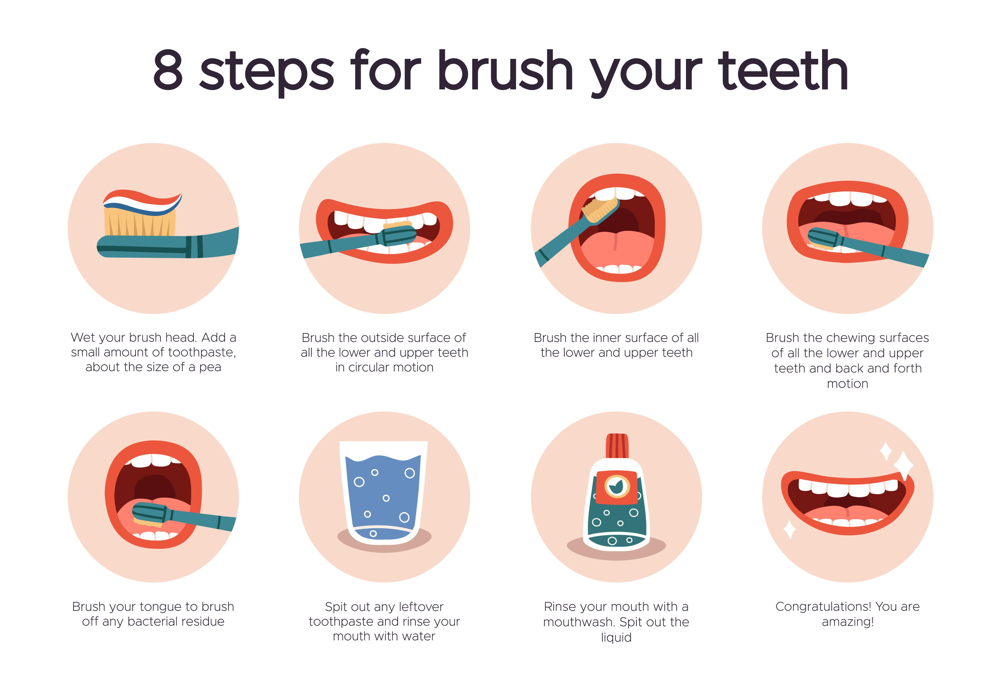

Slide 5
Prevention
Home Care
Fluoride: Toothpastes, Rinses, Supplements, Gels or Varnishes
Hydroxyapatite: Toothpastes and Rinses
Xylitol: Toothpastes, Rinses, Lozenges, and Candies
Preventive Dental Visits if Possible

Slide 6
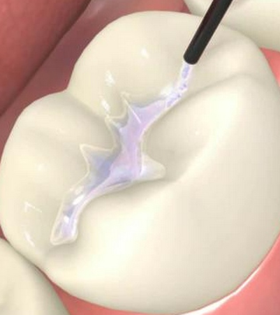
Pit and Fissure Sealants
Deciduous and Permanent Teeth

Slide 7
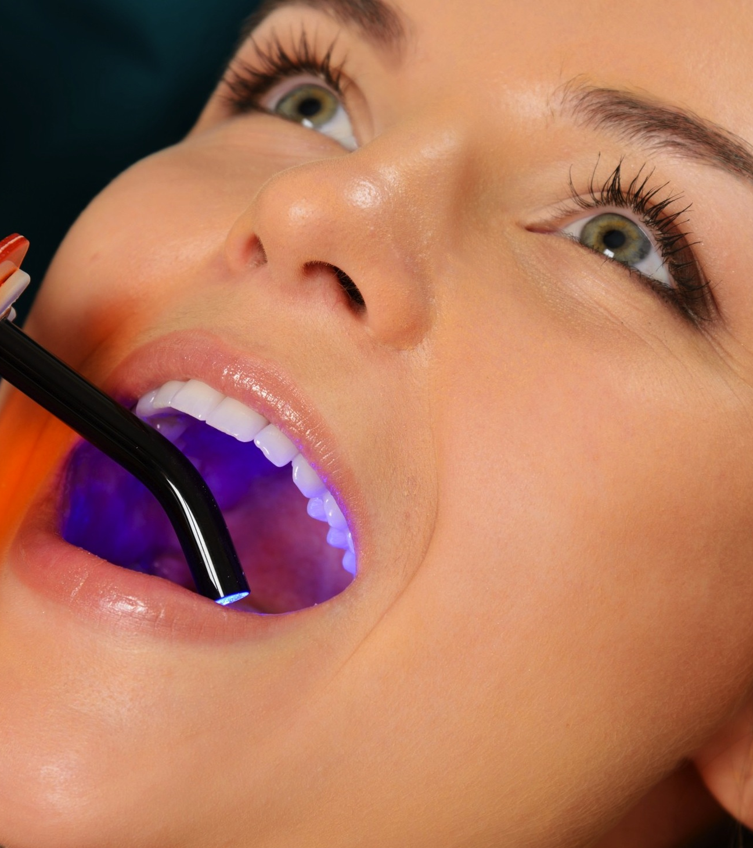
Rationale
Why sealants?
Moderate to High CAMBRA (Caries Management by Risk Assessment) evaluation
Deep pits and fissures
Deciduous and permanent teeth

Slide 8
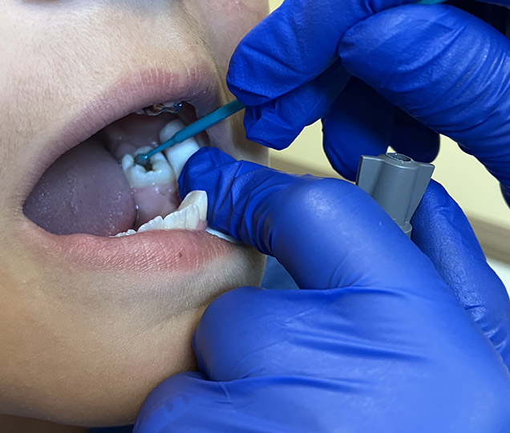
Silver Diamine Fluoride
Treating incipient and early carious lesions

Slide 9
Applying Silver Diamine Fluoride
Brush teeth before beginning to ensure surface is free of debris
Use plastic lined bib for patient, Provide protective eyewear, Apply a thin layer of petroleum jelly on patient’s lips and gingival border (if treating at the gum line)
Isolate and dry area to be treated (cotton rolls work, air if available)
Apply the silver diamine fluoride with a micro brush, saturating the lesion
Wait for the SDF to absorb, at least 10 and up to 60 seconds.
Dab with cotton roll to remove excess
Apply fluoride varnish to all the teeth, starting with the SDF untreated teeth and finishing with the ones with SDF
Reapply 2 to 4 weeks to ensure caries is arrested and then every 6 months if needed

Slide 10
Advantages VS Disadvantages of SDF
Easy to use
Will work for young children, challenging patients, seniors
Quick process, limited supplies need to use
Leaves treated areas black
Can stain skin, gingiva and lips
Can stain countertops

Slide 11
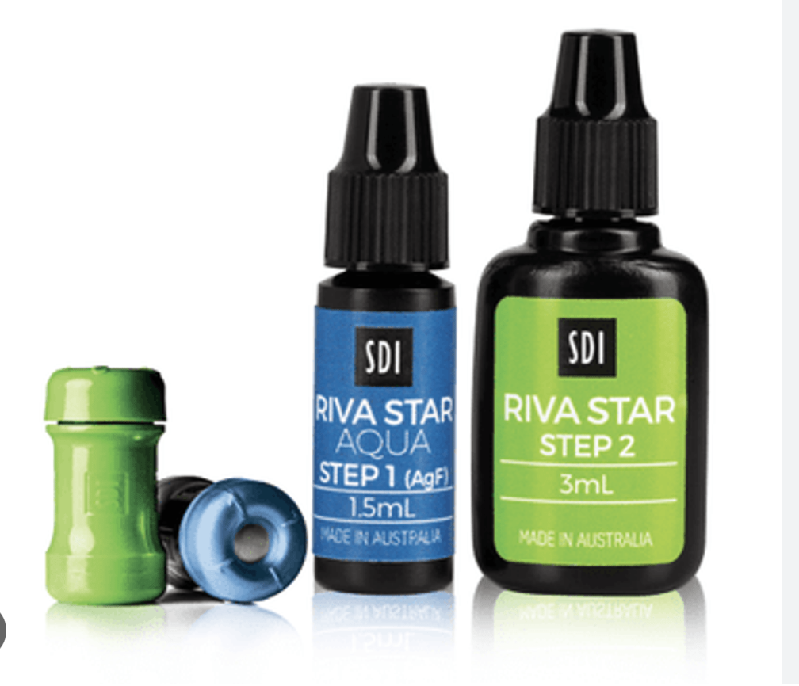
RIVA STAR
2 step process
Minimizes discoloration

Slide 12
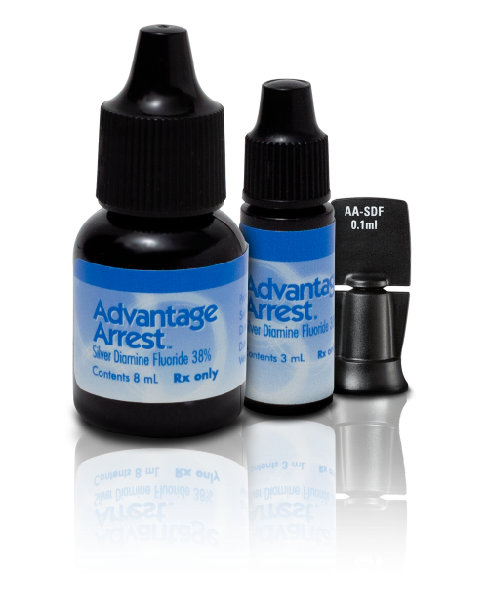
Advantage Arrest
38% Silver Diamine Fluoride
Liquid or gel
Various containers

Slide 13
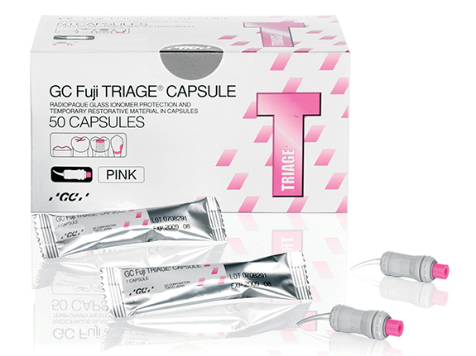
GLASS IONOMER SEALANTS
Why use them?
Glass ionomer sealants are a good option to use post SDF treatment.
They will cover the dark areas left where there had been decay
They are hydrophilic and can be easier to place.
They release fluoride up to 8 years after placement

Slide 14
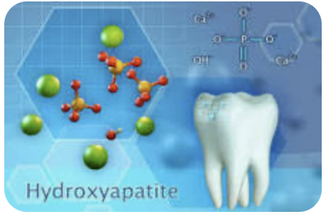
Remineralizing Enamel
Hydroxyapatite
Remineralization: Hydroxyapatite can help repair minor enamel damage by depositing calcium and phosphate ions back into the enamel structure, reversing early stages of tooth decay.
Plaque Reduction: Studies show that hydroxyapatite can reduce bacterial adhesion on teeth, lowering the risk of plaque formation and gum disease.
Whitening: Hydroxyapatite can gently polish teeth without the harsh abrasives found in some whitening products.
Sensitivity Relief: It can help reduce tooth sensitivity by sealing exposed dentin tubules, which are microscopic channels leading to the tooth nerve.

Slide 15
Advantages of Hydroxyapatite
Hydroxyapatite is non-toxic, even if swallowed, making it a safer option for children and individuals concerned about fluoride toxicity.
Clinical studies have shown hydroxyapatite to be as effective as fluoride in preventing cavities and re-mineralizing teeth.
While fluoride strengthens enamel by forming a fluorapatite layer, hydroxyapatite works by directly integrating with the enamel structure.

Slide 16
Prevention and Education is our primary goal in patient care. Early detection and minimally invasive treatment are the next steps in our work to provide healthy smiles.

