Slide 1

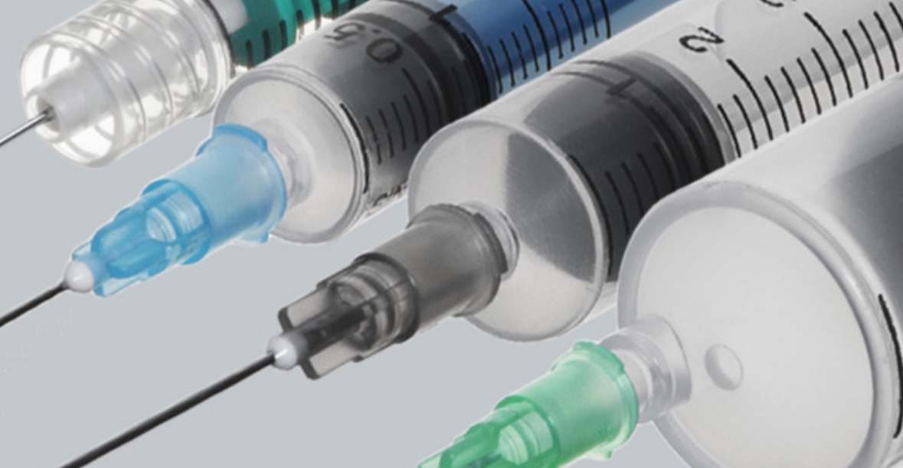
Medication Safety in the
Operating Room
Presenter: (Nama/Info)

Slide 2
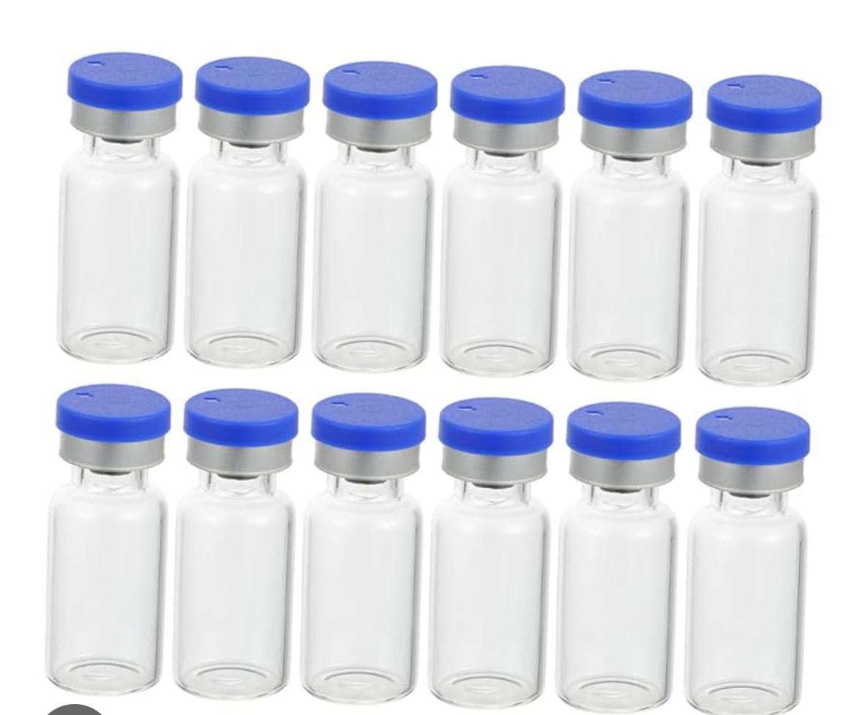
Types of Medication Errors:
Wrong Medications
Omitted Drugs
Wrong Doses
Some reports find errors in HALF of ALL surgeries!

Slide 3
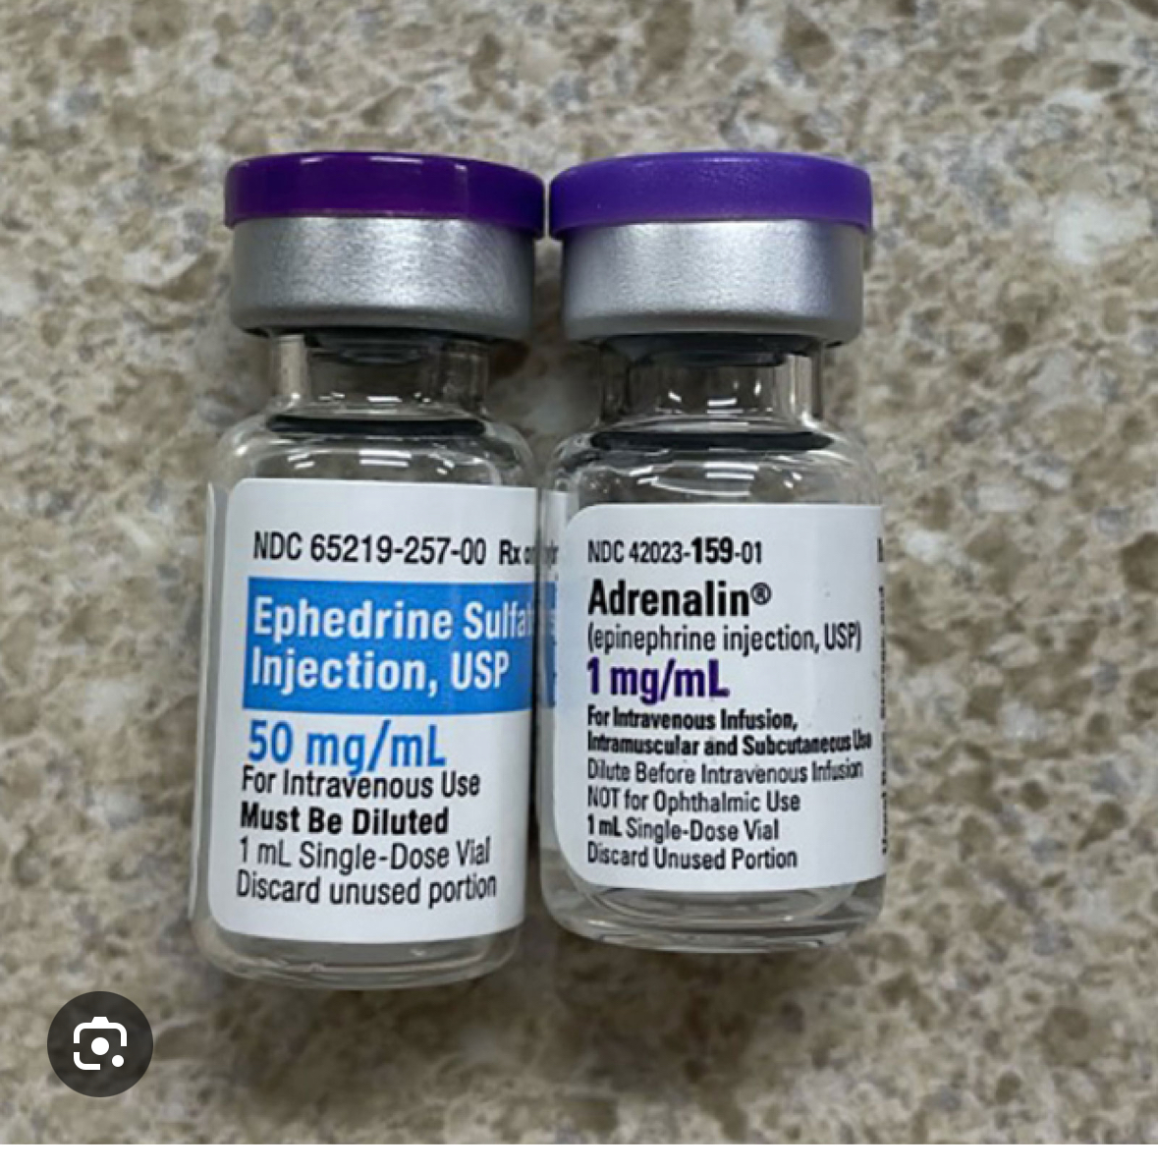
Key Causes:
        Mislabeling
        Incorrect Preparation
        Calculation Errors
        Communication Failures
        The high risk nature of certain drugs

Slide 4
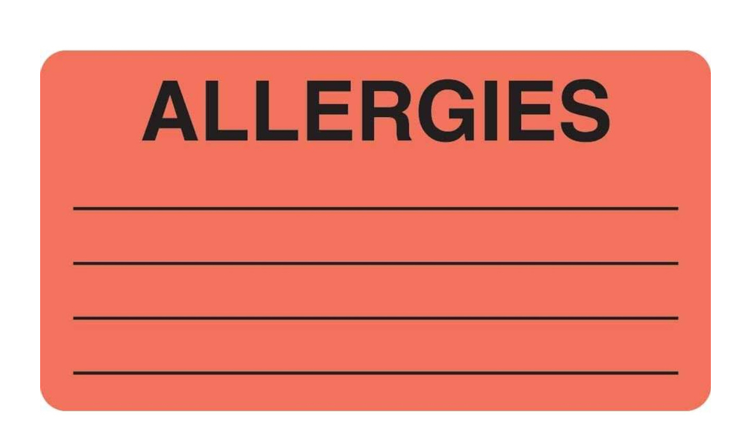
Common Causes:
    The Stressful fast paced environment
    Lack of standardized processes
    Individual and system factors such as gaps in knowledge…
      Communicating whether the patient has allergies
        When did the patient have the last dose
          Medication history

Slide 5
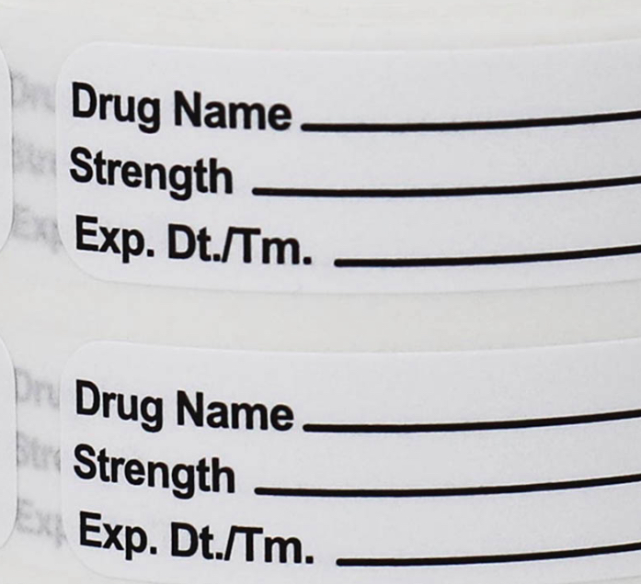
Prevention Strategies:
      Standardize medication preparation
      Foster a Culture of safety
      Improve communication
      Standardize drugs
      LABEL ALL MEDICATIONS ON THE FIELD

Slide 6
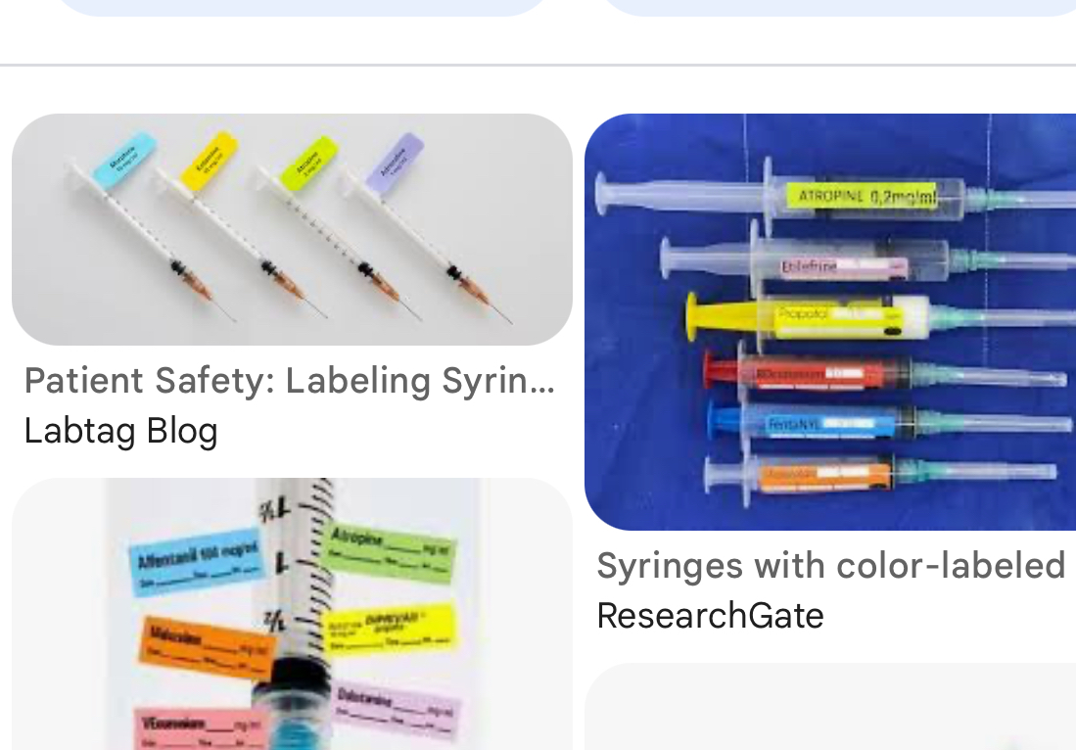
HOW DRUGS SHOULD BE LABELED:
      DRUG NAME
      STRENGTH
      DATE THE DRUG WAS DRAWN
      INITIALS OF PERSON PREPARING THE MEDICATION

Slide 7
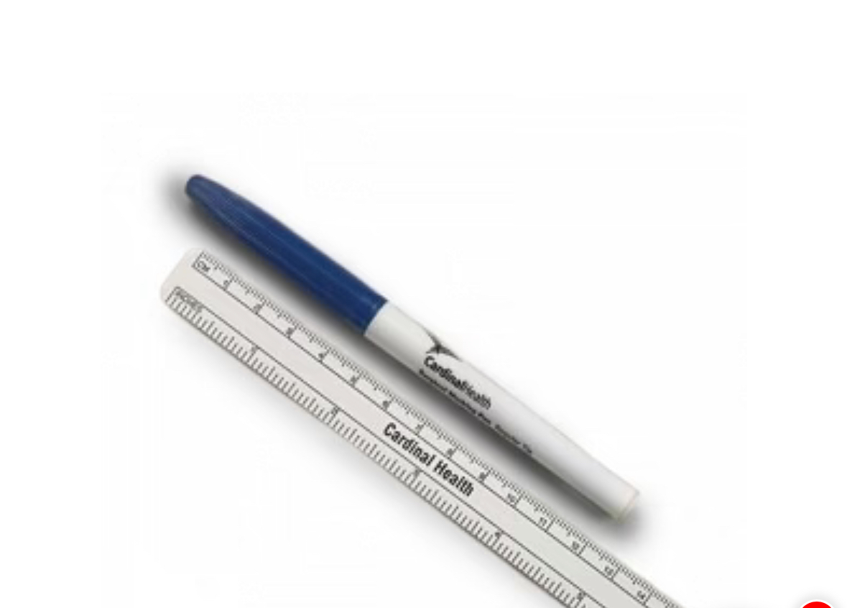
WHY IS LABELING THE MEDICATION IMPORTANT….
        REDUCES THE RISK OF MEDICATION ERRORS
        THIS IS A REGULATORY COMPLIANCE ISSUE
        IMPROVES COMMUNICATION!
        So when the surgeon reaches over, he knows what he is taking!
        Please label all syringes!!

