Slide 1

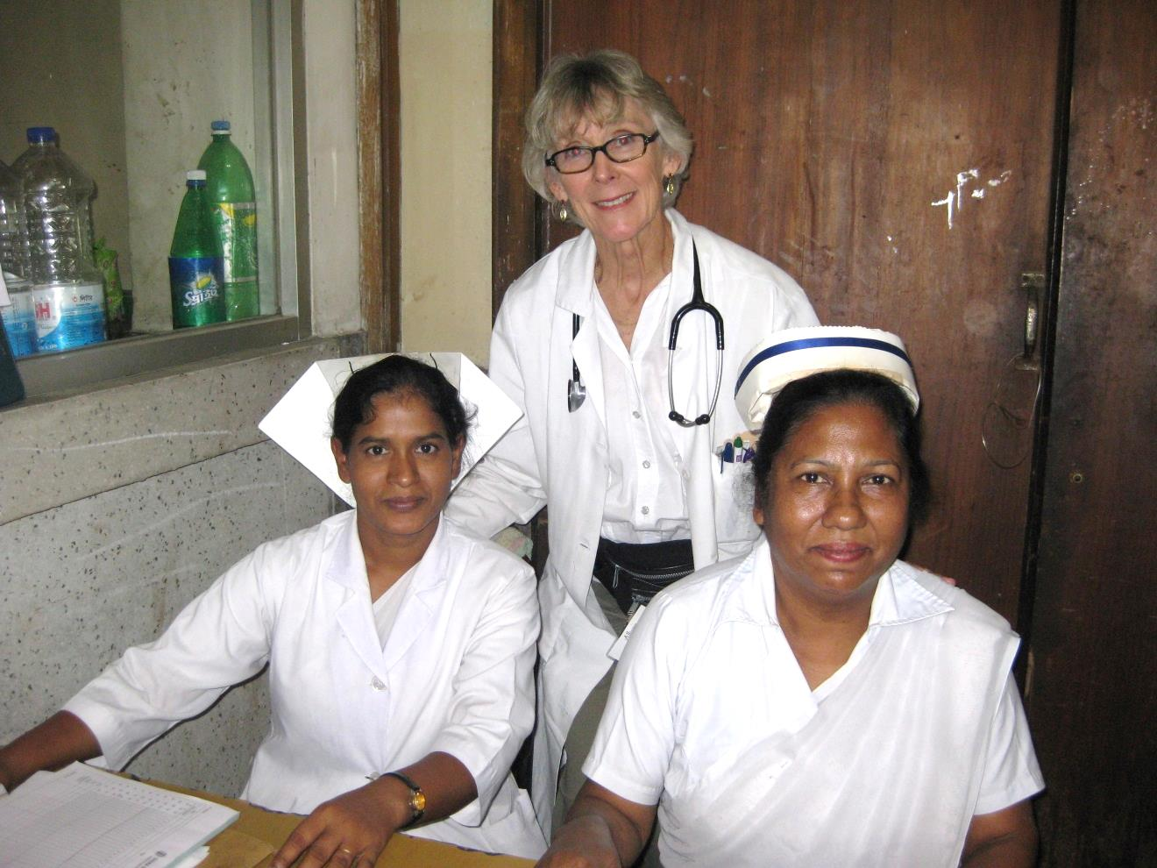
Title: (Ex: Nursing Care of Cleft Lip and Cleft Palate Patients)
Presenter: (Nama/Info)
(Ex: Nan Madden, RN, MS, PNP
Associate Clinical Professor
School of Nursing, University of California, San Francisco)
(Include relevant photos >>>

Slide 2
Learning objectives
At the end of this session/presentation you will be able to:
Define Malignant Hyperthermia
Name medications that cause Malignant Hyperthermia in susceptible patients.
Recognise the signs and symptoms of Malignant Hyperthermia
Know the only treatment for this disorder.
Name therapies important for supportive care.
Ask about family or patient history of problems with anesthesia at every preop encounter.
Notes:
Learning objectives should be: Specific, Measurable, Achievable, Relevant, Time-bound (SMART)
DO NOT use the verbs: understand and know (they are not measurable)
USE the sentence: After this learning experience, learner will be able to:
USE these verbs for KNOWLEDGE (mostly for lectures): define, describe, identify, list, outline, recall, reproduce, show, etc.
USE these verbs for SKILLS (mostly for practicals): apply, operate, measure, assemble, construct, design, demonstrate, examine, execute, fix, etc.
USE these verbs for ATTITUDE (mostly for small groups and practicals): accept, appreciate, embrace, relate, resolve, value, etc.
Example lecture: Preoperative planning
Highlight the importance of preoperative planning
Describe various techniques for preoperative planning
Formulate and draw an operative plan
Describe a surgical tactic step by step p (eg, positioning, choice of surgical approach, instruments, reduction technique, implants)
Incorporate patient safety protocols (mark site, time-out check list) in the preoperative plan

Slide 3
Malignant Hyperthermia: Definition
Hypermetabolic state characterized by muscle rigidity, tachycardia and hyperthermia that begins during anesthesia or sometimes shortly afterwards in the recovery room.
A potentially life threatening emergency that can be treated if recognized in time.

Slide 4
Who is affected?
People with an autosomal dominant abnormality in a muscle receptor ( ryanodine receptor or RYR1) that regulates calcium homeostasis in skeletal muscle.
Triggered by exposure to volatile anesthetics- halothane, isoflurane, sevoflurane, desflurane; or to succinylcholine.
1/100,000 adult patients.
1/30,000 pediatric patients.
50% of cases occur in patients under 19.
Can happen after prior anesthesia without problems.

Slide 5
Malignant Hypertension: Signs and Symptoms
Signs and Symptoms During the 1st Hour:
Muscle rigidity, masseter is often first.
Elevated heart rate
Elevated temperature- later sign.
Starts usually in the OR, but can begin later in PACU or even on the ward.
Secondary Derangements
Acidosis, hypoxemia, hypercapnia, hyperkalemia, and arrythmias must be monitored for and treated as needed.

Slide 6
Malignant Hyperthermia: Treatment
Dantrolene: antidote, and only known cure.
-2.5 mg/kg/dose IV
-Repeat as needed to 10 mg/kg total
-Total dose is sometime exceeded if there is insufficient response.
Supportive care including cooling, fluid management, and treating acidosis, hyperkalemia, hypoxemia, hypercapnia and arrhythmias as indicated.

Slide 7
Malignant Hyperthermia: Treatment
Cooling:
- Cooling blanket if available
- Ice to groin and axillae
- Iced saline via nasogastric tube
- Iced or cooled IV fluids

Slide 8
Malignant Hyperthermia: Treatment
Acidosis: follow with arterial blood gas and treat with Na Bicarb as needed.
Hyperkalemia: Treat with hyperventilation, bicarb, glucose and insulin.
Arrhythmias: No calcium channel blockers if dantrolene has been given! May treat with Lidocaine.
Fluids: Keep urine output 2ml/kg/hour – foley catheter to monitor- adjust fluids as needed.

Slide 9
Malignant Hyperthermia: Take Home Messages
Malignant Hyperthermia is a hypermetabolic state in people with an inherited defect in a muscle receptor that maintains calcium homeostasis in skeletal muscle when exposed to triggers.
Triggered by volatile anesthetics- halothane, isoflurane, desflurane, sevoflurane and/or succinylcholine.
Signs and Symptoms: First muscle rigidity and tachycardia followed by hyperthermia, then acidosis, hyperkalemia, hypoxemia, hypercapnia, arrythmias.
Treatment: Dantrolene 2.5 mg/kg/dose IV, repeat to 10 mg/kg total, and supportive care.
Prevent: Ask about family history of problems with anesthesia at every preop encounter!

Slide 10
Slide title (28pt)
Bullet point (24 pt)
Bullet point (24 pt)
Bullet point (24 pt)

Slide 13
Take-home messages
Take-home message #1
Take-home message #2
Take-home message #3
Notes:
Your take-home messages should
Match with your learning objectives
Summarize three to maximum five important points
Be your last slide (this is what your learners will remember and that will stay until the next speaker is up)
Your take-home message can
Be a powerful graphic or picture that is related to the topic
Not be something that has nothing to do with the topic (eg, a picture of your hospital or family or a “thank you” slide)
Example: Preoperative planning
Formulate a preoperative plan
Identify and assess benefits of preoperative planning
Develop a surgical tactic
Describe steps involved

Slide 14
New section headline
Subheadline (32 pt)
Notes:
Your take-home messages should
Match with your learning objectives
Summarize three to maximum five important points
Be your last slide (this is what your learners will remember and that will stay until the next speaker is up)
Your take-home message can
Be a powerful graphic or picture that is related to the topic
Not be something that has nothing to do with the topic (eg, a picture of your hospital or family or a “thank you” slide)
Example: Preoperative planning
Formulate a preoperative plan
Identify and assess benefits of preoperative planning
Develop a surgical tactic
Describe steps involved

