Slide 1

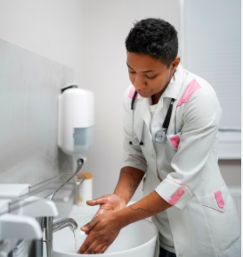
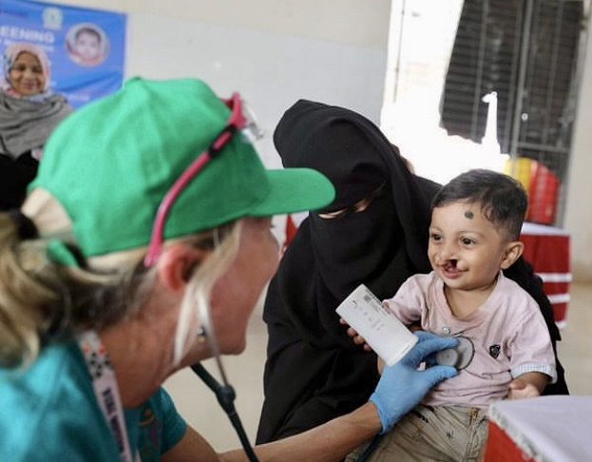
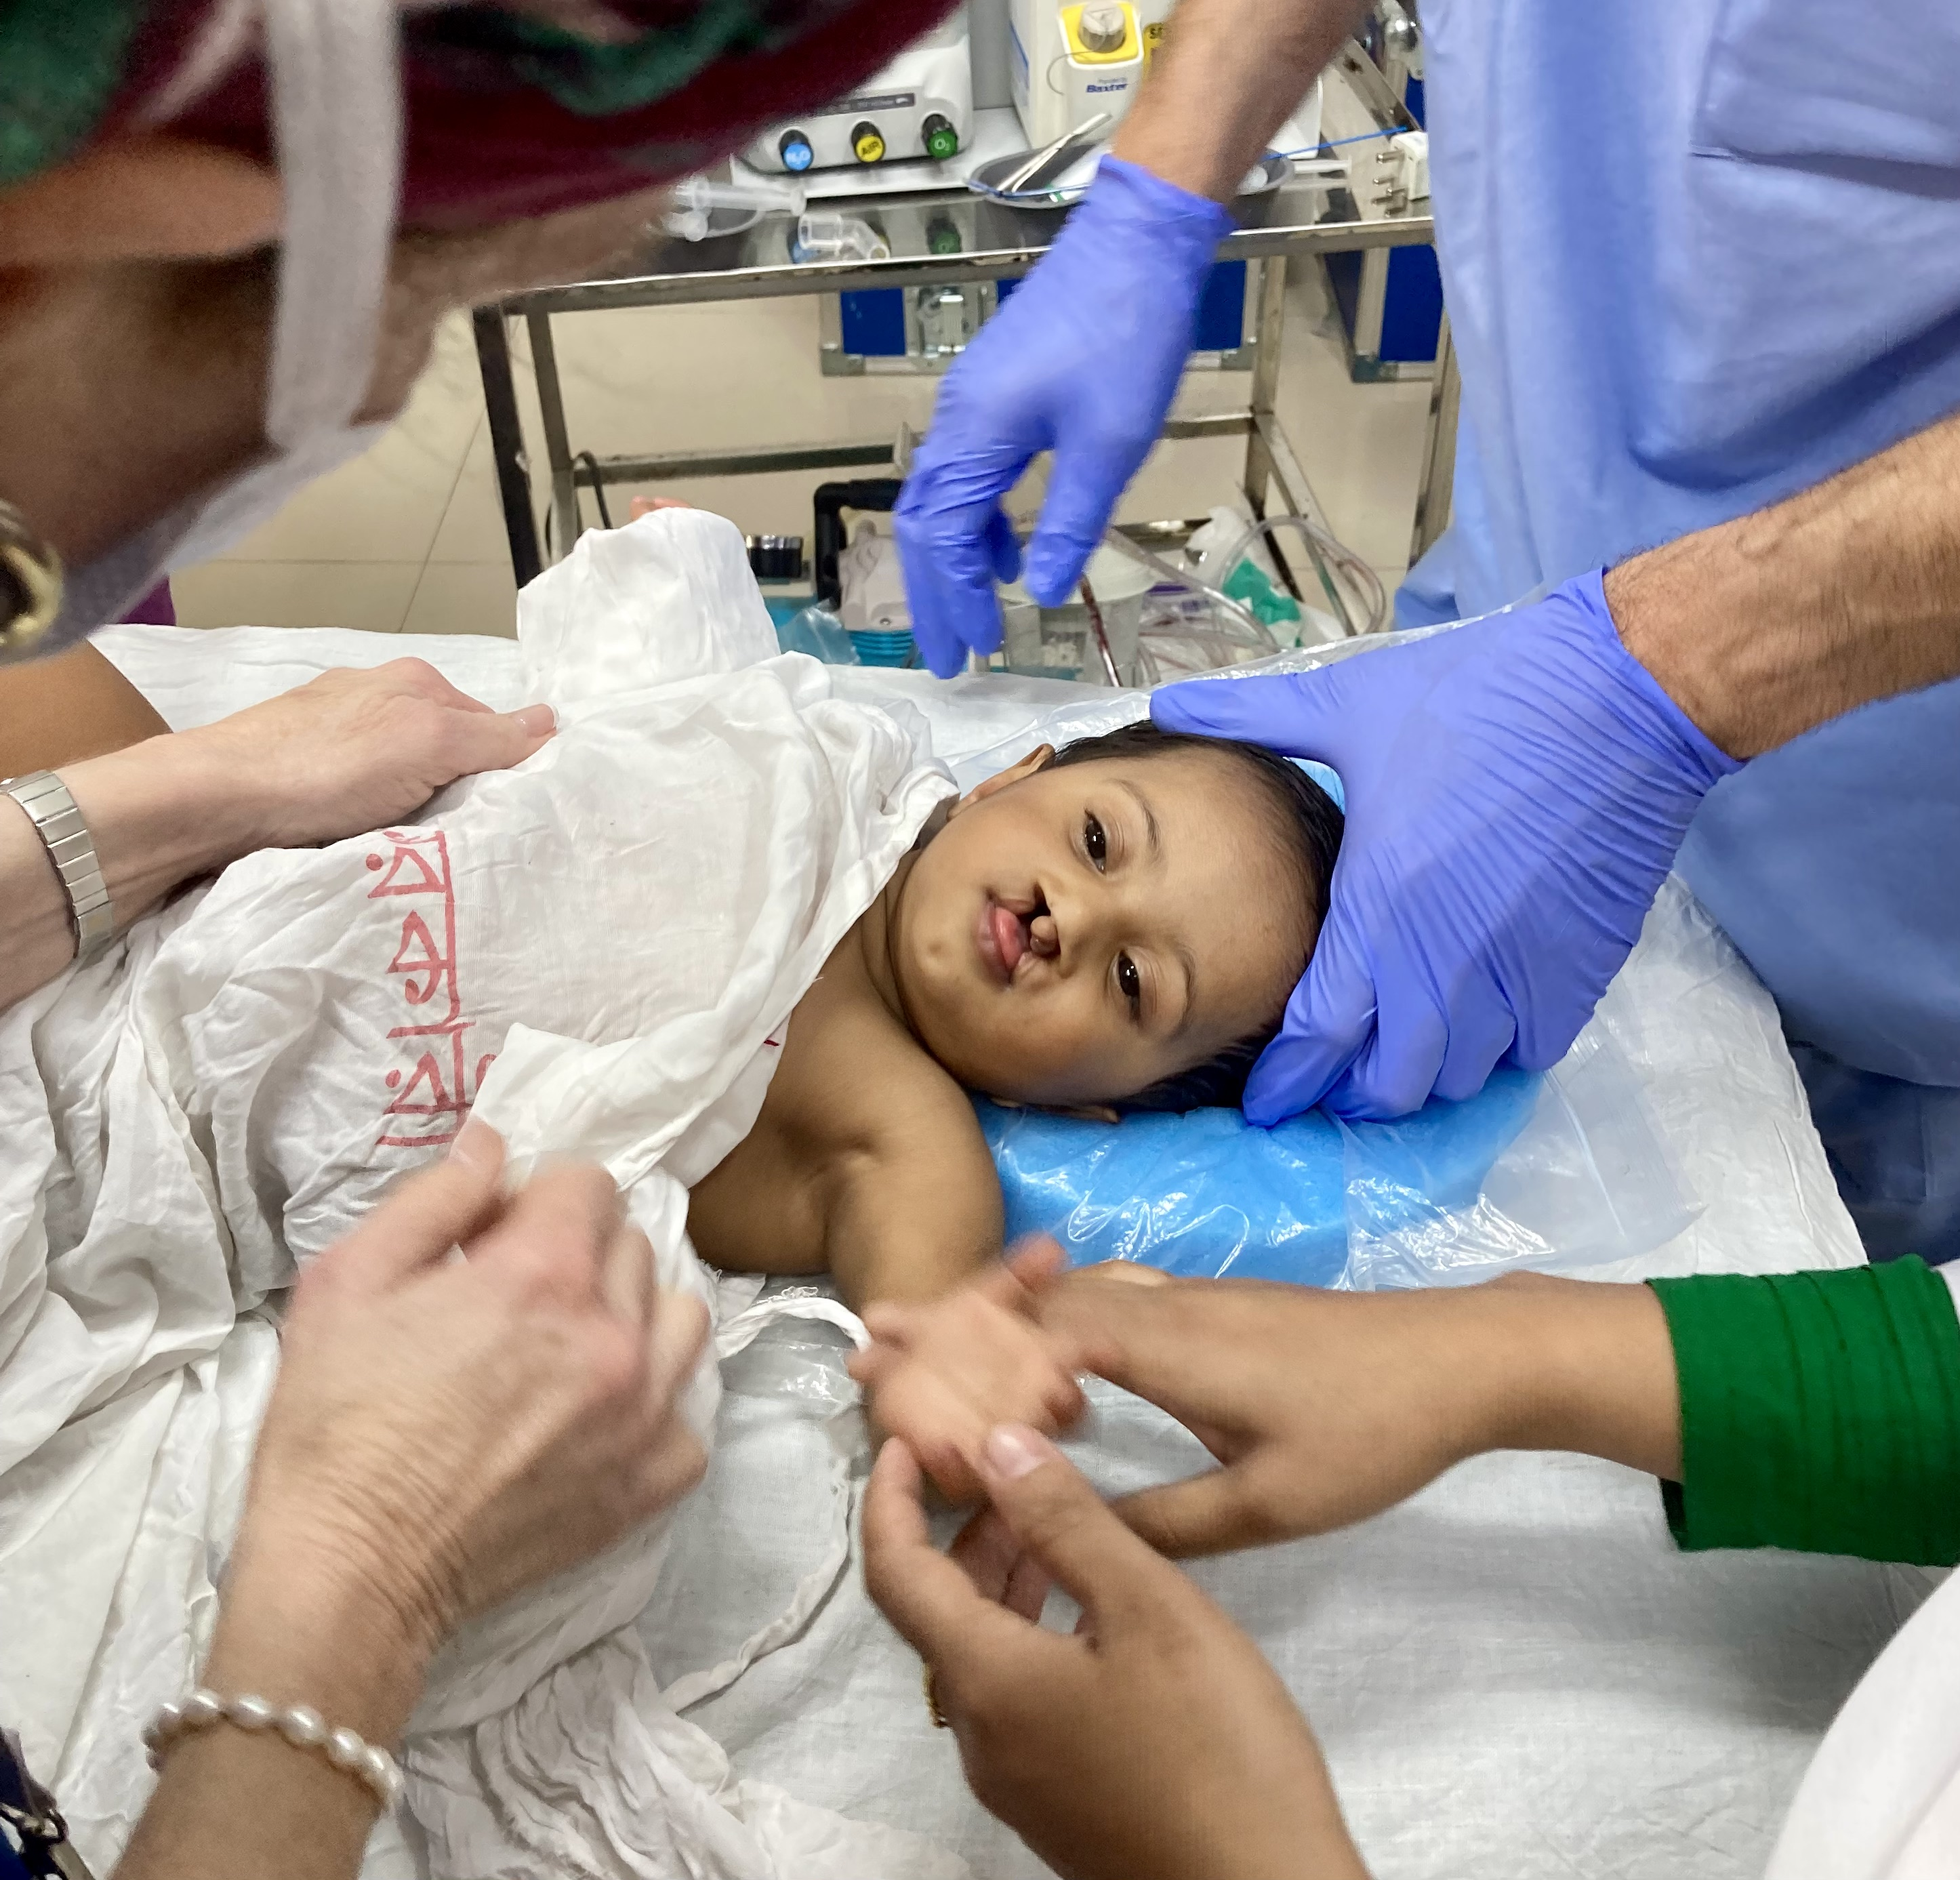
Hand Hygiene for Healthcare Workers

Slide 2

Hand Hygiene in the Healthcare Setting
Background
Definitions
Indications
Selection of Agents
Techniques
Surgical
Other

Slide 3
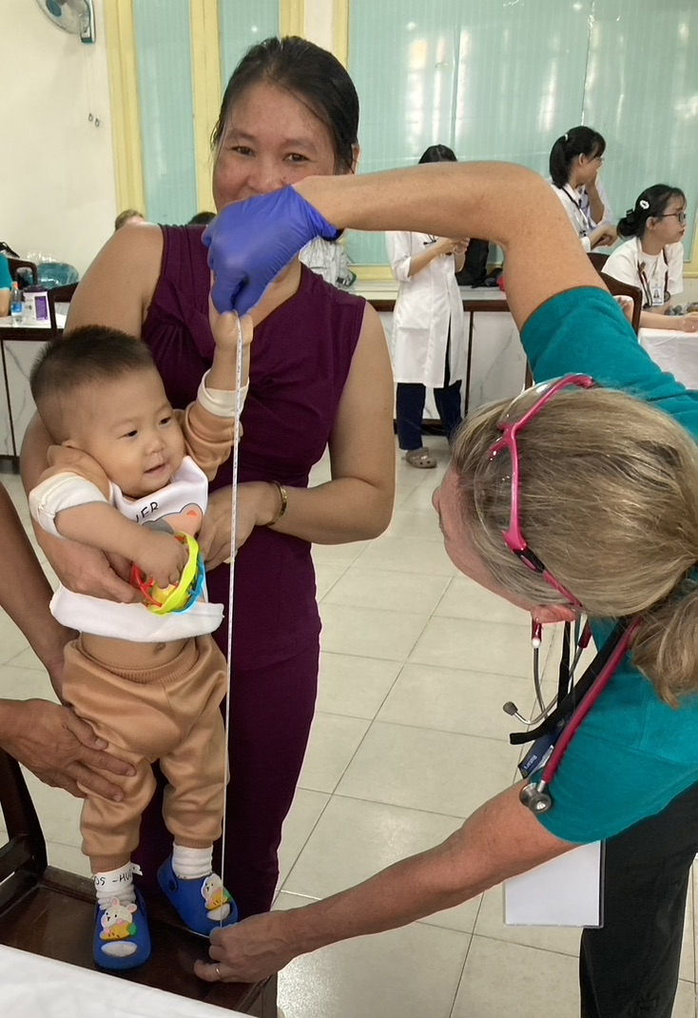
Why Is Hand Hygiene Important
Hand hygiene is the most important factor in preventing the spread of pathogens and antibiotic resistance in healthcare settings.
Hand hygiene reduces the incidence of healthcare associated infections.
Hand hygiene helps reduce antibiotic resistance in healthcare settings.
de Kraker MEA, Tartari E, Tomczyk S, Twyman A, Francioli LC, Cassini A, Allegranzi B, Pittet D. Implementation of hand hygiene in health-care facilities: results from the WHO Hand Hygiene Self-Assessment Framework global survey 2019. Lancet Infect Dis. 2022 Jun;22(6):835-844. doi: 10.1016/S1473-3099(21)00618-6. Epub 2022 Feb 23. PMID: 35202600; PMCID: PMC9132778.
Notes:
Clean hands are the single most important factor in preventing the spread of pathogens and antibiotic resistance in healthcare settings.
Hand hygiene reduces the incidence of healthcare associated infections.
CDC estimates that each year nearly 2 million patients in the United States get an infection in hospitals, and about 90,000 of these patients die as a result of their infection.
More widespread use of hand hygiene products that improve adherence to recommended hand hygiene practices will promote patient safety and prevent infections.

Slide 4
Self-Reported Factors for Poor Adherence with Hand Hygiene
Handwashing agents cause irritation and dryness
Sinks are inconveniently located/lack of sinks
Lack of soap and paper towels
Too busy/insufficient time
Understaffing/overcrowding
Patient needs take priority
Low risk of acquiring infection from patients
Notes:
Healthcare workers have reported several factors that may negatively impact their adherence with recommended practices including; handwashing agents cause irritation and dryness, sinks are inconveniently located, lack of soap and paper towels, not enough time, understaffing or overcrowding, and patient needs taking priority.
Lack of knowledge of guidelines/protocols, forgetfulness, and disagreement with the recommendations were also self reported factors for poor adherence with hand hygiene.
Perceived barriers to hand hygiene are linked to the institution and HCWs colleagues. Therefore, both institutional and small-group dynamics need to be considered when implementing a system change to secure and improve HCWs hand hygiene practice.

Slide 5
Definitions Related to Hand Hygiene
Hand hygiene
Performing handwashing, antiseptic handwash, alcohol-based handrub, surgical hand hygiene/antisepsis
Handwashing
Washing hands with plain soap and water
Antiseptic handwash
Washing hands with water and soap or other detergents containing an antiseptic agent
Alcohol-based handrub
Rubbing hands with an alcohol-containing preparation
Surgical hand hygiene/antisepsis
Handwashing or using an alcohol-based handrub before operations by surgical personnel
Guideline for Hand Hygiene in Health-care Settings. MMWR 2002; vol. 51, no. RR-16.
Notes:
Hand hygiene is a general term that applies to either handwashing, antiseptic handwash, alcohol-based handrub, or surgical hand hygiene/antisepsis.
Handwashing refers to washing hands with plain soap and water. Handwashing with soap and water remains a sensible strategy for hand hygiene in non-healthcare settings and is recommended by CDC and other experts.
Antiseptic handwash refers to washing hands with water and soap or other detergents containing an antiseptic agent.
Alcohol-based handrub refers to the alcohol-containing preparation applied to the hands to reduce the number of viable microorganisms.
Surgical hand hygiene/antisepsis refers to an antiseptic handwash or antiseptic handrub performed preoperatively by surgical personnel to eliminate transient and reduce resident hand flora. Antiseptic detergent preparations often have persistent antimicrobial activity.

Slide 6
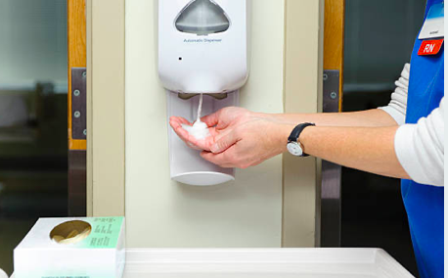
Indication for Hand Hygiene
When hands are visibly dirty, contaminated, or soiled, wash with non-antimicrobial or antimicrobial soap and water.
If hands are not visibly soiled, use an alcohol-based handrub for routinely decontaminating hands.
Guideline for Hand Hygiene in Health-care Settings. MMWR 2002; vol. 51, no. RR-16.
Notes:
Healthcare workers should wash hands with soap and water when hands are visibly dirty, contaminated or soiled and use an alcohol-based handrub when hands are not visibly soiled to reduce bacterial counts.

Slide 7
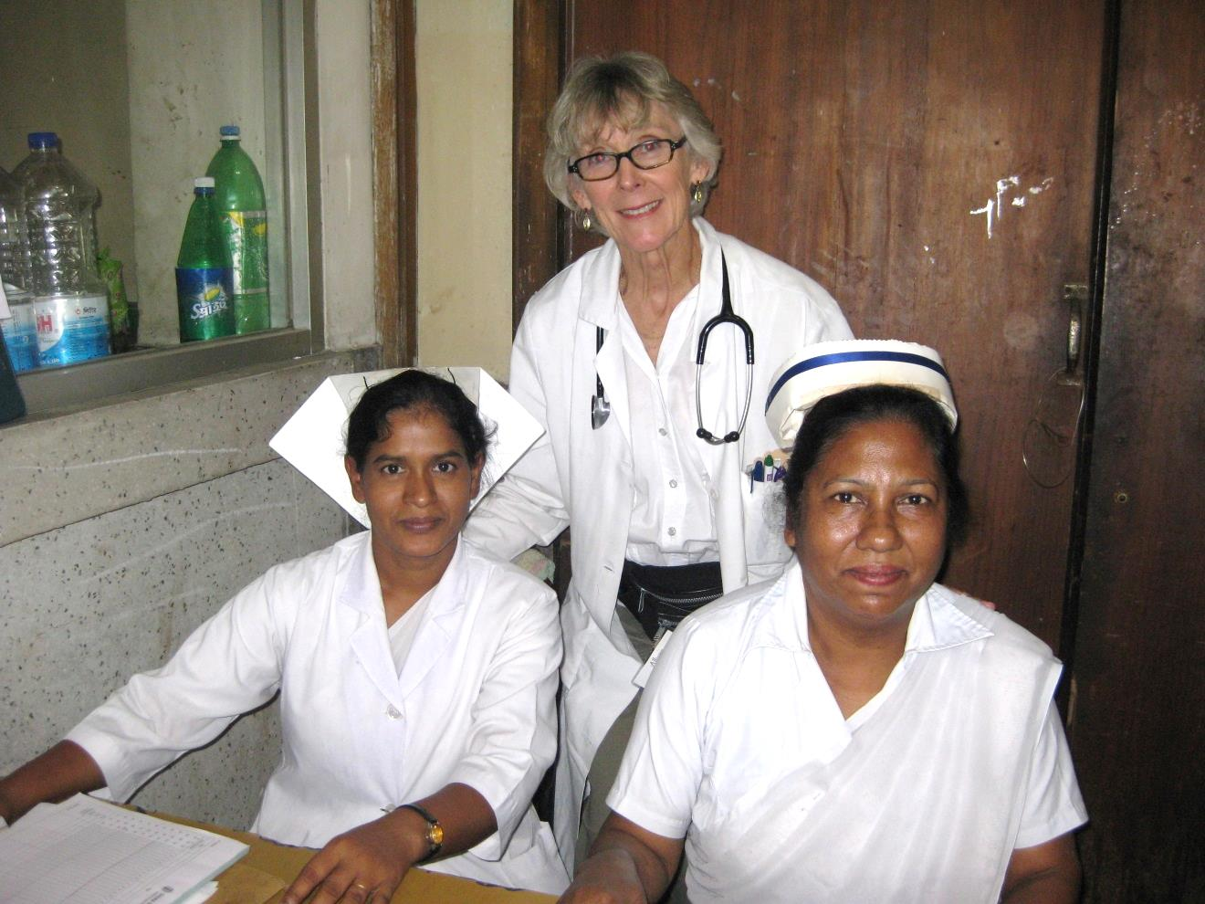
Selection of Hand Hygiene Agents: Factors to Consider
Efficacy of antiseptic agent
Acceptance of product by healthcare personnel
Characteristics of product
Skin irritation and dryness
Accessibility of product
Dispenser systems
Guideline for Hand Hygiene in Health-care Settings. MMWR 2002; vol. 51, no. RR-16.
Notes:
When evaluating hand hygiene products for potential use in healthcare facilities, administrators or product selection committees should consider the relative efficacy of antiseptic agents against various pathogens and the acceptability of hand hygiene products by personnel.

Slide 8
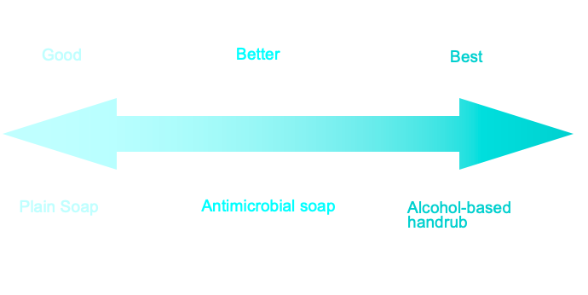
Efficacy of Hand Hygiene Preparations in Killing Bacteria
Notes:
Plain soap is good at reducing bacterial counts but antimicrobial soap is better, and alcohol-based handrubs are the best.

Slide 9
Recommended Hand Hygiene Technique
Handrubs
Apply to palm of one hand, rub hands together covering all surfaces until dry
Volume: based on manufacturer
Handwashing
Wet hands with water, apply soap, rub hands together for at least 15 seconds
Rinse and dry with disposable towel
Use towel to turn off faucet
Notes:
These recommendations will improve hand hygiene practices of HCWs and reduce transmission of pathogenic microorganisms to patients and personnel in healthcare settings.
When decontaminating hands with an alcohol-based handrub, apply product to palm of one hand and rub hands together, covering all surfaces of hands and fingers, until hands are dry.
When washing hands with soap and water, wet hands first with water, apply the amount of soap recommended by the manufacturer, and rub hands together for at least 15 seconds, covering all surfaces of the hands and fingers. Rinse hands with water, dry thoroughly with a disposable towel, and use the towel to turn off the faucet.

Slide 10
Gloving
Wear gloves when contact with blood or other potentially infectious materials is possible
Remove gloves after caring for a patient
Do not wear the same pair of gloves for the care of more than one patient
Do not wash gloves
Guideline for Hand Hygiene in Health-care Settings. MMWR 2002; vol. 51, no. RR-16.
Notes:
Wearing gloves reduces the risk of healthcare workers acquiring infections from patients, prevents flora from being transmitted from healthcare workers to patients, and reduces contamination of the hands of healthcare workers by flora that can be transmitted from one patient to another.
Gloves should be used when HCWs have contact with blood or other body fluids.
Gloves should be removed after caring for a patient.
The same pair of gloves should not be worn for the care of more than one patient.
Gloves should not be washed or reused.

Slide 11
Hand Hygiene Summary
PREVENTION
IS PRIMARY!
Hand hygiene protect patients, protects healthcare personnel
and promotes quality healthcare

