Slide 1

Alliance for Smiles Dental Health Education

Slide 2
Learning objectives
At the end of this session/presentation you will be able to
Understand the importance of oral hygiene care
Integrate pre- and post surgical oral care
Describe the causes of tooth decay and prevention techniques
Notes:
Learning objectives should be: Specific, Measurable, Achievable, Relevant, Time-bound (SMART)
DO NOT use the verbs: understand and know (they are not measurable)
USE the sentence: After this learning experience, learner will be able to:
USE these verbs for KNOWLEDGE (mostly for lectures): define, describe, identify, list, outline, recall, reproduce, show, etc.
USE these verbs for SKILLS (mostly for practicals): apply, operate, measure, assemble, construct, design, demonstrate, examine, execute, fix, etc.
USE these verbs for ATTITUDE (mostly for small groups and practicals): accept, appreciate, embrace, relate, resolve, value, etc.
Example lecture: Preoperative planning
Highlight the importance of preoperative planning
Describe various techniques for preoperative planning
Formulate and draw an operative plan
Describe a surgical tactic step by step p (eg, positioning, choice of surgical approach, instruments, reduction technique, implants)
Incorporate patient safety protocols (mark site, time-out check list) in the preoperative plan

Slide 3
Prevention is KEY!
Alliance for Smiles
Educational Mission
Dental Health for Infants and Children
Teeth that last a lifetime begin with early PREVENTION.

Slide 4
Pre and Post surgery: Oral Hygiene care
Pre surgery: Be sure to brush the child’s teeth twice a day. Morning and night.

Slide 5
Post surgery oral care
Clean
Clean the child’s teeth and gums using a small gauze pad or a small cloth dipped in plain water.
Do NOT use
Do NOT use a toothbrush in the child’s mouth until 3 weeks after surgery or as instructed by the surgeon.
Have
Have the child rinse with or drink plain water after eating to help clean the mouth.
Make
Make sure to always use a soft bristle toothbrush when brushing starts again.

Slide 6
Post surgery oral care

Slide 7
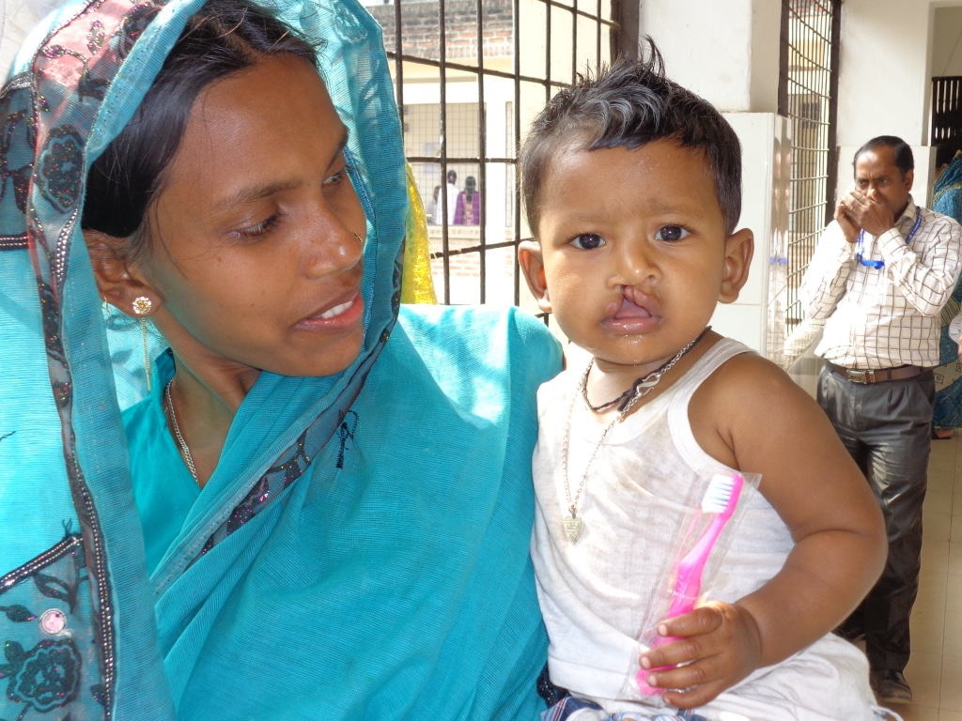
Pre and post surgery: Oral hygiene care Be sure to take away toothbrushes and any objects that the child could place in the mouth!

Slide 8
TOOTHBRUSHING! A daily habit!
MOST IMPORTANT!
Brush your child’s teeth
MORNING and NIGHT for 2 minutes

Slide 9
Poor oral health can lead to tooth infections!
.

Slide 11
Brushing!!

Slide 12
Tooth decay
Sugar + Plaque = ACID
ACID + Healthy Tooth = Decay (A cavity)
Limit sweet treats!
Good food is needed for strong teeth and a healthy body.

Slide 13
Even though bacteria on the teeth (“plaque”) can’t always be seen, you must remove it by brushing every day!

Slide 14
Start preventive Oral Hygiene care early!
****Clean the baby’s teeth as soon as seen with a small soft toothbrush.
Children—as soon as the child can rinse and spit, add a paper thin layer of toothpaste (if available)

Slide 15
Your child’s BABY teeth are very important!
Baby teeth are very important!
They will help your child eat, speak and smile!!
Dental health is part of overall body health.
!

Slide 16
Oral hygiene care starts at day one!!
Start preventive Oral Hygiene care early!
Babies—even before teeth are in the mouth, gently wipe the mouth with a clean damp cloth after nursing or bottle feeding.
****Nothing but water in the bottle at bedtime to prevent tooth decay (cavities) NO formula, milk or juice.

Slide 17
Adults need Oral Hygiene care
REMEMBER! Adults need dental hygiene care too!
BRUSH TWICE A DAY—Morning and Night for 2 Minutes
Limits sweet treats! Less sugar!

Slide 18
Take-home messages
Start brushing and cleaning the mouth before teeth erupt
Be mindful of specific directions for pre and post surgery cases
Use proper oral health care techniques
Notes:
Your take-home messages should
Match with your learning objectives
Summarize three to maximum five important points
Be your last slide (this is what your learners will remember and that will stay until the next speaker is up)
Your take-home message can
Be a powerful graphic or picture that is related to the topic
Not be something that has nothing to do with the topic (eg, a picture of your hospital or family or a “thank you” slide)
Example: Preoperative planning
Formulate a preoperative plan
Identify and assess benefits of preoperative planning
Develop a surgical tactic
Describe steps involved

Slide 19
Alliance for Smiles Dental Health Education

Slide 20
(Include relevant photos >>>

Slide 21
Slide title (28pt)
Bullet point (24 pt)
Bullet point (24 pt)
Bullet point (24 pt)

Slide 23
New section headline
Subheadline (32 pt)
Notes:
Your take-home messages should
Match with your learning objectives
Summarize three to maximum five important points
Be your last slide (this is what your learners will remember and that will stay until the next speaker is up)
Your take-home message can
Be a powerful graphic or picture that is related to the topic
Not be something that has nothing to do with the topic (eg, a picture of your hospital or family or a “thank you” slide)
Example: Preoperative planning
Formulate a preoperative plan
Identify and assess benefits of preoperative planning
Develop a surgical tactic
Describe steps involved

