Slide 1
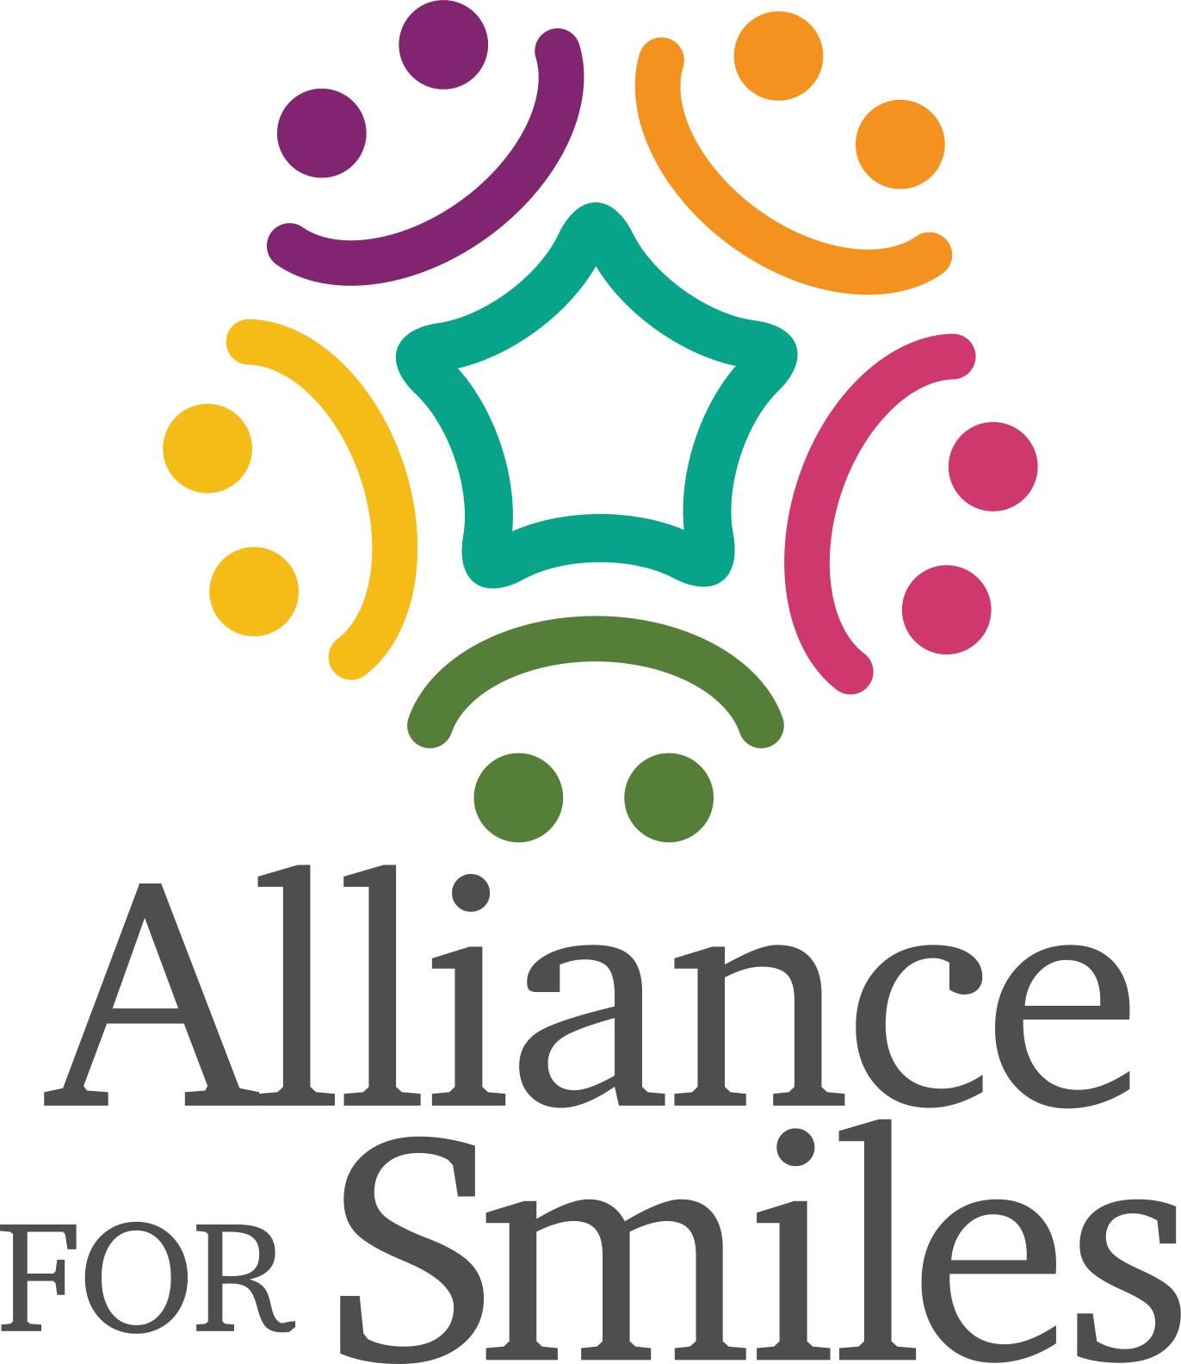
Mission Trip Dental Teams
Dental Treatments and Dental Health Education on a mission trip.

Slide 2
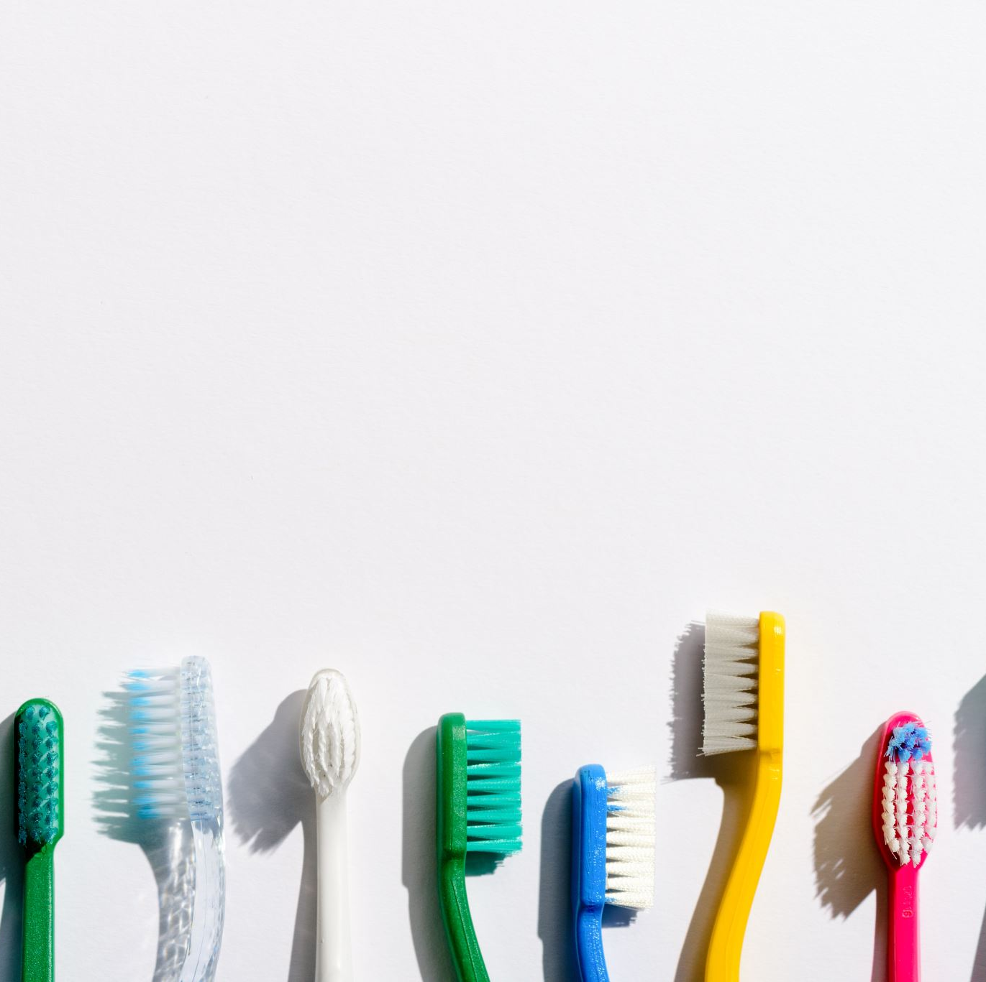
WE ARE DIFFERENT!
WE SPECIALIZE IN AND REALIZE THE IMPORTANCE OF ORAL HEALTH TO OVERALL HEALTH!!

Slide 3
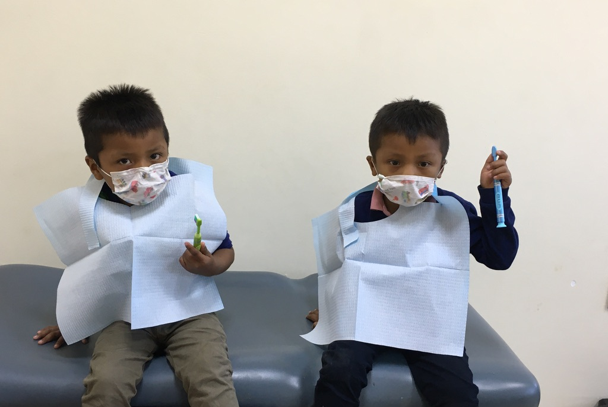

Slide 4
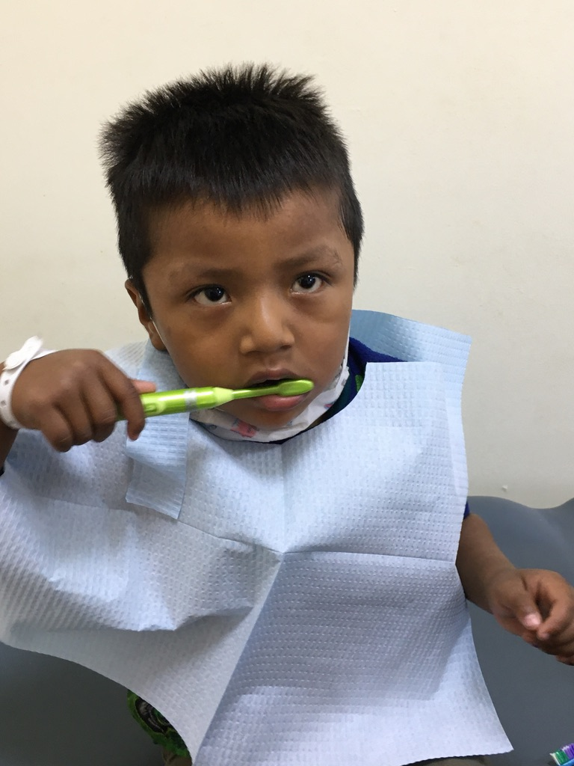

Slide 5
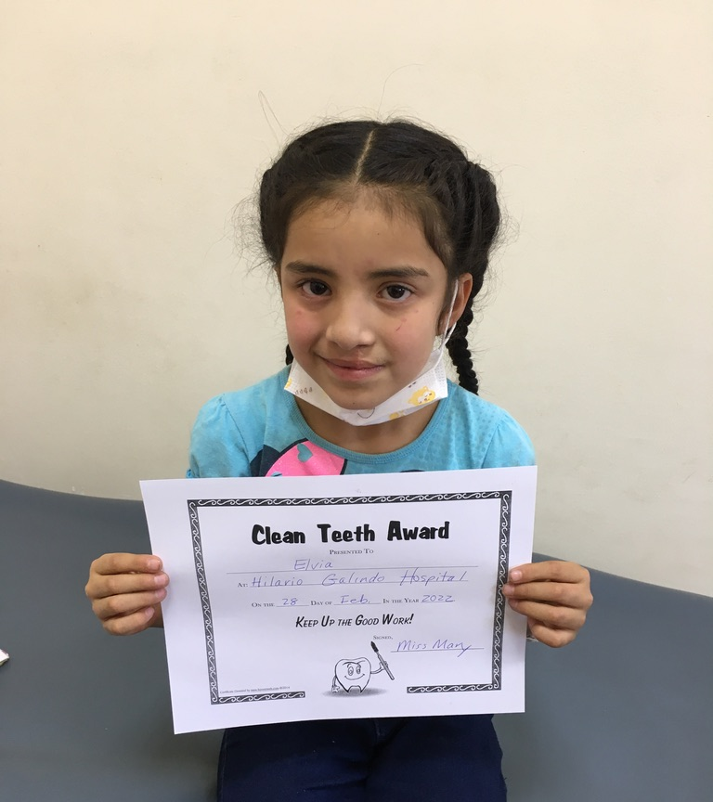
PREVENTION IS KEY!!

Slide 6
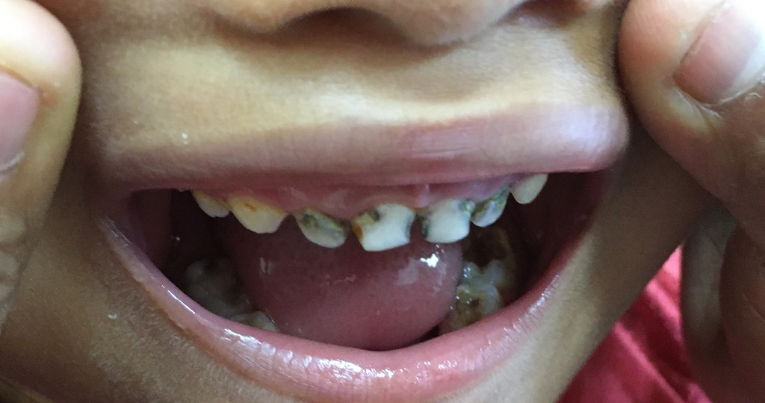

Slide 7
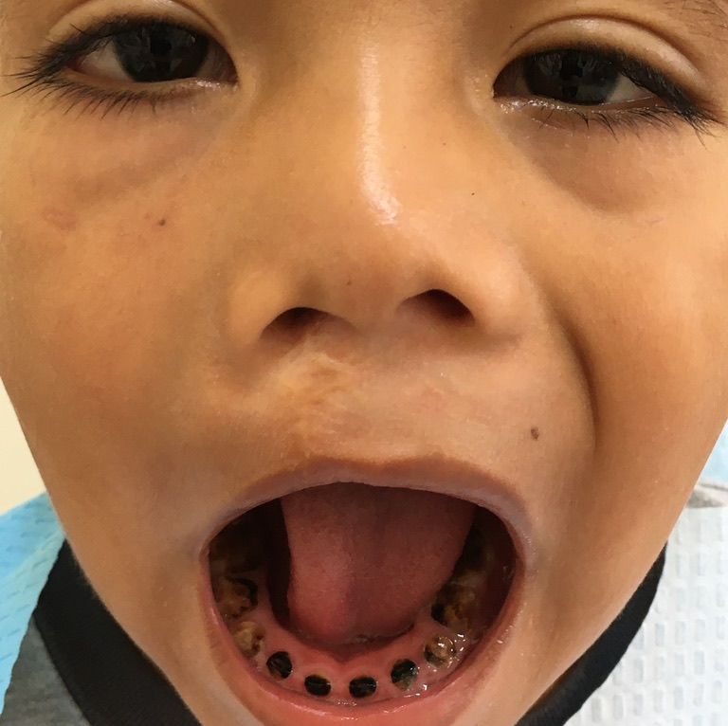

Slide 8
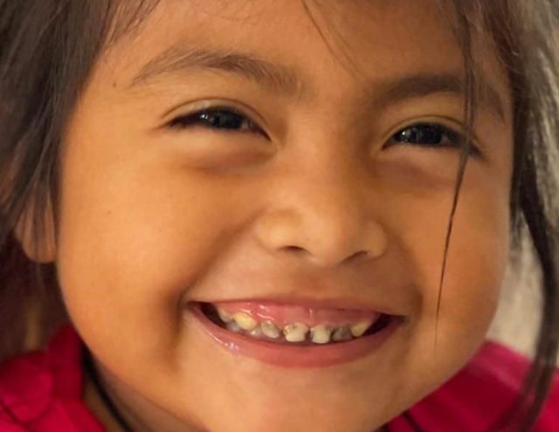

Slide 9
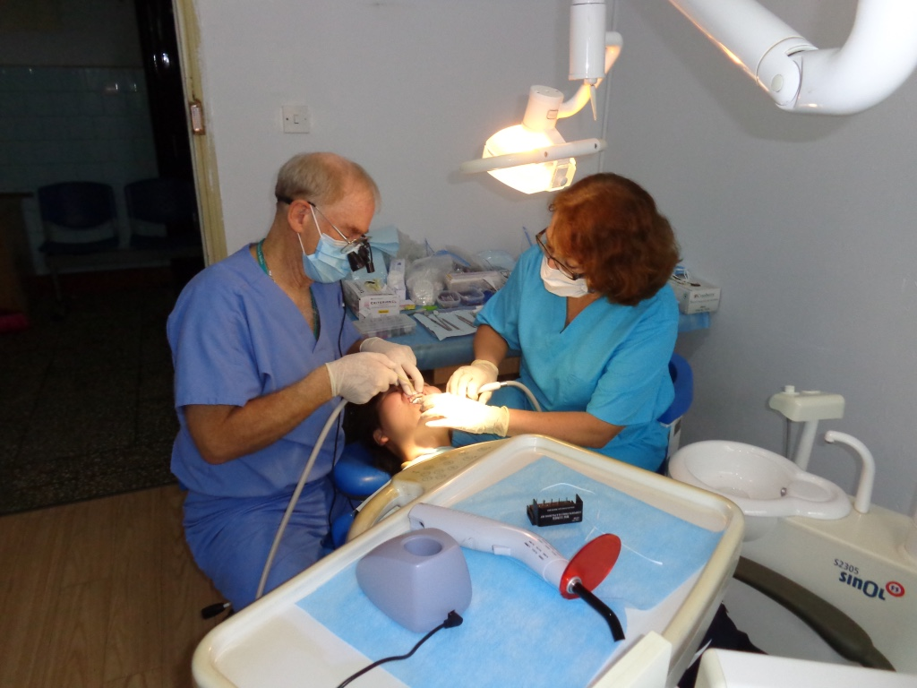
DENTAL
RESTORATIONS
EXTRACTIONS

Slide 10
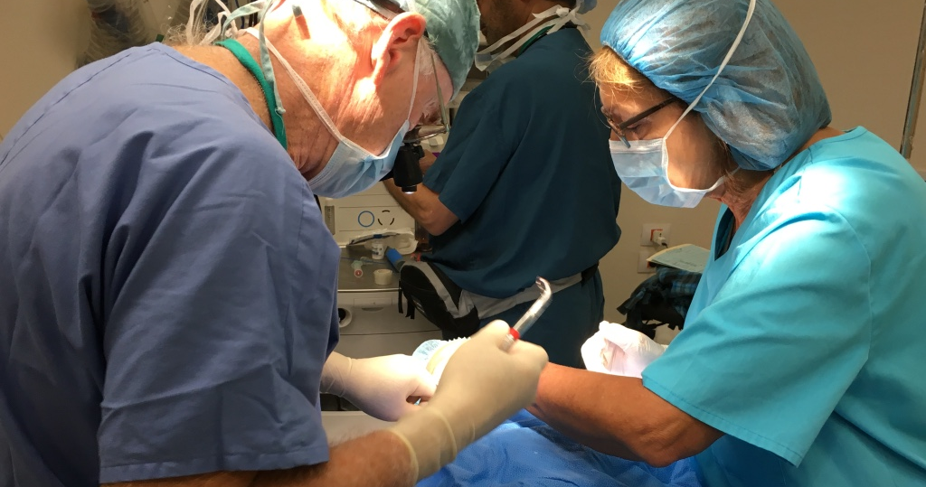

Slide 11
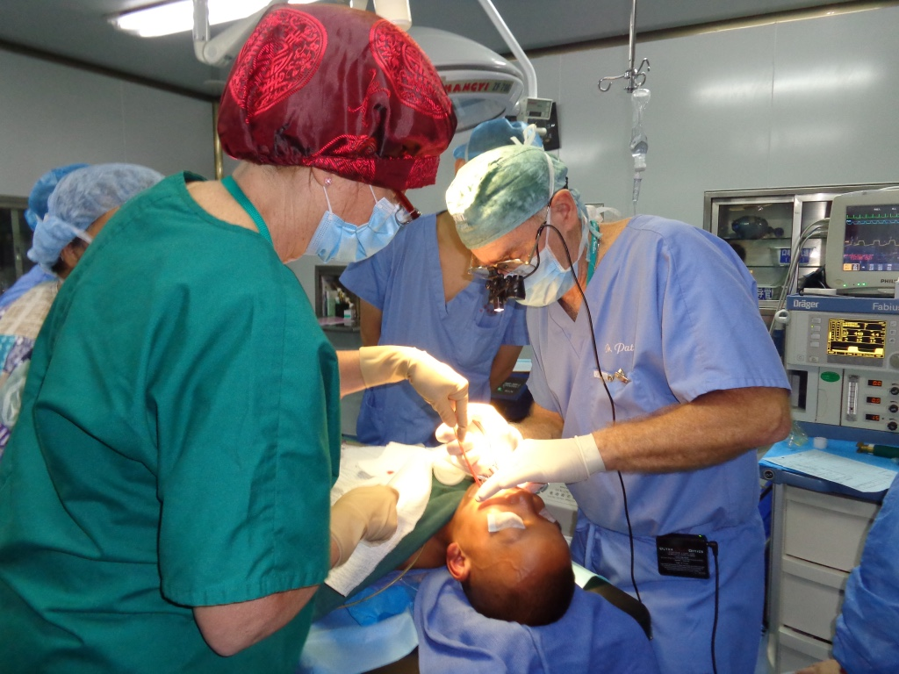

Slide 12
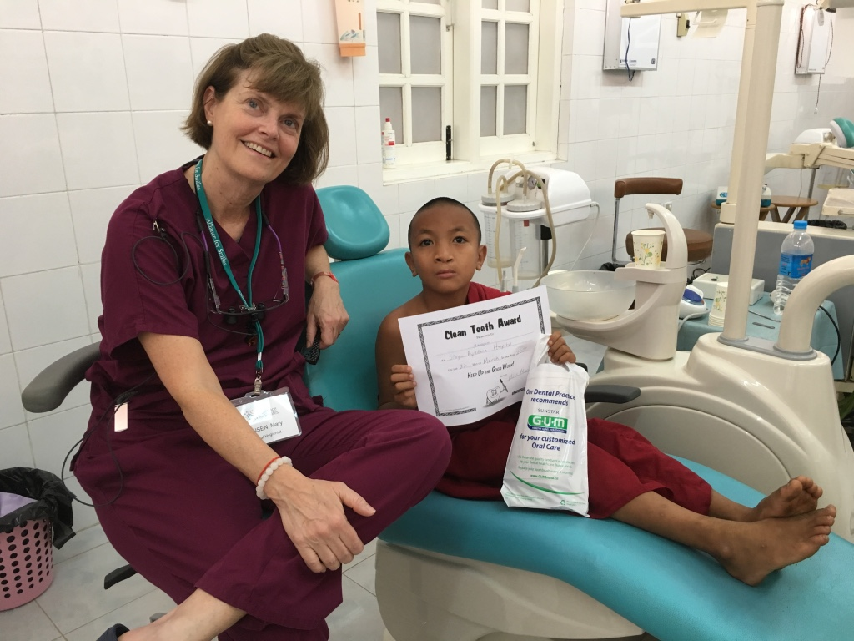
DENTAL HYGIENE
DENTAL CLEANINGS
DENTAL SEALANTS
FLOURIDE TREATMENTS
SILVER DIAMINE FLUORIDE
MOST IMPORTANT EDUCATION

Slide 13
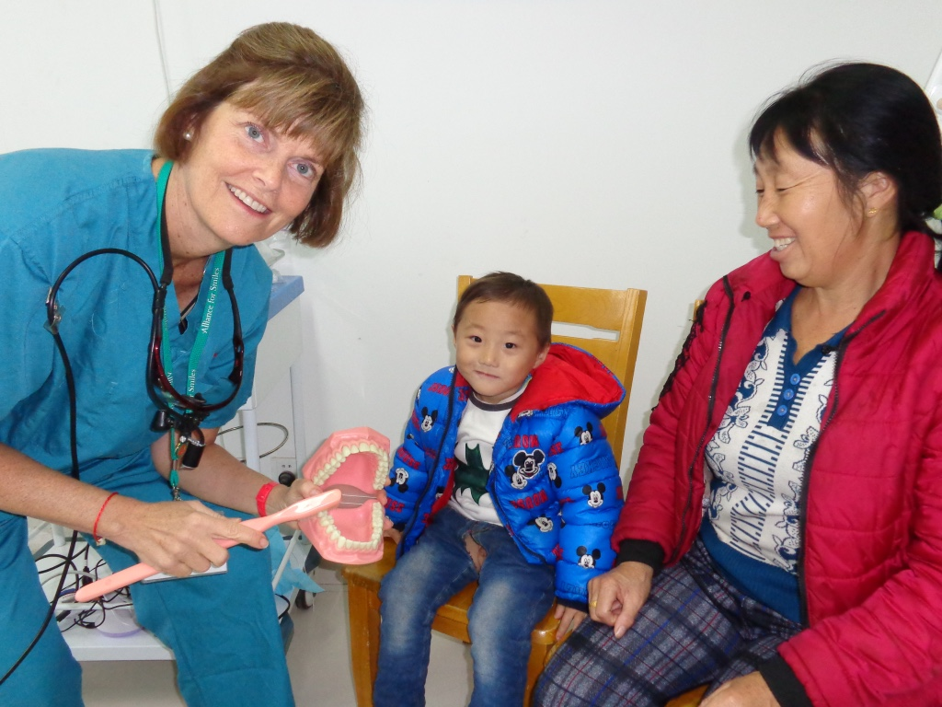

Slide 14
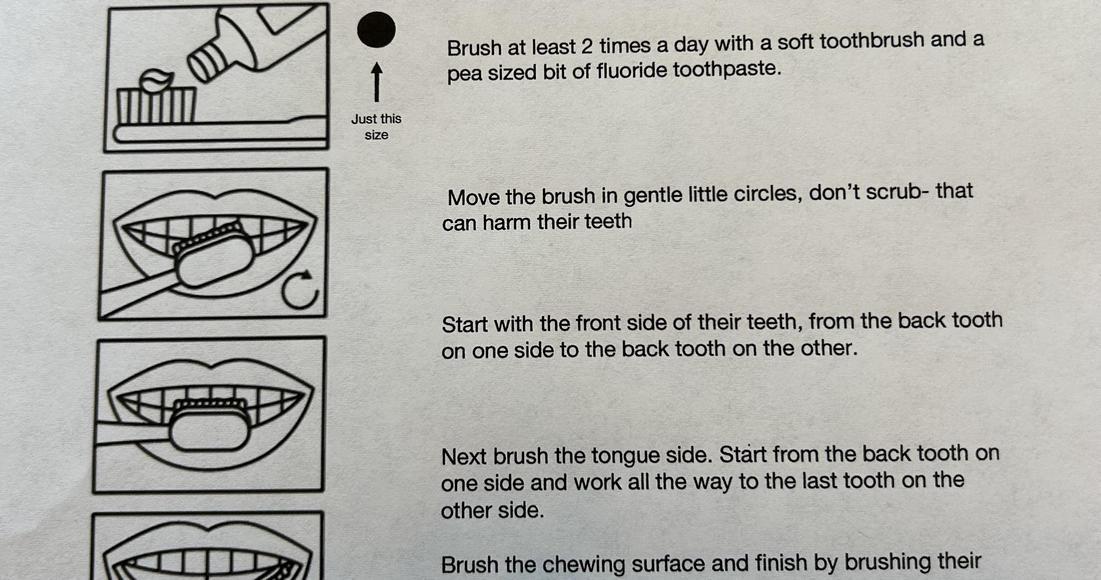

Slide 15
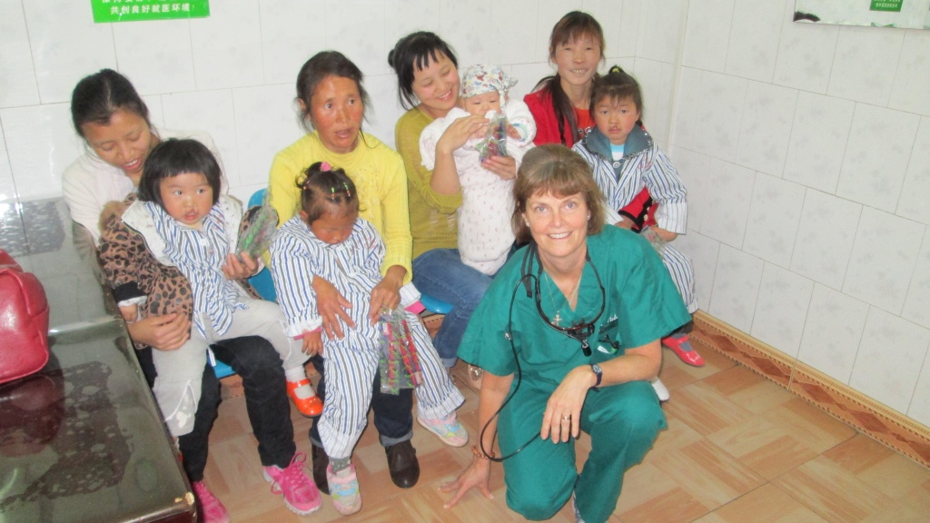
Dental Health Education

Slide 16
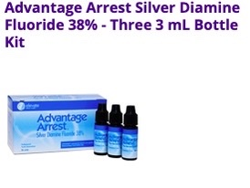

Slide 17
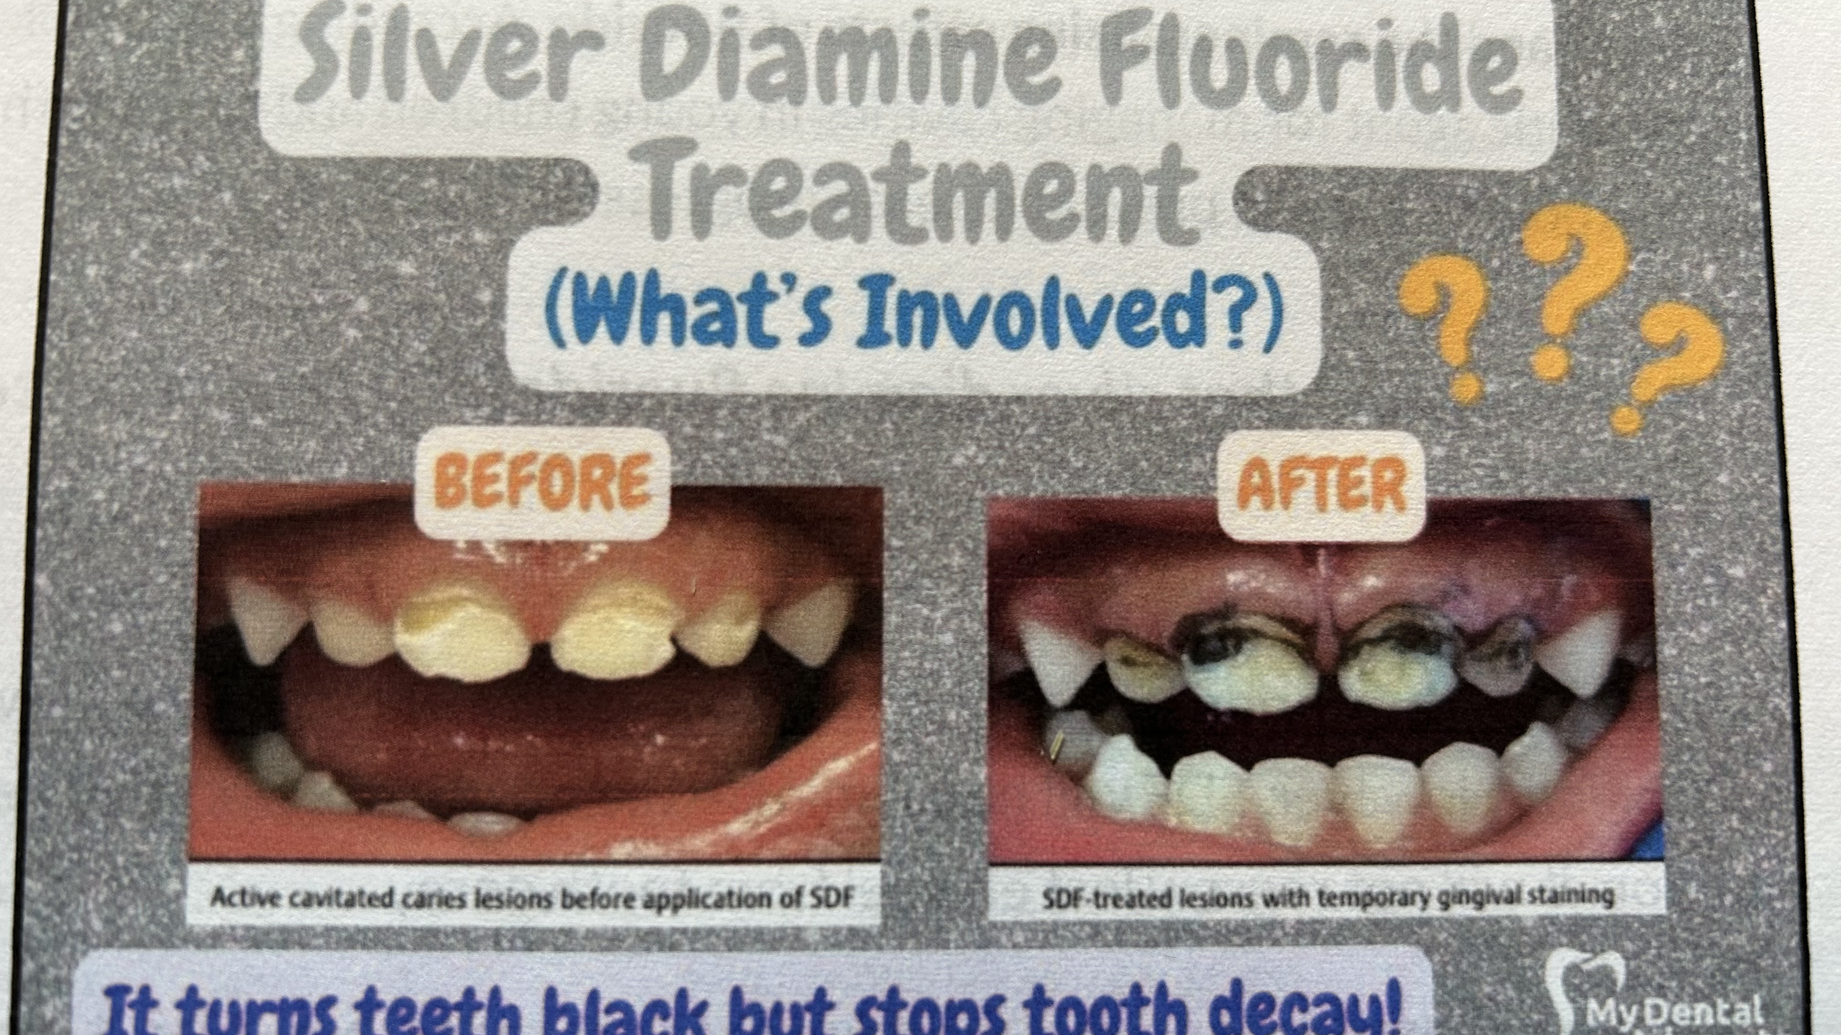

Slide 18
Silver Diamine Fluoride
Advantages of SDF
✓ Relieves tooth sensitivity. ✓ Prevents abscesses by slowing down or stopping tooth decay. ✓ Can buy time for children who are too young or fearful, or who have special needs, until they can manage.
✓ Avoids fillings or extractions by stopping decay.

Slide 19
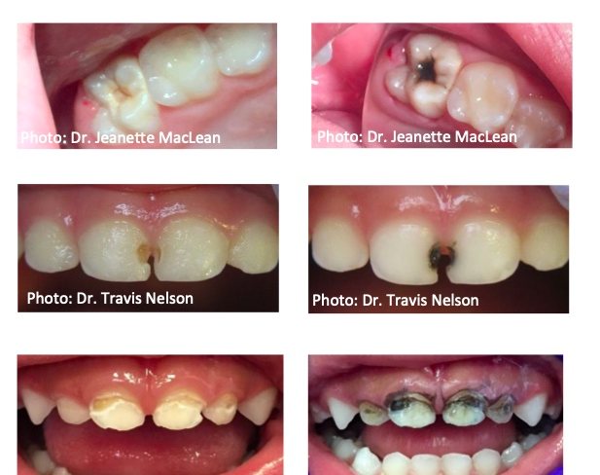

Slide 20
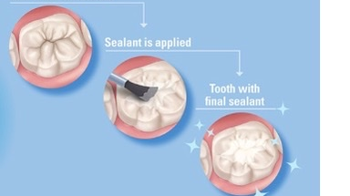

Slide 21
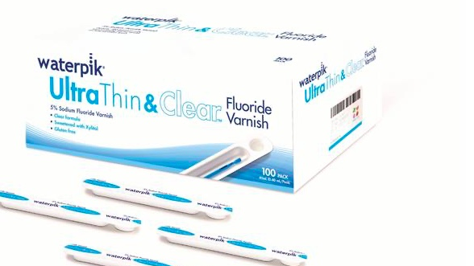

Slide 22
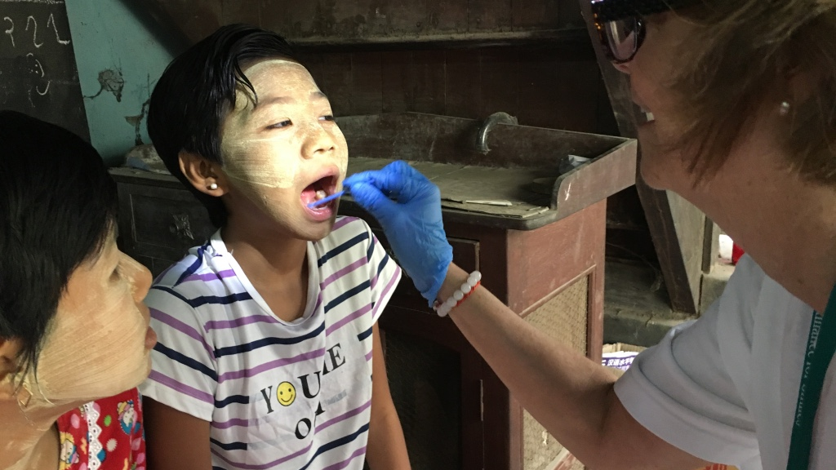

Slide 23
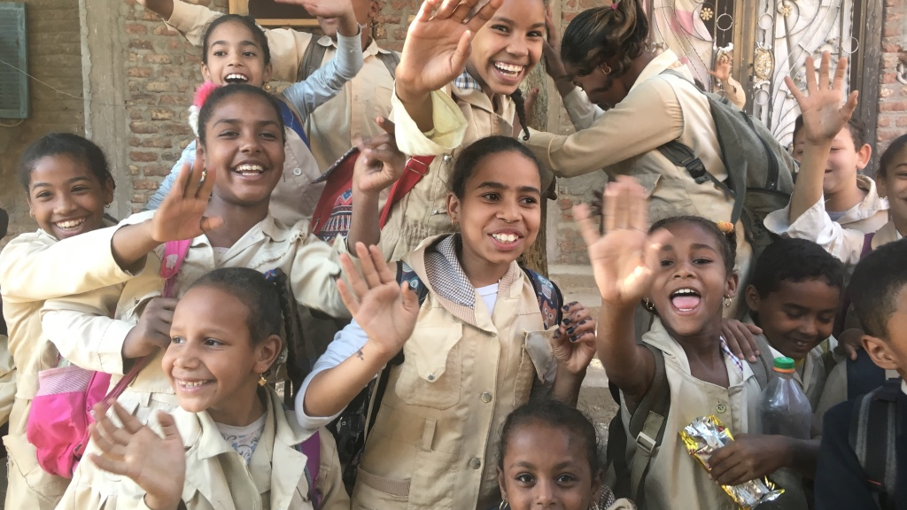

Slide 24
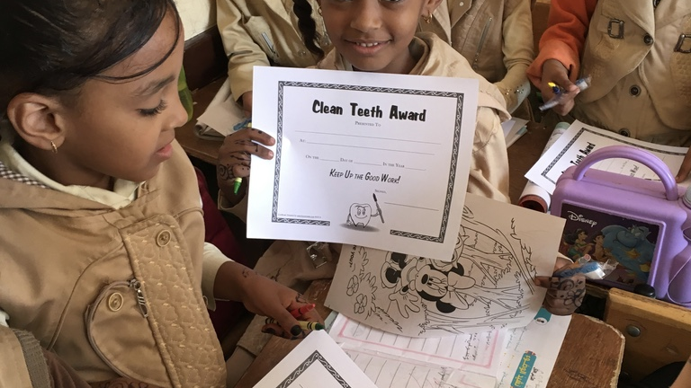

Slide 25
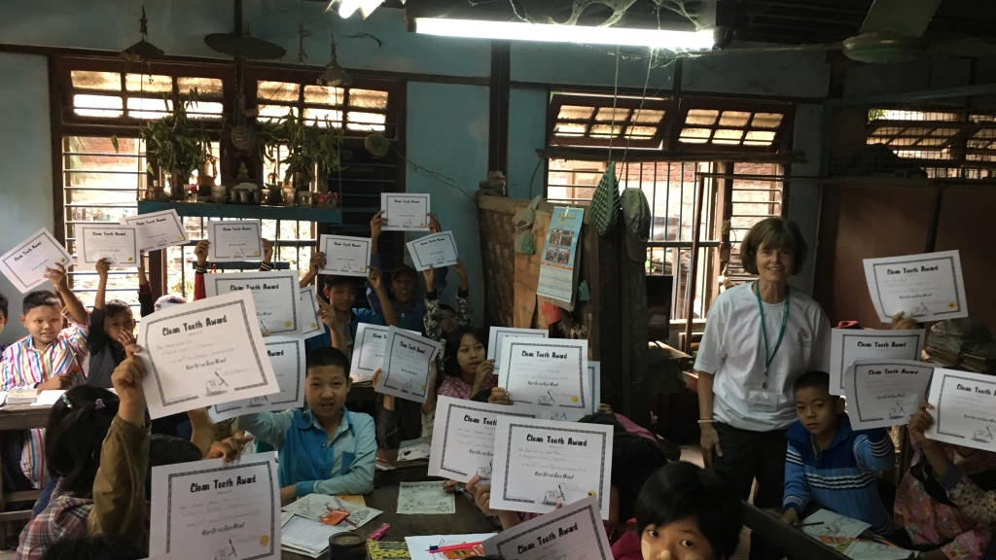

Slide 26

“The world is experiencing a large and growing crisis in access to oral healthcare that, if left unchecked, risks an unmanageable explosion of oral disease, especially in developing countries.”
2012 FDI World Health Federation

Slide 27
Mission Trip Dental Teams
Take Away—
AFS mission trip dental teams provide much needed dental treatment and education to foster overall oral health.

