Slide 1
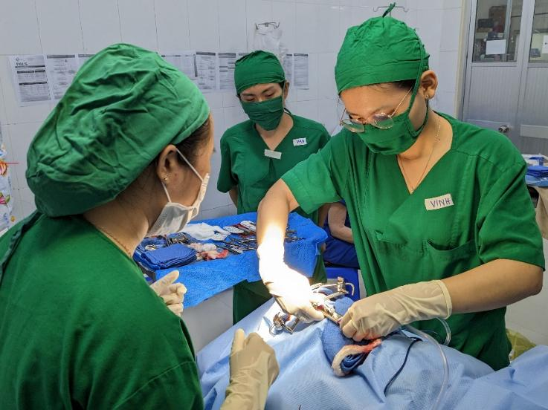
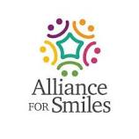
Cleft Lip and Palate Overview: Epidemiology and Syndromes
Dr. Surgeon, M.D.
Plastic and Reconstructive Surgery

Slide 2
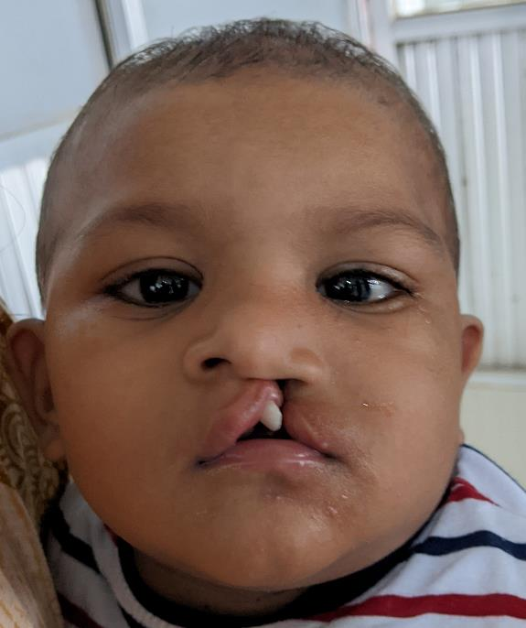
Classic Cleft epidemiology
1: 500-1000 live births, F>M, Asians/Hispanics>Caucasians>Blacks.
Epidemiologic studies starting in the ’40’s show that CL(P) is distinct from CP alone and both tend to cluster in families.
Inheritance is not mendalian and is dependant on various factors which are summarized in “Cleft tables” for non syndromic clefting.

Slide 3
Cleft model statistical analysis
Nonsyndromic clefting originally attributed to multifactorial inheritance (ie; multiple genes involved).
Recent review of old data may support a single or a few major genes could result in same outcomes.
*Empiric risk tables still best for counseling parents.*

Slide 4
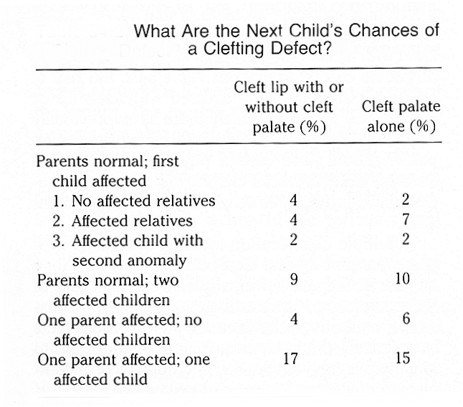
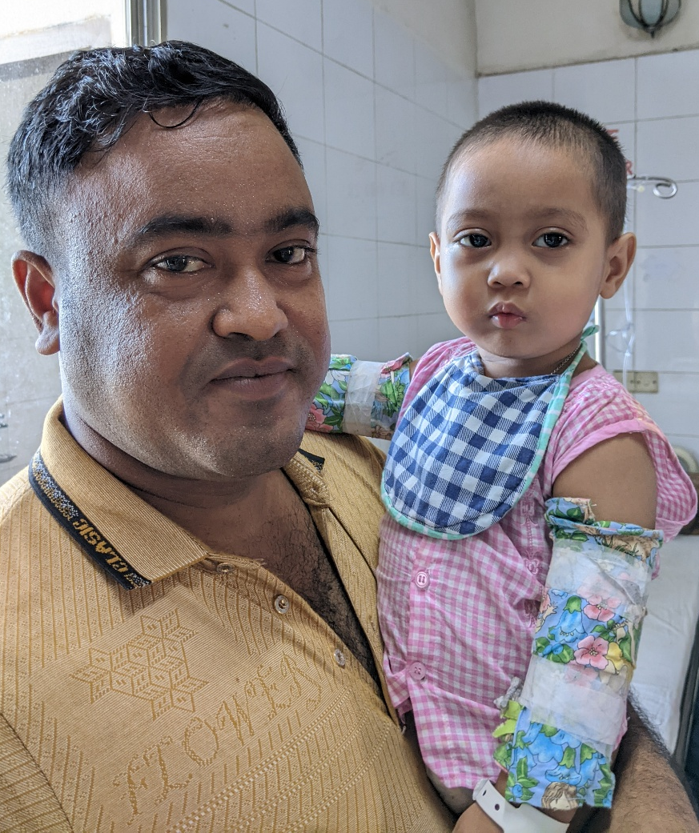
Notes:
Standard cleft risk table for counselling patients and families

Slide 5
Environmental factors
CL(P) and CP may represent one feature of exposure related syndrome (noted with alcohol, anticonvulsants, 13 cis-retinoic acid).
No single agent has been identified to cause CL(P) or CP alone.
Smoking has been implicated in a 2-6 fold relative risk increase for clefting

Slide 6
Laterality of clefting
Left more common overall in both familial and sporadic (approx 1.5:1).
Bilateral slightly more common than left in multiple malformation syndromes, but less common than R/L combined.
Cleft lip and palate L > R, M>F
Cleft palate F > M
Unilateral L : Unilateral R : Bilateral
6 : 3 : 1

Slide 7
Cleft associations and syndromes
Cleft Lip (P) associated with 35% chance of syndrome.
Cleft palate alone associated with a 54% chance of syndrome.
Submucous CP with 55% chance of syndrome.
More than 300 syndromes associated with orofacial clefting.
Rollnick BR, Pruzansk S: Genetic services at a center for craniofacial anomalies. Cleft Palate J 18:304-313, 1981.

Slide 8
963 children with clefting examined at Children’s Hospital, San Diego
Jones MC: Etiology of facial clefts: Prospective evaluation of 428 patients. Cleft Palate J 25:16-20, 1988.
Notes:
The following slides are all from the noted study. The general breakdown is still valid today, however genetic testing has further defined certain specific diagnoses. Cleft lip with or without palatal cleft is the most common

Slide 9
Incidence of multiple malformations by cleft type
Notes:
Children with VPI are substantially more likely to have multiple malformation cleft syndromes

Slide 10
Multiple malformation CL(P) findings (sporadic and familial)
Bilaterality/ severity of clefting more common with multiple malformations.
Family history more common (24%).
Common abnormalities in multiple malformation (n:52).
Single palmar crease (13), ear tags/pits (10), torticollis/plagiocephaly (9), cardiac defects (5), supernumery nipples (4), retardation (3), scoliosis (2), cyptorchidism (2), strabismus (2)

Slide 11
Multiple malformation CP findings
58% (191/328) have single defect, however- this includes 24/191 with Pierre-Robin sequence (underestimate?)
Family history 12%
Additional anomalies (n:31)
Ear pits/tags (7), developmental delay/retardation (7), single palmar crease (6), prominent lingual frenulum (4), palatal tumors (3), strabismus (2)

Slide 12
CL (P) with multiple malformation
CHARGE, Goldenhar syndrome
Multiple malformations not associated with known syndrome
Anticonvulsant, fetal alcohol syndrome, maternal diabetes
Van der Woude, Ectrodactyly, Opitz, Aarskog, Waardenburg
Down’s, VCFS

Slide 13
CP alone with multiple malformation
Goldenhar syndrome, Kabuki, Mobius, CHARGE
Stickler syndrome
Van der Woude, Treacher Collins, Spondyloepiphyseal dysplasia, Otopalataldigital
Down’s, Prader-Wili
VCFS

Slide 14
VPI with multiple malformations
36.1% unknown pattern
33.3% with VCFS
19.4% with single gene
5.5% with unknown genesis (auriculovertebralfacial or Rubenstein-Taybi)
Notes:
Of patients with VPI alone and multiple malformations, VCFS is the most common at %33

Slide 15
Stickler Syndrome
Most common disorder for CP alone (17.5%), prevalence 1-3:10,000
Cleft palate, myopia, retinal detachment, glaucoma, cataracts, hyperextensibility, may have Pierre-Robin sequence, slender fingers, CHL/SNHL, low nasal bridge with upturned nose and malar flattening
Autosomal dominant, variable expression, Type IIa and XIa collagen disorder
Notes:
80% of Sticklers have a variant COL 2a1 gene and is Autosomal Dominant. There can be multigene collagen disorders that act in an Autosomal Recessive manner and phenotypically give what appears to be Stickler Syndrome. The all have collagen disorders which can lead to various embryologic fusion issues as well as later retinal detachments or hyperextensible joints.

Slide 16
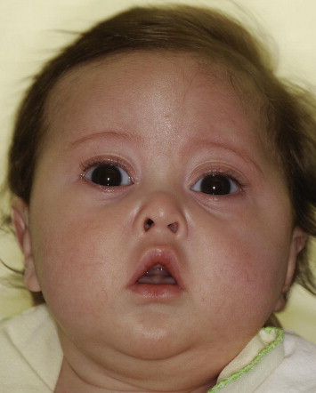
Stickler syndrome
Subtle findings
Small upturned nose
Nasal bridge flattening
Flattened malar process
Commonly just cleft palate

Slide 17
Stickler syndrome genes
Mutation in Type II and XI collagen gene (COL2A1, COL11A1, COL11A2)- type I, II, III
Periodic eye exams, especially type I
Gene locus chromosome 6p22 to 6p21.3 for COL11A1-2, chromosome 12 for COL2A1
Genetic testing

Slide 18
Velocardiofacial Syndrome
Abnormal facies (malar flattening, nasal abnormalities)
Conotruncal cardiac defects (TOF, truncus arteriosus, VSD, transposition, may have carotids in posterior pharyngeal wall)
Developmental delay, growth delay
Cleft palate or occult SMCP
Pierre-Robin sequence in 15-20%
Chronic ear disease due to ETD

Slide 19
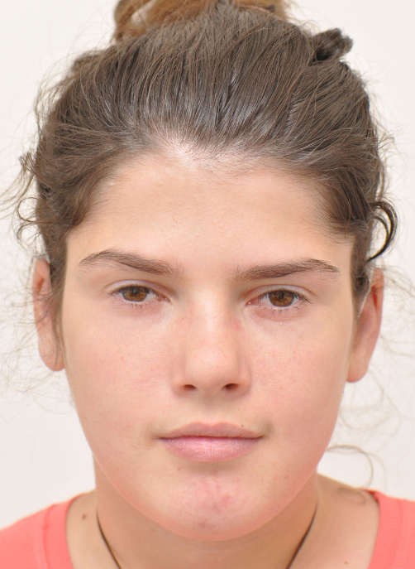
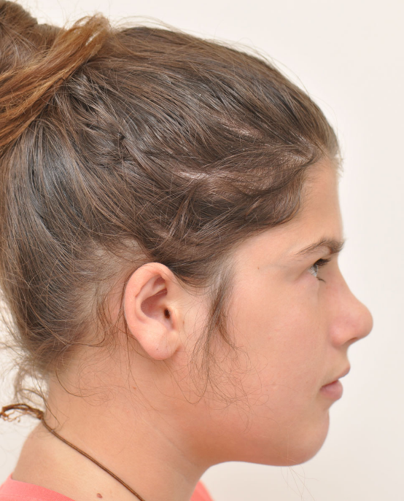
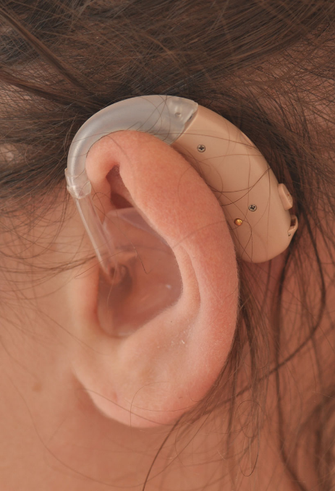
VCFS
Notes:
Elongated face, “almond shaped eyes”, may have smaller than normal mouth, ears can have superior helical rim folding “flap”, may have SMCP alone

Slide 20
VCFS
Incidence may be as high as 1:2-4000 live births
Variable phenotypic expression, 10% autosomal dominant, 90% sporadic
22q11 micro deletion

Slide 21
VCFS
Fluorescent in situ hybridization (FISH) test for 22q11 now available
Association with 22q11 deletion in DiGeorge, Kabuki make up, CHARGE, Smith-Lemi-Opitz
Subgroup (28%) of post adenoidectomy VPI patients without SMCP found to have 22q11 deletion *
* Perkins J et al. Presence of 22q11 deletion in postadenoidectomy velopharyngeal insufficiency Arch Otol Head Neck Surg 126: 645-648, May 2000.
Notes:
Children who have VPI after adenoidectomy should be considered for possible VCFS

Slide 22
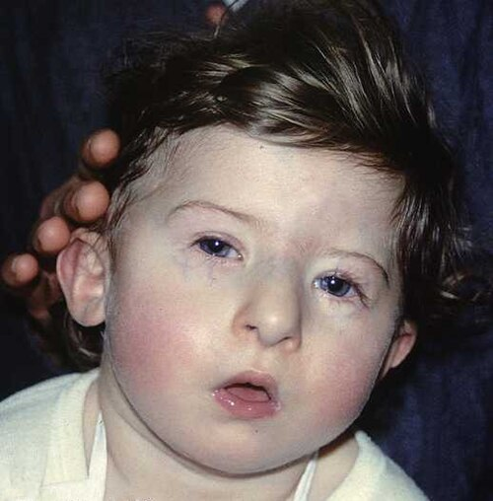
DiGeorge sequence
Associated with VCFS (10%), 3rd/4th pouch syndrome
Conotruncal cardiac anomaly
Hypocalcemia
Thymic aplasia
Immune deficiency (T- cell)
Shortened cochlear/Mondini, middle ear abnormalities
May have cleft palate
22q11.2 deletion
Notes:
Similar to VCFS but also with thymic aplasia, can have immune issues, autism spectrum, spinal abnormalities

Slide 23
Pierre- Robin Sequence
Mandibular hypoplasia, glossoptosis, secondary cleft palate
1: 2,000- 50,000 live births
30% have occult Stickler syndrome?
Airway management, nasal trumpet, gavage feedings
Tracheotomy or tongue-lip adhesion in severe cases

Slide 24
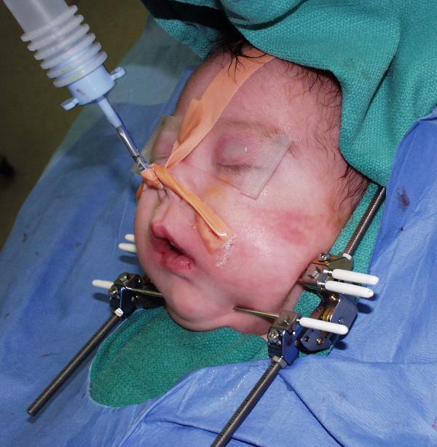
Pierre- Robin Sequence
Most children with tracheotomy decannulated by 18 months
Mandible growth accelerates and most children attain normal mandible profile by age 4-6
Growth failure does occur and treated by grafting or distraction osteogenesis
Notes:
Micrognathia, glossoptosis, cleft palate

Slide 25
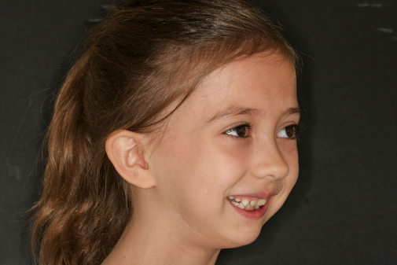
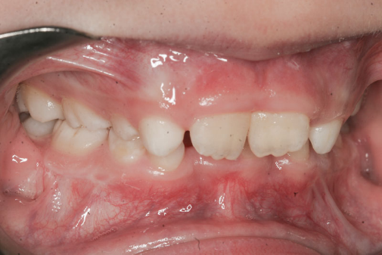
Pierre- Robin Sequence
Notes:
Is a sequence (series of physical findings) and can be associated with other cleft syndromes such as Stickler Syndrome

Slide 26
Treacher- Collins
Flattened malar bones with non fused zygomatic arch, coloboma, deformed pinnae, “fish like” mouth, antimongoloid palpebral fissure, mandibular hypoplasia, CHL and ossicular defects, may have cleft palate
1st and 2nd Branchial arch abnormality
Tessier 6,7,8 cleft
Autosomal dominant with variable penetrance
Gene locus 5q31-34

Slide 27
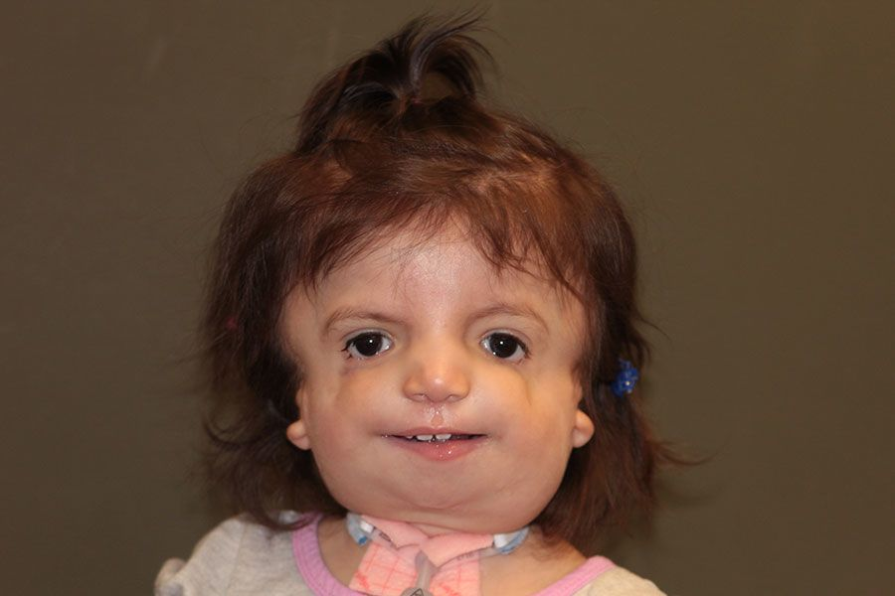
Treacher- Collins

Slide 28
Goldenhar syndrome
Hemifacial Microsomia, Goldenhar (includes eye and vertebral abnormality), Facioauriculovertebral syndrome, Oculoauriculovertebral syndrome
1: 3,500-5000 live births
1st and 2nd branchial arch hypoplasia/ abnormalities and upper vertebral hypoplasia
Cause unknown, favor autosomal dominant with variable expression

Slide 29
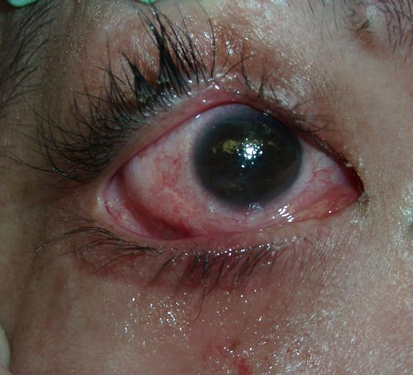
Goldenhar syndrome/ Hemifacial Microsomia
Microtia
Mandible and maxilla hypoplasia
Ossicular abnormalities/ CHL, auricular tags very common
Macrostomia/ lateral facial clefting
Cleft lip and palate
Epibulbar Dermoid
Salivary fistulas, agenesis of parotid gland
Lingual hypoplasia, speech delay
Notes:
Photo shows lower globe epibulbar dermoid

Slide 30
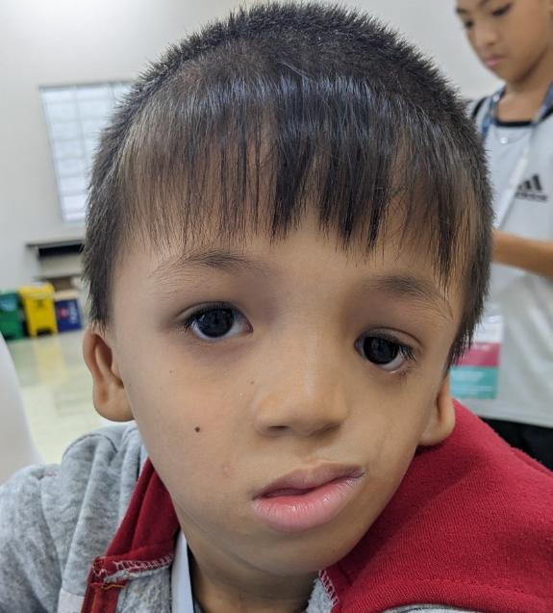
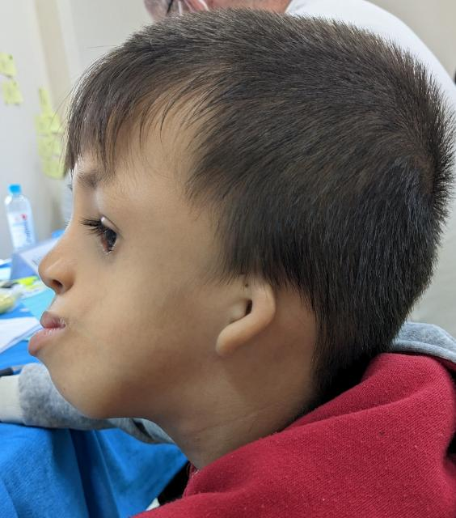
Goldenhar syndrome

Slide 31
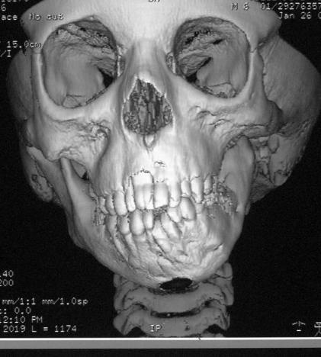
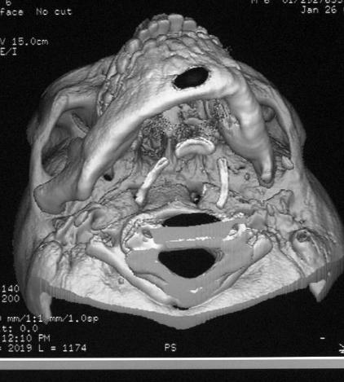
Goldenhar syndrome
Notes:
CT shows underdeveloped hemifacial growth. Condyle can be significantly under developed or absent

Slide 32
Van der Woude
Lower lip pits, CL/P
Autosomal dominant: 1:40,000-1:100,000
Common clefting syndrome, approx 2% of oral clefts
IRF6 gene, 1q32-41
Some times lower lip pits are only finding (64%)

Slide 33
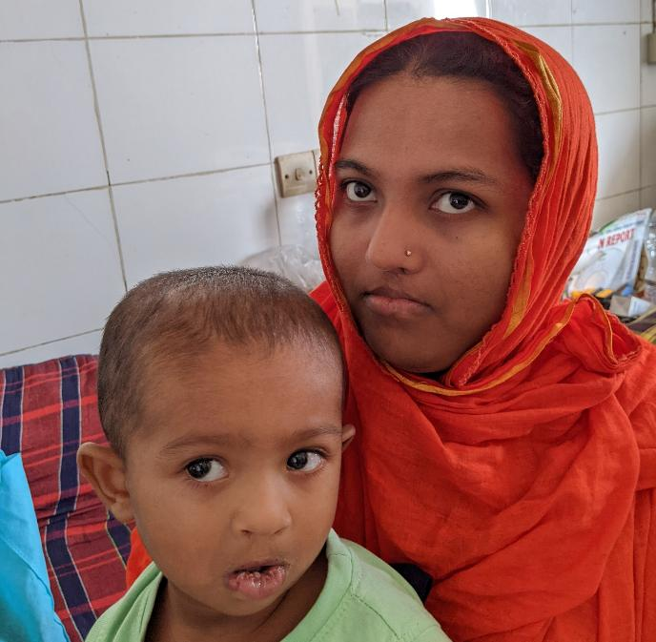
Notes:
Both mother and child have lower lip pits

Slide 34
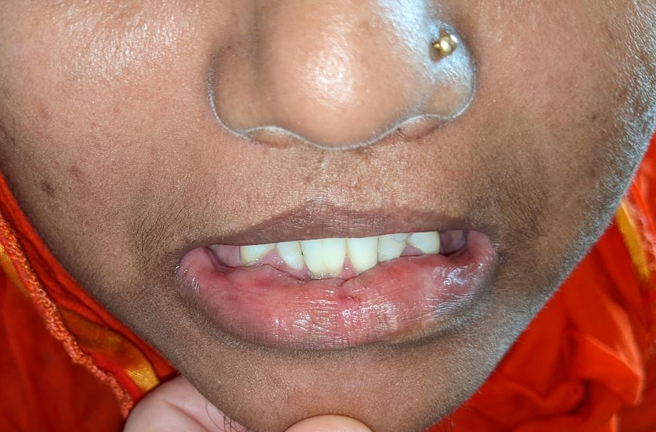
Notes:
Close up of subtle lower lip pits in mother

Slide 35
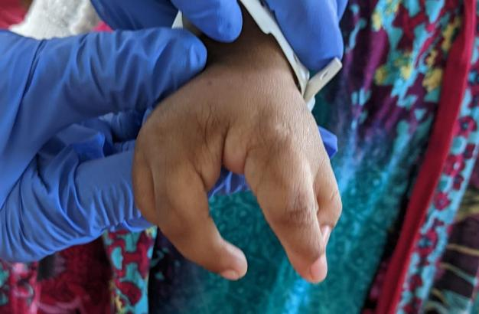
EEC (Ectrodactyly Ectodermal Dysplasia Clefting Syndrome)

Slide 36
EEC
Very rare, 1:90,000
Autosomal Dominant with variable expression, TP63 gene (3q27)
Ectodermal: scaly skin, sparse eyelashes, teeth/saliva issues
Ectrodactyly: cleft hand (lobster claw)

Slide 37
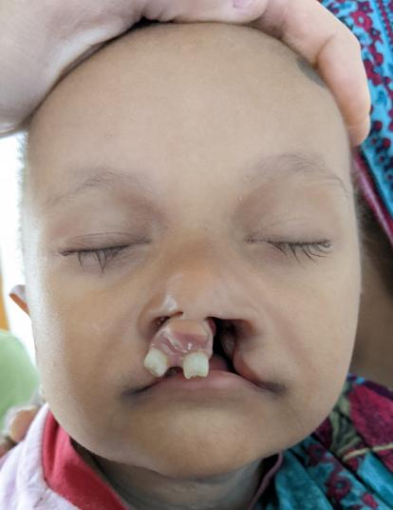
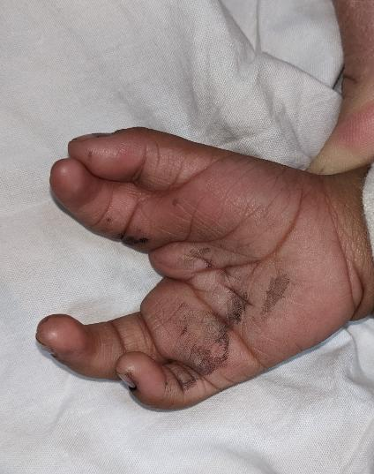
Notes:
Sparse eyelashes and “lobster claw deformity” hand

Slide 38
Summary
CL(P) and CP are common
CP and VPI more associated with syndromes (especially Stickler and VCFS)

Slide 39
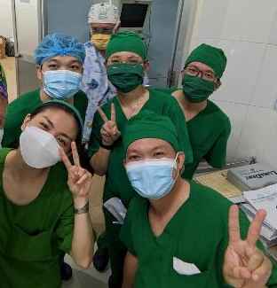
Questions/ comments
Notes:
Insert picture of choice, local surgical team used in this case.

