Slide 1

Alliance FOR Smiles Cleft Speech Education

Slide 2
Prevention is KEY!
Alliance for Smiles
Educational Trip
Cleft Speech
Cleft Speech discussion for the Team and Family.

Slide 3
Learning objectives
At the end of this session/presentation you will be able to
Describe the structure and role of the resonating cavity and oral tract in speech production
Explain velopharyngeal function and its importance in speech
Learn pre- and post- palate repair speech
Understand how to pull it all together for clinical decision making
Notes:
Learning objectives should be: Specific, Measurable, Achievable, Relevant, Time-bound (SMART)
DO NOT use the verbs: understand and know (they are not measurable)
USE the sentence: After this learning experience, learner will be able to:
USE these verbs for KNOWLEDGE (mostly for lectures): define, describe, identify, list, outline, recall, reproduce, show, etc.
USE these verbs for SKILLS (mostly for practicals): apply, operate, measure, assemble, construct, design, demonstrate, examine, execute, fix, etc.
USE these verbs for ATTITUDE (mostly for small groups and practicals): accept, appreciate, embrace, relate, resolve, value, etc.
Example lecture: Preoperative planning
Highlight the importance of preoperative planning
Describe various techniques for preoperative planning
Formulate and draw an operative plan
Describe a surgical tactic step by step p (eg, positioning, choice of surgical approach, instruments, reduction technique, implants)
Incorporate patient safety protocols (mark site, time-out check list) in the preoperative plan

Slide 4
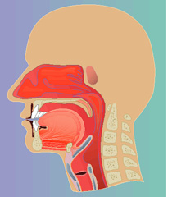
Resonating Cavities of Vocal Tract
Nasal Consonants,
Nasalized speech
Oral Speech,
Vowels,
Oral Pressure Consonants
Coupling Point
Larynx

Slide 5
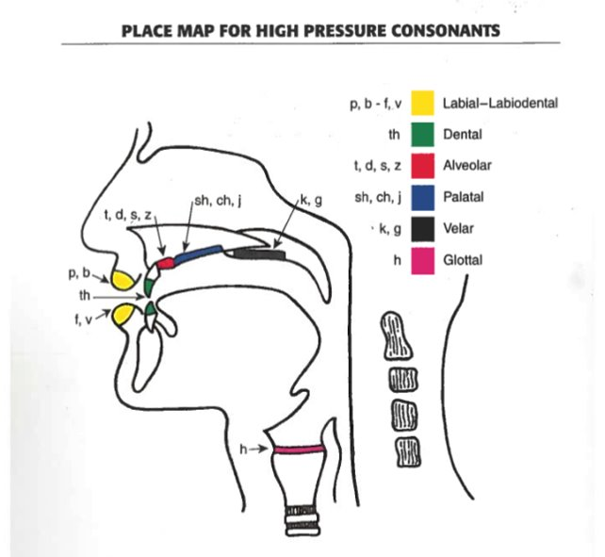
Articulation
Peterson-Falzone, Trost-Cardamone et al.,​

Slide 6
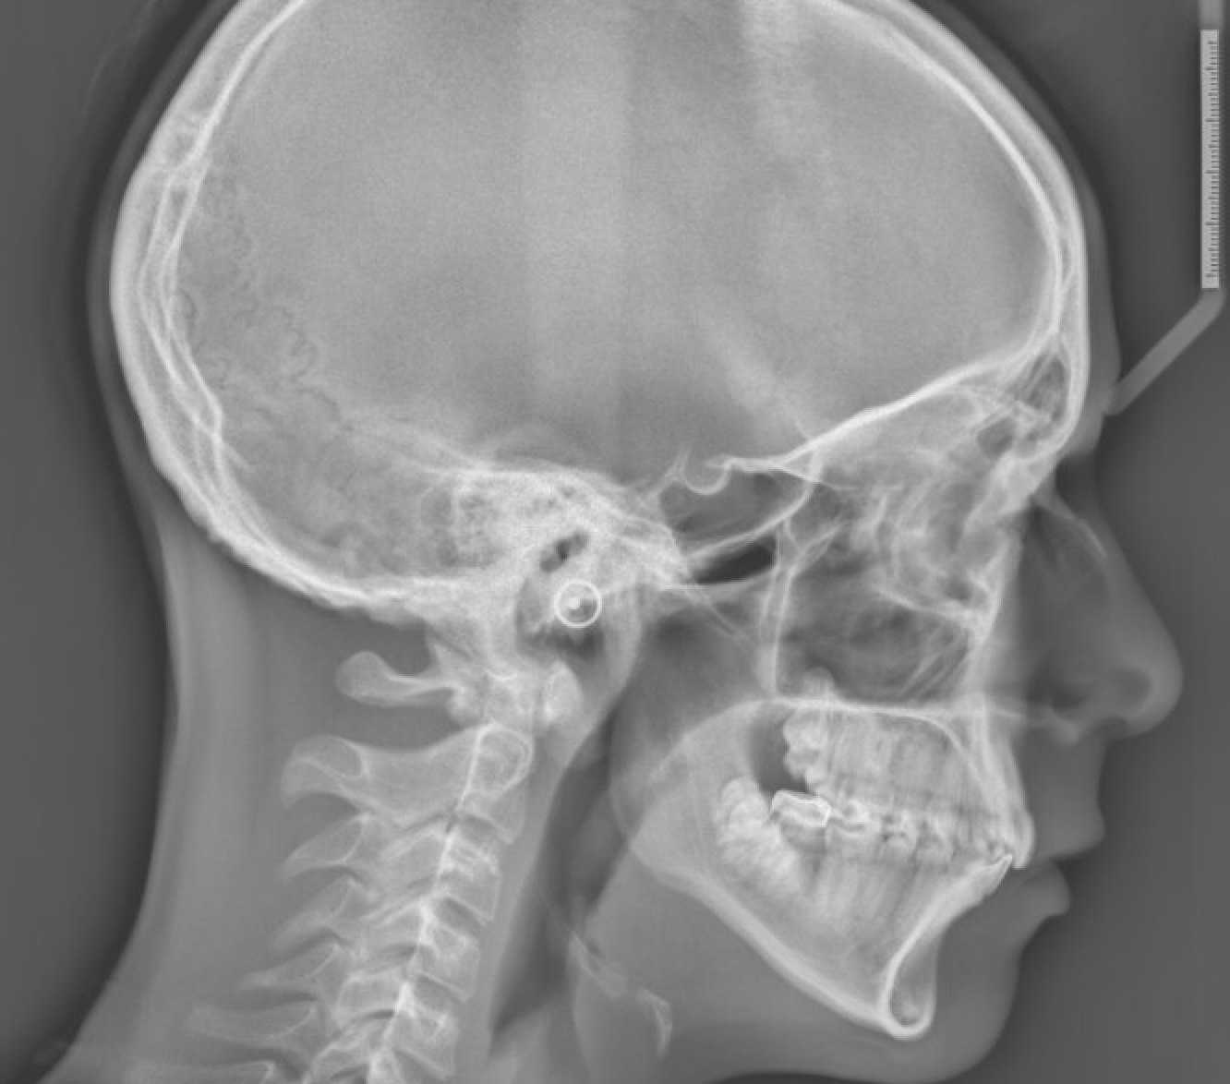
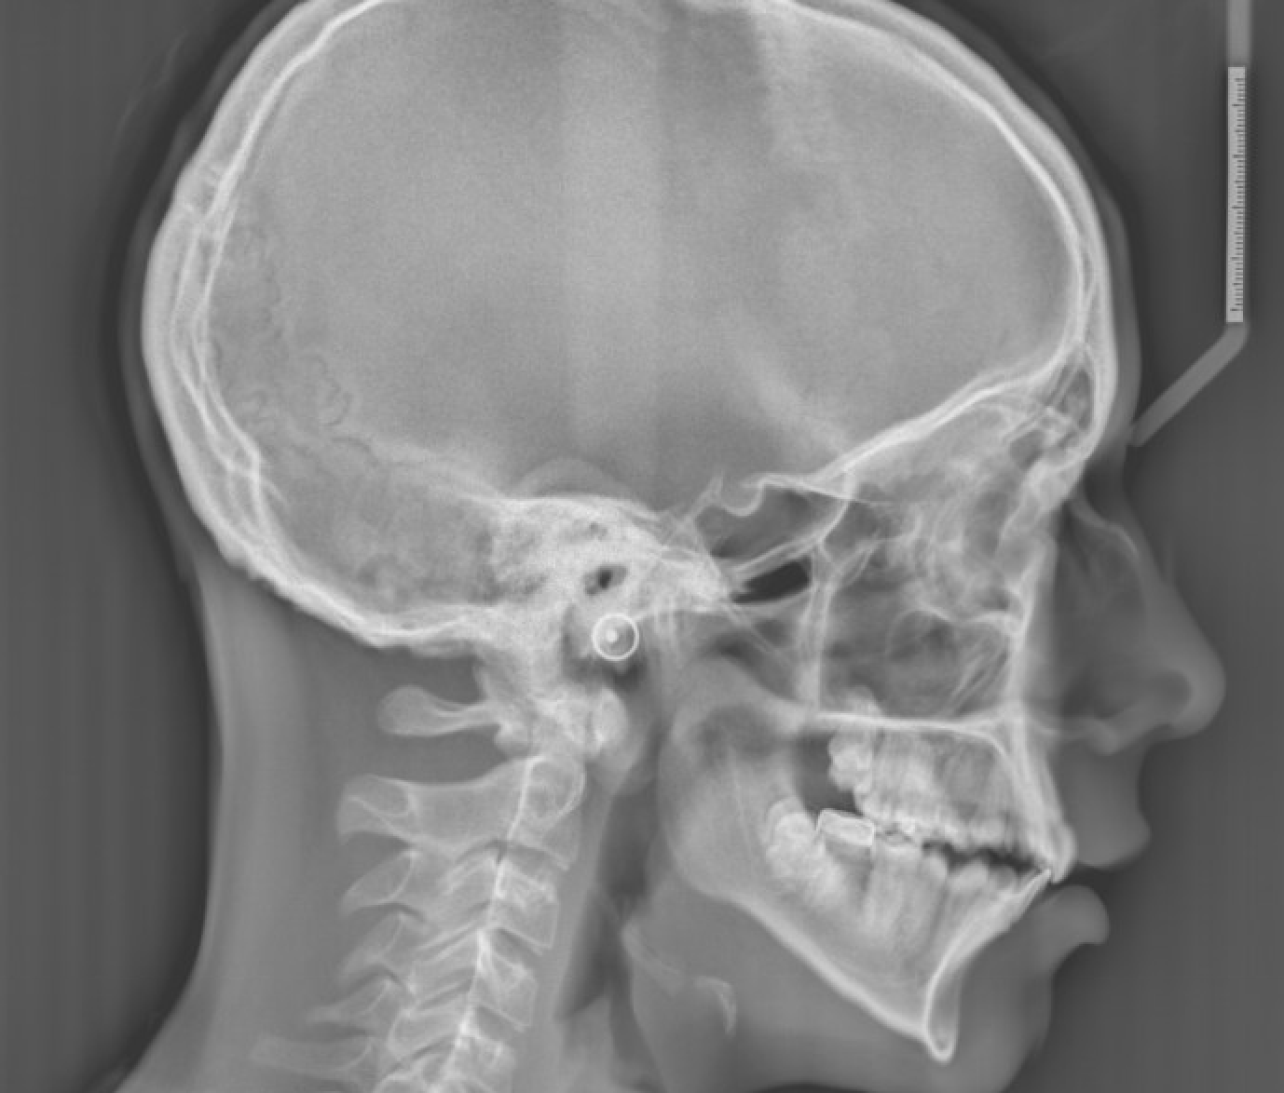
Velopharyngeal Function, lateral cephalometric view
At Rest
Oral Speech: sustained phonation of a voiceless fricative (e.g., s, sh)

Slide 7
Velopharyngeal View: Nasopharyngeal view
At Rest
Closure of Pressure Consonant

Slide 8
Pre-Palate Repair Speech Milestones, up to 1 year of age
Hearing & Understanding
Talking: Phonation and Cooing Stage
Eye contact
Smiles
Responds to name
Imitates activities
Recognizes words for common items
Respond and performs routine upon requests
Understands simple questions
Uses a variety of sounds
Sings along
Jargon with babbling
Imitates
Says “mama” or “dada”
First true words (noun and verbs)

Slide 9
Pre-Palate Repair Speech
HYPERnasality will be present (observed in cry)
Nasal and low pressure (/m/, /n/, and /w/, "y", /l/ /h/) consonants will be recognizable
Pressure consonant /p, b, t, d, s, sh, k, g/ will not be clear until there is a repaired palate/adequate velopharyngeal mechanism that can support normal speech.

Slide 10
Pre-Palate Repair Speech & Language Activities
Mouth Play show front of the mouth consonants and non-speech movements (e.g., tongue wagging, lip smacking, lip pucker [kiss])
Use gravity (e.g., tummy time, sitting) to encourage forward speech and non-speech productions
Reinforce babbling – front of mouth babbling. Praise lips for /m, p, b, w/ and tongue wagging for /t, d, n/ and allow temporary nasal for oral (e..g, m/p, n/d). Celebrate jargon (not recognizable strings of sounds).
Language Talk to baby. Narrate the day. Use questions (e..g, Where’s mama?” and reward baby looking to mama) and make comments (“mmm” yummy”). Teach nouns and verbs.
Family: Get family/siblings involved. Siblings to model anterior placements.
Ignore glottal/throat sounds, such as growling, grunting or excessive screaming/squealing and yelling -- Say/Model “OH NO” or “OPPs” instead of the glottal sound “uh-oh” to comment during play activities

Slide 11
Post-Palate Repair Milestones, up to 2 years of age
Hearing & Understanding
Talking
Comprehends 500 to 900 words
Identifies several body parts
Listens to 5 to 10 minute stores
Understands some personal pronouns
Uses 2-3 word phrases/sentences
Uses some questions
Relates personal experiences
Speech is about 70% intelligible

Slide 12
Post-Palate Repair Perceptual Speech Evaluation
Oral mechanism exam
Screening of VP closure
Resonance assessment
Phonological assessment
Intelligibility assessment
Language assessment

Slide 13
Clinical Features of ‘Cleft Palate Speech’
Perceptual Speech Assessment
Hypernasality*: is excessive sound energy to the nasal cavity and is a resonance disorder not a voice disorder.
Nasal emission* on consonants requiring oral pressure, can be audible or inaudible
Weakened oral pressure consonants*
Compensatory phonological errors**
*Obligatory or unavoidable errors
(probably require physical management)
**Obligatory or Learned errors (persist after physical management; require speech therapy)

Slide 14
Clinical Decision Making POST PALATE REPAIR
Obturator?
Surgery?
Speech Therapy?

Slide 15
Resources
Parameters Of Care – https://acpacares.orgwp-content//uploads/2025/02/2024-ACPA_ParametersOfCare_Final.pdf
The Clinician's Guide to Treating Cleft Palate Speech, 2nd Edition
by Sally J. Peterson-Falzone, PhD, Judith Trost-Cardamone, PhD, Michael P. Karnell, PhD and Mary A. Hardin-Jones, PhD

