Slide 1
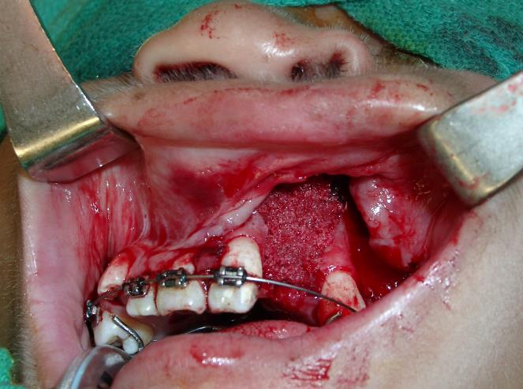

Alveolar Bone Grafting in Cleft Lip and Palate
Dr. Surgeon, M.D.
Plastic and Reconstructive Surgery
Notes:
Insert your own name and change pictures as desired through out talk.

Slide 2
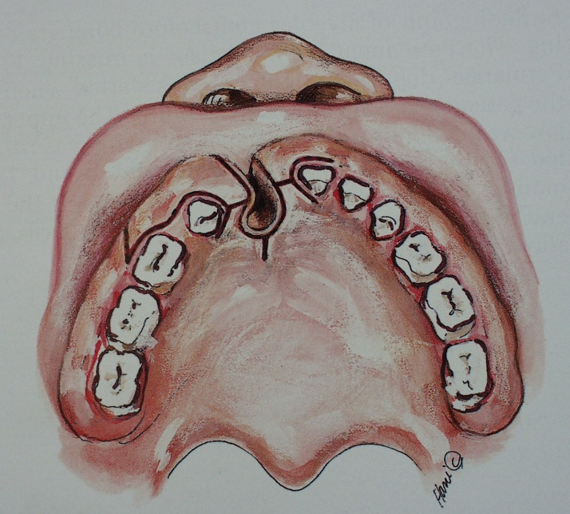
Alveolar Bone Graft Timing
Prior to eruption of canine (typically age 7-9)

Slide 3
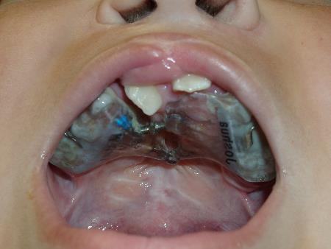
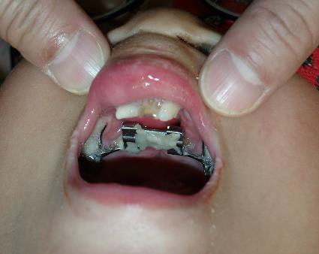
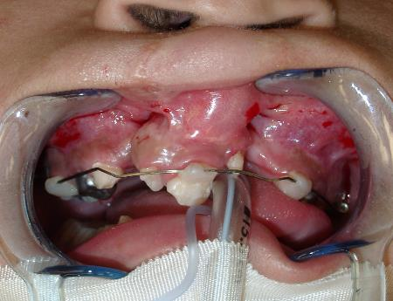
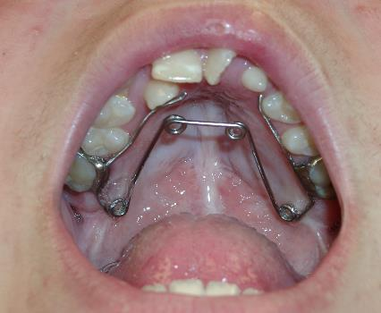
Palatal Expansion, Orthodontia Prior (if needed)
Align greater and lesser segments
Contiguous alveolar arch
Typically as canine erupts
Pre alveolar graft and post alveolar graft orthodontia
Notes:
Attempt to align maxillary segments in anticipation of bone grafting

Slide 4
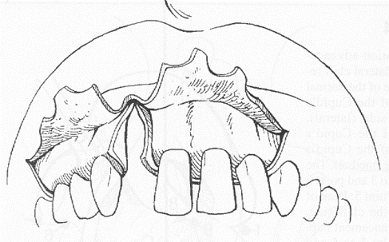
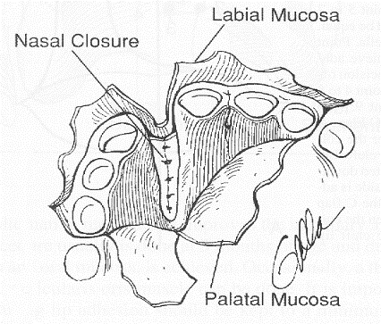
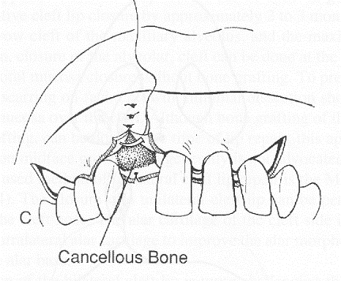
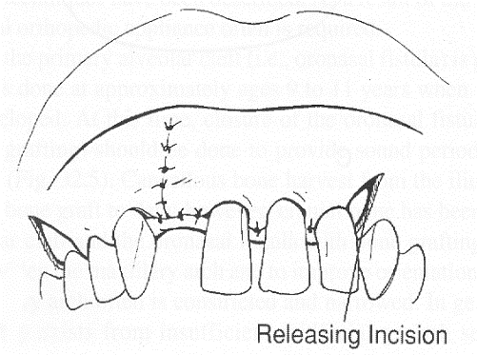
Alveolar Bone Grafting Technique

Slide 5
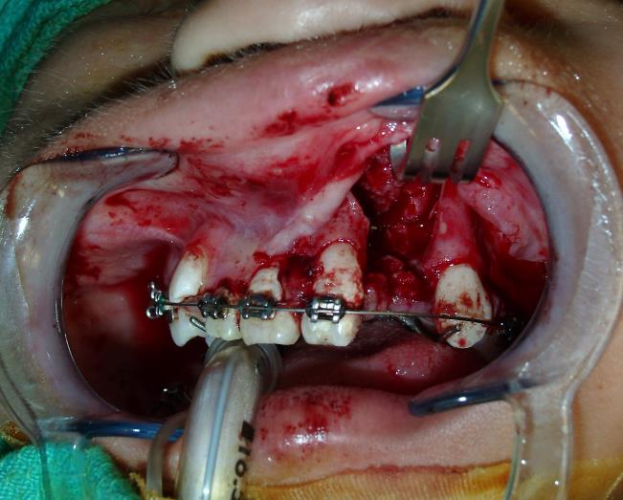
Wide Exposure, Turn in Flaps for Nasal Closure
Notes:
Bone graft shown is from iliac crest. Generally harvest occurs from iliac crest in growing patients, but consider tibia plateau if skeletally mature as more tolerable for patient.

Slide 6
Generously Pack Bone Graft

Slide 7
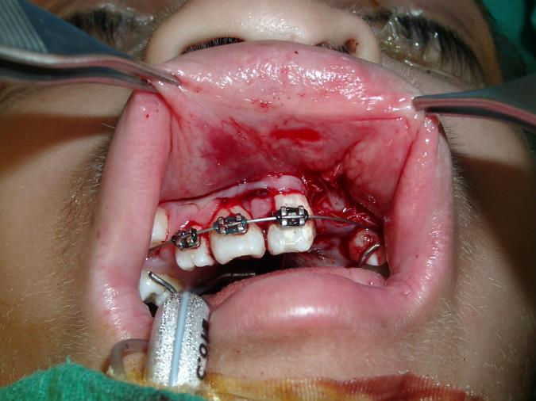
Water Tight Closure

Slide 8
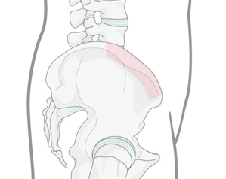
Illiac Crest Harvest Site (non skeletally mature)
Common harvest site
Ok in growing patients
Can be associated with numbness and pain
Simple harvest

Slide 9
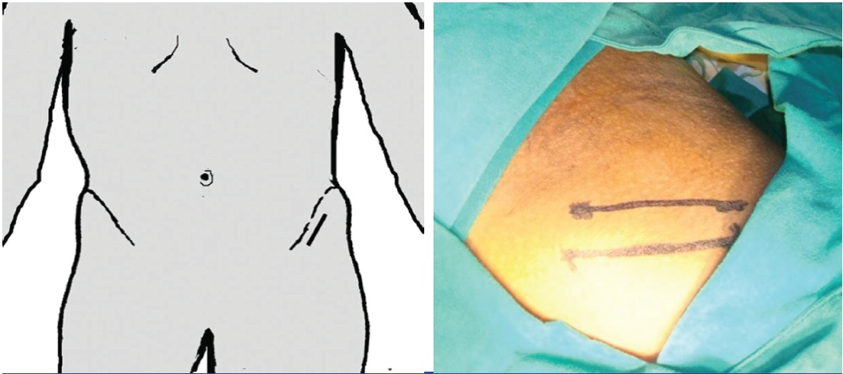
Incision Below and Parallel to Illiac Crest

Slide 10
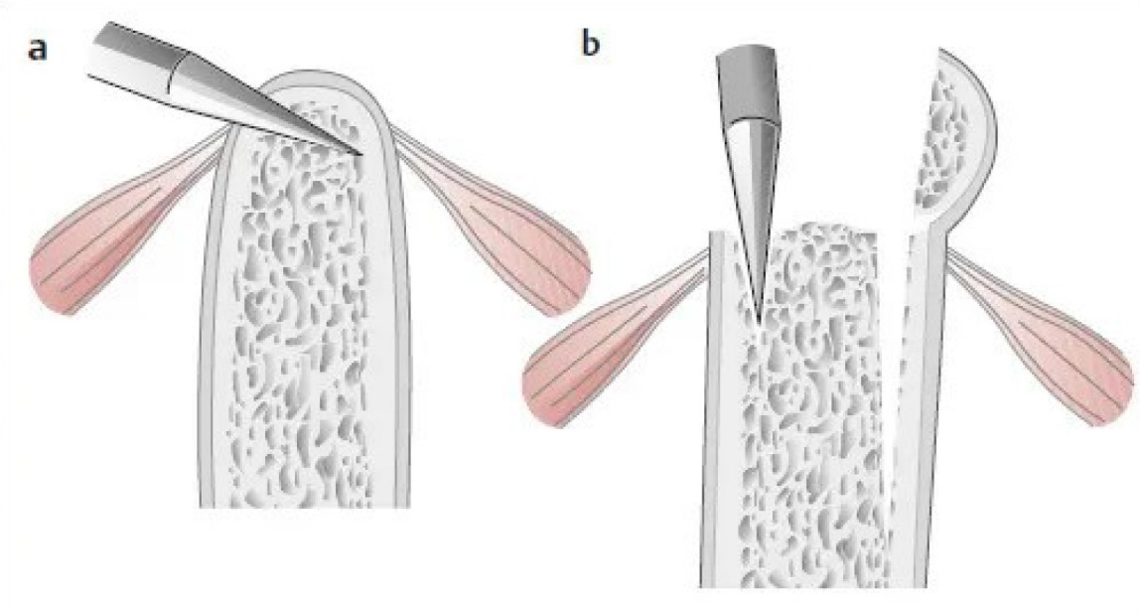
Elevate Illiac Crest, Hinged to Medial Cortex

Slide 11
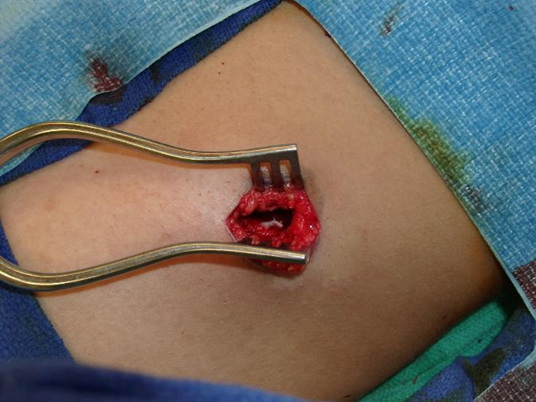
Currette Bone Graft Through Small Incision

Slide 12
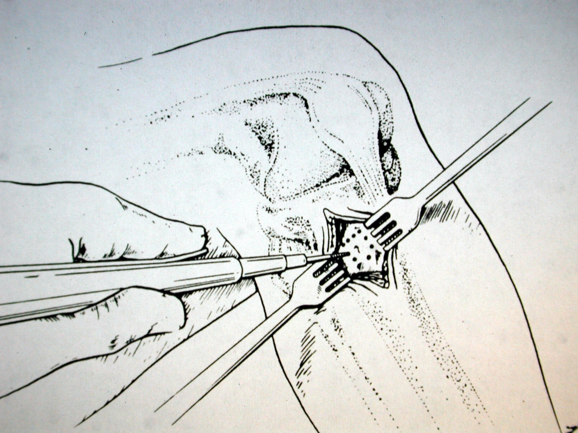
Consider Tibial Plateau in skeletally mature

Slide 13
Tibia Advantages
Primarily cancellous but some cortical bone
Easy surgical procedure
Little post-op pain
Good quantity of bone available
Can be done with 2 teams
Can be done in the office

Slide 14
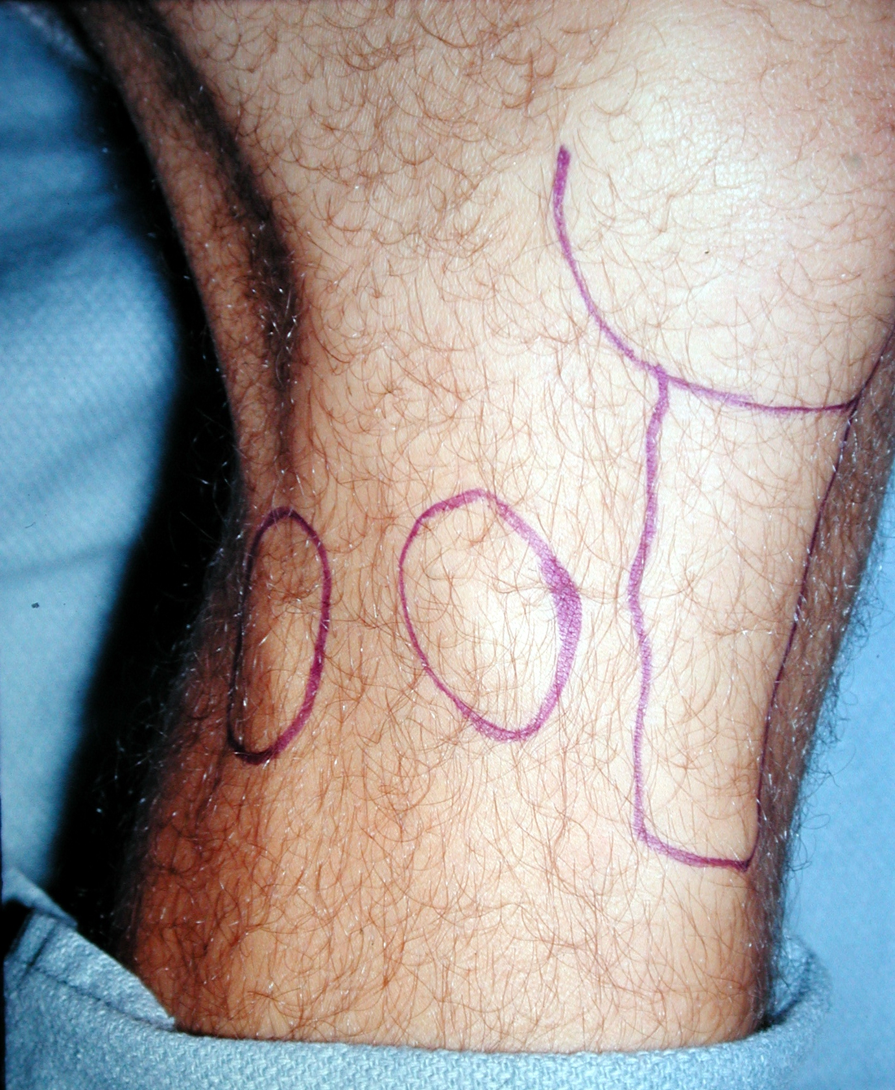
General Landmarks
Patellar ligament is MIDLINE
Fibular head is LATERAL
GERDY’S TUBERCLE…..bony protuberance between above structures

Slide 15
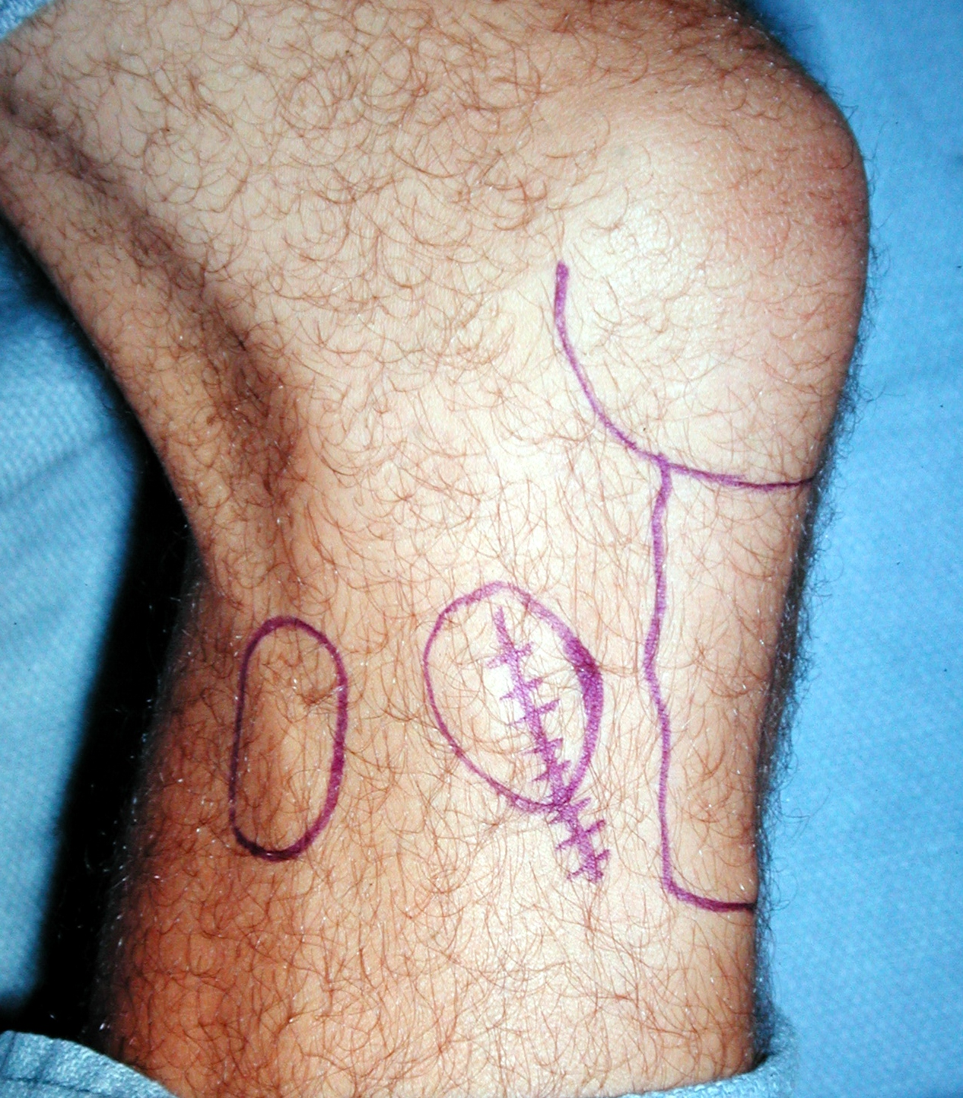
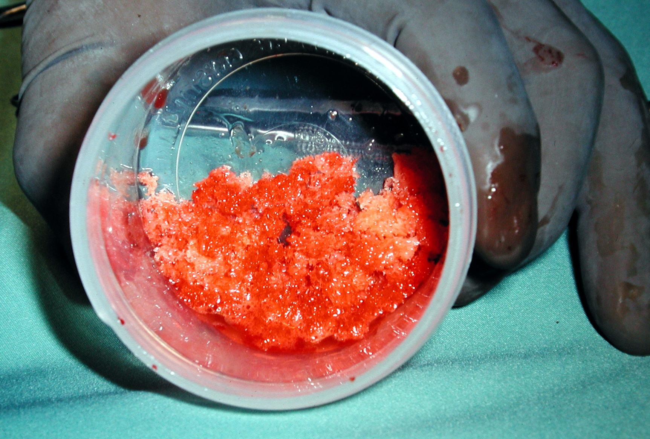
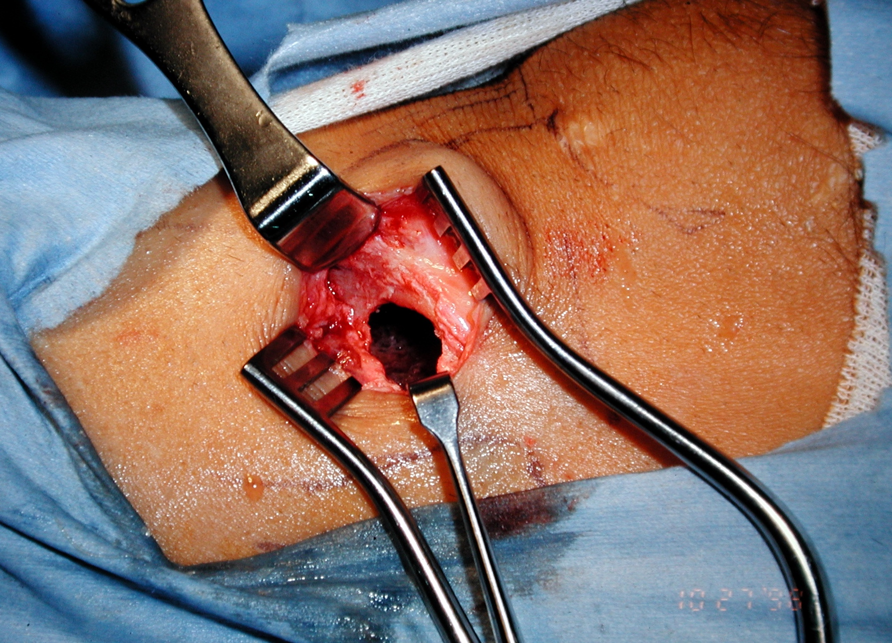
Approach, Curette Harvest

Slide 16
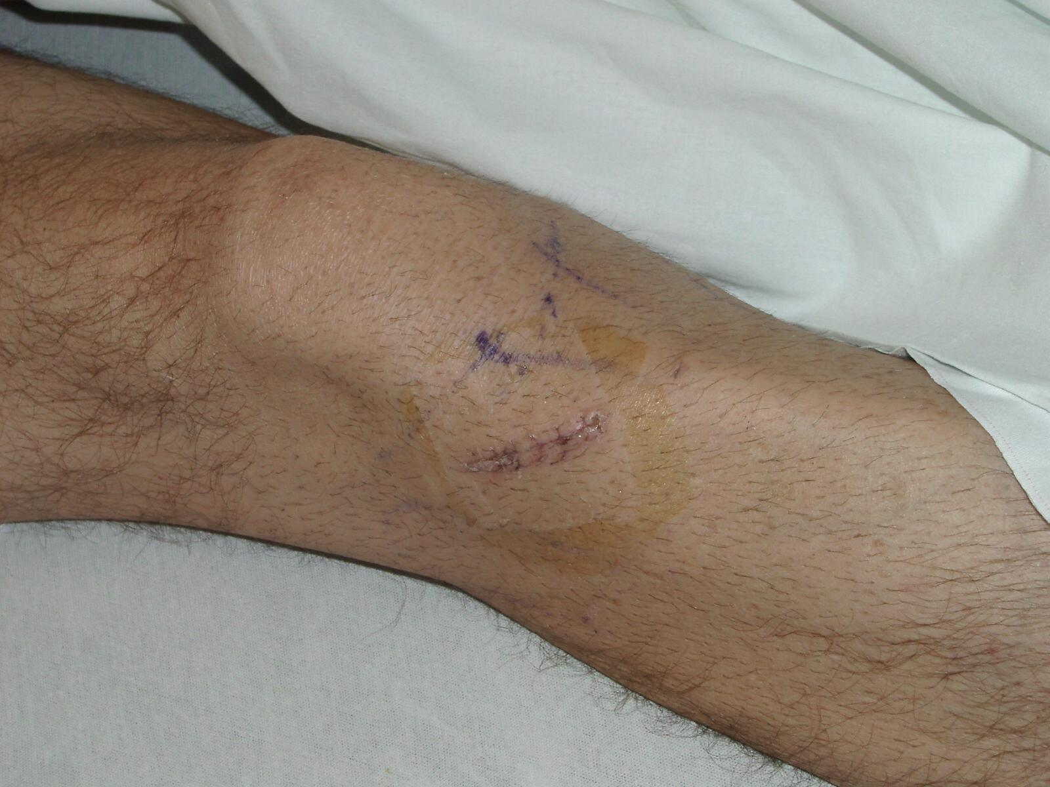
Final Result

Slide 17
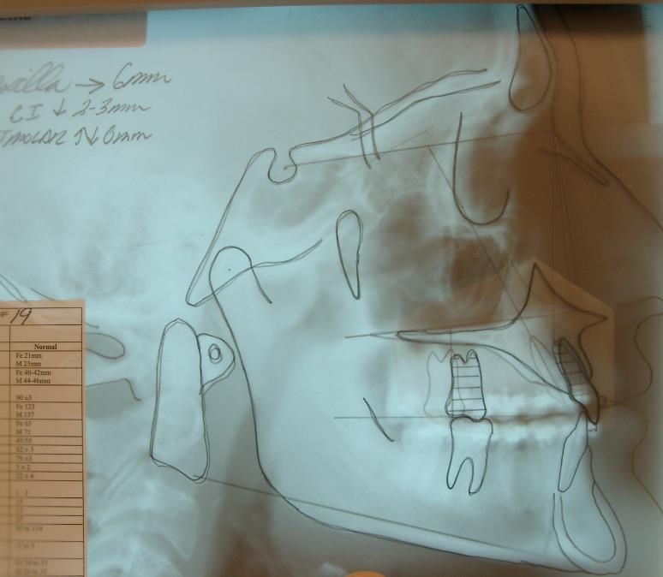
May Require Orthognathic Surgery Later
Final occlusal alignment
Skeletally mature
Usually age 14+

Slide 18
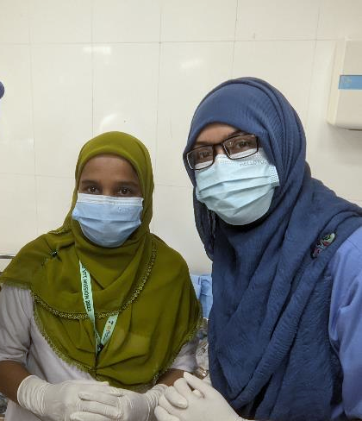
Questions/ comments
Insert picture of local team here

