Slide 1

Alliance FOR Smiles Cleft Speech Education
Identifying Misarticulations Due to Dental (tooth) and Occlusal (arch form) Deviations

Slide 2
Prevention is KEY!
Alliance for Smiles
Educational Trip
Cleft Speech
Cleft Speech discussion for the Team and Family.

Slide 3
Learning objectives
At the end of this session/presentation you will be able to
Assess the impact of dental and occlusal situation on speech
Notes:
Learning objectives should be: Specific, Measurable, Achievable, Relevant, Time-bound (SMART)
DO NOT use the verbs: understand and know (they are not measurable)
USE the sentence: After this learning experience, learner will be able to:
USE these verbs for KNOWLEDGE (mostly for lectures): define, describe, identify, list, outline, recall, reproduce, show, etc.
USE these verbs for SKILLS (mostly for practicals): apply, operate, measure, assemble, construct, design, demonstrate, examine, execute, fix, etc.
USE these verbs for ATTITUDE (mostly for small groups and practicals): accept, appreciate, embrace, relate, resolve, value, etc.
Example lecture: Preoperative planning
Highlight the importance of preoperative planning
Describe various techniques for preoperative planning
Formulate and draw an operative plan
Describe a surgical tactic step by step p (eg, positioning, choice of surgical approach, instruments, reduction technique, implants)
Incorporate patient safety protocols (mark site, time-out check list) in the preoperative plan

Slide 4
Arch Form Deviations
crossbite
(UL or BL/Complete)
lowered palatal vault
protrusive premaxilla
retrusive premaxilla
Lateralization
Lack of space
Compensatory errors of dorso-palatal production
Dentalization of bilabials /p, b, m, w/
Diffuse sibilant production
Restricts tongue’s articulatory space
Interferes with bilabials, labiodentals, and tip alveolars for which the tongue has to “reach back” to accomplish correct placement.
Think Pierre Robin sequence

Slide 5
Dental Deviations
missing teeth
rotated teeth
ectopic teeth
in premaxillary area
diastemas
or edentulous spaces
Frontal lisp.
Oral airflow escape
anterior: distorts sibilant fricatives
anterior: diffuse sibilants; buccal: lateralization of airstream
can cause shift in place and/or distortion of tip alveolars.

Slide 6
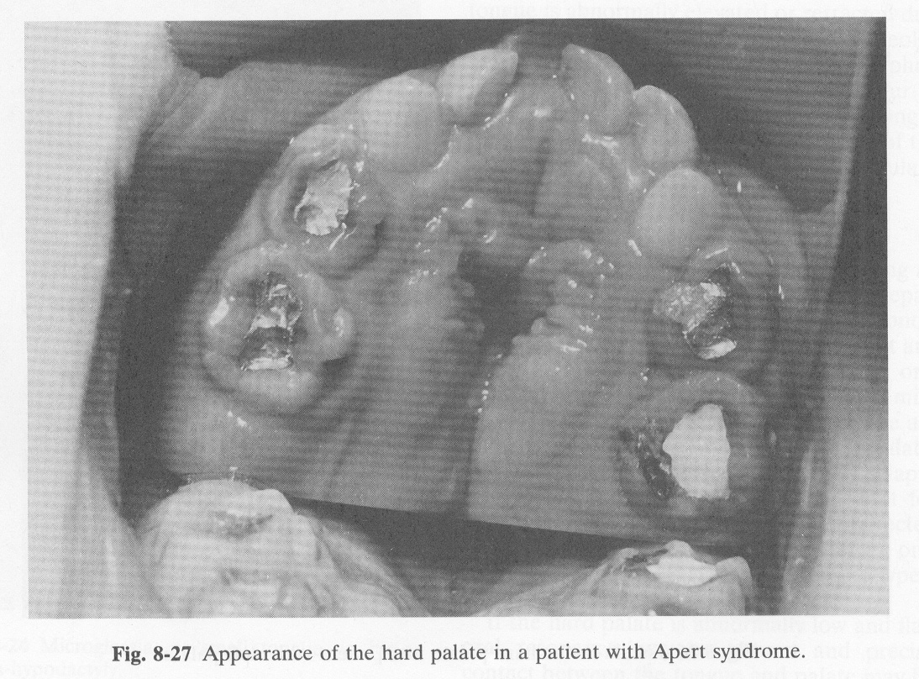
Palatal Morphology

Slide 7
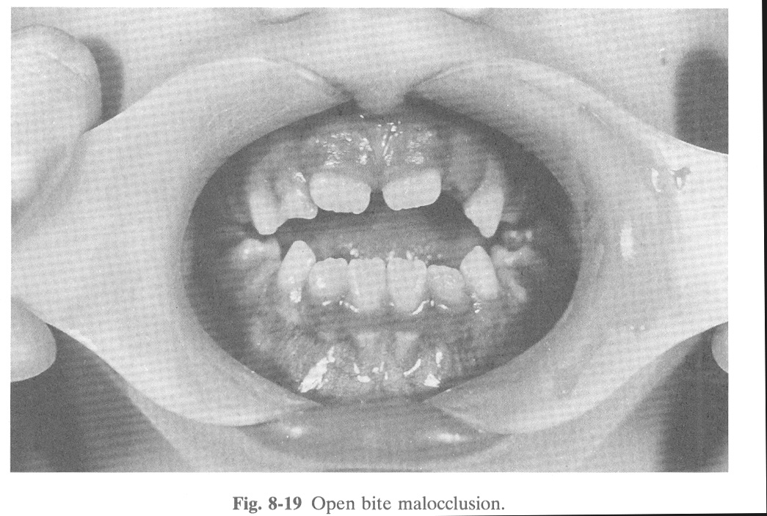
Open Bite
Genetic Factors
Habitual Factors: thumb sucking, tongue thrust
Dental factors: prolonged use of orthodontic appliance; missing teeth
Airway: tonsillar hypertrophy may push tongue forward

Slide 8
Alliance for Smiles Cleft Speech Education

