Slide 1
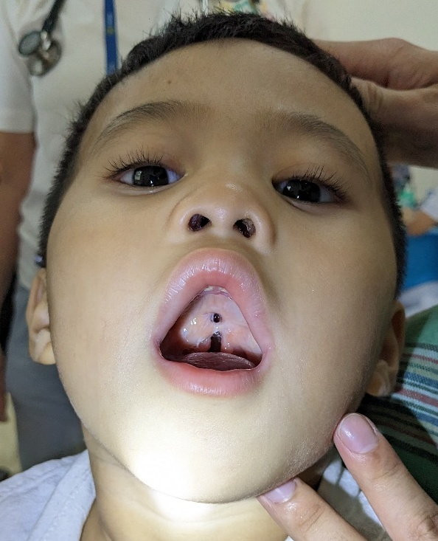

Treatment of Palatal Fistula
Dr. Surgeon, M.D.
Plastic and Reconstructive Surgery

Slide 2
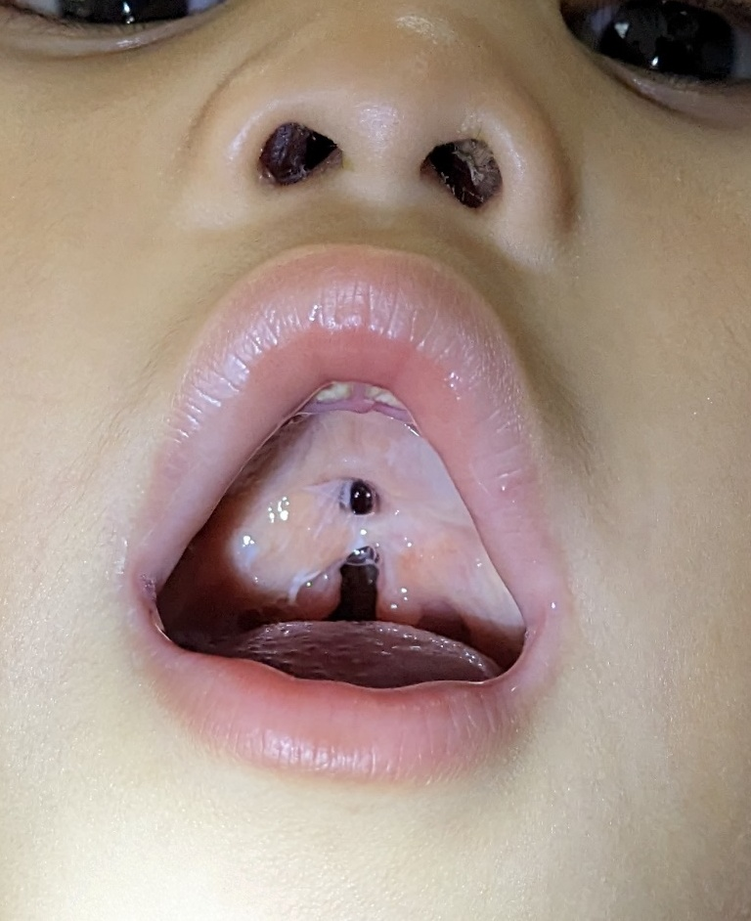
Palatoplasty Fistula Rates
Despite advances, fistula rates similar
Incidence reported 0-63% *
Most large series 10-25%
* Emory, R.E., Clay, R. P., Bite, U., et al. Fistula formation and repair after palatal closure: an institutional perspective. Plast. Reconstr. Surg. 99:1535, 1997.

Slide 3
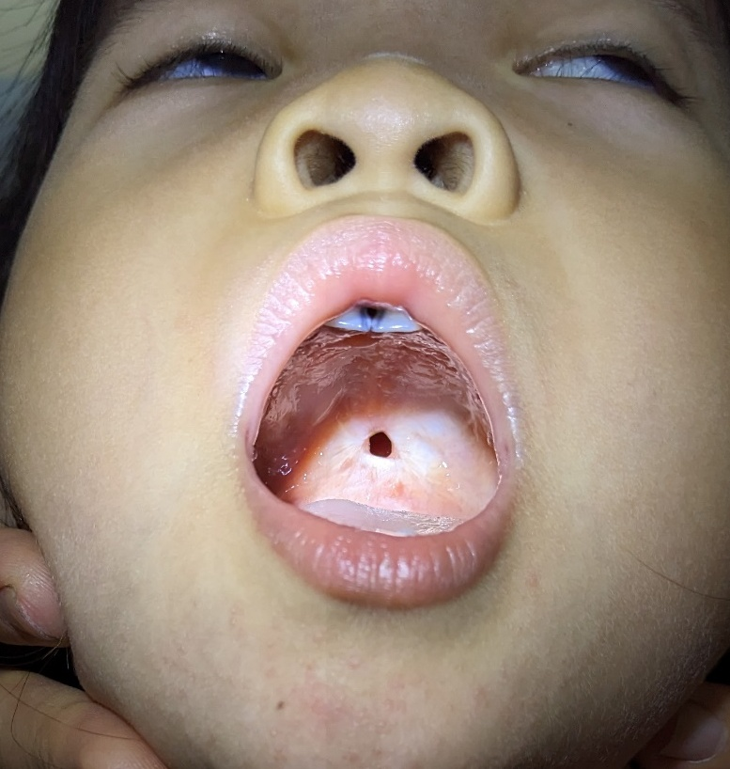
Location
Most commonly hard palate/ soft palate junction *
Two layer closure area
Tension
  Relaxing incisions
  Hamulus fracture?
  Pedicle dissection
* Musgrave, R.H., Bremner J.C. Complications of cleft palate surgery. Plast. Reconstr. Surg. 26:180, 1960.
Notes:
Hamulus fracture was common at one time, becoming less common as not clear there is benefit

Slide 4
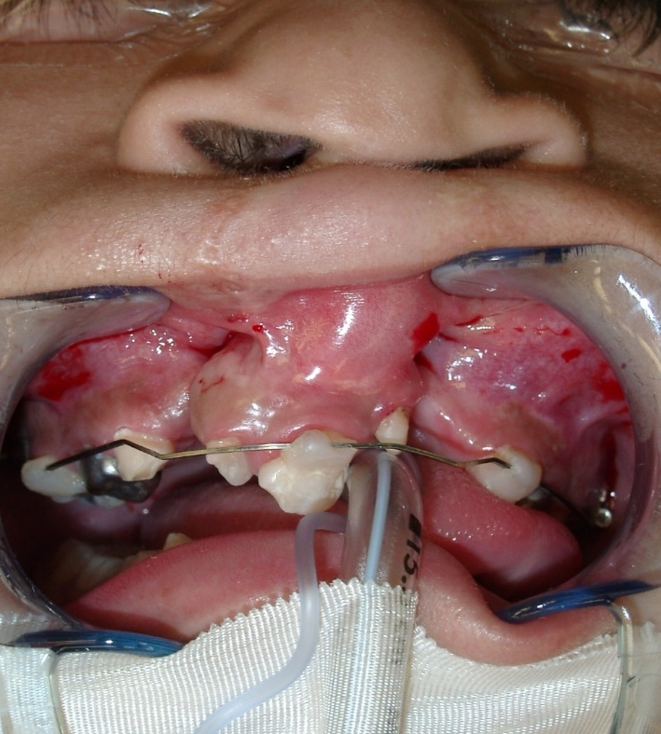
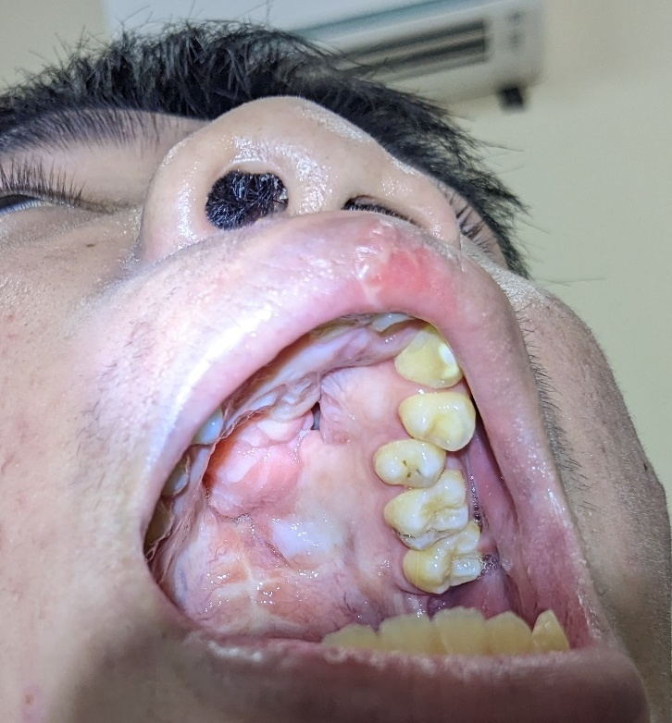
Other fistula locations
Alveolus
Premaxilla- maxilla (incisive foramen)
Notes:
Alveolar fistula in left picture, Premaxilla- maxilla fistula on right

Slide 5
Fistula Predictors:
Fistula CL/P vs CP alone
Meta analysis, 9294 pts, 44 studies
Incidence 8.6% overall
CL/P 17.9%
CP alone 5.4%
Fistula Incidence after Primary Cleft Palate Repair: A Systematic Review of the Literature Hardwicke, Joseph T.; Landini, Gabriel; Richard, Bruce M.
Plastic and Reconstructive Surgery. 134(4):618e-627e, October 2014.

Slide 6
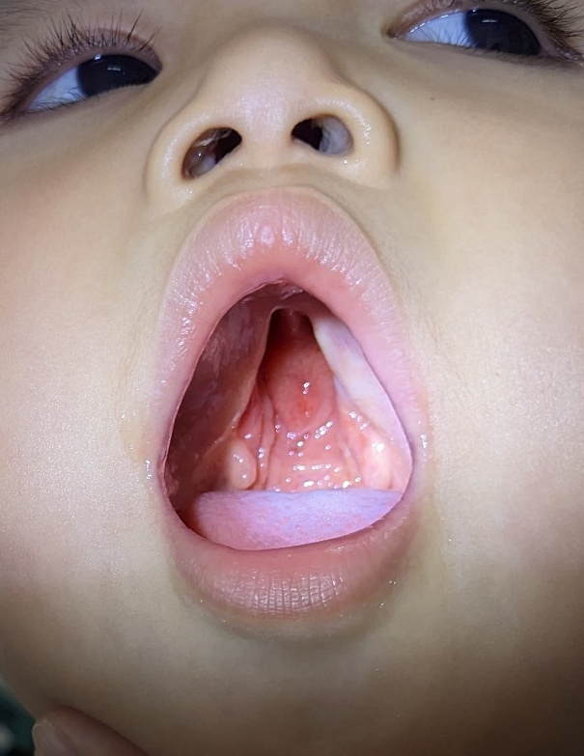
Fistula Predictors
Width/ type of cleft *
  4.6% incomplete
  7.7% complete unilateral
  12.5% complete bilateral
Type of repair
  346 patients with 21% rate overall
  Von Langenbeck higher than Wardill- Killner #
* Musgrave, R.H., Bremner J.C. Complications of cleft palate surgery. Plast. Reconstr. Surg. 26:180, 1960.
# Amaratunga, N.A. Occurrence of oronasal fistulas in operated cleft palate patients. J. Oral Maxillofac. Surg. 46:834, 1988.

Slide 7
Fistula rate in Furlow Palatoplasty
Reported from 4.1-10% *,#,%
Fistula rate higher in syndromic vs. non syndromic patients %
* LaRossa, D., Jackson, O.H., Kirshner, R.E., et al. The Children’s hospital of Philadelphia modification of the Furlow double-opposing z-palatoplasty: long term speech and growth results. Clin. Plast. Surg. 31:243, 2004.
# Cohen, S.R., Kalinowski J., LaRossa D., et al. Cleft palate fistulas: A multivariate statistical analysis of prevalence etiology and surgical management. Plast. Reconstr. Surg. 87:1041, 1991.
% Bresnick, S., Walker, J., Clarke-Sheehan, N., et al. Increased fistula risk following palatoplasty in Treacher Collins syndrome. Cleft Palate Craniofacial J. 40: 280, 2003.

Slide 8
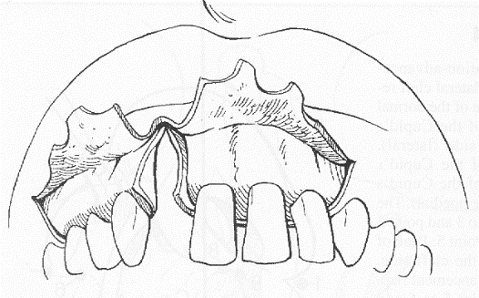
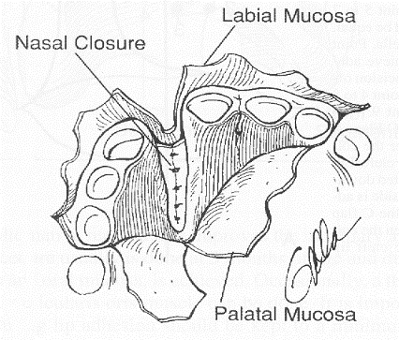
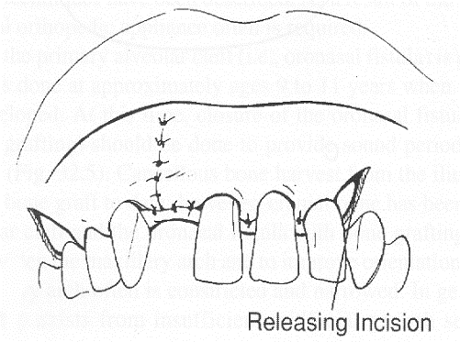
Alveolar Fistula Exposure

Slide 9
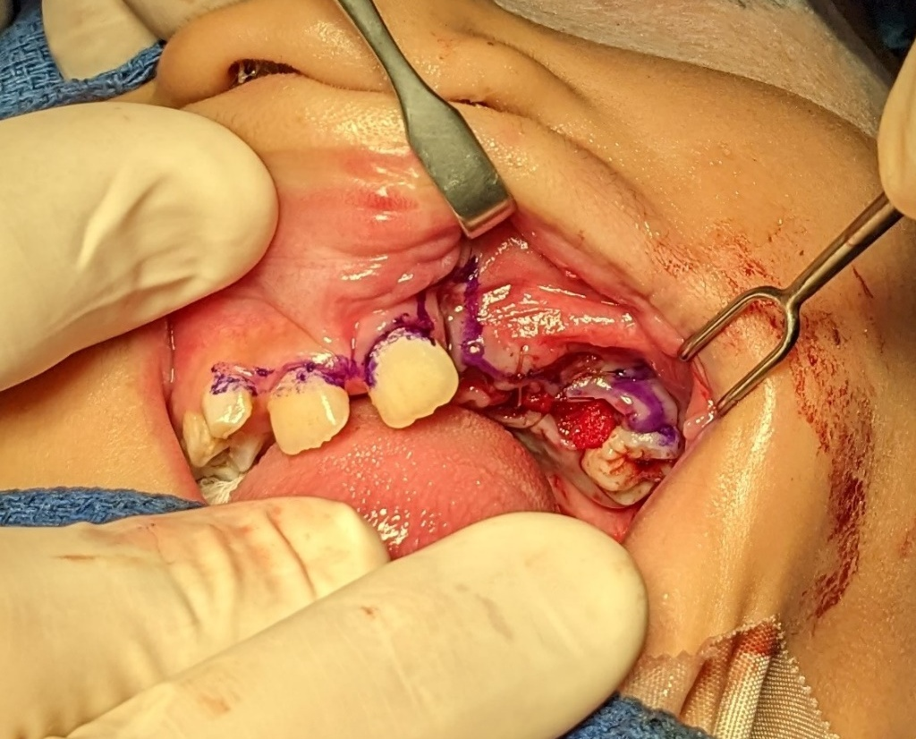
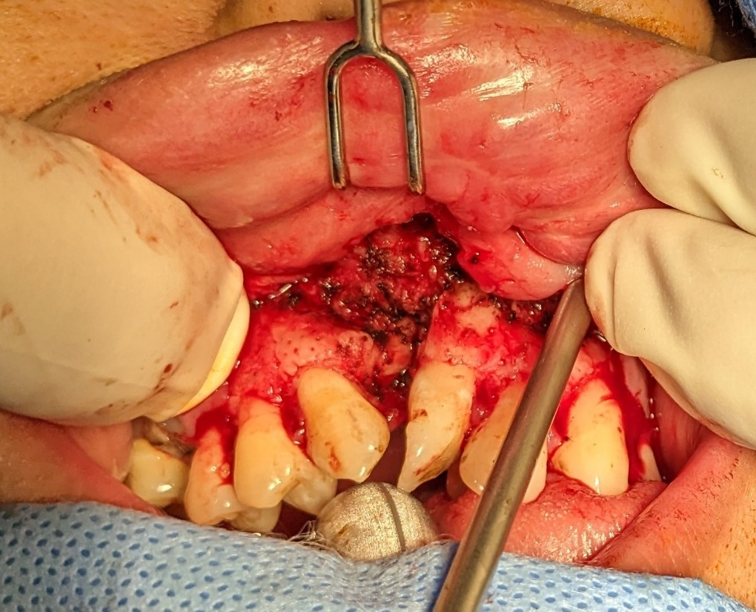
Notes:
Markings shown on left, exposure on right. Note: these are not the same patient

Slide 10
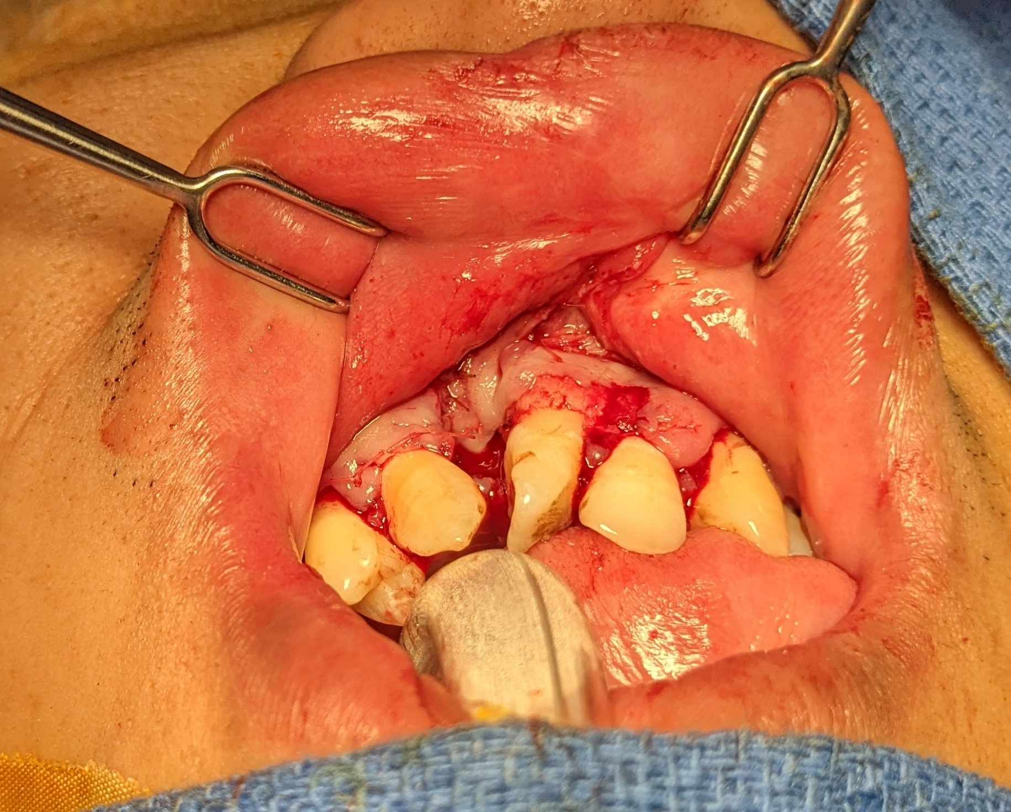
Notes:
Closure of the patient shown on right in previous slide

Slide 11
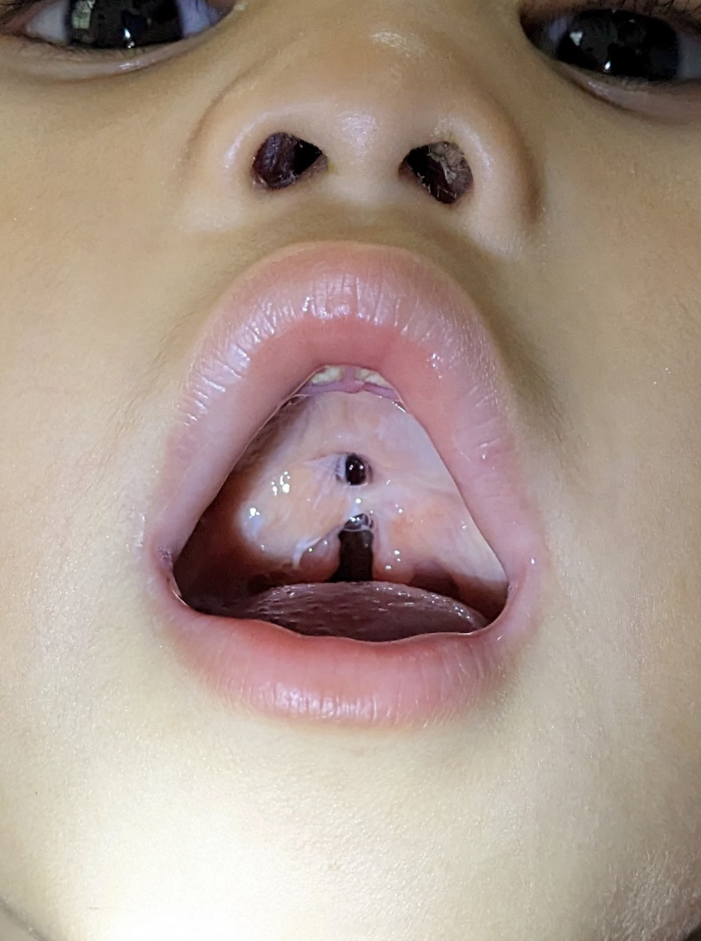
Uncomplicated Fistula
Revision palate repair
Wide release
Turn over flaps for nasal lining

Slide 12
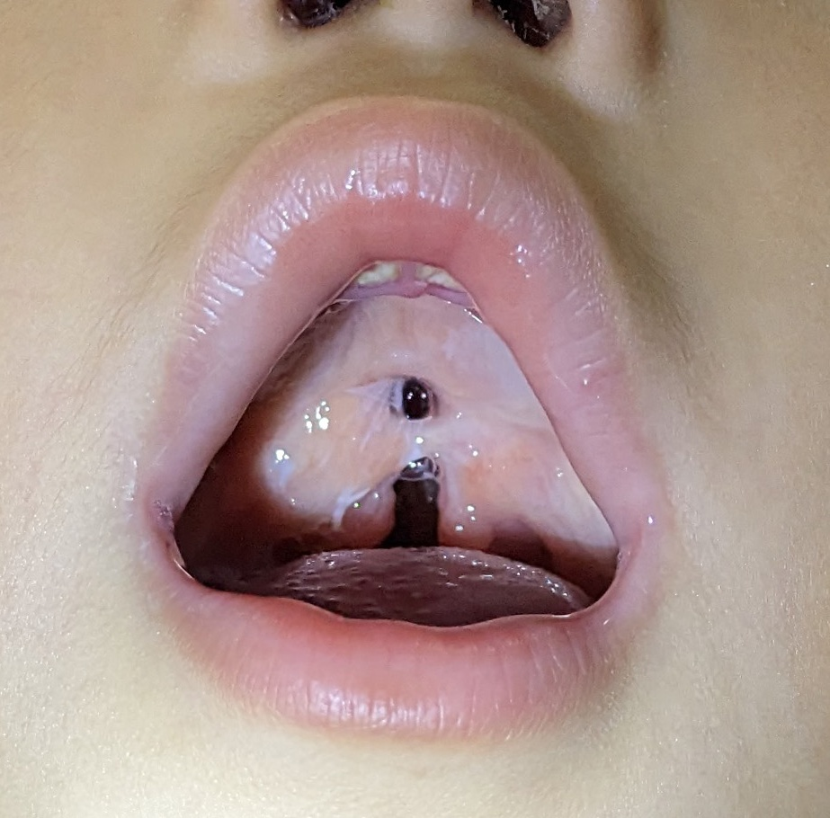
Notes:
Describe turn over flaps in central fistula. In this repair the entire palate was revised in order to get a reasonable muscle repair centrally. See next slide

Slide 13
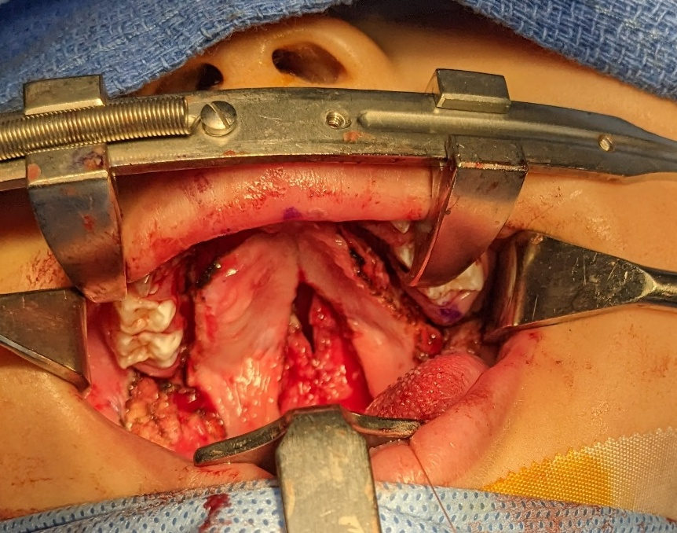

Slide 14
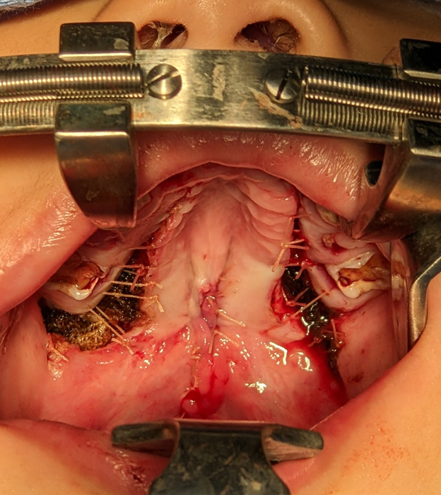

Slide 15
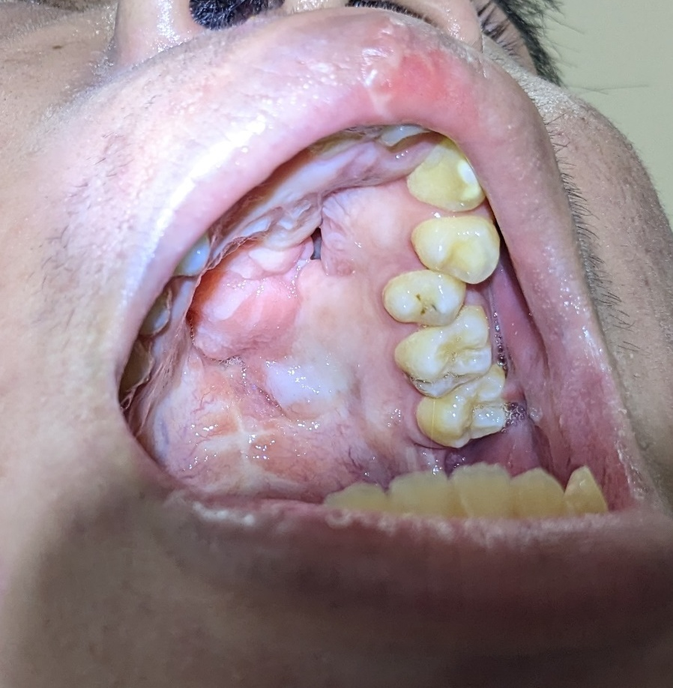
Complicated Fistula
Prior failed repair
Scarring
Wide
Multiple fistula
Notes:
Consider Interpositional Tissue Grafting, Buccal Fat Pad grafting, Tongue Flap or Pharyngeal Flap in complicated cases.

Slide 16
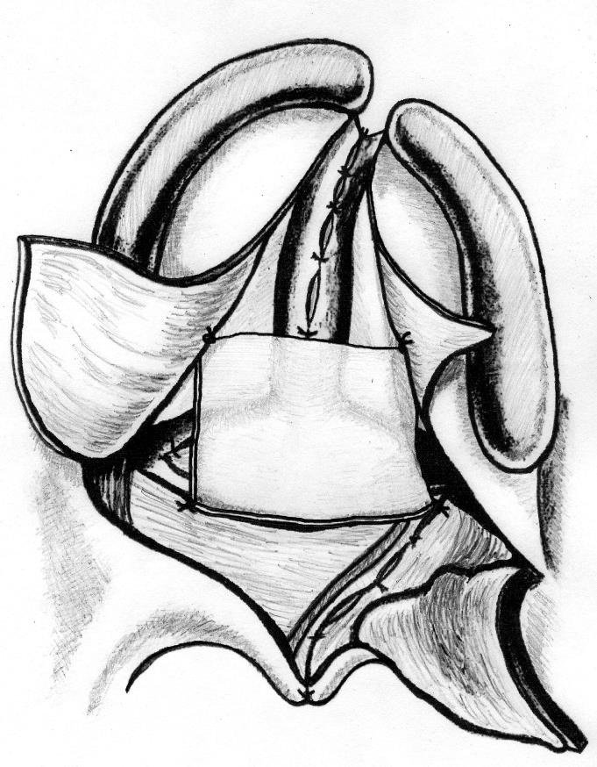
Interpositional graft: Decellularized Dermis
Notes:
Interpositional grafting can be done with decellularized dermis or temporalis fascia. This is for complex fistulas and prior failed revision cases with poor tissue laxity or quality. This article is for primary repairs, but technique applies to revisions (fistula) as well.

Slide 17
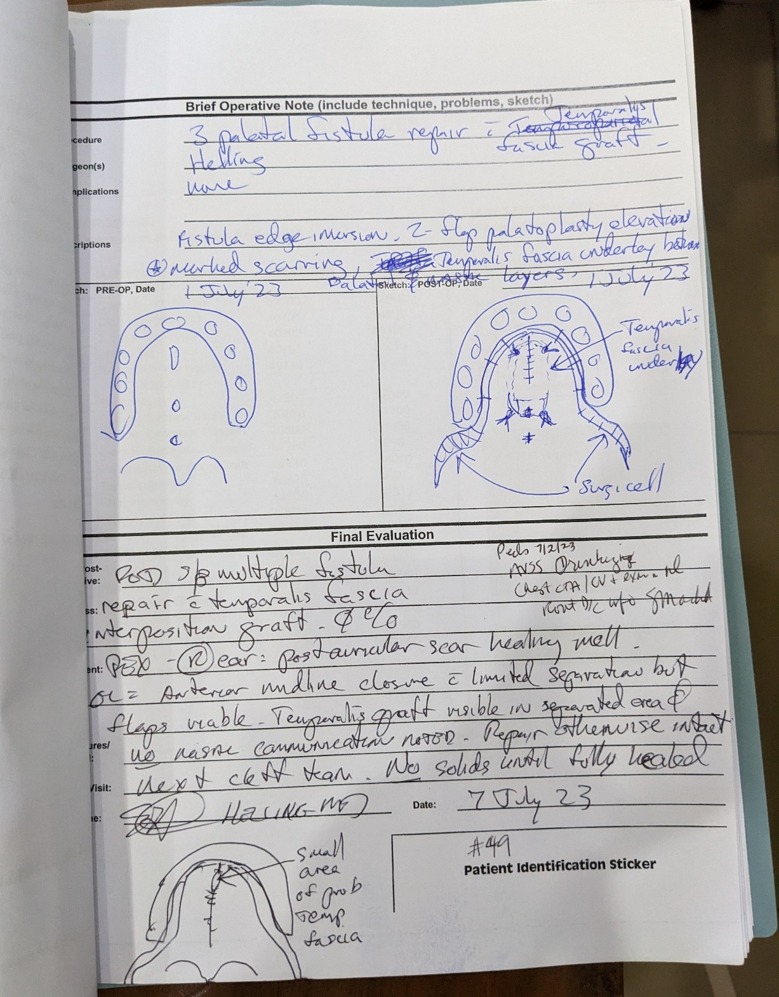
Notes:
Medical record showing placement of temporalis fascia in multiple fistula patient

Slide 18
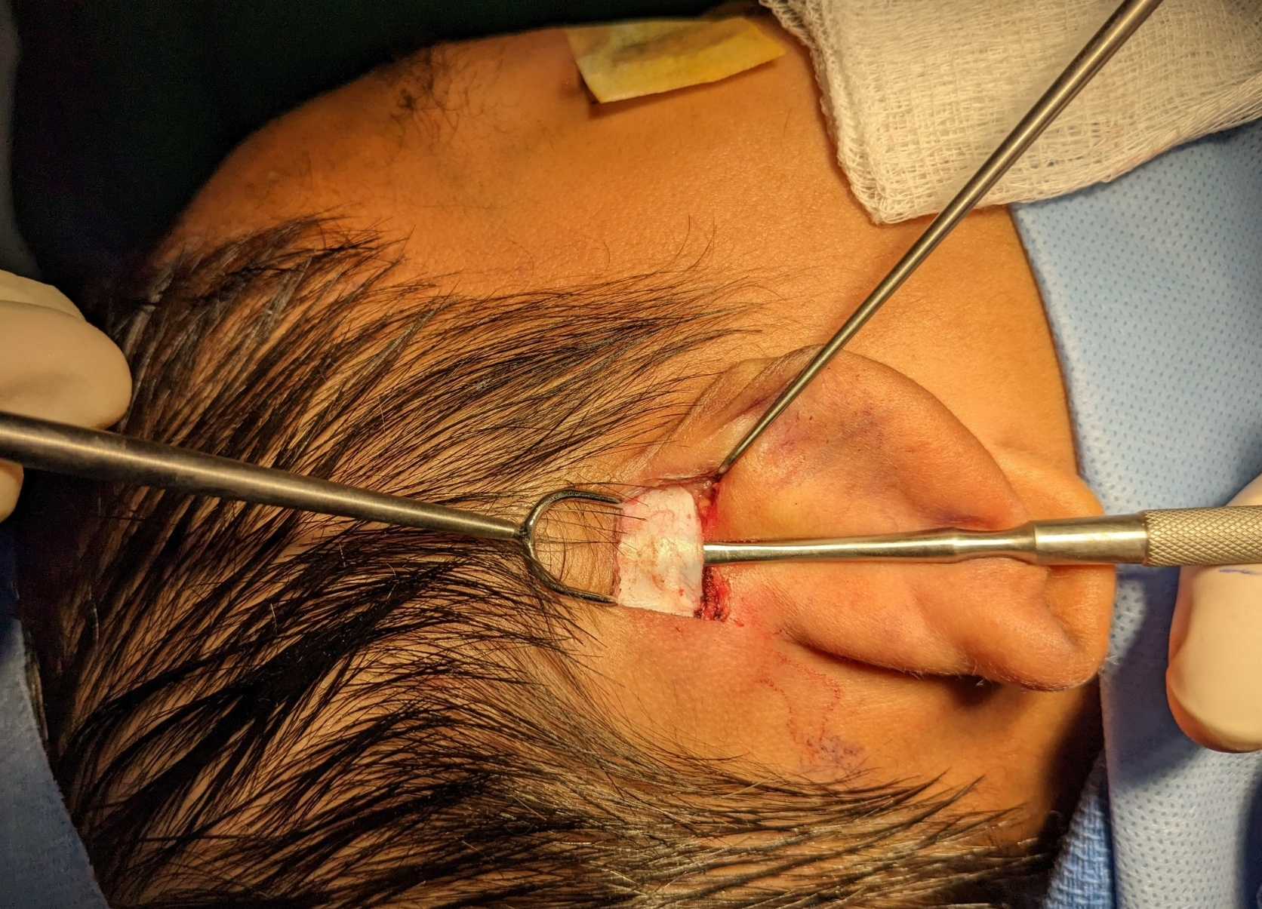
Temporalis fascia barrier
Notes:
Temporalis fascia harvest. Off the shelf decellularized dermis (Alloderm or similar) could be used to avoid harvest site but has additional cost

Slide 19
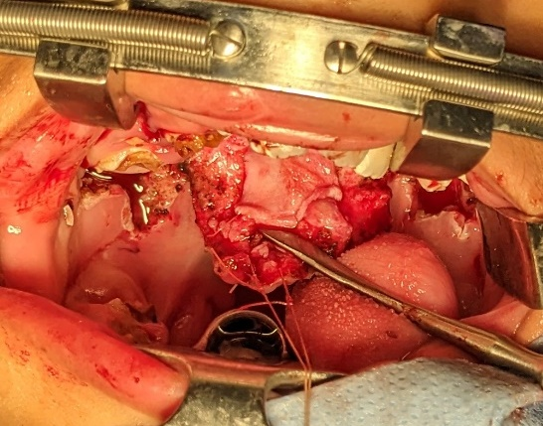
Notes:
Fascia anchored to superior aspect of repaired palatal flaps. Palate flaps have not yet been sutured to alveolus.

Slide 20
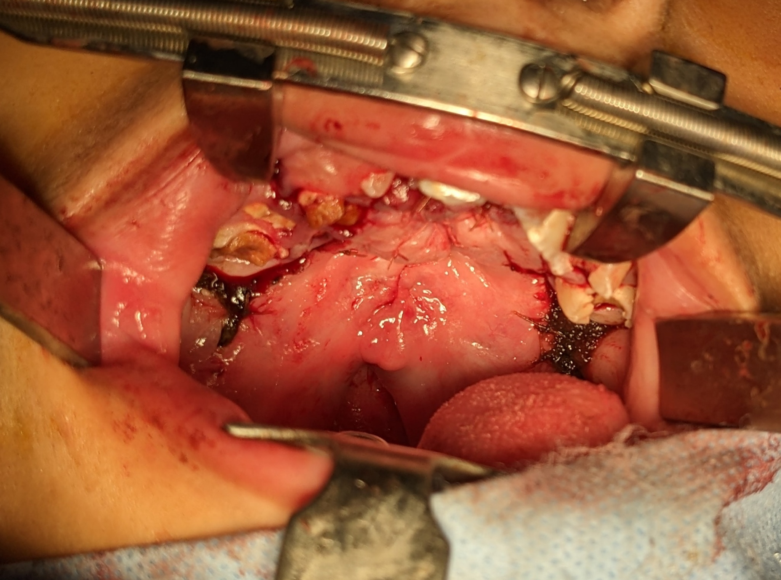
Notes:
Palatal flaps now sutured in place, temporalis fascia is between hard palate mucosa and palatal bony shelves

Slide 21
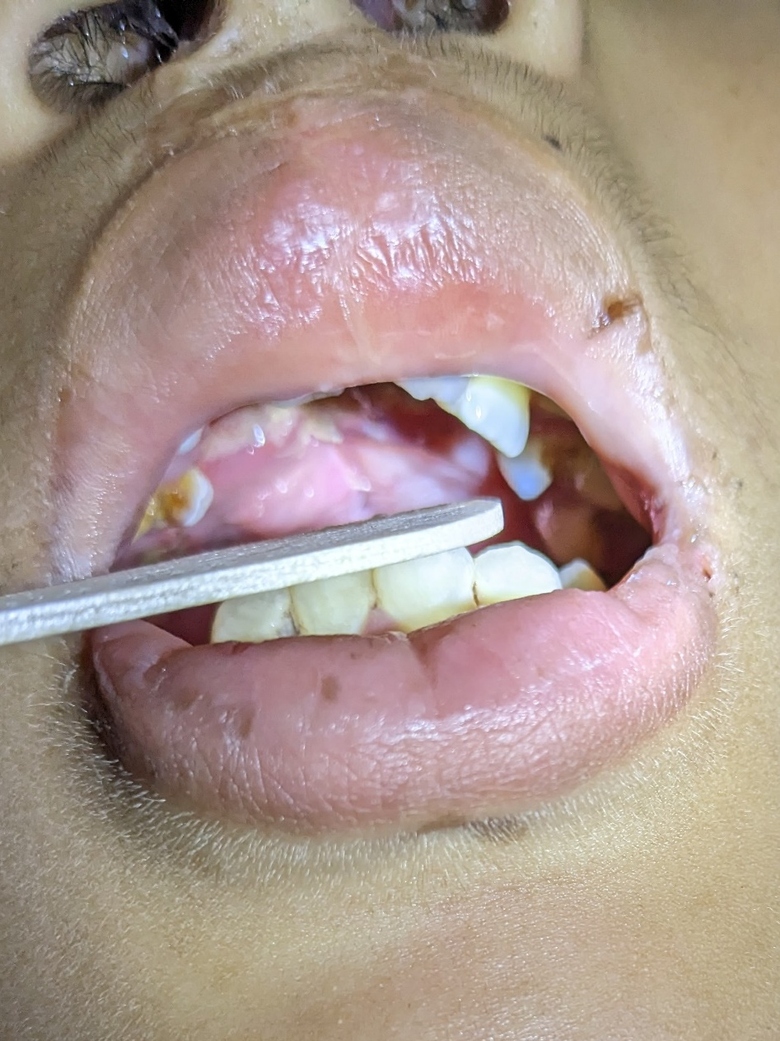
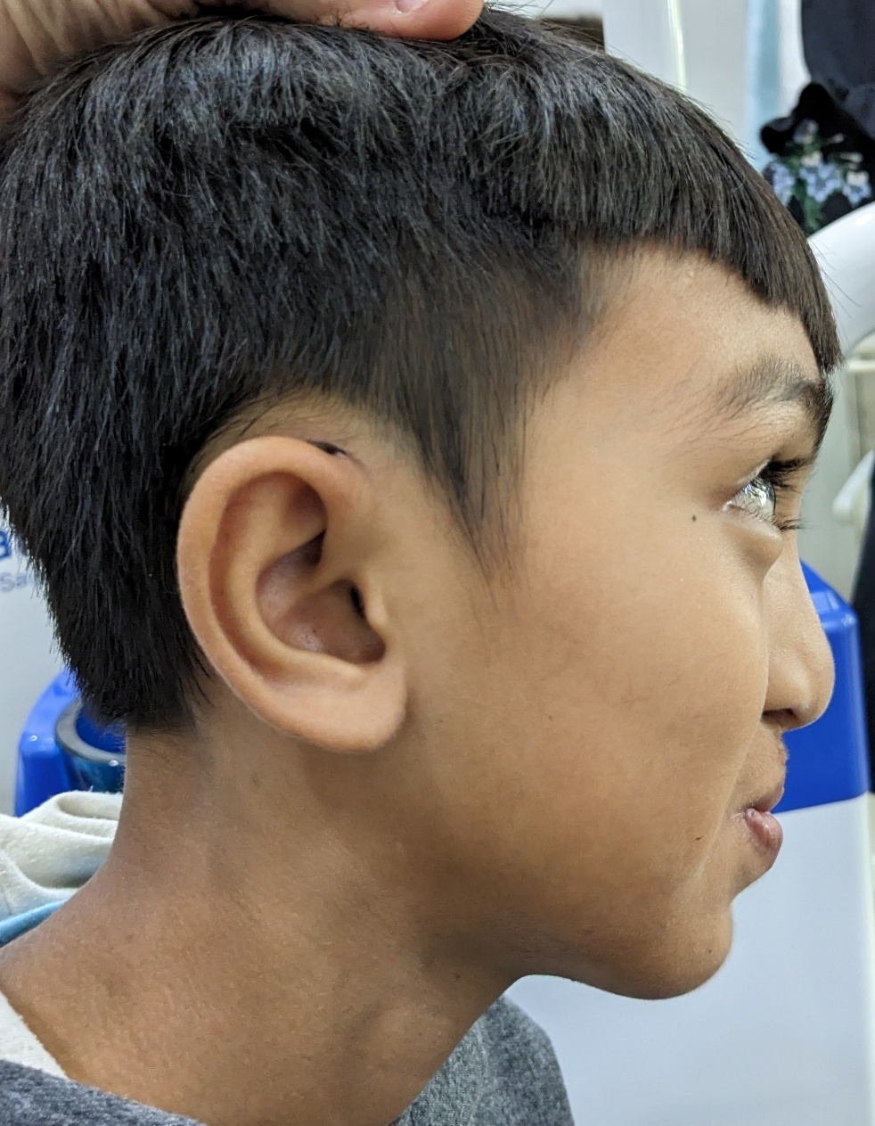
Notes:
One week post op. No apparent fistula. R superior helical harvest site healing well.

Slide 22
Buccal fat pad grafting
Meta analysis of 23 studies
57.4% used fat in lateral relaxing incisions
30.1% in hard/soft palate mucosal defects
Fistula rate 2.8%
No fistulas in fistula repair cases
*** level of evidence low***
Buccal Fat Pad in Primary and Secondary Cleft Palate Repair: A Systematic Review of the Literature Carolina Romero-Narvaez 1, Lawrence O Lin 2, Richard E Kirschner 1 Cleft Palate Craniofac J 2023 Oct 18

Slide 23
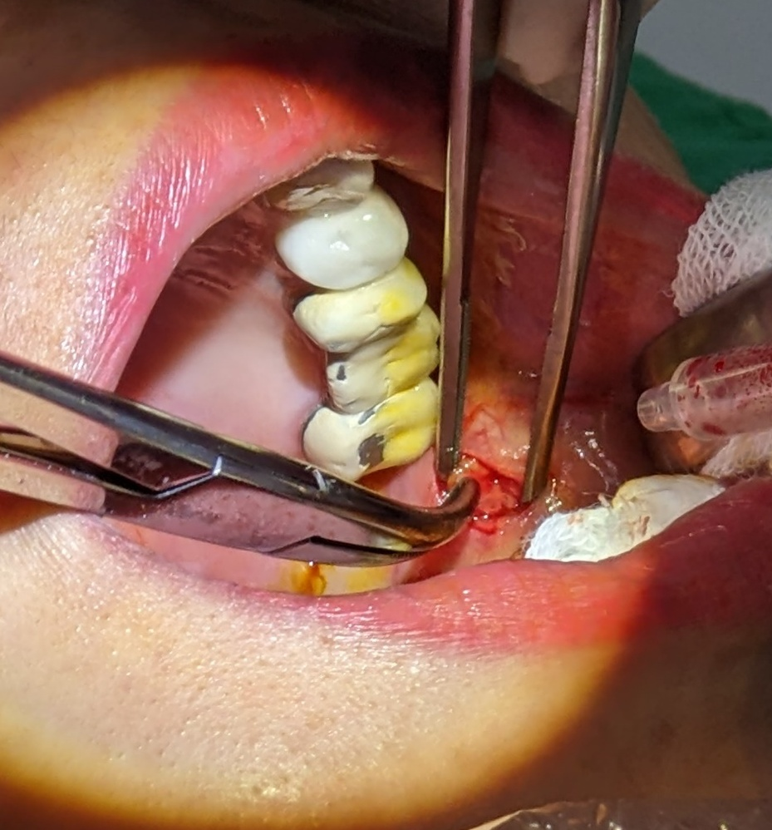
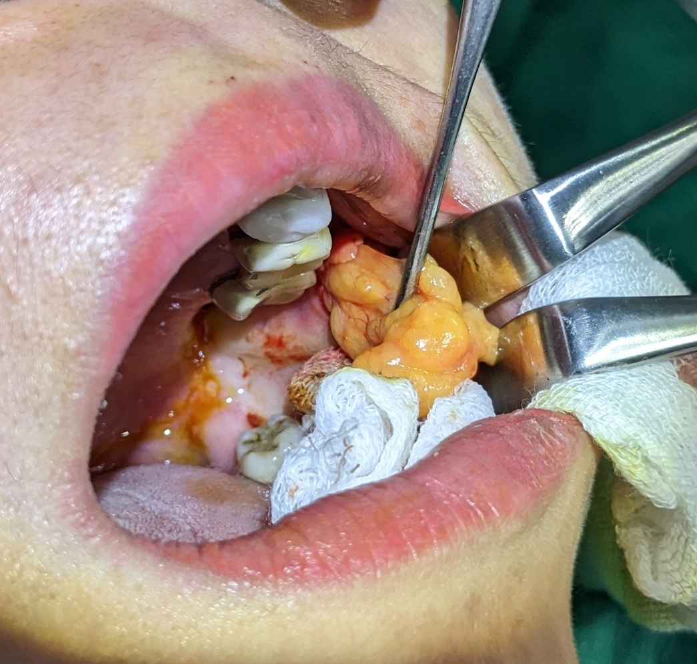
Notes:
This is not a cleft patient, but fat harvest is similar. Fat taken from lateral relaxing incision and draped on nasal aspect of closure to sandwich between oral closure and palatal shelves.

Slide 24
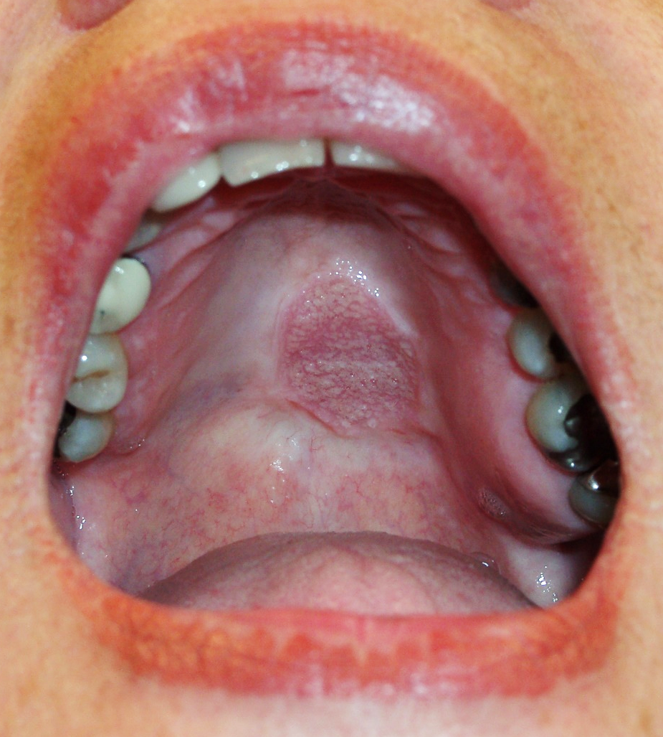
Tongue flap
Two stage procedure
Considered best option for wide fistula
Notes:
This is the gold standard for very large fistulas that have failed repair. May not be a good choice on mission as it requires take down in 2-3 weeks.

Slide 25
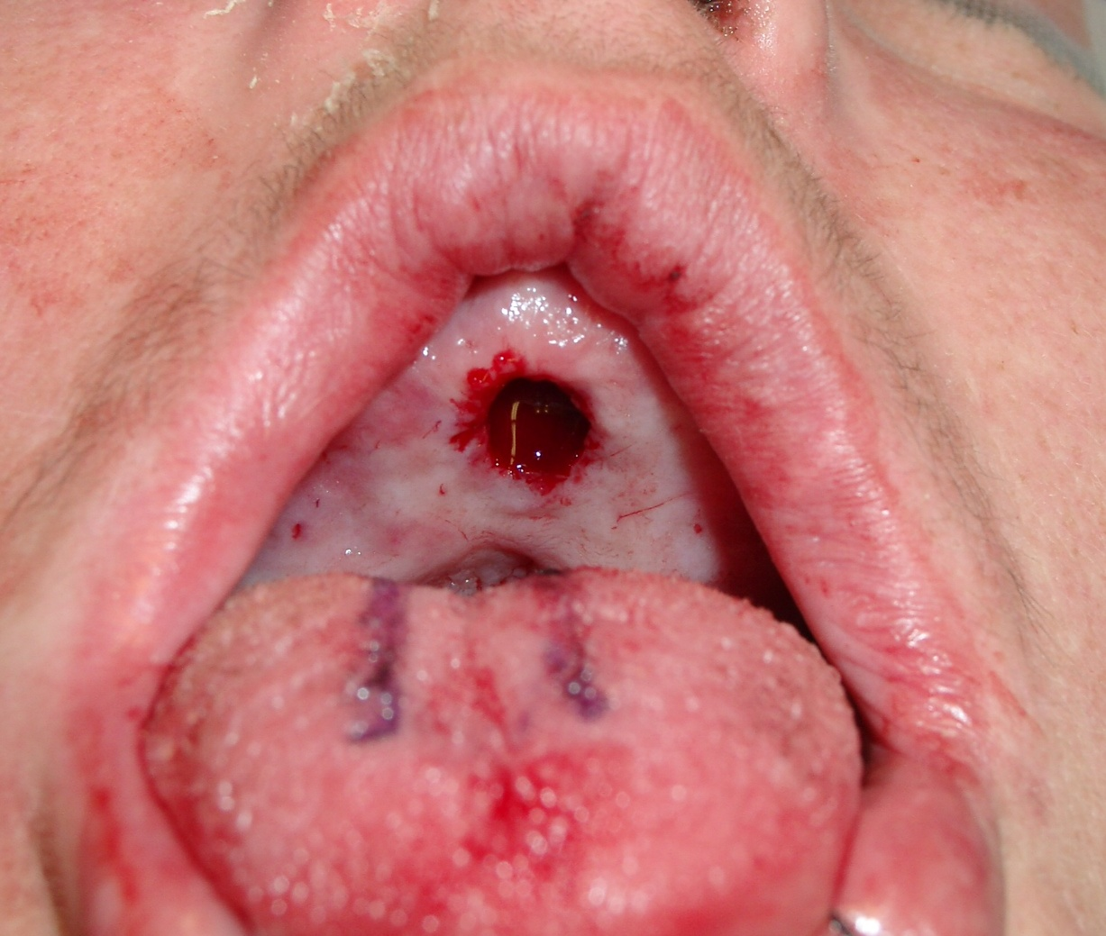

Slide 26
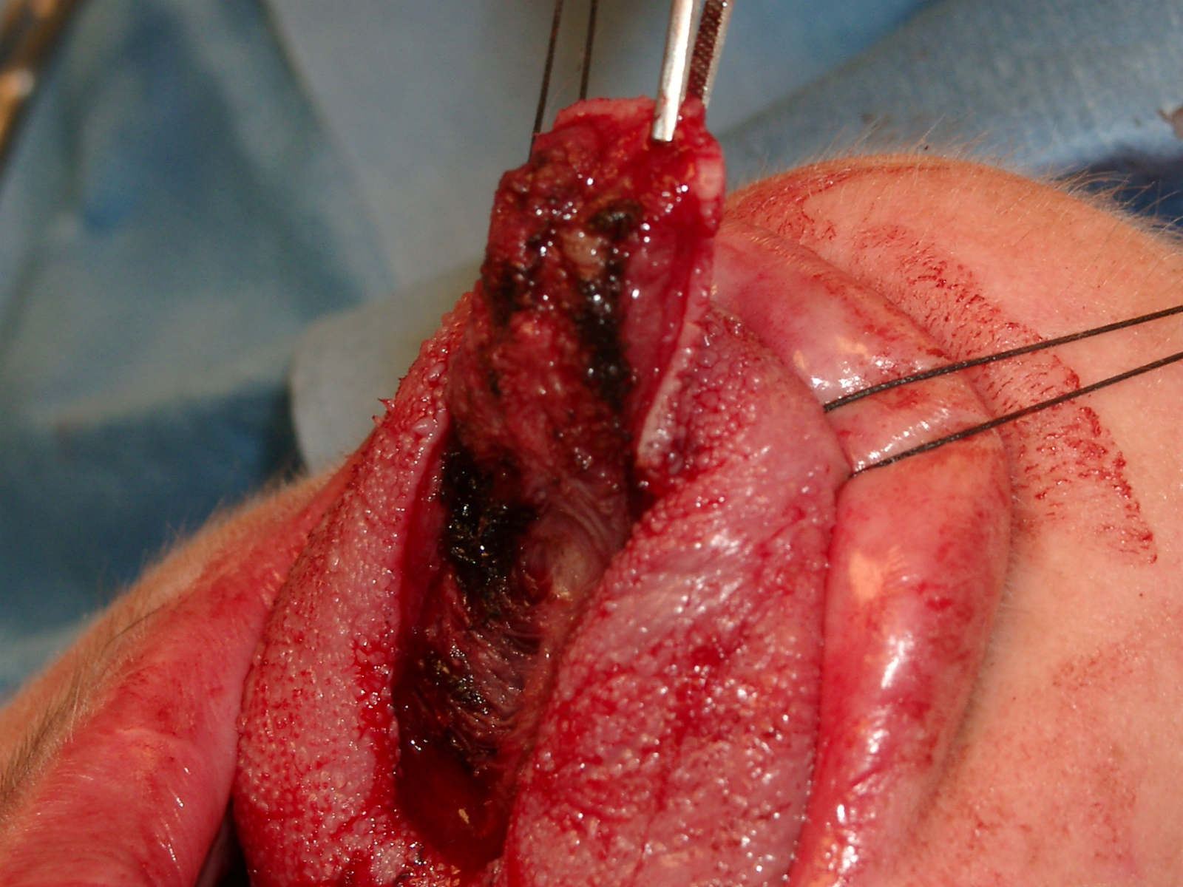
Notes:
Anterior based tongue flap is most common. In rare cases flap can be posteriorly based if fistula is very far posterior. It is also reasonable to use a pharyngeal flap in that case.

Slide 27
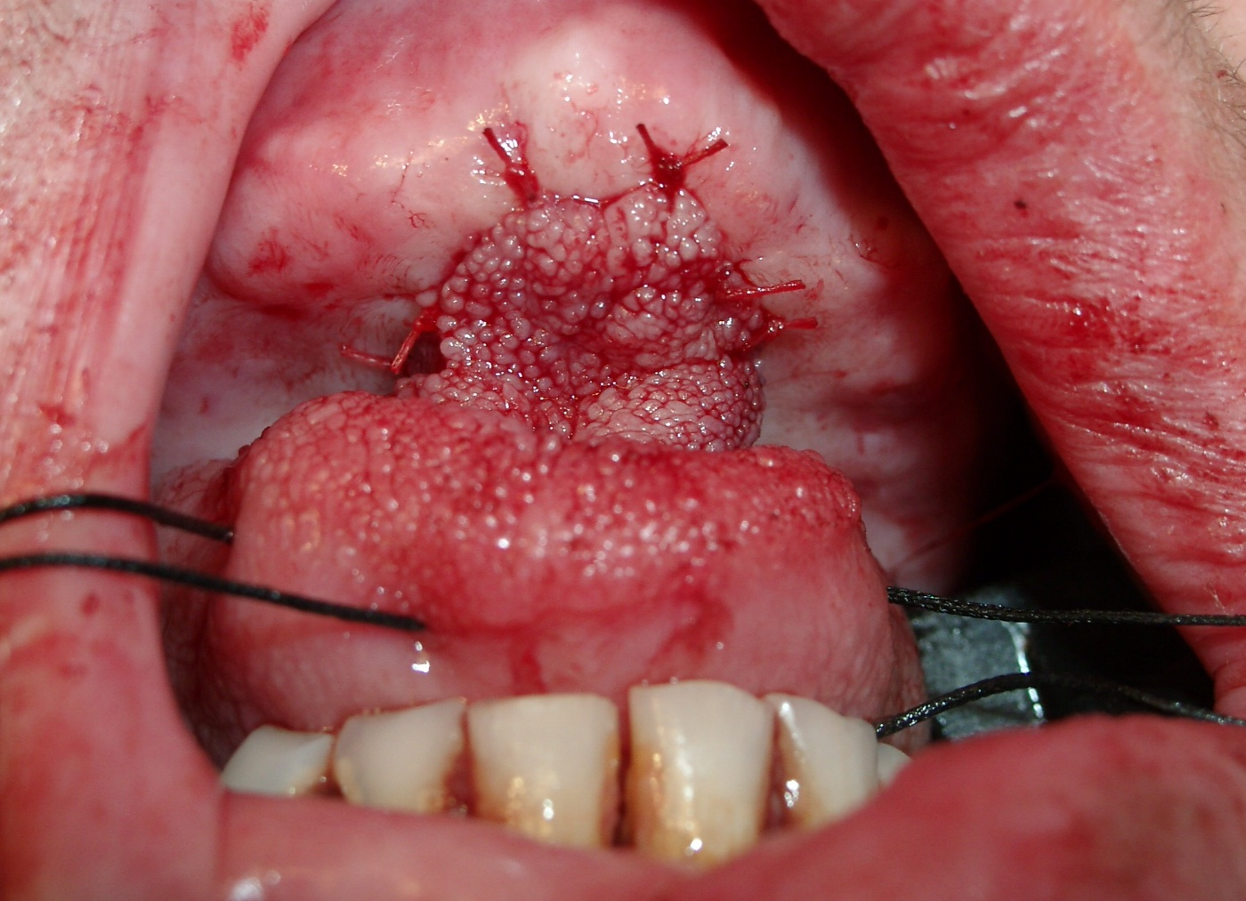

Slide 28
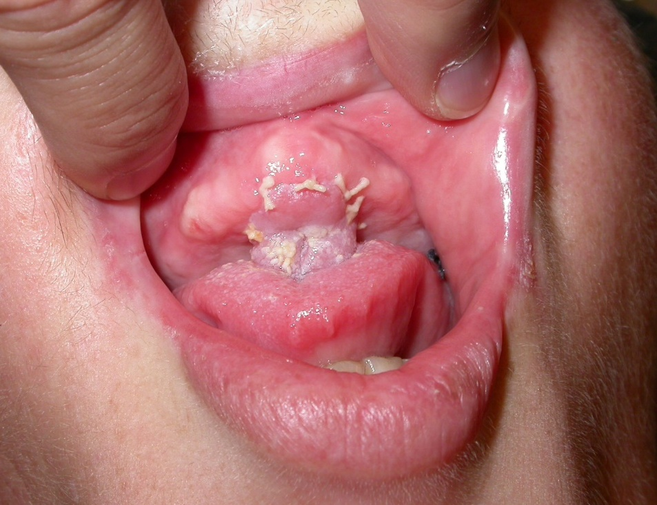

Slide 29
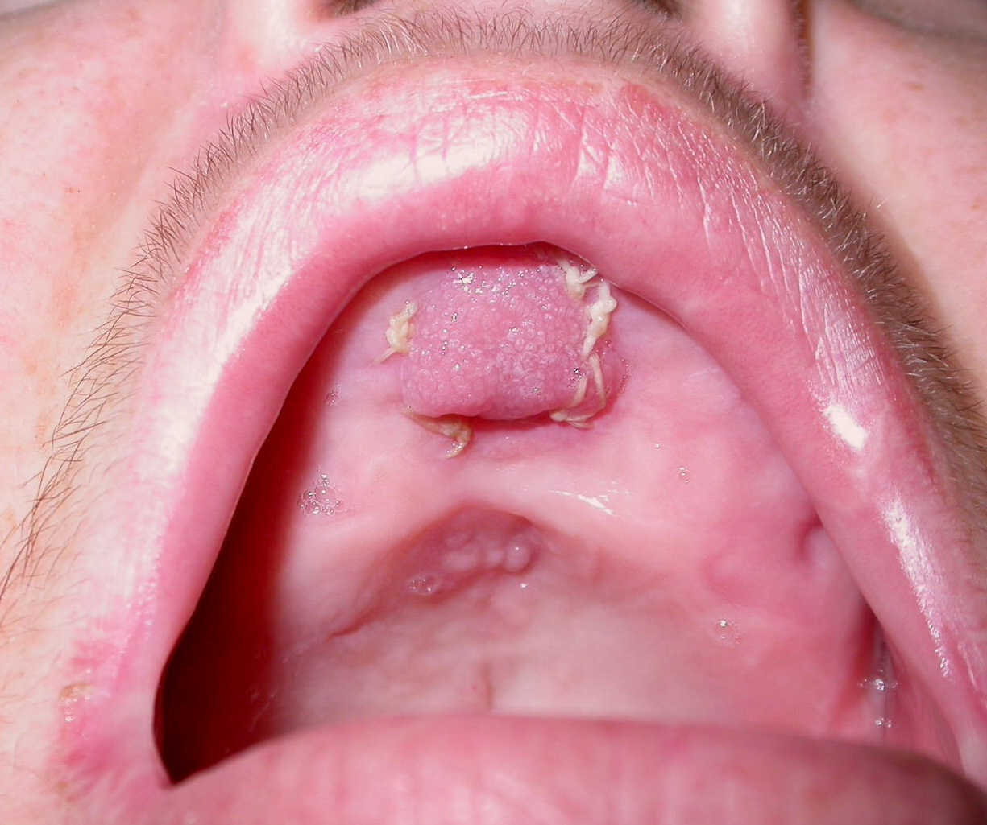

Slide 30
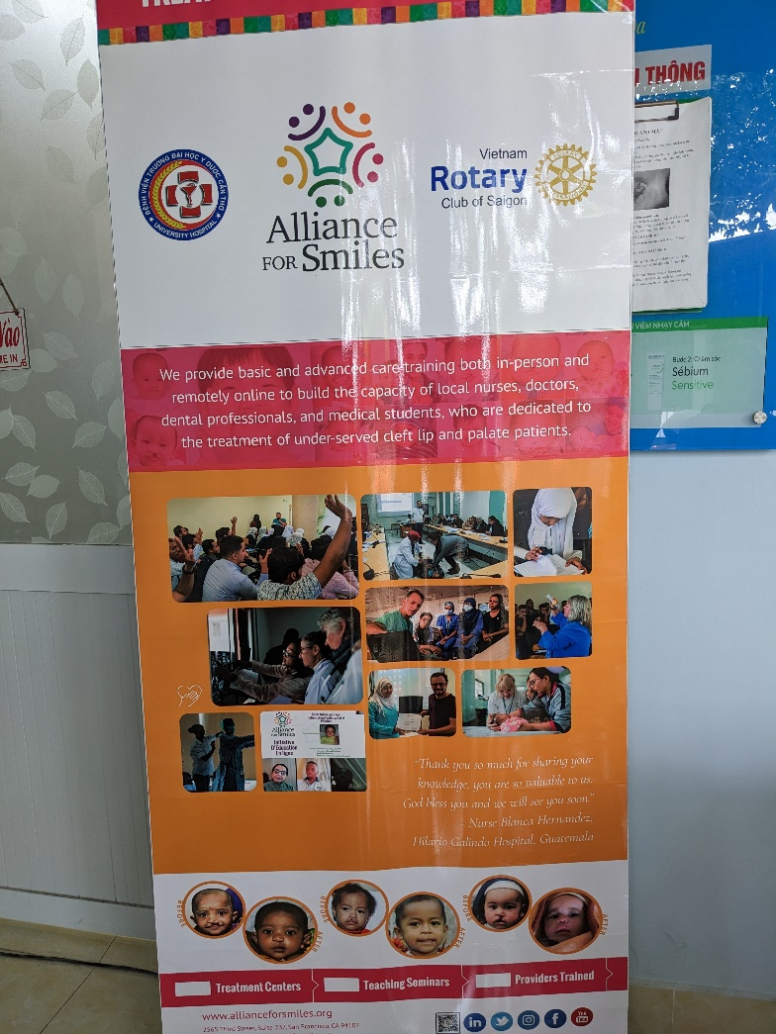
Summary
Palatal fistula common
Initial and small fistula
  Standard revision with turnover flaps
Large/scarred/revision
  Interposition graft
  Fat graft
  Tongue flap
  Pharyngeal flap
  Prosthesis
Notes:
Prosthesis not shown in lecture. A simple denture can act as an obturator, particularly for hard palate fistulas. Does not work well in growing patients as will need upsizing frequently.

Slide 31
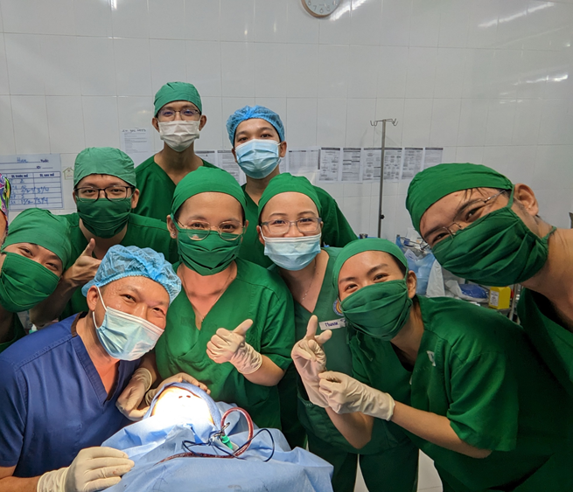
Questions/ comments
Notes:
Vietnamese surgical team from Can Tho. Insert picture of choice.

