Slide 1
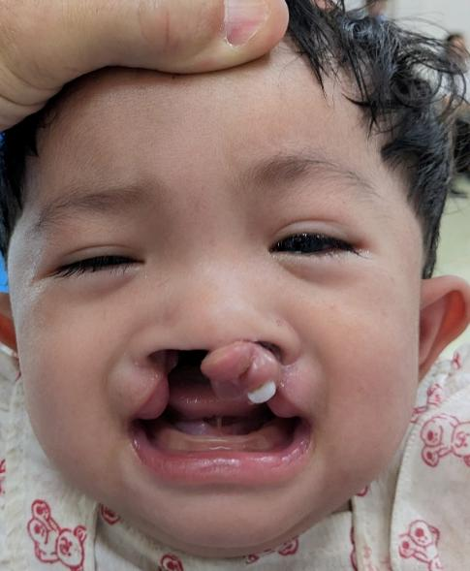
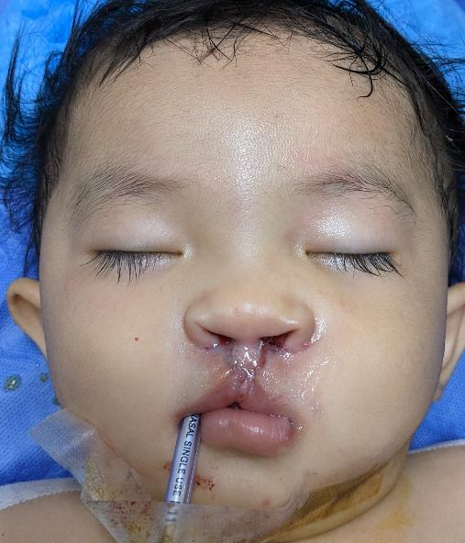

Surgical Treatment of Cleft Lip and Palate
Dr. Surgeon, M.D.
Plastic and Reconstructive Surgery
Notes:
Insert your own name and change pictures as desired through out talk.

Slide 2
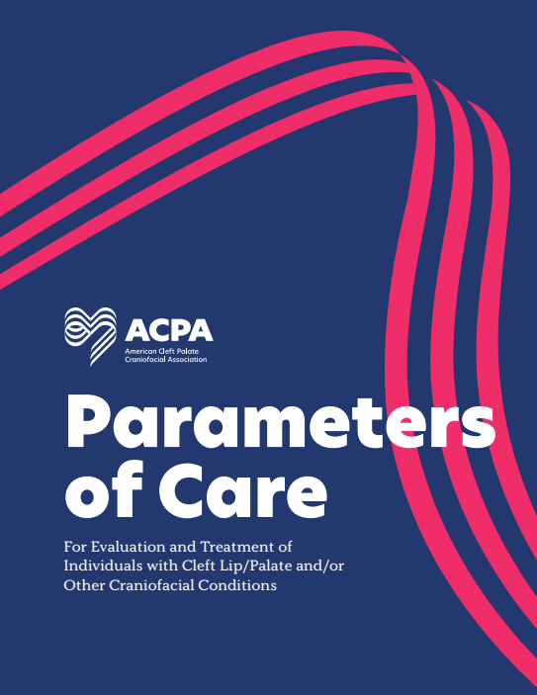
Overview
Common ACPA treatment sequence
Cleft team makeup
Associated issues

Slide 3
Cleft management- timing
Prenatal- Ultrasound identification, education (intrauterine surgery?)
Birth-3 months- feeding, education, OAE, identification of syndrome
Tongue adhesion if airway issues
3 months- primary lip repair (role of lip adhesion?), usually BMT
8-12 months- primary palate repair, speech therapy, audiologic evaluation
Notes:
This follows the generally accepted ACPA treatment sequence. OAE: Otoacoustic emission testing for hearing.

Slide 4
Cleft management- timing
1-5 years- Speech, Audiology, Dental
5-13 years- Speech, Audiology, presurgical orthodontia (usually age 6-7) or palatal expansion, Alveolar bone graft (usually after age 7), Pharyngeal flap or Palatoplasty for VPI/speech if needed. Fistula repair if needed.
14-18 years- orthognathic surgery, lip revision and rhinoplasty if needed.

Slide 5
Surgical Cleft Repair
Tongue adhesion
Lip adhesion
Lip repair, tip rhinoplasty
Palatoplasty
Intervelarveloplasty/ Furlow palatoplasty
Pharyngeal flap
Sphincter pharyngoplasty
Pharyngeal implant/ injection
Alveolar bone graft
Notes:
Overview of surgical options.

Slide 6
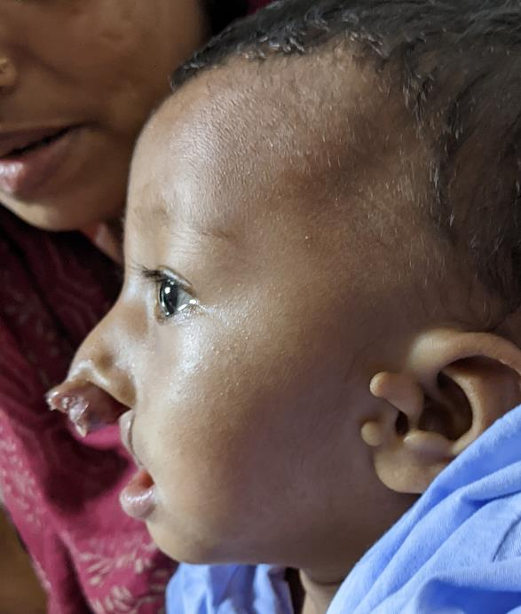
Taping
Helpful to align segments
Non complex
May be required prior to NAM
Notes:
Taping is very reasonable in austere environments. Discuss in detail if desired. Picture shows child with premaxilla “locked out” that may have been prevented with early taping.

Slide 7
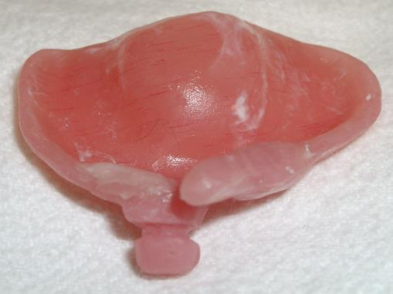
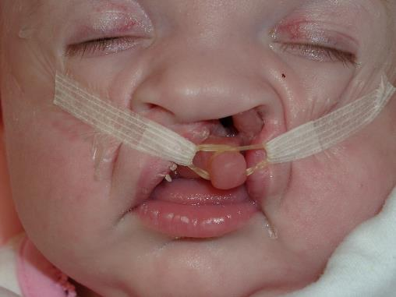
Presurgical Naso Alveolar Molding (PNAM)
Sequential molding plates align segments
Second stage nasal dome elevation extension
Notes:
Usually requires impressions and at least two palatal prosthesis as child grows.

Slide 8
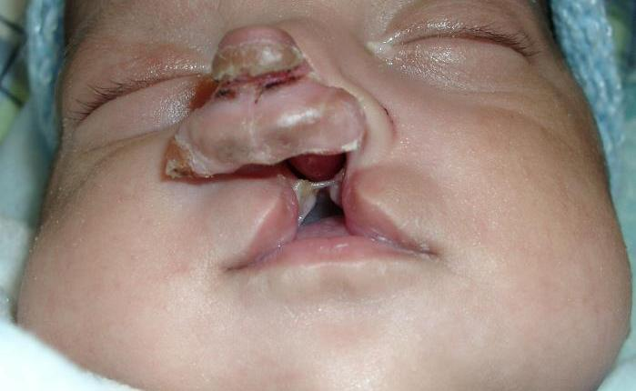
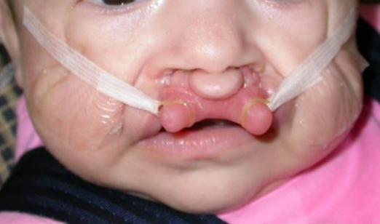
Notes:
Pictures show “locked out” child that was sequentially molded back into position with PNAM prior to surgery

Slide 9
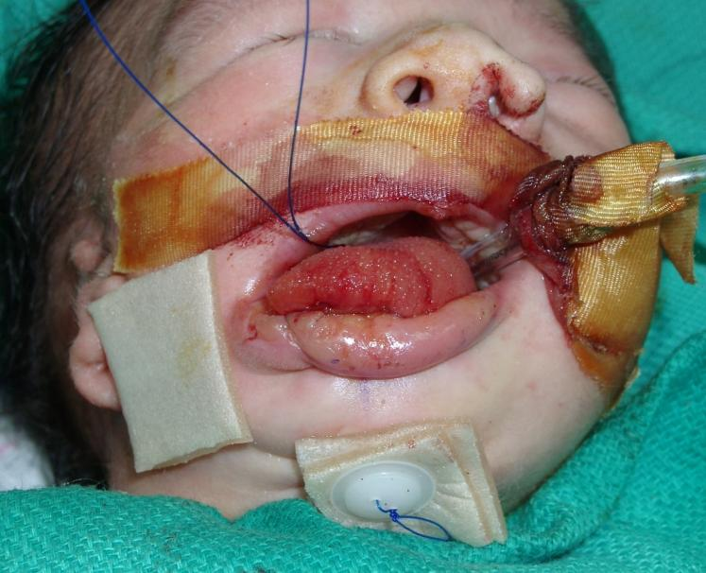
Tongue Adhesion
Rare
Usually for Pierre Robin Sequence
Adhese tongue to lower lip and release at later date
Chin suture through base of tongue
Notes:
Picture shows tongue sutured to lower lip

Slide 10
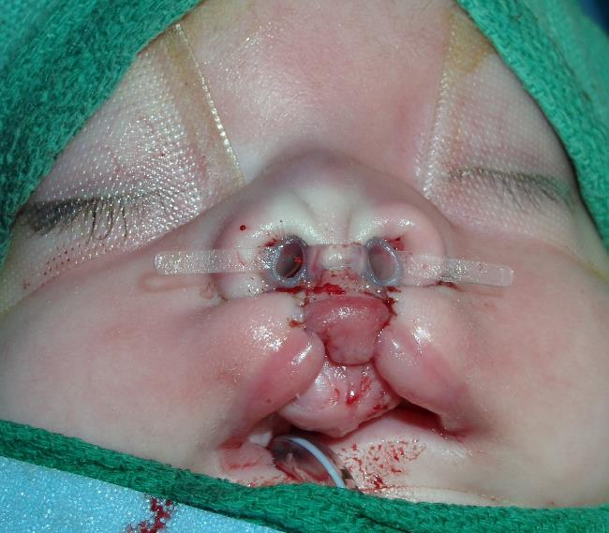
Lip adhesion
Not common
Used to approximate very wide cleft prior to definitive closure
Molding of premaxilla/ maxilla
Utilizes tissue you may wish to use later
Notes:
May be an option for difficult premaxilla outward rotation. Will cause scarring and may make subsequent surgery more difficult.

Slide 11
Lip repair
Most common Millard for unilateral, Mulliken bilateral repair
Alternatives include straight line repair and geometric repair
Repair when child has no airway issues, and meets the “rule of 10’s” (10 lbs., 10 gms Hb, 10 weeks old)
Early repairs heal with less scarring

Slide 12
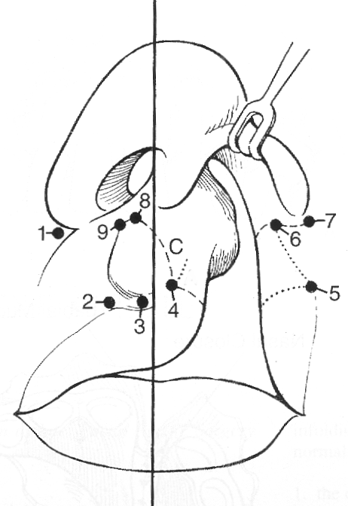
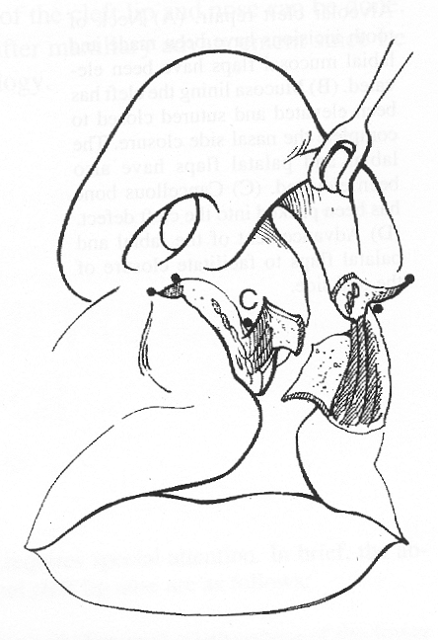
Millard technique
Notes:
Classic “rotation advancement” repair for unilateral lip repair. Variation can include Mohler modification (shown) with extension into base of columella

Slide 13
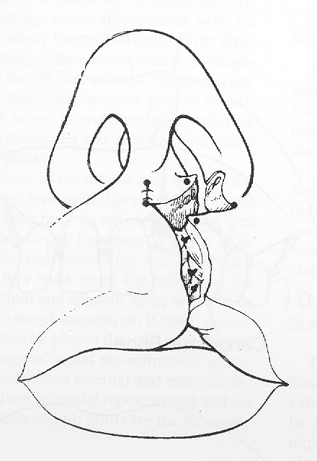
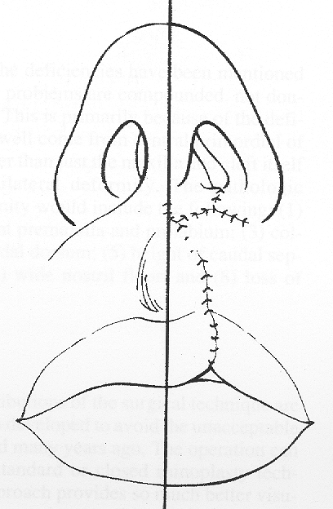
Millard technique

Slide 14
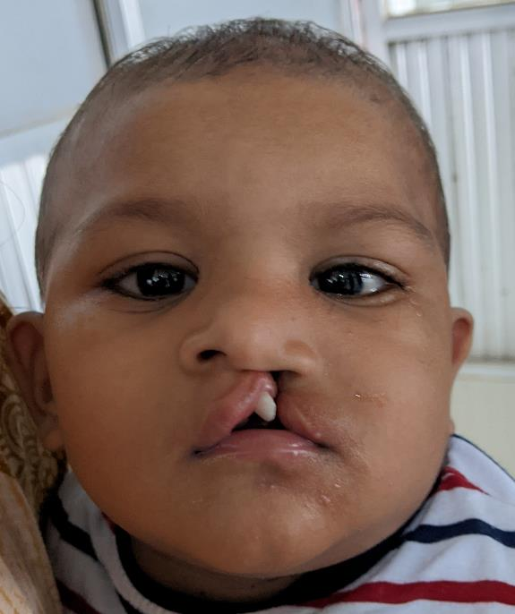
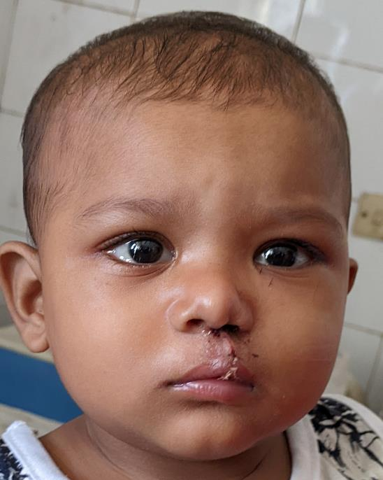
Millard technique

Slide 15
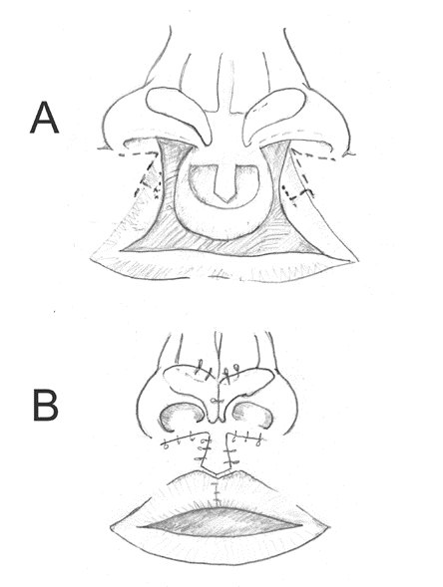
Mulliken BCL Repair

Slide 16

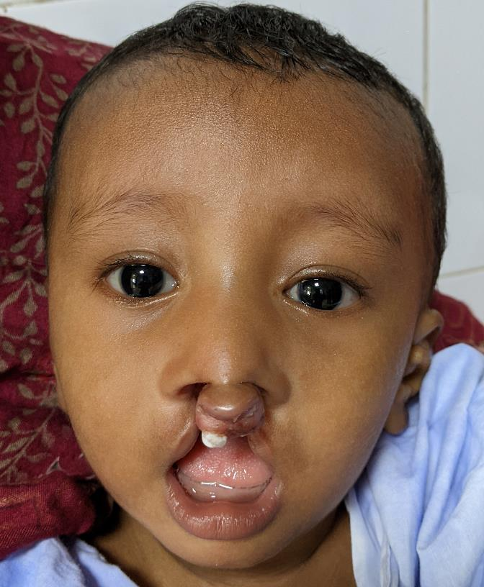
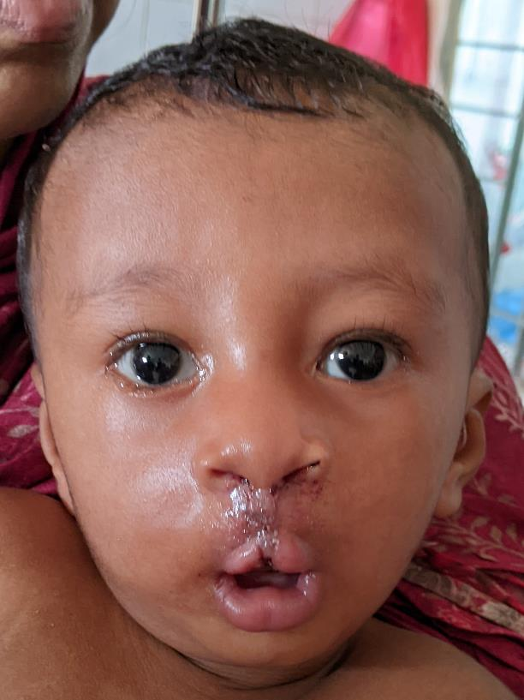

Slide 17
Palatoplasty
Hard palate/ soft palate commonly done together
Based on greater palatine artery, relaxing incisions lateral to hamulus allow soft palate closure.
Levator/ tensor attachment to hard palate reoriented
Done around one year as speech studies show better results if done prior to significant speech
Type of repair may be tailored to n-p closure pattern and a-p distance
Notes:
Short palate may opt for Furlow as initial repair, but in general midline closure allows more options for revision surgery if needed.

Slide 18
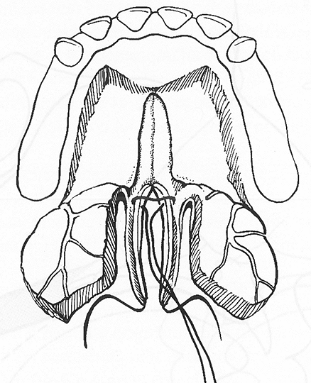
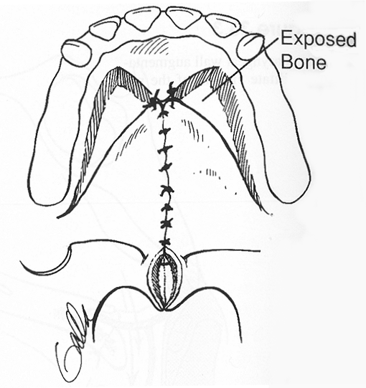
Wardill-Killner V-Y pushback
Notes:
Theoretically can lengthen short palate

Slide 19
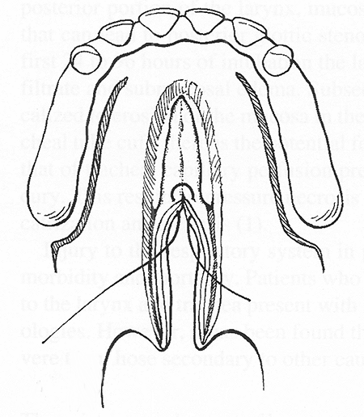
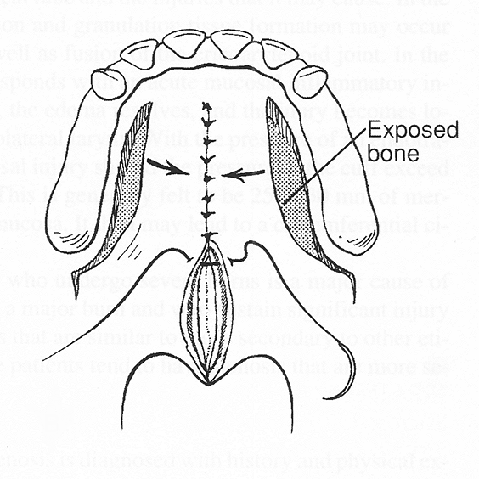
Von Langenbeck repair

Slide 20
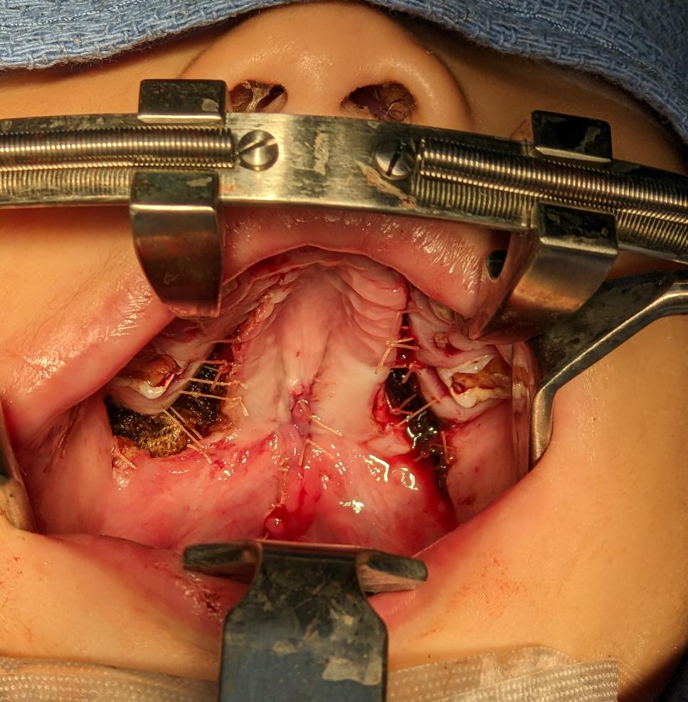

Slide 21
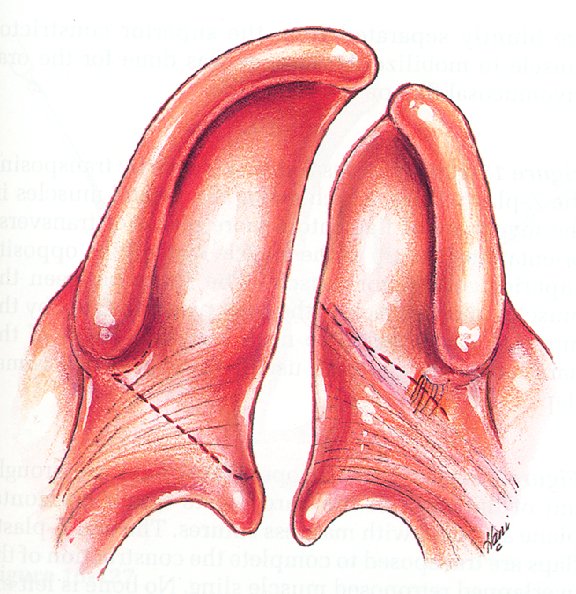
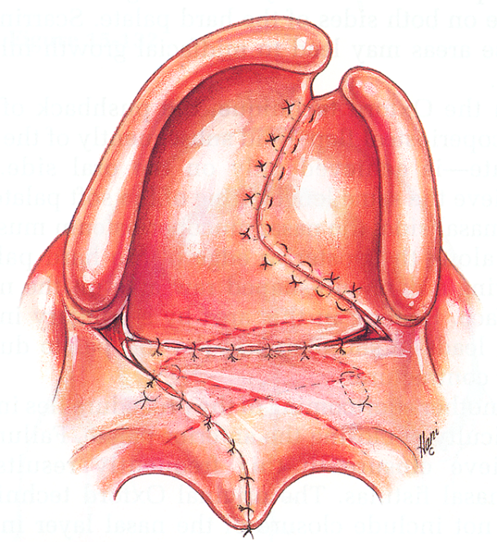
Furlow palatoplasty

Slide 22
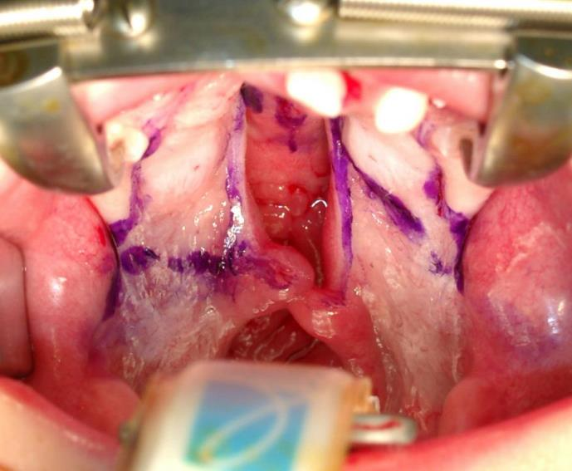
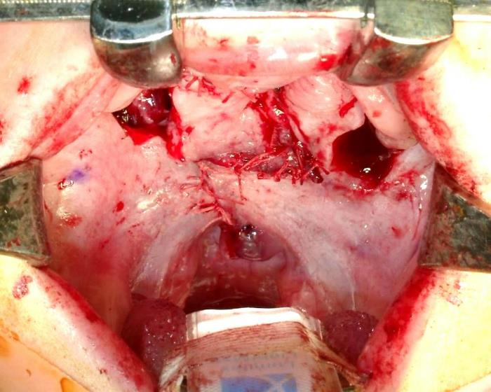
Furlow Technique

Slide 23
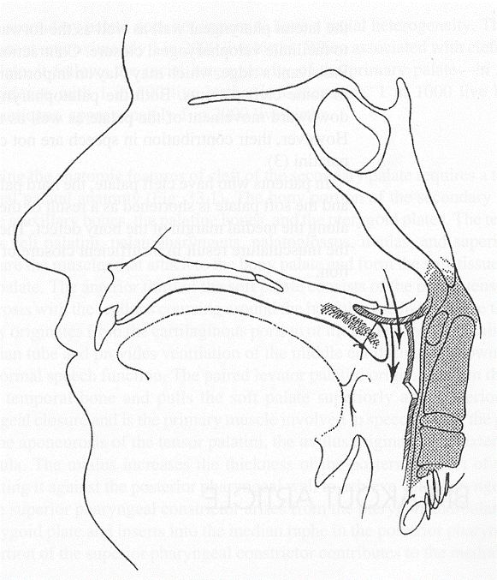
Pharyngeal Flap
VPI with greater than a 10 mm (young) and 5mm (older) a-p closure failure
“Gold standard” for improvement in VPI
Most commonly superiorly based

Slide 24
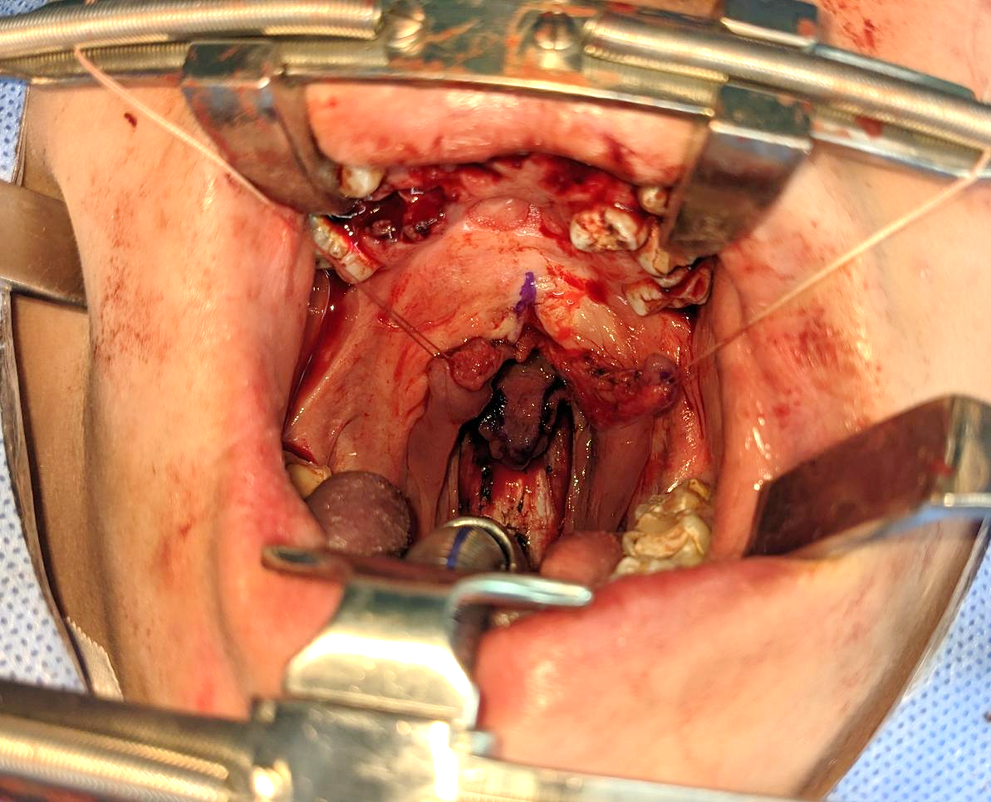
Notes:
Pharyngeal flap is elevated with prevertebral fascia visible (white). Flap outline marked with surgical marker. Soft palate separated in midline. A pharyngeal flap may not be possible in someone who has had a Furlow palatoplasty.

Slide 25
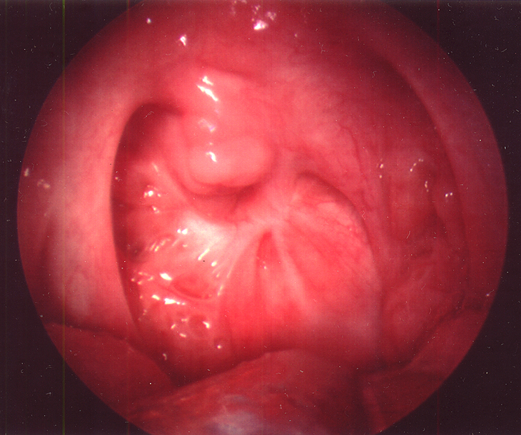
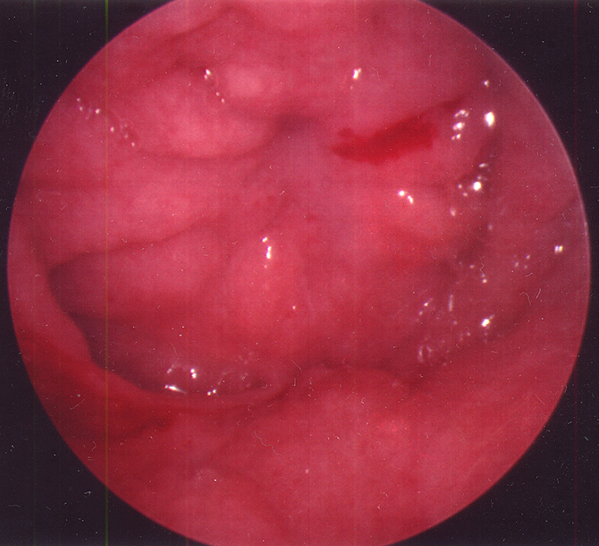
Pharyngeal flap complications, sleep apnea/ stenosis
Notes:
Picture on left shows posterior oral cavity/ pharyngeal wall adhesion from pharyngeal flap. Picture on right is same patient endoscopic view of posterior nasopharynx with soft palate adhesed to lower adenoid pad of posterior pharyngeal wall

Slide 26
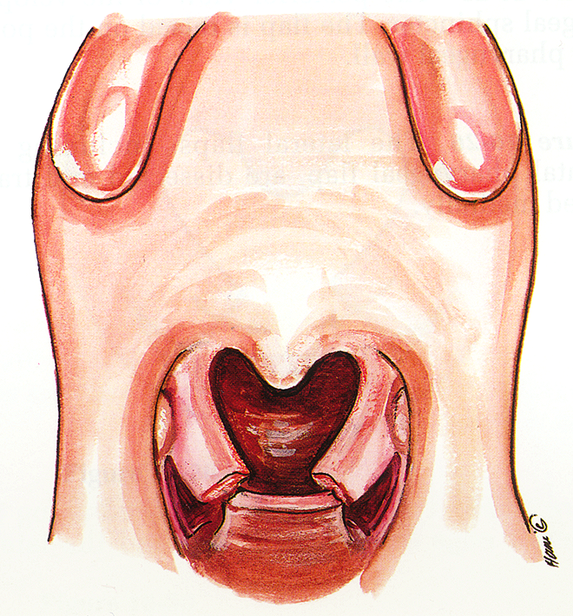
Sphincter pharyngoplasty
Orticochea 1968
Current modifications place palatopharyngeus behind soft palate, overlapping horizontally
Notes:
For limited A-P distance closure problems with dynamic palate/pharynx. Helpful for lateral leakage if noted on nasopharyngoscope

Slide 27
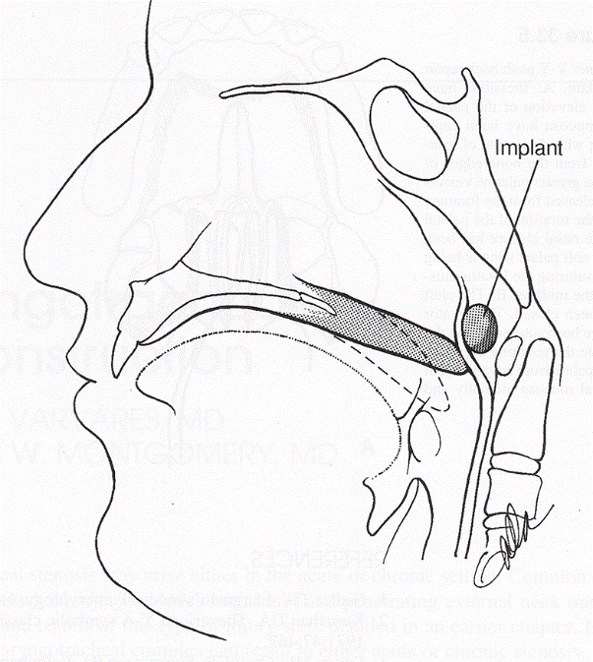
Posterior pharyngeal wall augmentation
Implant (not used anymore)
Fat
Infrequent procedure
Only for very limited closure problems that are a-p oriented
Notes:
Generally fat grafting is the only posterior wall augmentation done at present. Can be problematic if patient gains weight (sleep apnea).

Slide 28
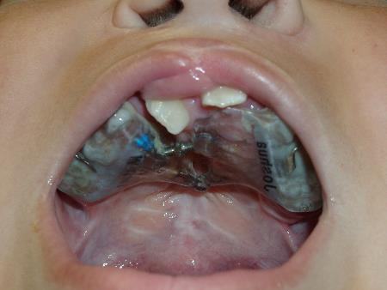
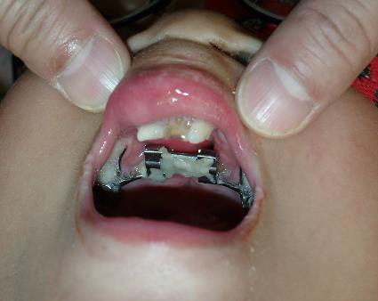
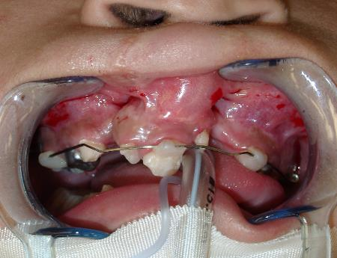
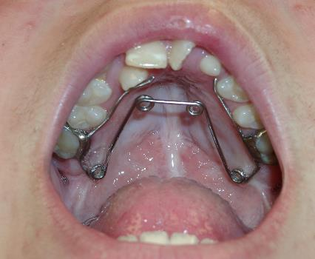
Palatal Expansion, Orthodontia
Align greater and lesser segments
Contiguous alveolar arch
Typically as canine erupts
Pre alveolar graft and post alveolar graft orthodontia
Notes:
Attempt to align maxillary segments in anticipation of bone grafting

Slide 29
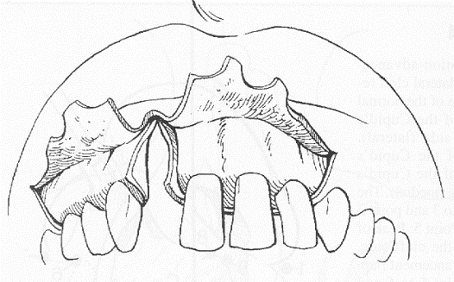
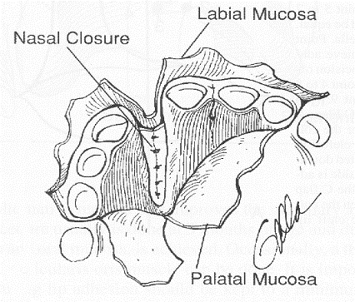
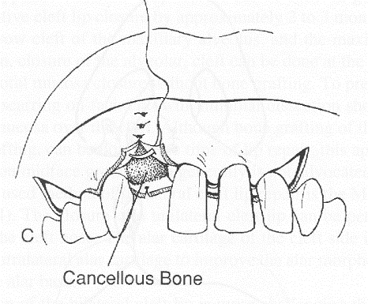
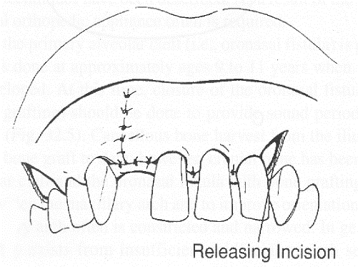
Alveolar Bone Grafting

Slide 30
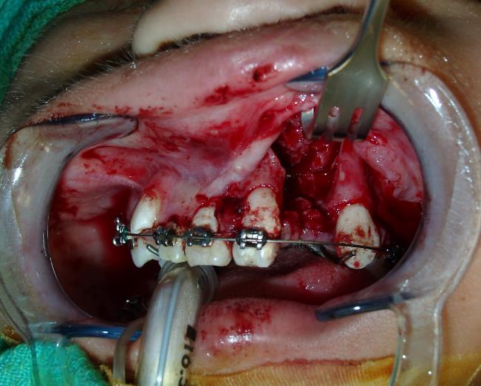
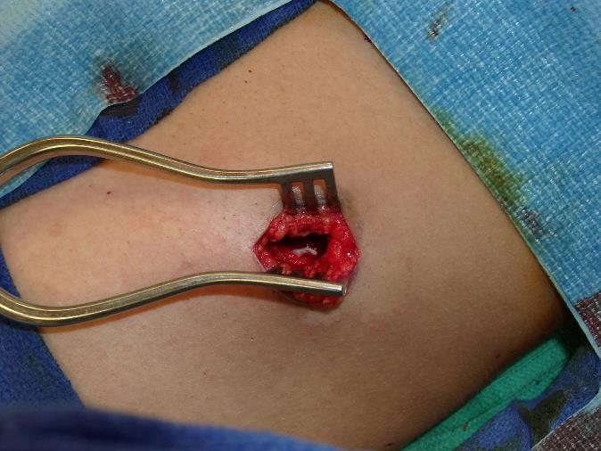
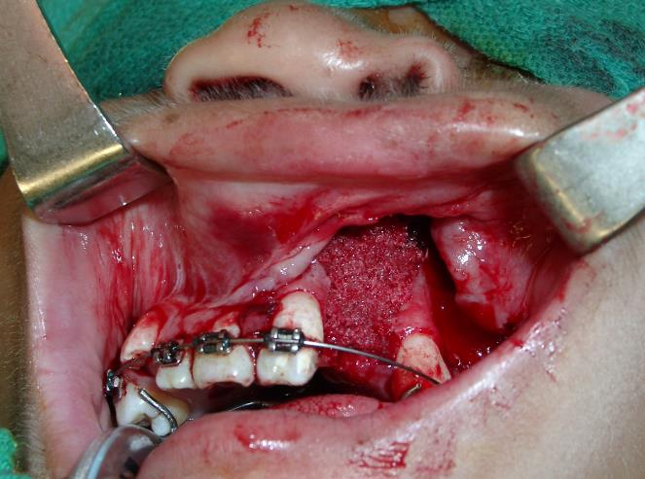
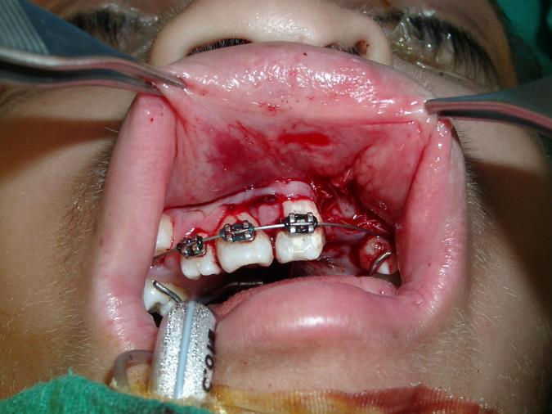
Notes:
Bone graft shown is from iliac crest. Generally harvest occurs from iliac crest in growing patients, but consider tibia plateau if skeletally mature as more tolerable for patient.

Slide 31
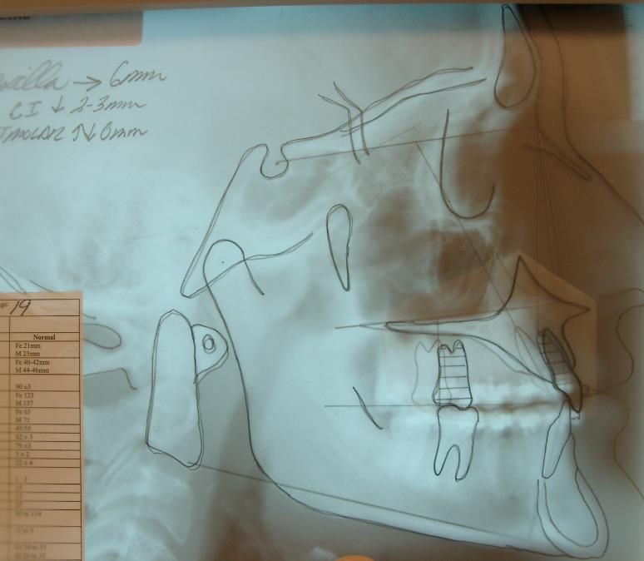
Orthognathic Surgery
Final occlusal alignment
Skeletally mature
Usually age 14+

Slide 32
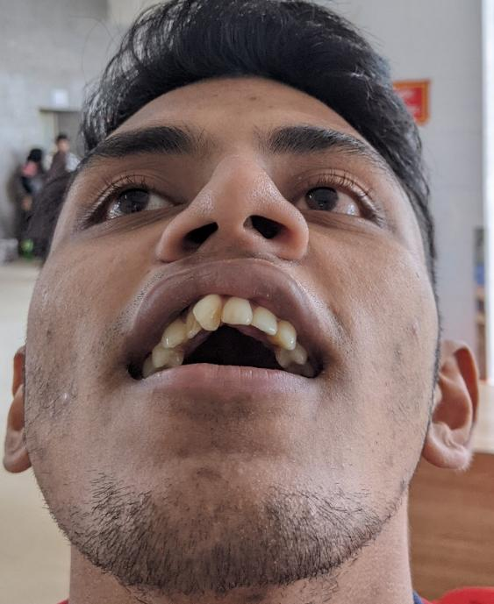
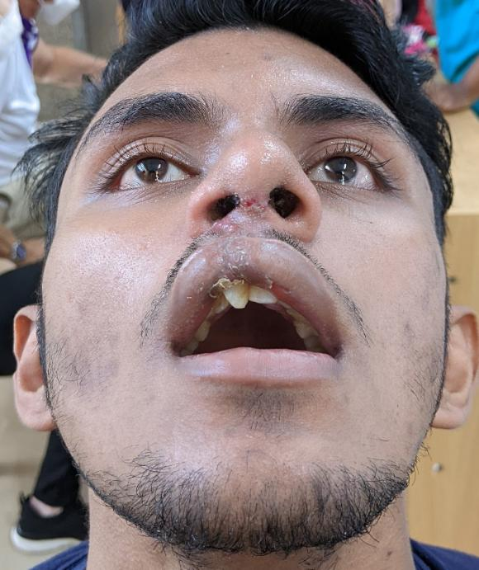
Final Rhinoplasty & “Touch up”
After Lefort if required
Age 14+
Notes:
This patient had a lip revision with correction of Orbicularis diastasis, lip scar narrowing and Open Rhinoplasty with tip modification

Slide 33
Cleft- Craniofacial Team
Director
Plastic Surgeon
Audiologist
Otolaryngologist
Oral Surgeon
Dentist
Orthodontist
Speech Pathologist
Psychologist
Social Worker
Geneticist
Nurse
Pediatrician
Photographer

Slide 34
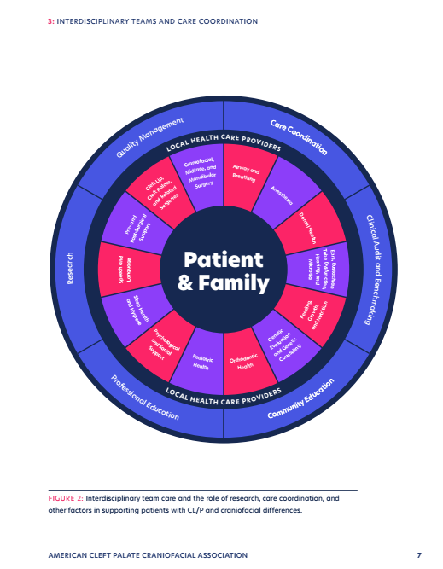
Associated Medical issues
Hearing, school seating, assistive devices, special schooling
Psychosocial issues
Syndromic care
Other routine medical issues
Notes:
Figure on left is from current ACPA Parameters of Care guideline

Slide 35

Associated Medical issues
Speech therapy may be intensive
Schools should have SLP, however- they may require guidance on VPI/ Cleft issues
Nasopharyngoscopy and nasometry are useful to assess progress (or failure) and presurgical planning
Notes:
Figure on left shows dental alignment issues due to clefting despite repair, may have associated speech issues

Slide 36

ETD/ OME/ Cholesteatoma
Consider prophylactic BMT
Close f/u by PEX and audio at least annually
Exam under anesthesia may be required in some patients
Other providers may not recognize serious ear problems
Notes:
Figure on left shows lack of air in middle ear and mastoid.

Slide 37
Summary
Surgery generally follows a standard sequence
Continuous team care, not just when procedures are due

Slide 38

Questions/ comments
Insert picture of local team here

