Slide 1
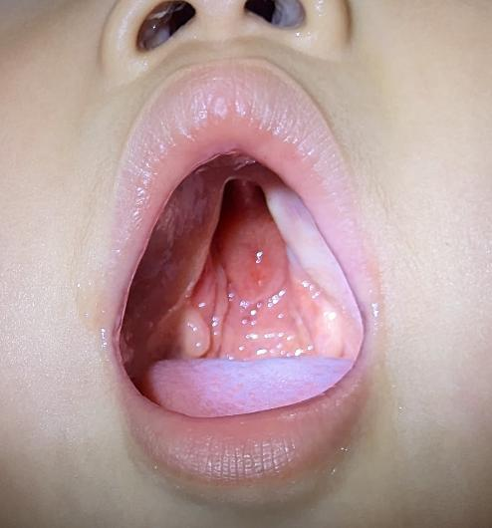

Cleft Lip and Palate Overview: Embryology, Anatomy and Teams
Dr. Surgeon, M.D.
Plastic and Reconstructive Surgery

Slide 2
Overview
Embryology
Anatomy
Cleft variants
Cleft team

Slide 3
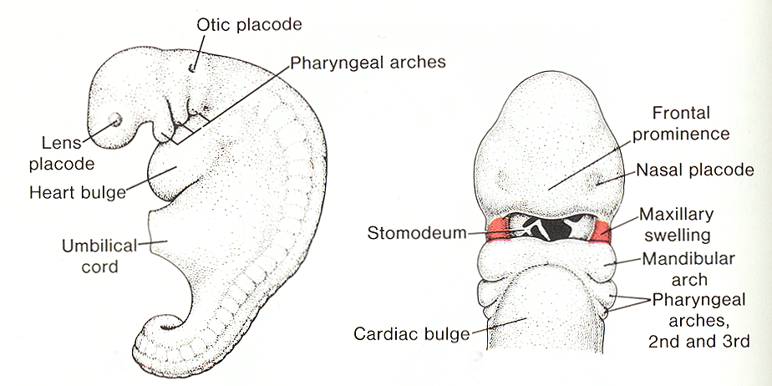
Embryology, 4 ½ weeks

Slide 4
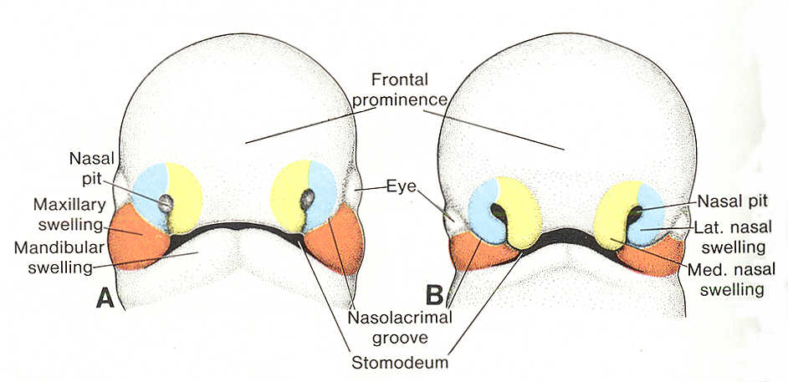
5 Weeks 6 Weeks
Notes:
Frontonasal process is divided into medial and lateral nasal process. The medial nasal process develops into the philtrum and premaxilla. The maxillary swelling fuses to the lateral nasal process and becomes the nasolacrimal groove/ nasolacrimal duct and the medial nasal process fuses to the maxillary swelling to become the philtral column.

Slide 5
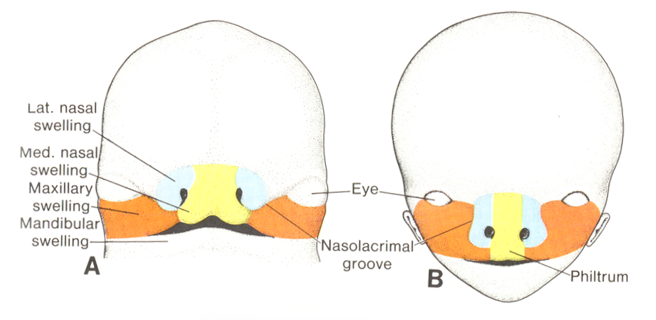
7 Weeks 10 Weeks

Slide 6
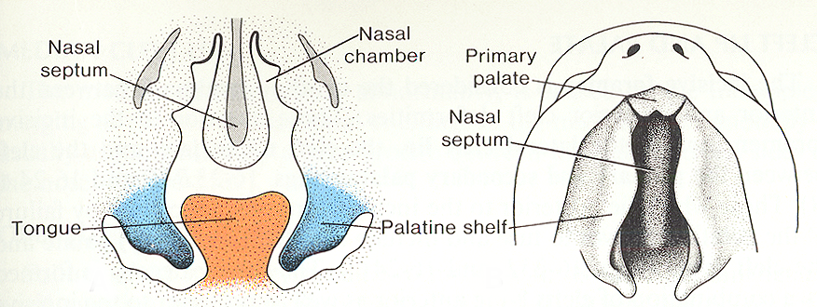
Palate, 6 ½ weeks
Notes:
The palatal shelves are and extension of maxilla and are initially oriented downward. The rotate upward and fuse to the nasal septum in the midline posterior to the incisive foramen. The premaxilla (frontonasal process) fuses to the palatal shelves anteriorly from the incisive foramen forward.

Slide 7
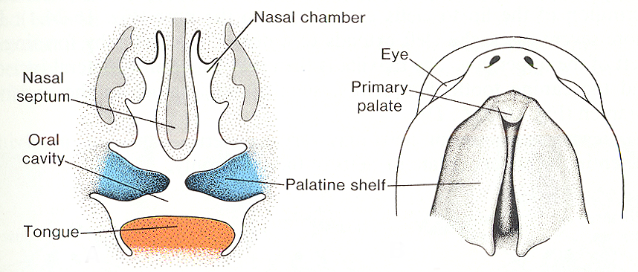
Palate, 7 ½ weeks

Slide 8
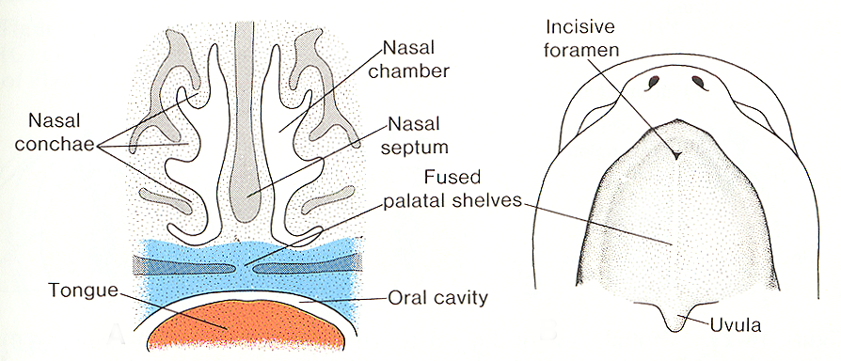
Palate, 10 weeks

Slide 9
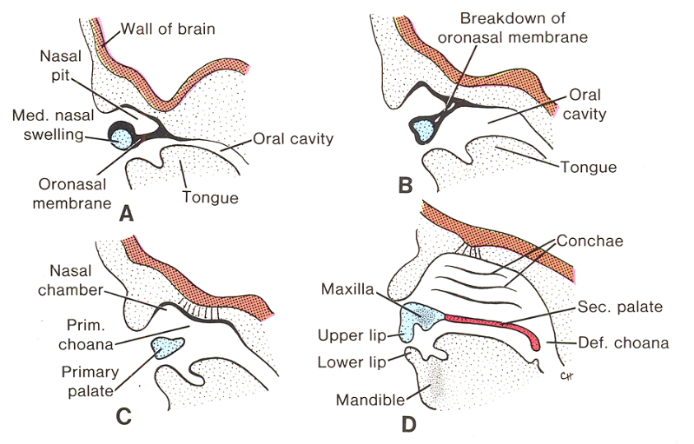
Nasal Cavity- 5 ½, 6, 7, 9 weeks
Notes:
The Oronasal membrane ruptures between the 3rd and 7th week of gestation. Failure to rupture or incomplete rupture can result in Choanal Atresia or Choanal Stenosis. Newborns are obligate nasal breathers and the hallmark of Choanal Atresia in a newborn is episodic apnea that resolves with crying (mouth breathing). Choanal Atresia is associated with other clefting syndromes such as Treacher Collins, Crouzon, Pfeiffer, etc.

Slide 10
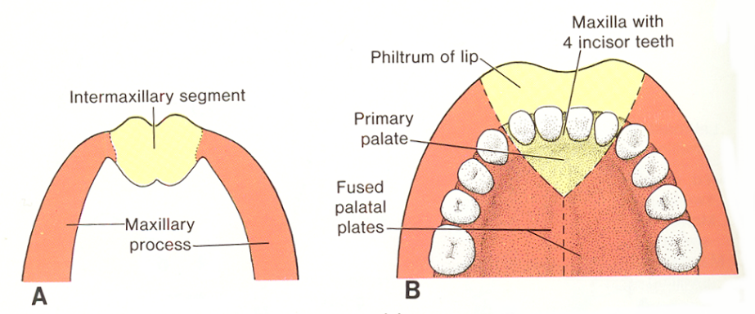
Palate formation

Slide 11
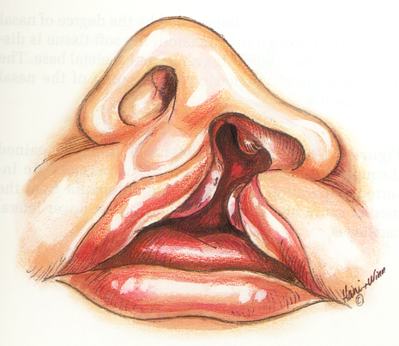
Unilateral Cleft Lip anatomy
Orbicularis insert into alar base/ columella
Flattened alae cleft side, horizontally oriented nostril
Short cleft side columella
Septum to noncleft side
Nasal tip lower on cleft side

Slide 12
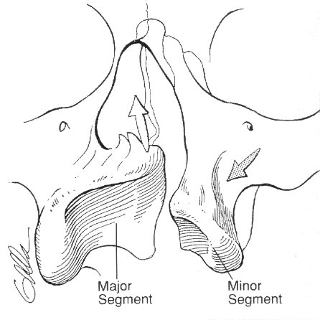
Unilateral Cleft Lip anatomy
Bony abnormalities if cleft involves alveolus
Major segment superior to minor segment
Bony cleft width variable

Slide 13
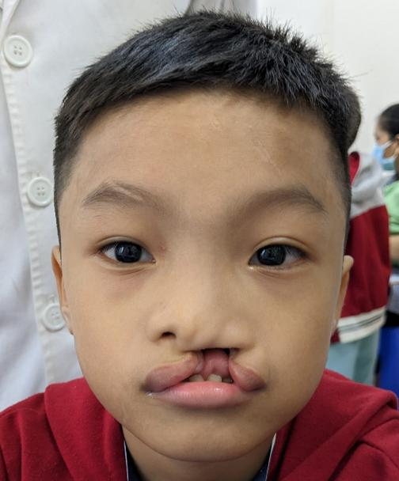
Notes:
Point out alar widening, horizontal shape and depression on cleft side with columella to non cleft side.

Slide 14
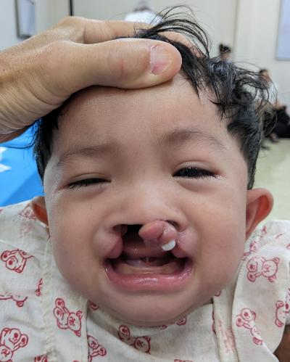
Bilateral Cleft Lip Anatomy
May be asymmetric
Premaxilla segment may be completely free and anterior
Maxillary collapse (“locked out”)

Slide 15
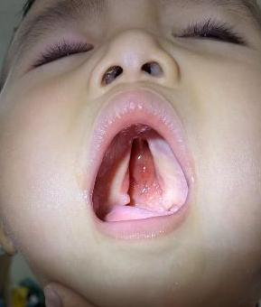
Cleft Palate anatomy
Tensor palatini and Levator palatini insert into posterior aspect of hard palate
May be covered with a mucosal layer (SMCP)
May be unilateral or bilateral

Slide 16
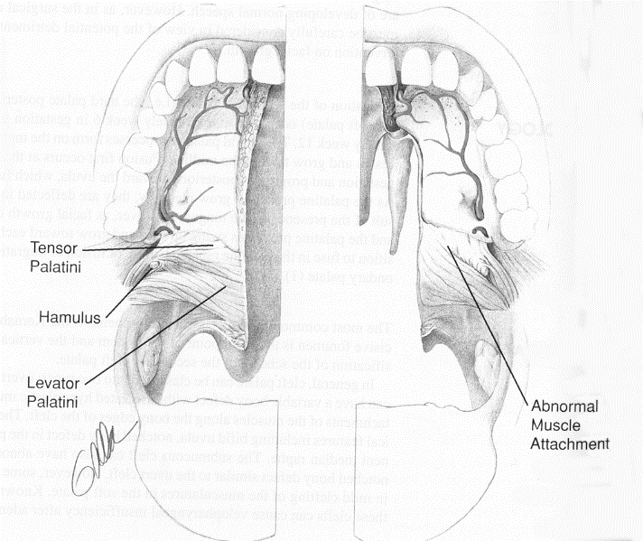
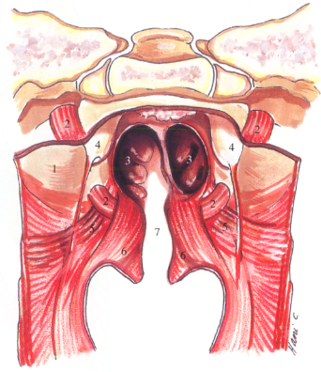
Cleft Palate anatomy
Tensor Palatini innervated by mandibular branch of CN V, all other palatal musculature from pharyngeal plexus. Tensor opens eustachian tube by originating at the lateral aspect. Levator contributes when older, originates near medial eustachian tube.

Slide 17
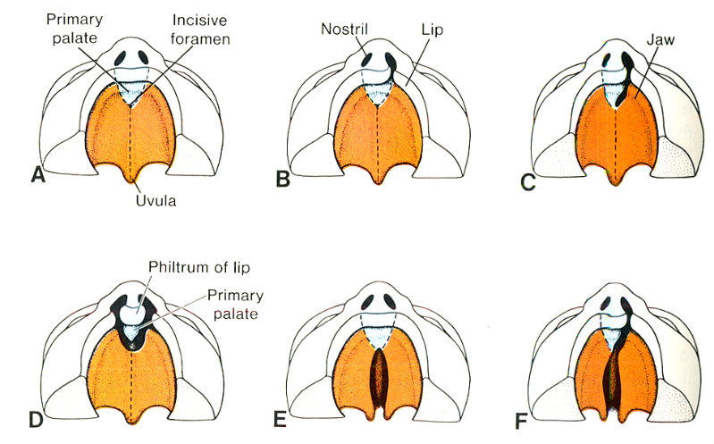
Cleft Variations

Slide 18
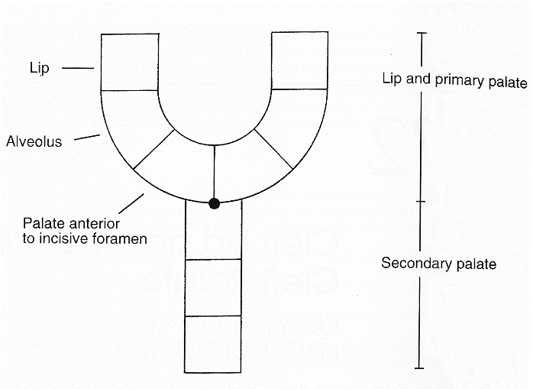
Cleft Staging, “striped Y”
Notes:
Kernahan “Striped Y” classification.

Slide 19
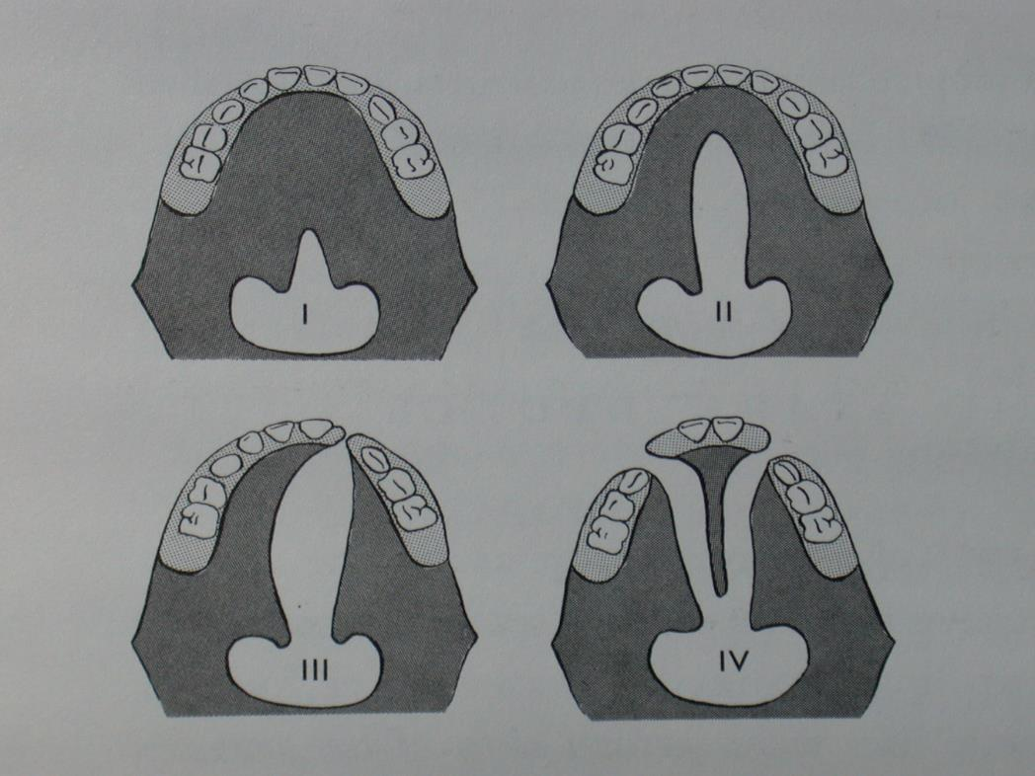
Veau Classification

Slide 20
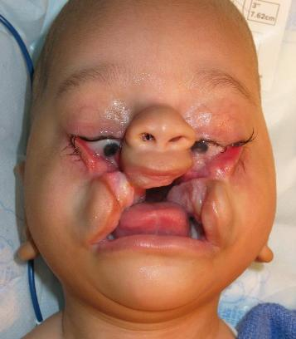
Atypical Clefts (Tessier)
Notes:
Tessier cleft system is descriptive based on location relative to midline of face. These typically occur along natural embryologic fusion locations due to lack of fusion.

Slide 21
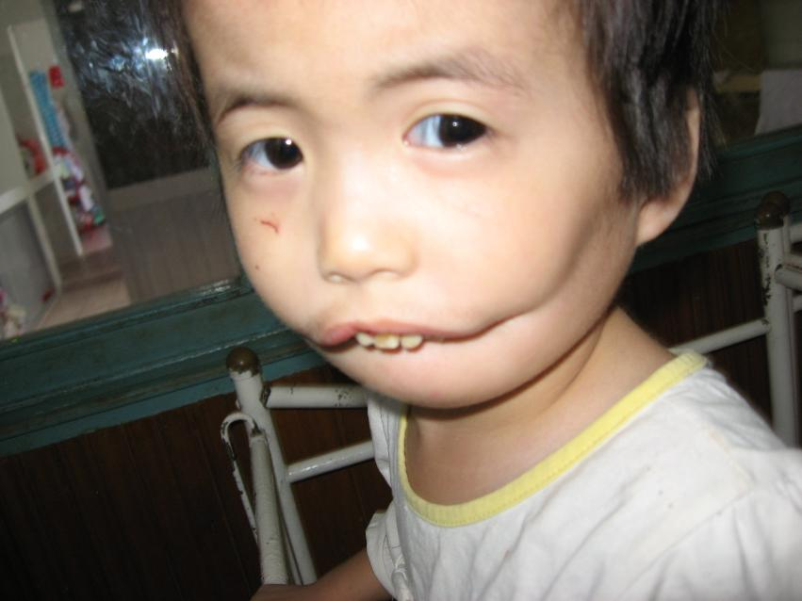
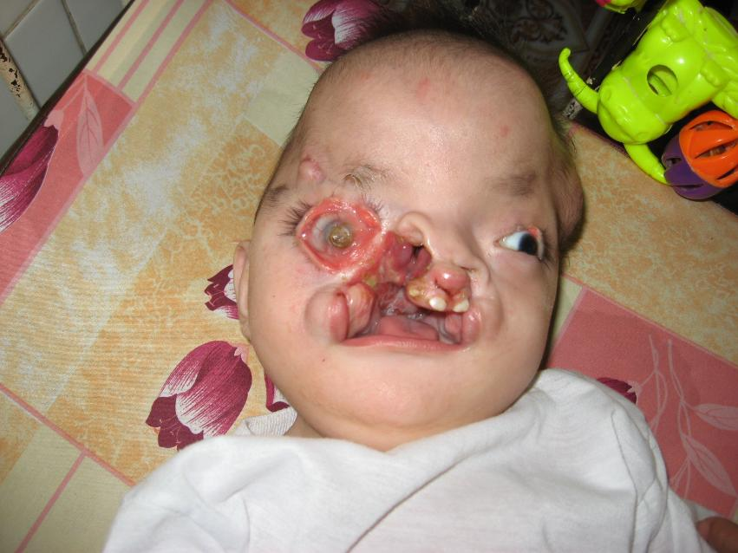
Variations of Tessier clefting

Slide 22
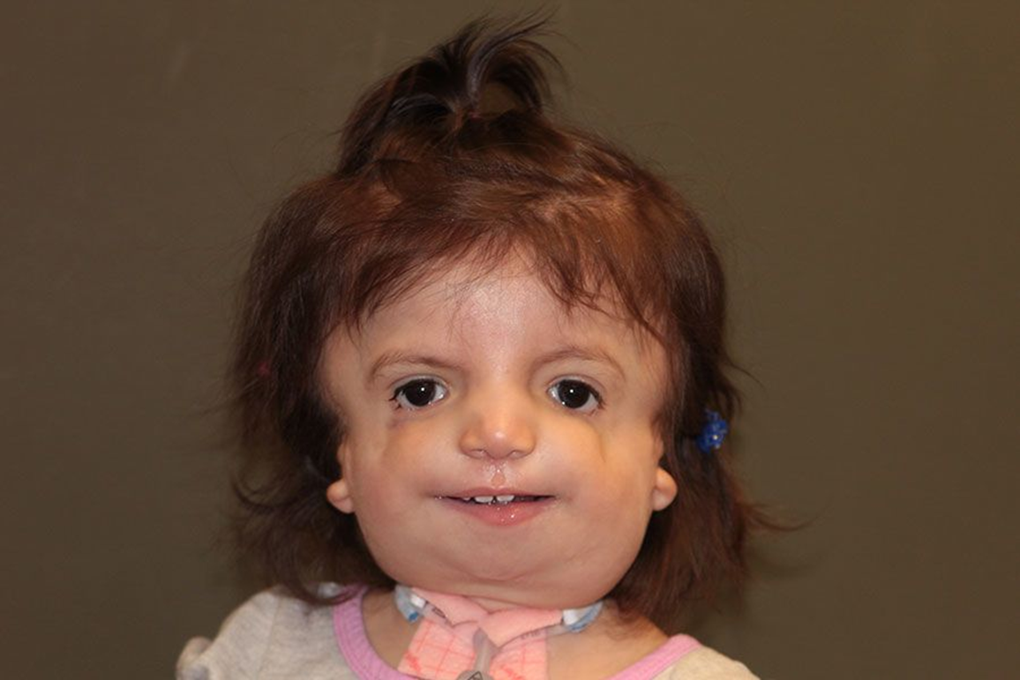
Treacher- Collins: Tessier 6,7,8

Slide 23
Midline facial clefting and duplication
Holoprosencephaly: Failure of development of medial nasal swelling (frontonasal process).
Associated with defect in brain development.
Rare and frequently incompatible with life.
Frontonasal dysplasia: duplication of frontonasal process
Encephalocele: failure of fusion, herniation

Slide 24
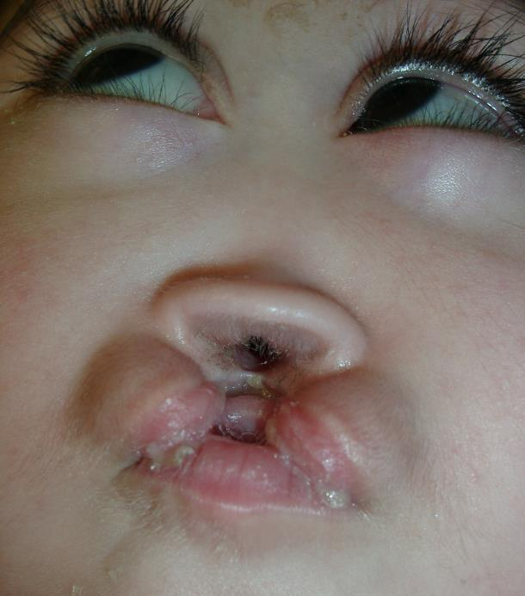
Holoprosencephaly: failure of formation
Notes:
Infant shows lack of formation of midline structures to include nasal septum and premaxilla. Infant is looking up and right due to chronic seizures. Likely due to absence of corpus callosum which moderates neural activity between hemispheres. Degree of findings variable, can be mild underdevelopment to a single eye (Cyclops) deformity. Advanced cases are nearly always fatal.

Slide 25
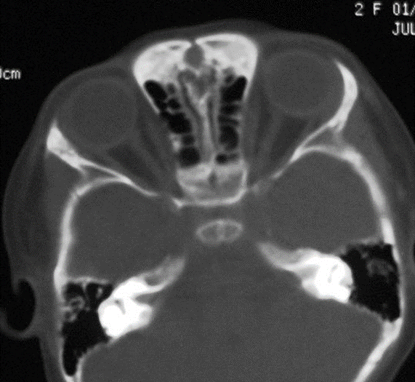
Frontonasal Dysplasia: duplication
Notes:
CT scan showing duplication of the nasal dorsum, septum and likely cristi galli (not shown)

Slide 26
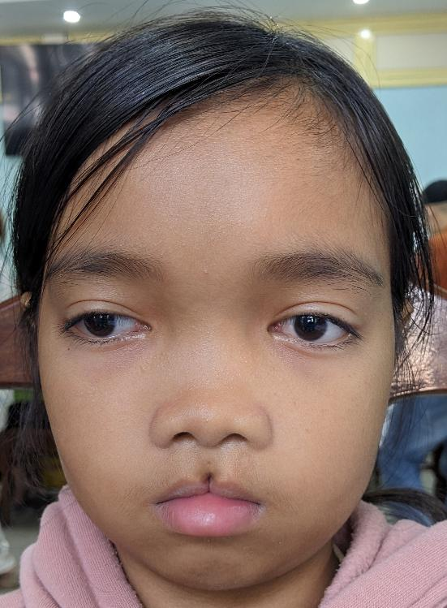
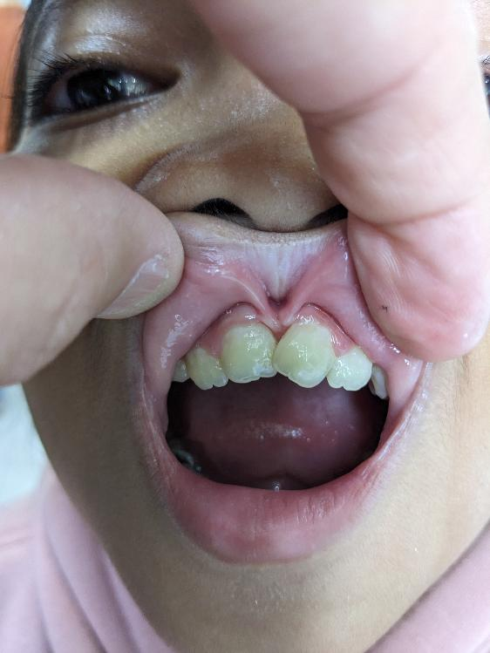
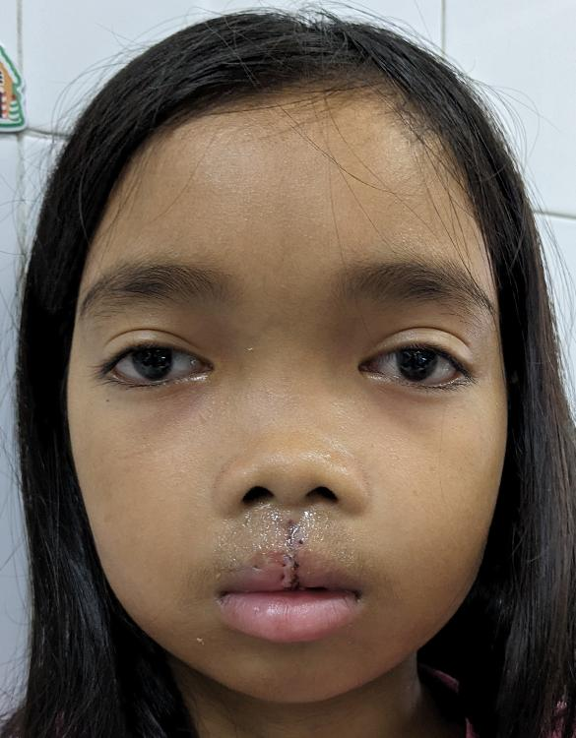
Midline failure of fusion (Tessier 14)
Notes:
Tessier clefts can be incomplete or multiple and simultaneous. Certain nasocular clefts can have coloboma or epibulbar dermoids. This child has a mild midline cleft of lip, premaxilla and midline facial widening. She does not have duplication of midline as seen in Frontonasal dysplasia

Slide 27
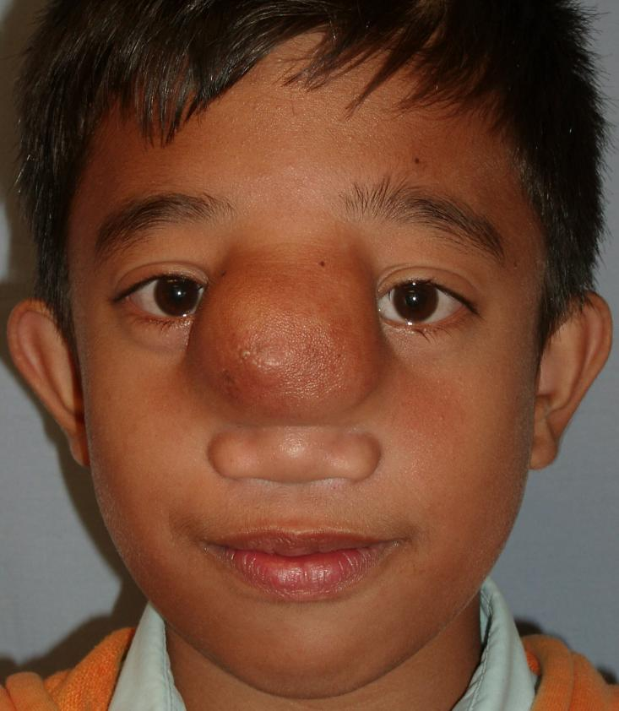
Frontonasal Encephalocele: failure of fusion with herniation
Notes:
CNS contents descend through failure of fusion in frontonasal process. Variations can include extranasal glioma or dermoid

Slide 28
Cleft- Craniofacial Team
Director
Plastic Surgeon
Audiologist
Otolaryngologist
Oral Surgeon
Dentist
Orthodontist
Speech Pathologist
Psychologist
Social Worker
Geneticist
Nurse
Pediatrician
Photographer
Notes:
Make up of Cleft Team per ACPA. These slides can be deleted or used for other talks as needed.

Slide 29

Associated Medical issues
Hearing, school seating, assistive devices, special schooling
Psychosocial issues
Syndromic care
Other routine medical issues
Notes:
American Cleft Lip and Palate Craniofacial Association Parameters of Care. Outlines general/ mainstream sequence of cleft care and cleft team components, can be found on ACPA website

Slide 30
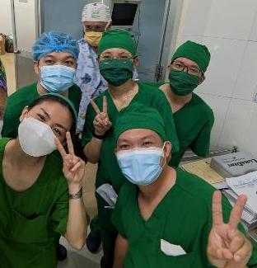
Questions/ comments
Notes:
Insert picture of choice, local surgical team used in this case.

